Slide 1
Seafloor Geodesy
Dave Chadwell (cchadwell@ucsd.edu)
Scripps Institution of Oceanography
With contributions from Mark Zumberge and Jeff McGuire

Slide 2
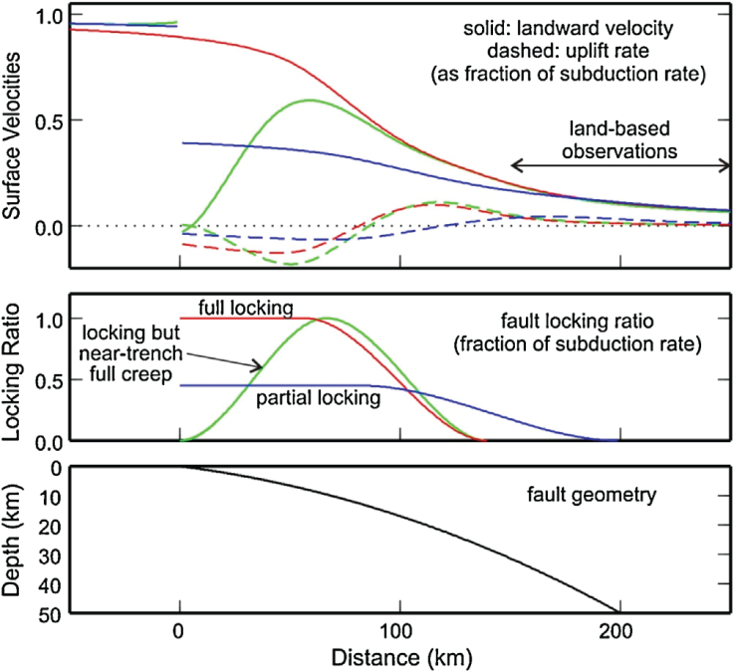
Motivation for seafloor geodesy
Wang and Trehu, 2016

Slide 3
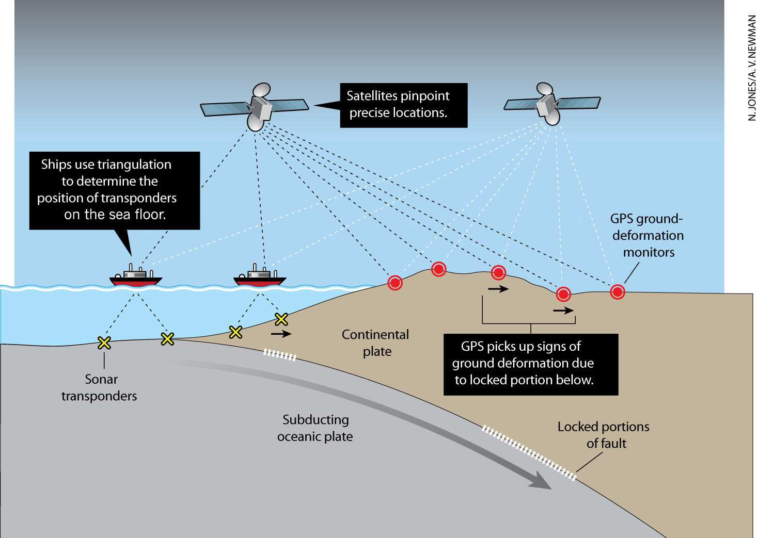
GPS-Acoustic approach combines GPS and precision acoustic ranging to measure seafloor motion with centimeter resolution.
(Newman, 2011)
Proven centimeter-level positioning over the past 20 years, but has been limited because of the high cost of ships at ~$30-50k/ day

Slide 4
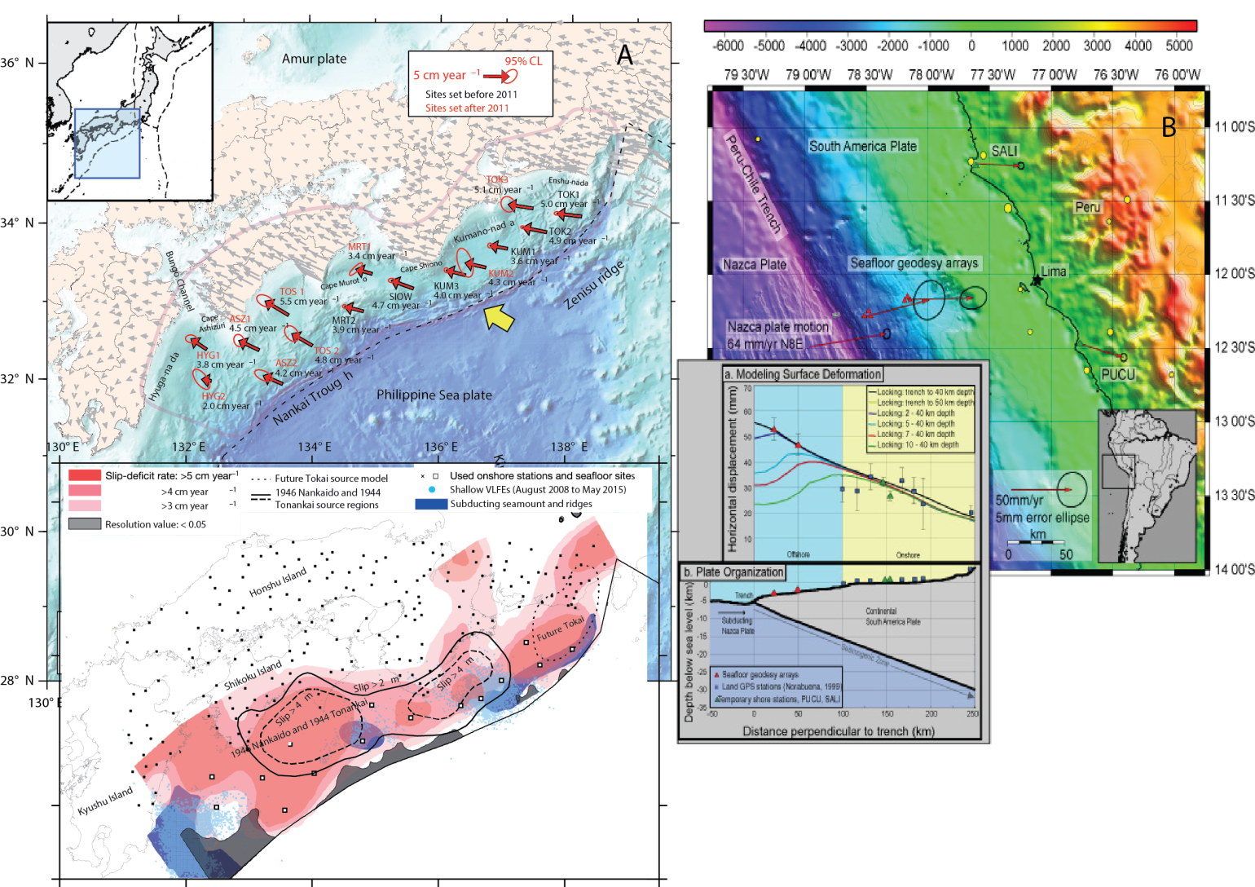
Measurement of interseismic motion with GPS-A
(Gagnon et al., 2005)
(Yokota et al., 2016)

Slide 5
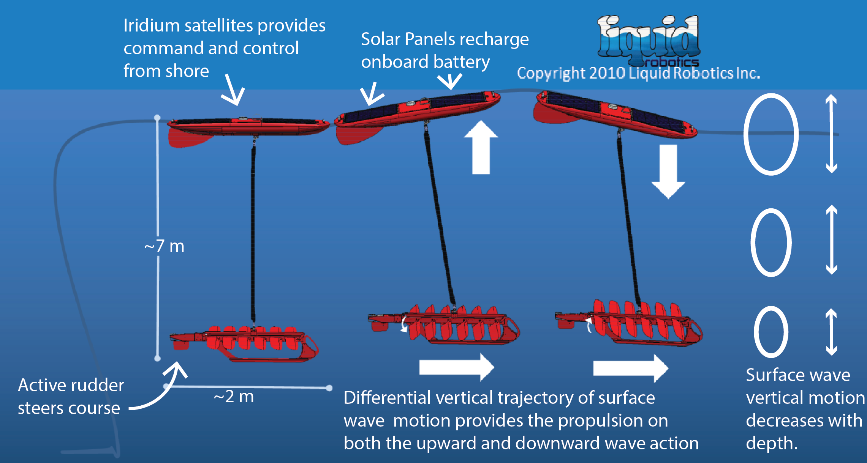
Wave Glider Operation
Harvesting of renewable energy sources allow the Wave Glider to operate for months at sea.

Slide 6
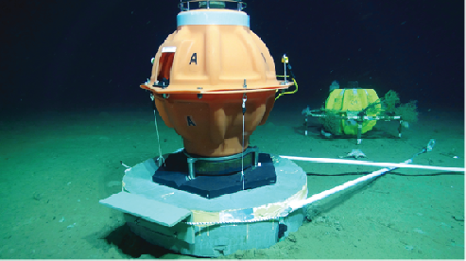
Technical Accomplishments in 2014
    Commercial transponder system successfully adapted for GPS-Acoustic measurements. This frees the technology from individual engineering groups.
    New permanent, low-cost benchmarks for seafloor geodesy were deployed at all three sites. Transponders can be removed and replaced while maintaining millimeter-level repeatability. Time series can be extended indefinitely. Transponders can be recovered and reused elsewhere.
    Wave Glider successfully demonstrated as a vehicle for collecting GPS-Acoustic data. GPS-A data can be collected without using high-cost ships.
CONCLUSION: Expanded array of GPS-A sites in Cascadia and the Aleutians now viable.

Slide 7
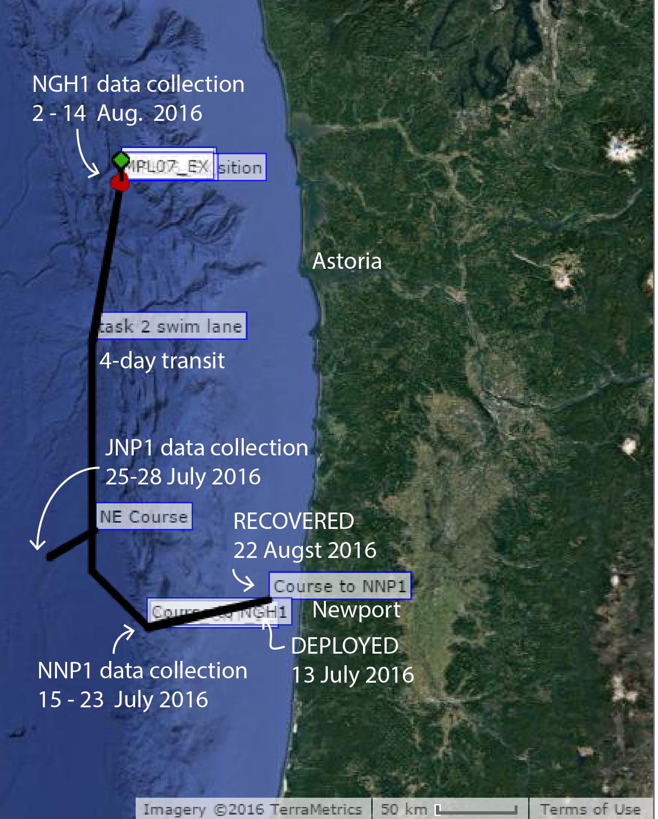
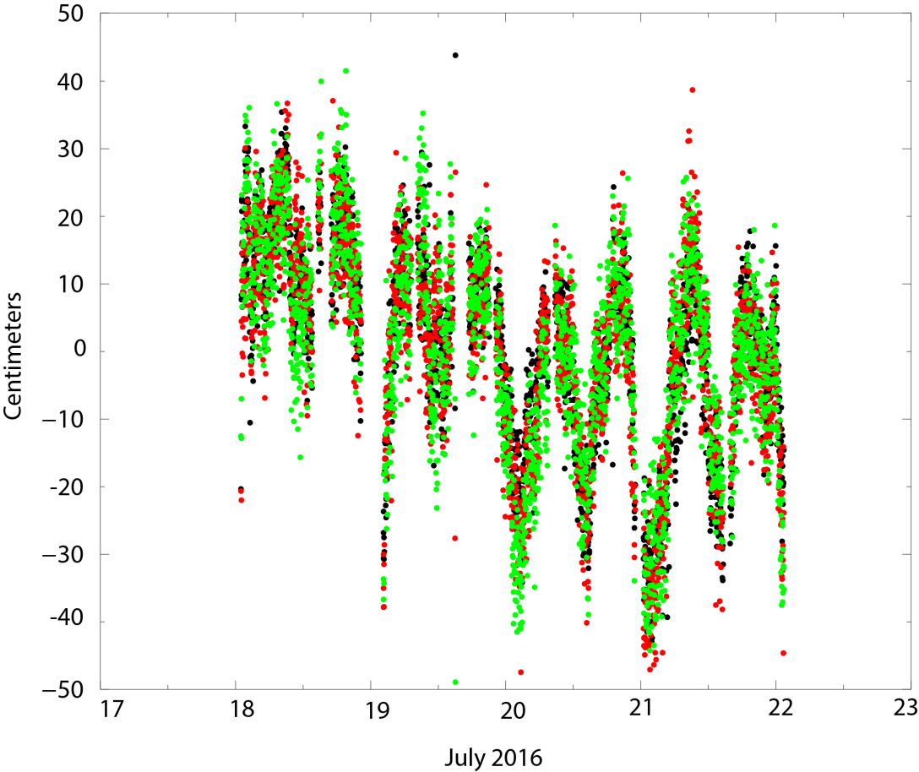
A 40-day mission track
GPS-A residuals: near-real time via IRIDIUM
Cost of data collection: ~$50k/day on UNOLS DP vessel versus ~$500/day on Wave Glider
(Chadwell et al. White Paper)

Slide 8
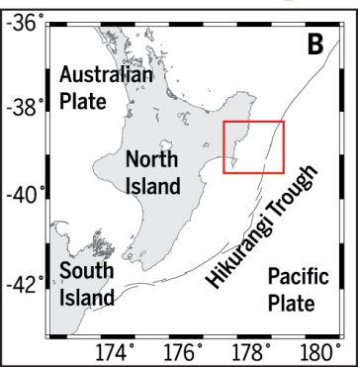
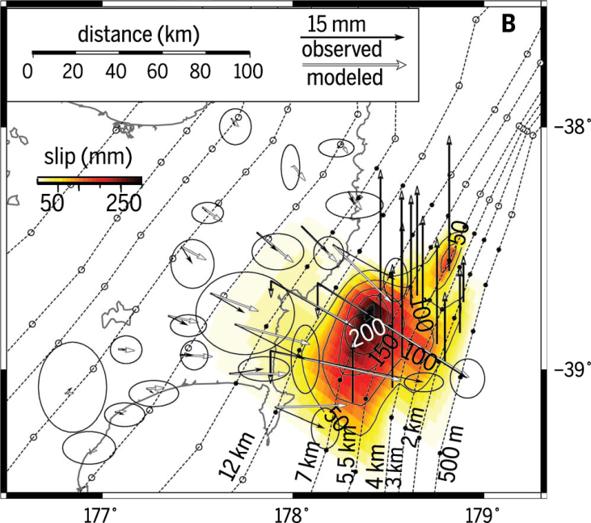
Seafloor pressure gauge captures slow slip event
(Wallace et al., 2016)

Slide 9
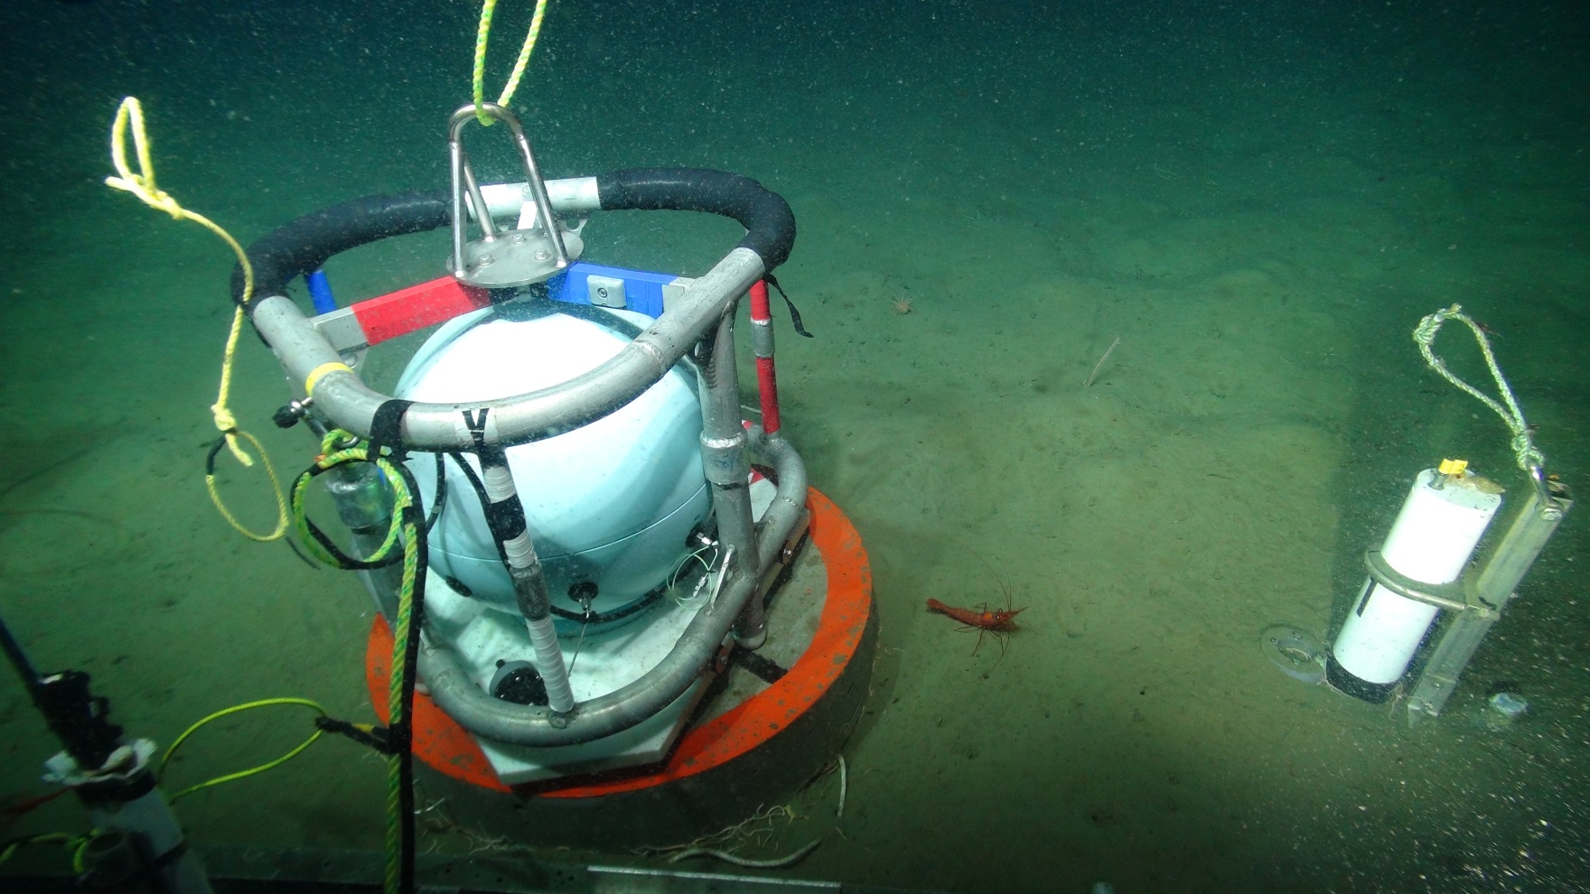
A pressure gauge with an in situ calibration system detects seafloor height change without contamination from gauge drift. It can be used in campaign mode and for continuous observations. Accuracy is equivalent to ~ 1 cm height change. Currently a campaign test is underway on six benchmarks in an E-W line across the Cascadia Subduction Zone offshore Oregon.
(Zumberge et al.)

Slide 10
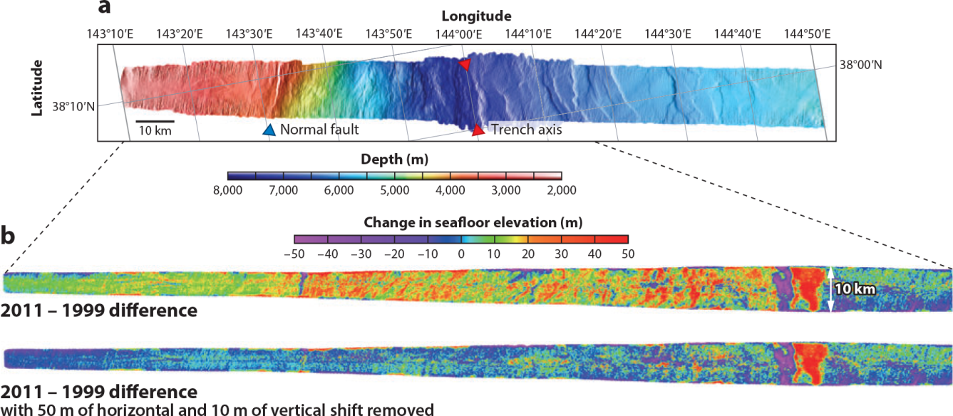
Repeat bathymetry
Fujiwara et al. 2011
By slowing ship down and increasing sounding density may be possible to increase the resolution to meter-level or better (DeSanto,Sandwell,Chadwell,JGR,2016)

Slide 11
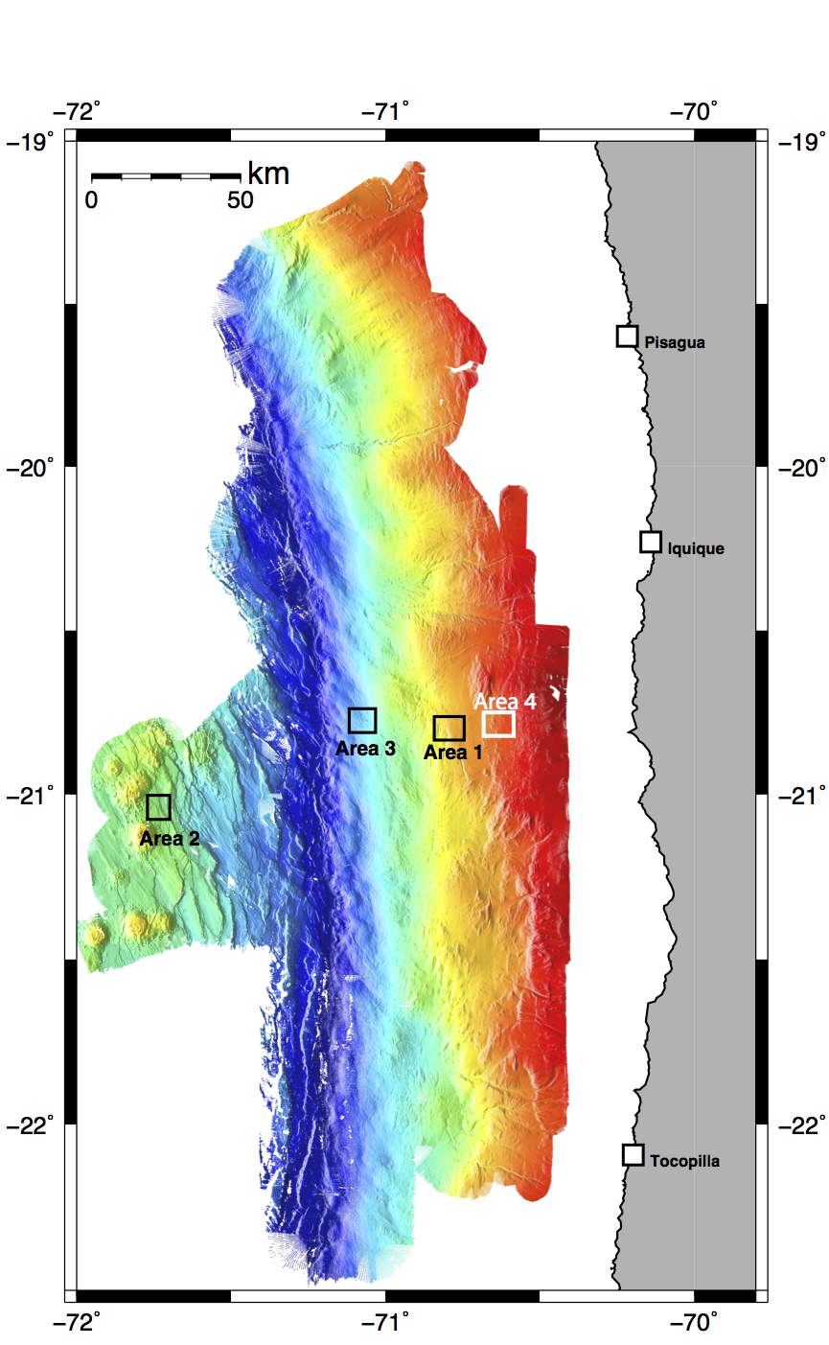
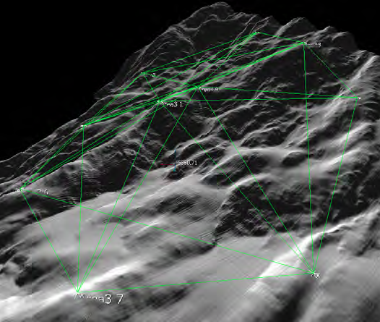
Continuous Seafloor Strain Monitoring in the Iquique Seismic Gap:
3 GEOMAR Arrays: ~10 sensors each;
2-3 km diameter circular arrays; Interrogations every 1.5-3 hours; strain sensitivity about 1e-6
~30 baselines monitored/array
2014 M8.2
3km

Slide 12
Continuous Seafloor Strain Monitoring in the Iquique Seismic Gap:
WHOI Array:
8 seafloor tripods, 1 Moored transceiver
Baselines 2-5 km. Array 15km.
2014 M8.2
Acoustic Ray Paths: Iquique Locked Zone
Moored
Transceiver
WHOI
Instruments
Bathymetry
15 km
West
East

Slide 13
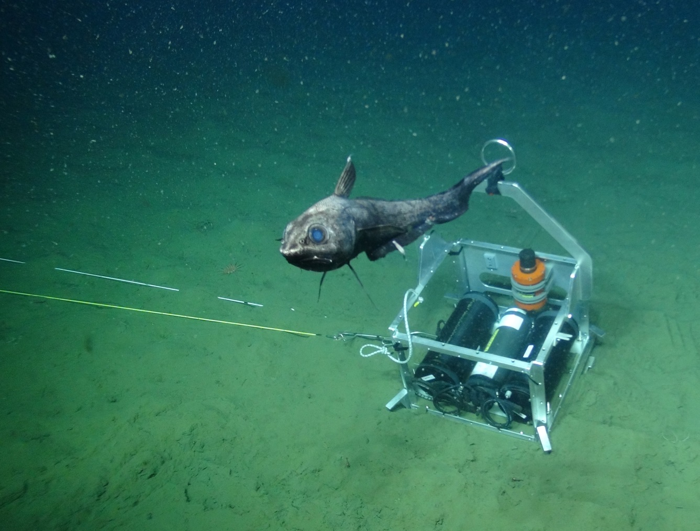
A long baseline (200 m) optical fiber strainmeter was deployed at 1900 m depth near the toe of the accretionary prism offshore Oregon. A 100-day record revealed an unexpected correlation between tidal height and seafloor strain.
(Zumberge et al.)

Slide 14
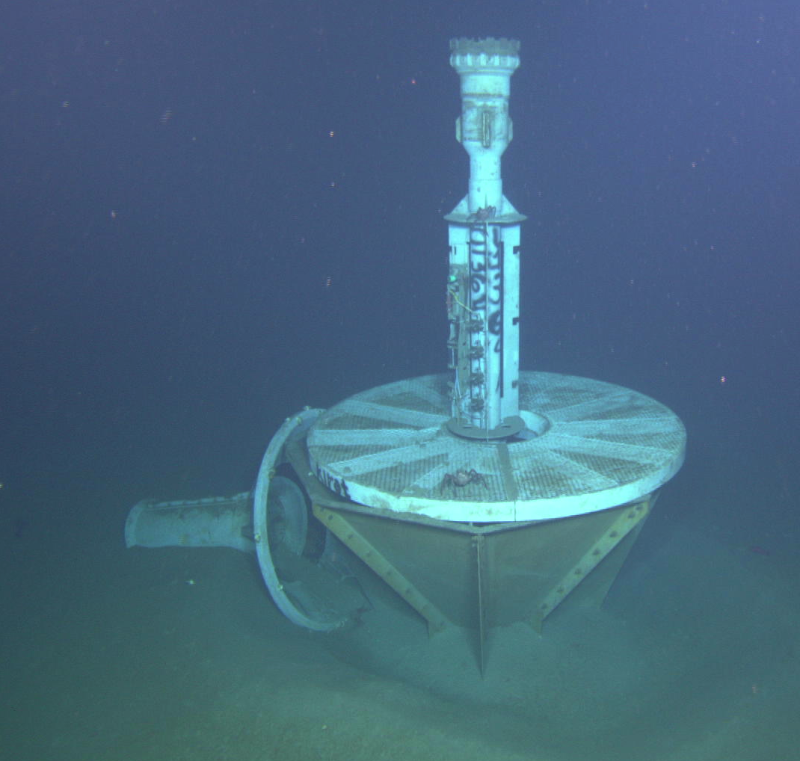
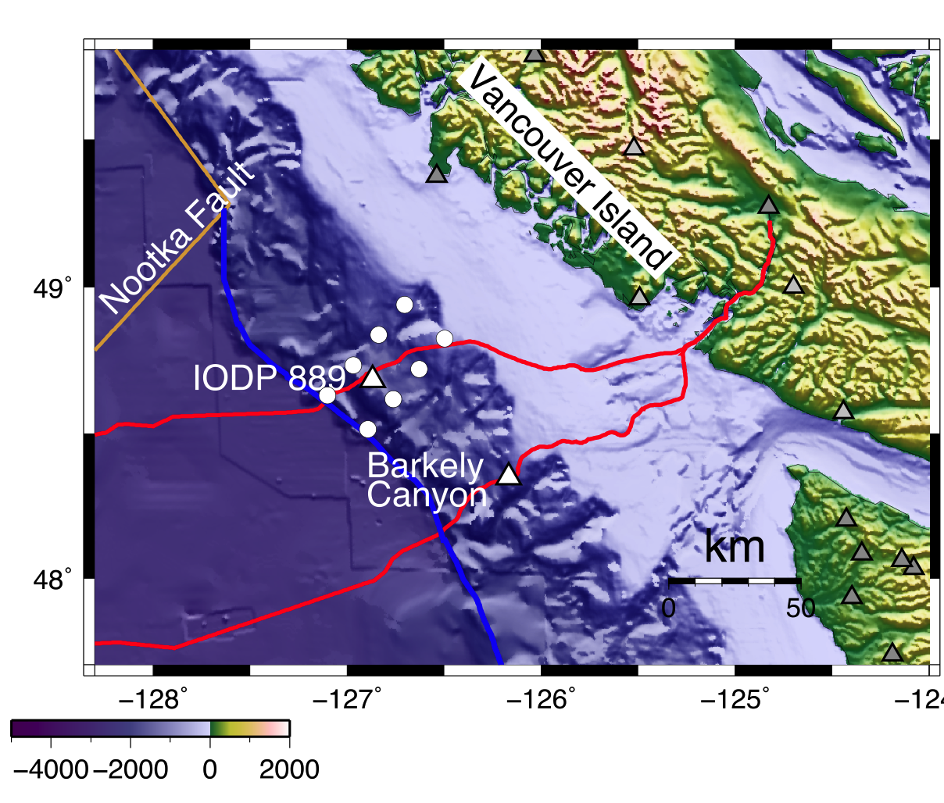
A Seafloor Geodesy Observatory at the Updip Edge of the Locked Zone
WHOI, Univ. of Miami, PGC, ONC (McGuire)
ONC Cabled Observatory
IODP 1364A
~20 Feet
In Fall 2015, this site will host a number of sensors for studying strain anomalies, including some with real-time telemetry, with the goal of understanding strain build up and release near the updip end of the seismogenic zone. Sensors will include:
-ACORK formation pressure sensors -seafloor seismometer
-seafloor APG array -borehole tiltmeters
-borehole seismometer -borehole temperature string
Notes:
The other half of the problem is looking at how strain accumulates before a big earthquake.
On land we typically due this with GPS receivers that can record the long-term buildup of strain
In the crust.
In cascadia it appears that signal is largely located offshore.
That’s a little harder to do offshore because ….
GeoPRISMS is actually made it a point in Cascadia to begin installing geodetic benchmarks above the locked zone
In Cascadia. Dave Chadwell from scripps is

Slide 15
An optical tilt meter has been developed that doubles as a broadband seismometer. The instrument is self-leveling and relies on the stability of laser light and monolithic flexures to provide high long-term stability. A year-long test was made at the Albuquerque Seismic Lab in a 60-m-deep borehole. Methods for inserting the instrument in the shallow sediment using an ROV have been tested.
(Zumberge et al.)

Slide 16
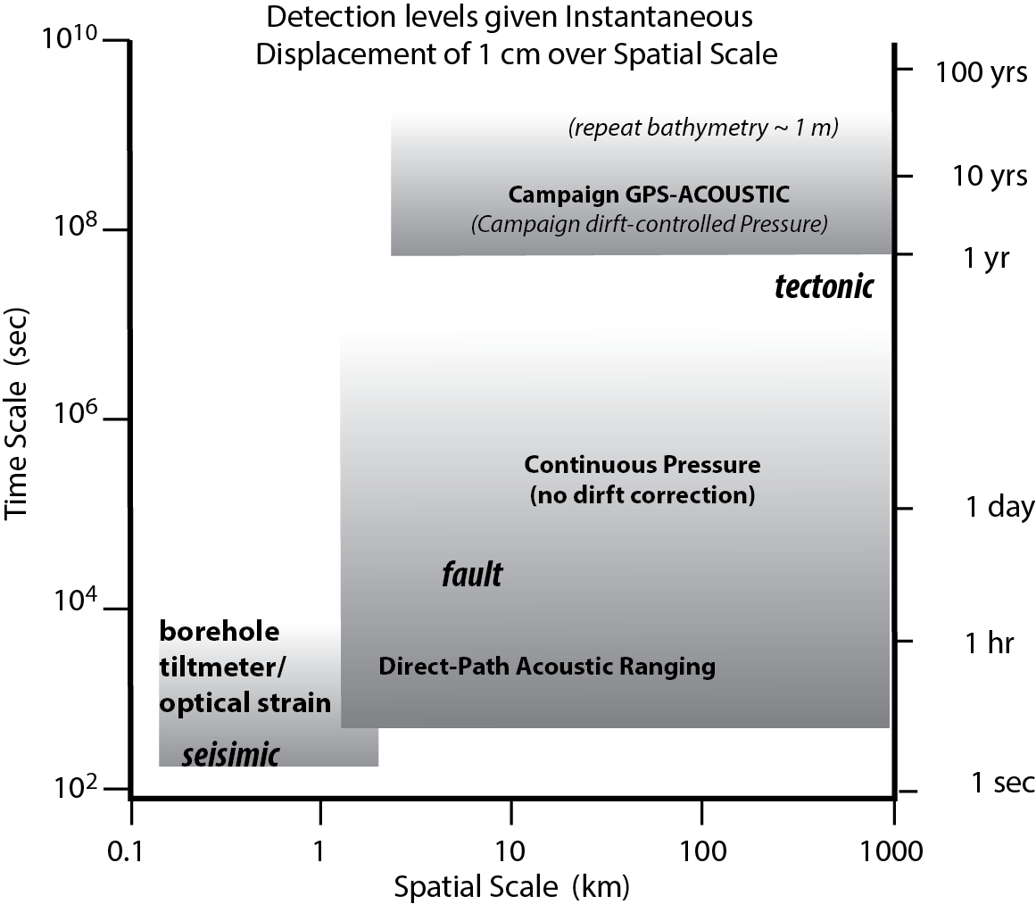
Techniques and resolution

