Slide 1
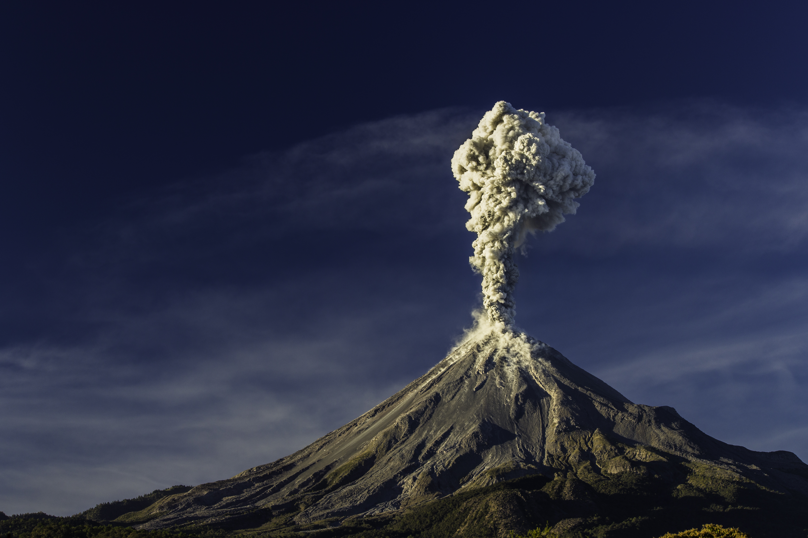
We are
a Mexican company providing tools, systems and solutions for seismology, geodesy and civil engineering.
But we are more than just suppliers…

Slide 2
We go with our Clients by their side, from the start of their idea, with knowledge and cutting edge technology to provide the right solution to their needs and to achieve together precise and accurate results for their research.

Slide 3
With offices in México, Perú and Chile we deliver and install all over Latin America
Understanding of needs
Total cost of the project
Training
Coverage against eventualities
Instrumentation selection
Implementation
24/7 Support
Flexibility for instrumentation purchase
Your ally in research

Slide 4
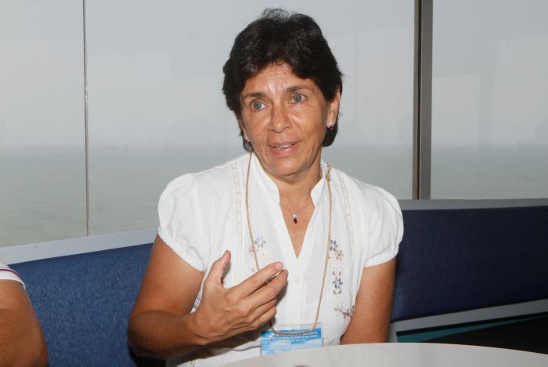
“
We are inspired by people who push their boundaries, people who think differently, visionary and extremely perfectionist,
creative and passionate.
Una cosa es el reglamento, pero ninguna norma te sirve, o ninguna ley sirve de nada si no se lleva a la práctica, se vigila, se cuida, se observa, no solo la parte constructiva, sino el uso de suelo”.
Dr. Xyoli Perez
Jefa del Servicio Sismológico Nacional de la UNAM
“
en Chile y en el mundo entero. Conocemos más del espacio que de nuestros propios océanos, sobre todo con lo que ocurre en nuestro fondo marino”.
Dr. Sergio Barrientos
Director del Centro Sismológico de la U de Chile.
“
Sobre gestión del riesgo siempre se está en el filo de la navaja. Si esto (las erupciones) ocurre en el momento en que no debe haber un error, puede ocurrir una tragedia”.
Dra. Martha Lucia Calvache
Director Técnico de Geoamenazas del SGC.

Slide 5
We share our passion from the mystery of volcanoes
Seismology
Communications
to the depths of the ocean
Civil engineering
Geodesy

Slide 6
As every project is different, every solution is unique, tailored to our Clients needs
We strive for cost efficiency, quality certainty, innovation and functionality
Genius to get precision data

Slide 7
In Ampere we understand the long and difficult journey that has to be undertaken to install an instrument, therefore we have a strict sense of quality and testing to make sure that our Clients will be able to deploy and operate succesully all the products that we supply.
Your ally in research

Slide 8
Trust is a fundamental concept in Ampere.
We guarantee the long-term reliability of the solutions we provide to help our Clients to focus on the importance of their research
Evidence for science

Slide 9
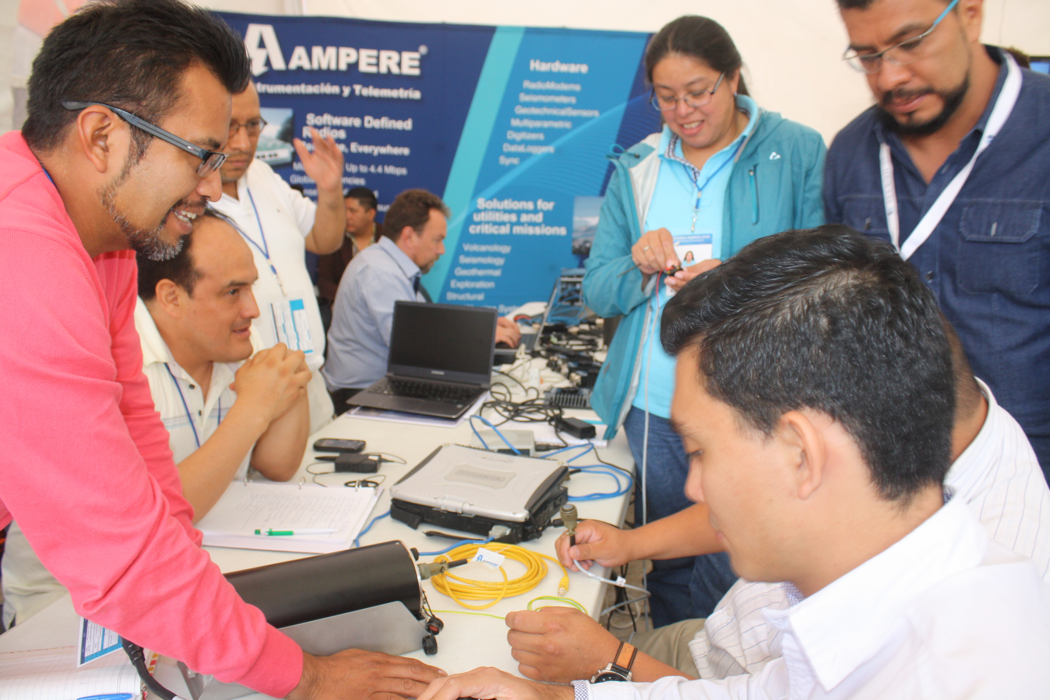
For Ampere every challenge turns into investigation, learning and development of solutions therefore we work closely with the Manufacturers to achieve the success of our clients project.
Your ally in research

Slide 10
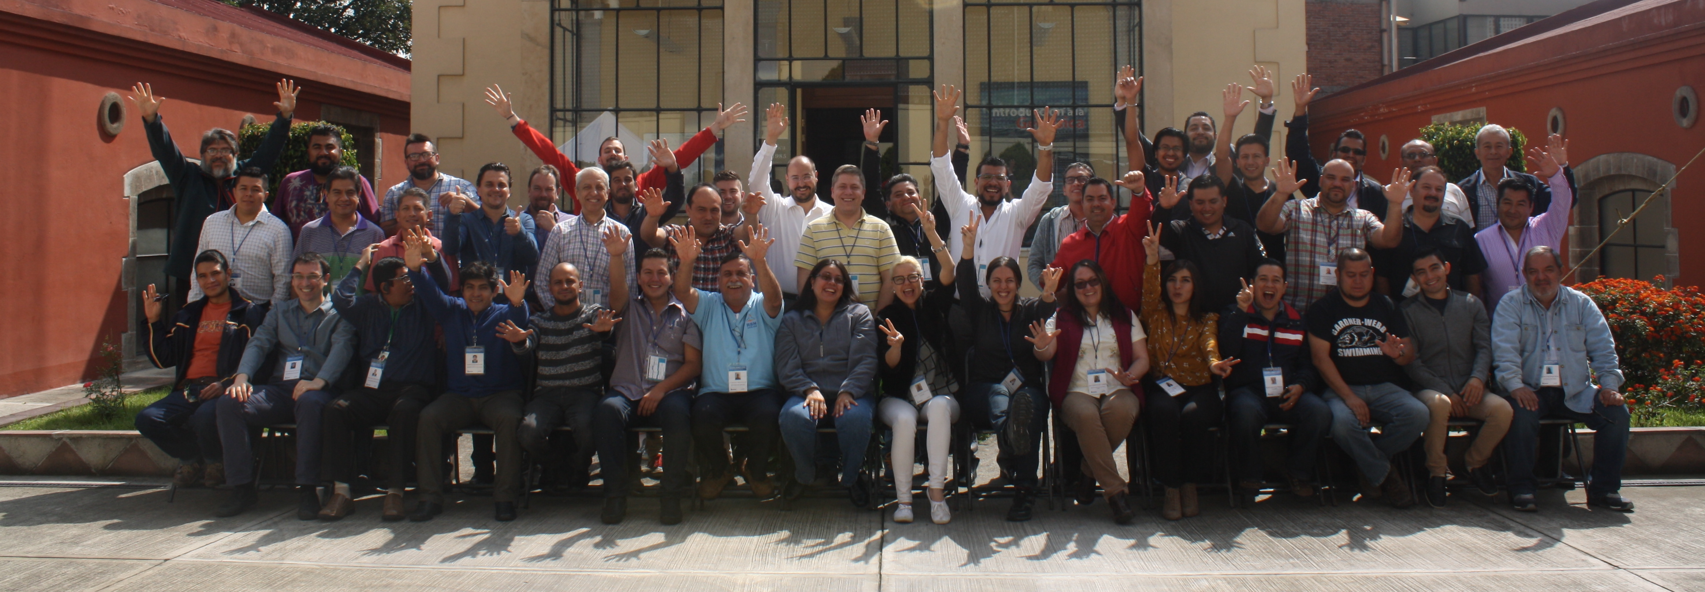
For more than 50 years we have delivered excellence to our bussiness partners
Our goal now, is to become the leading Latin American supplier for seismological, geodetical and civil engineering scientific research institutions
Because we like to say that exists to
GIVE VOICE AND VOTE TO SCIENCE TO PROTECT LIFE
Thank you!

