Slide 1
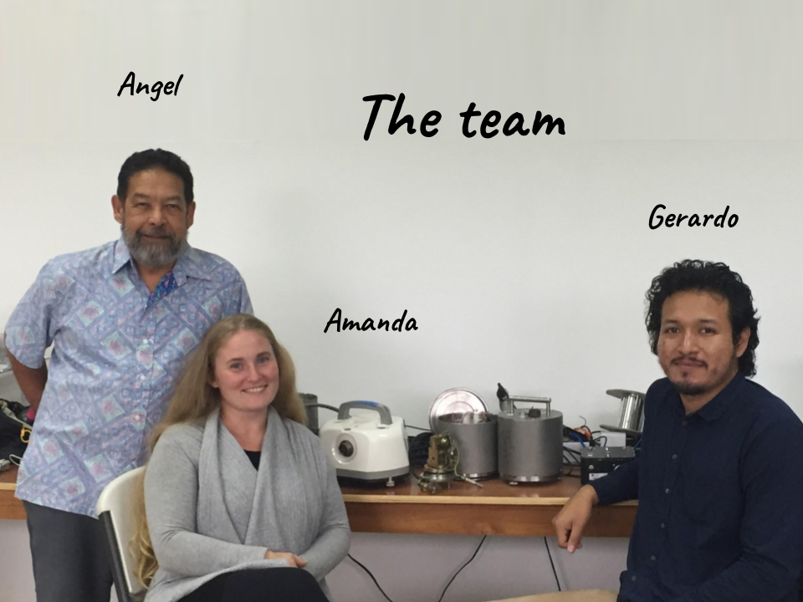
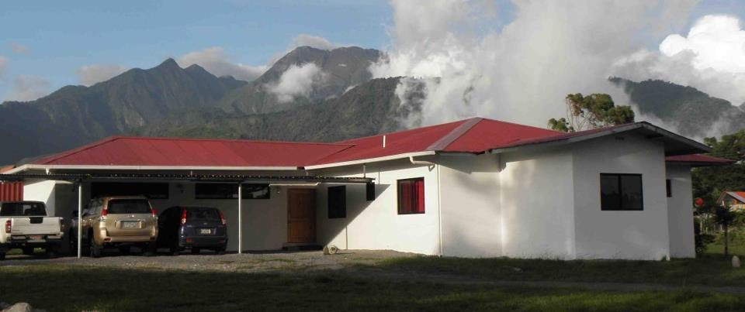

Angel Rodriguez
ChiriNet & OSOP
Eqchiriqui@gmail.com

Slide 2
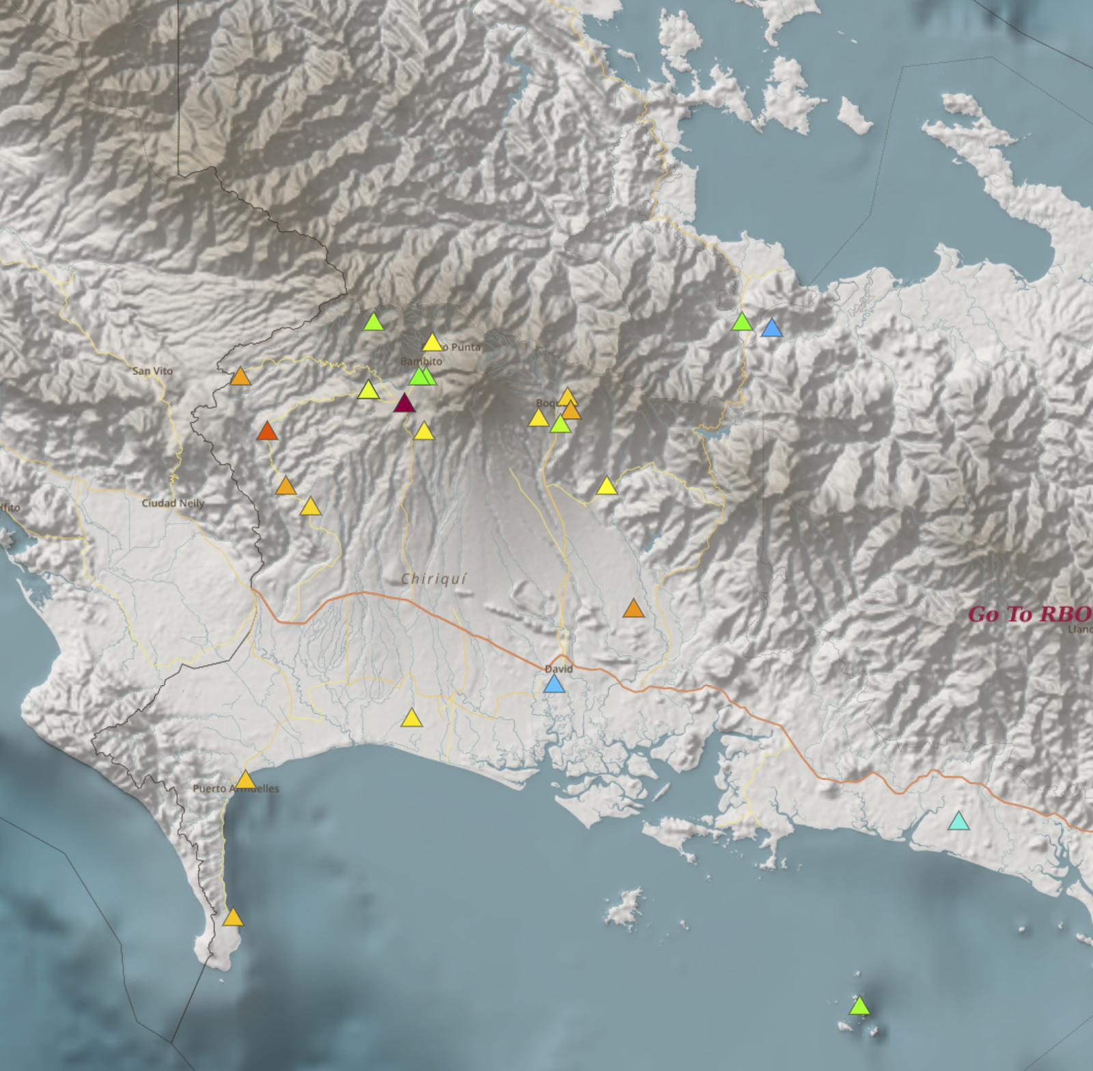
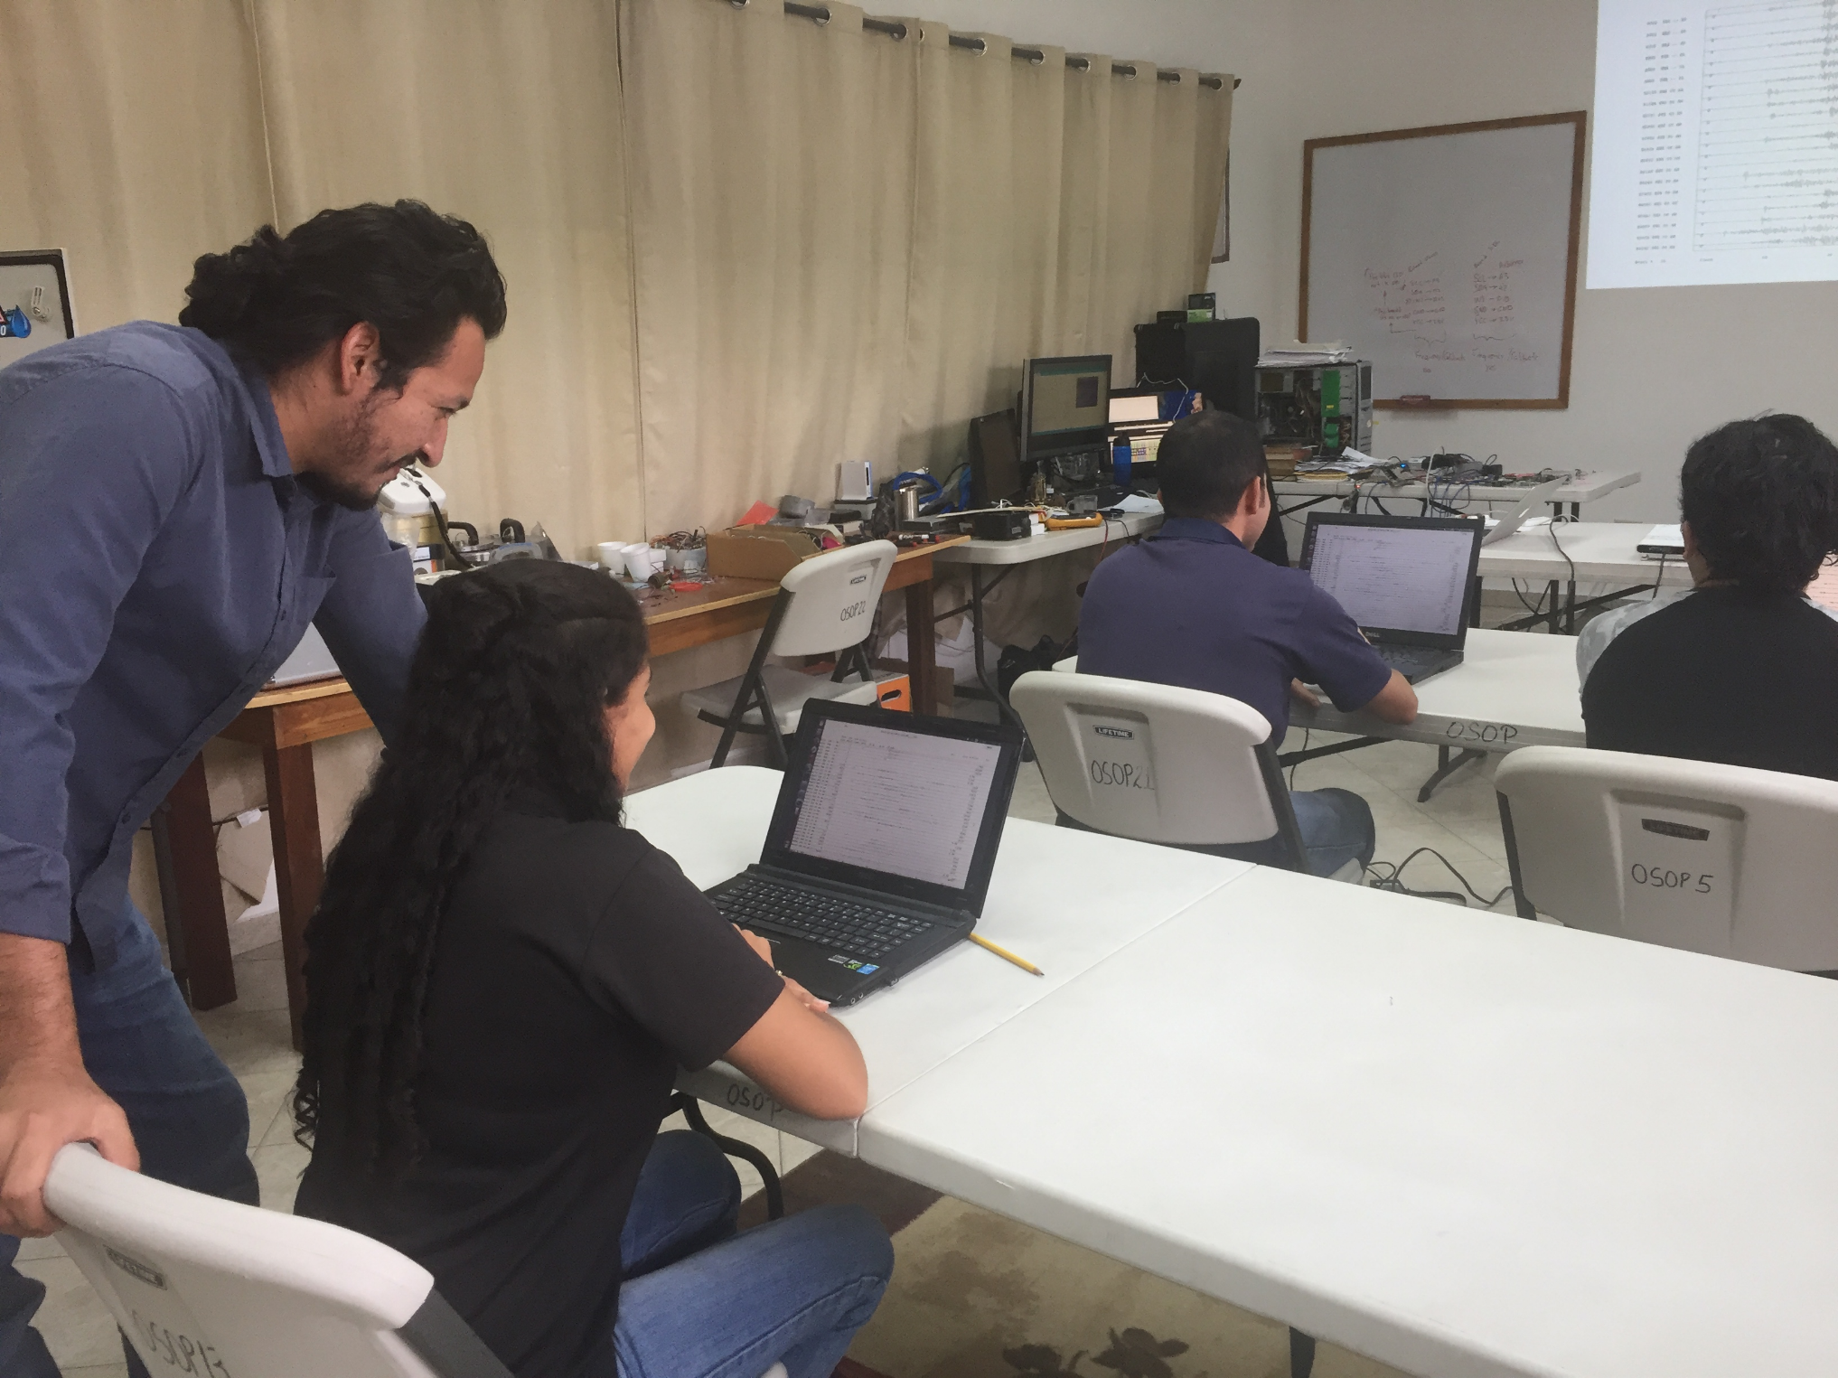
ChiriNet
Seismic Network
27 Stations
Trained Community Volunteers

Slide 3
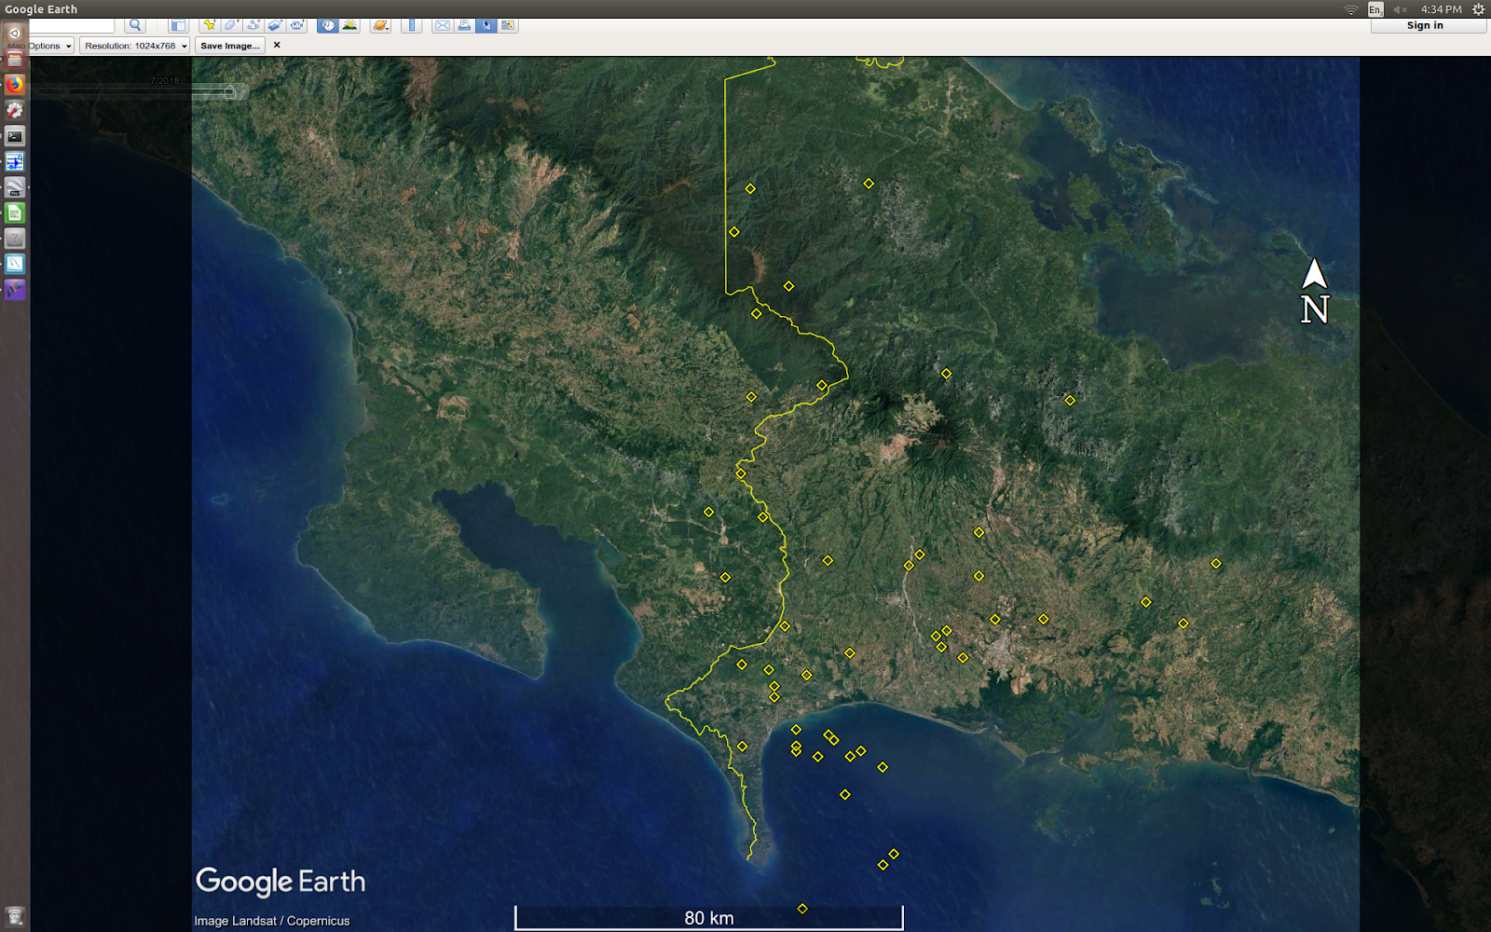
OSOP
May and June, with automatic system (Seiscomp3).
45

Slide 4
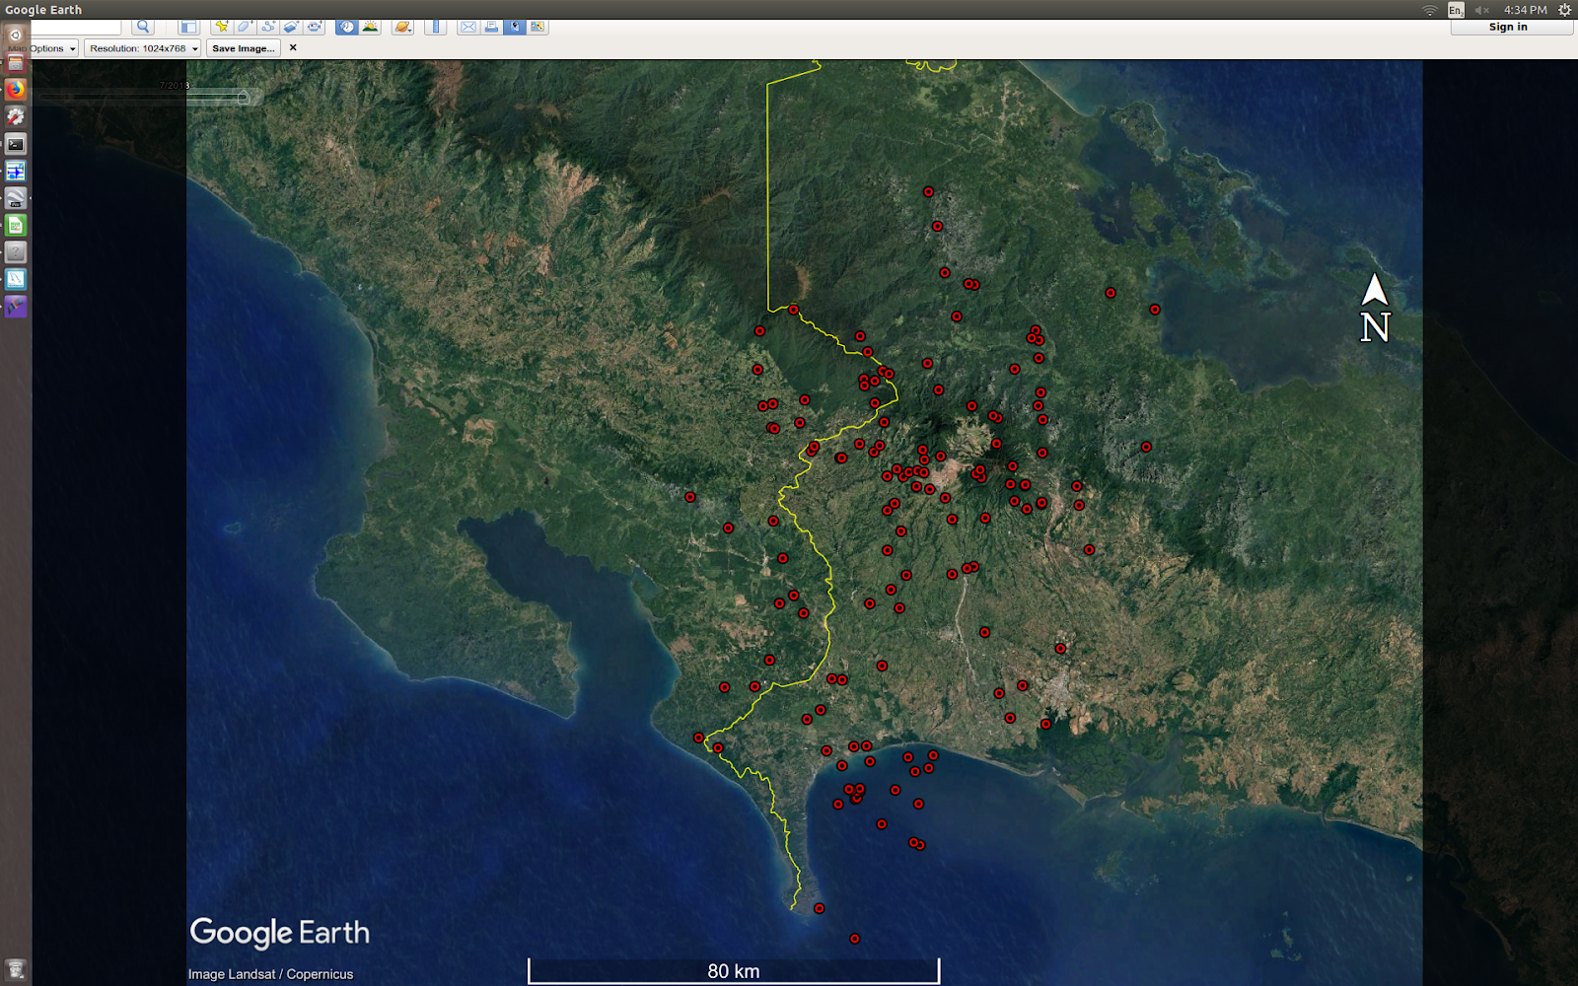
Raspberry Shake.
May and June, with semi-automatic system (Earthworm and Seisan).
153

