Slide 1
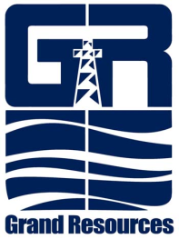


New Electromagnetic and Optical Fiber Strainmeters and Tiltmeters for Measuring Deformation
Scott DeWolf
Larry Murdoch, Liwei Hua, Hai Xiao, Leonid Germanovich, Stephen Moysey, and Alexander Hanna
Clemson University
In cooperation with UNAVCO and Grand Resources, Inc.
Funded by U.S. Department of Energy National Energy Technology Laboratory
Notes:
1

Slide 2
Outline
Background and motivation
Electromagnetic Instrument Developments
Optical Fiber Instrument Developments
Conclusion

Slide 3
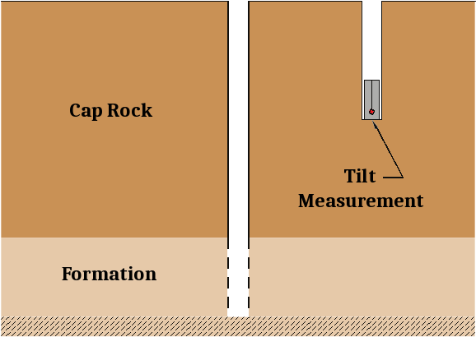
Background and Motivation
Before Injection

Slide 4
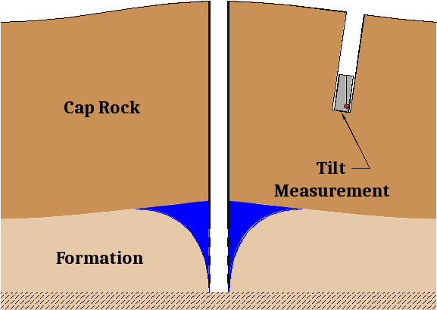
Background and Motivation
During Injection

Slide 5
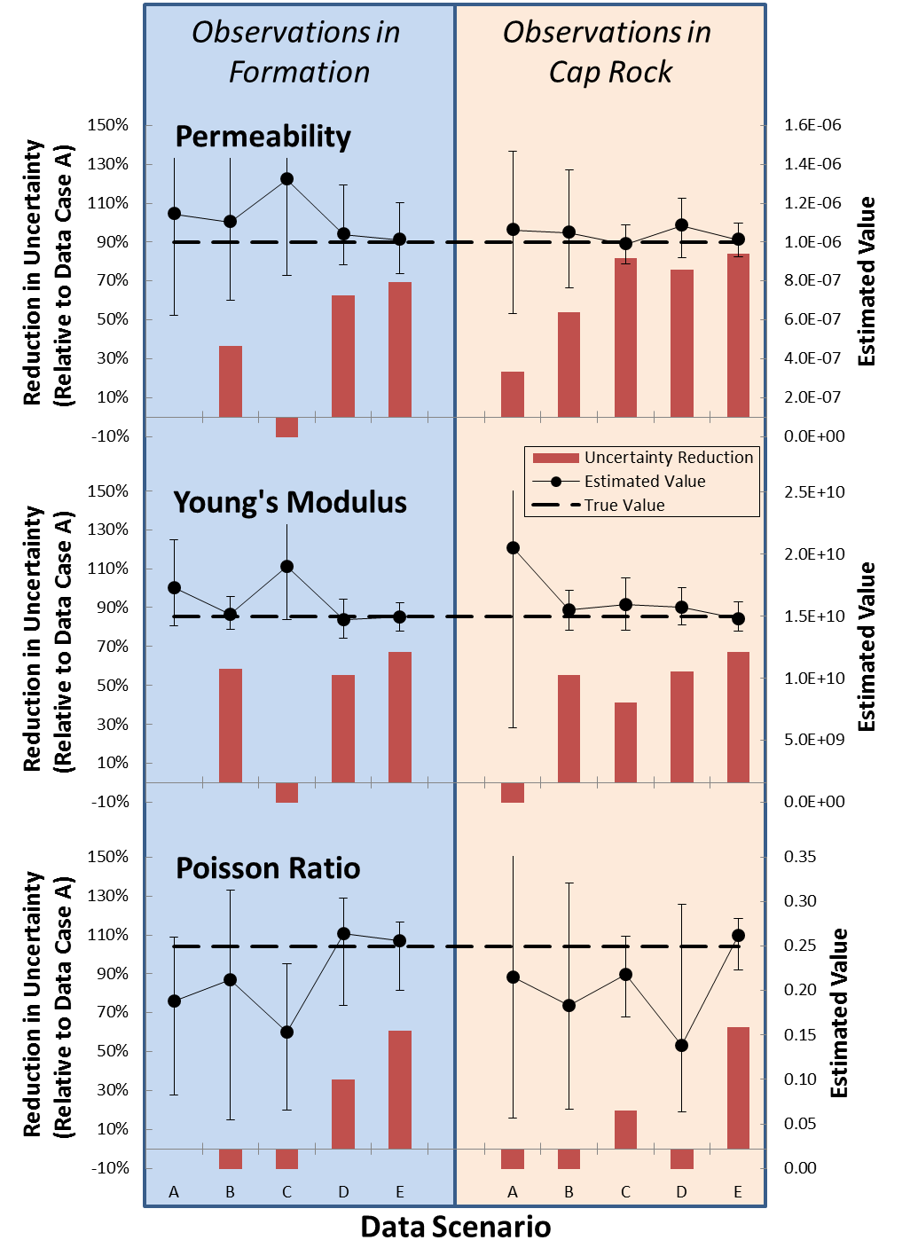
Background and Motivation
Previous innovations
  Strain & tilt improves parameter estimation
  Measurements in cap rock
Project goals
  Develop low-cost strainmeters & tiltmeters
  Inversion of real strain & tilt data
The resulting deformation is traditionally monitored by making pressure and/or tilt measurements in one or more nearby wells. These data can be used to estimate the geomechanical properties of the injection site. However, modeling results suggest that the material parameters can be better constrained with the inclusion of strain measurements.
Explanation of Data Scenarios:
A – Reservoir Pressure Data Only
B – Tilt Meter Data Only
C – Strain Tensor Data Only
D – Confining P + Tilt Data
E – Confining P + Tilt + Strain Data

Slide 6
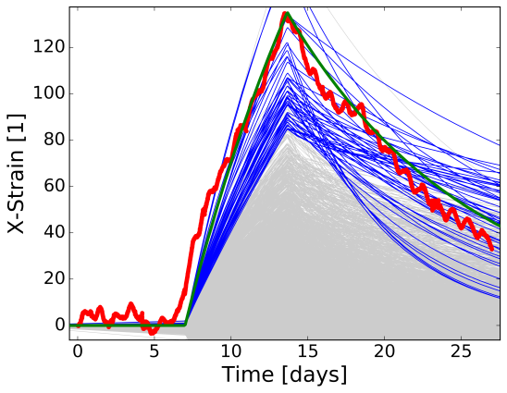
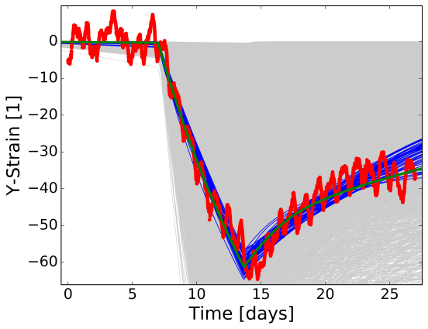
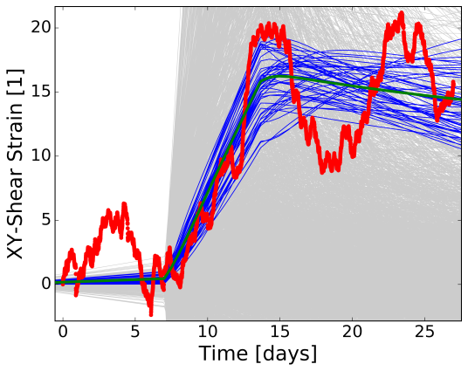
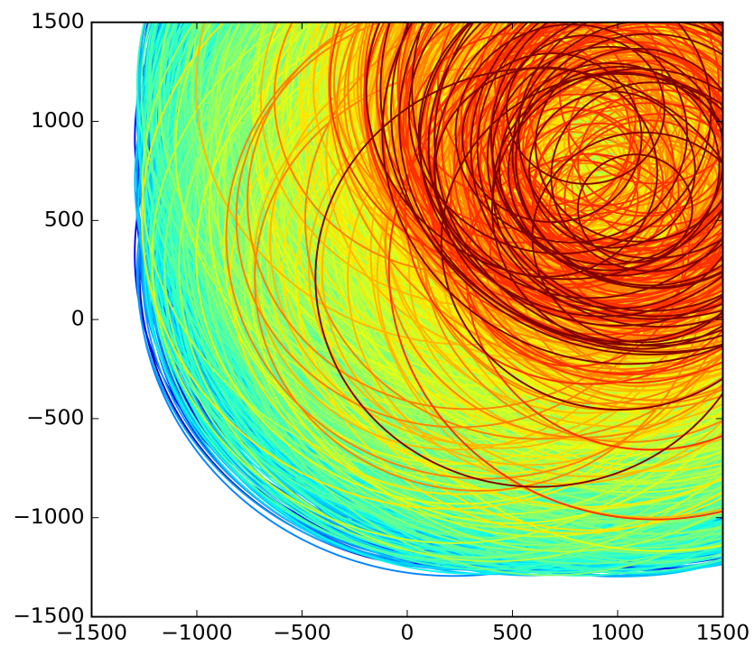
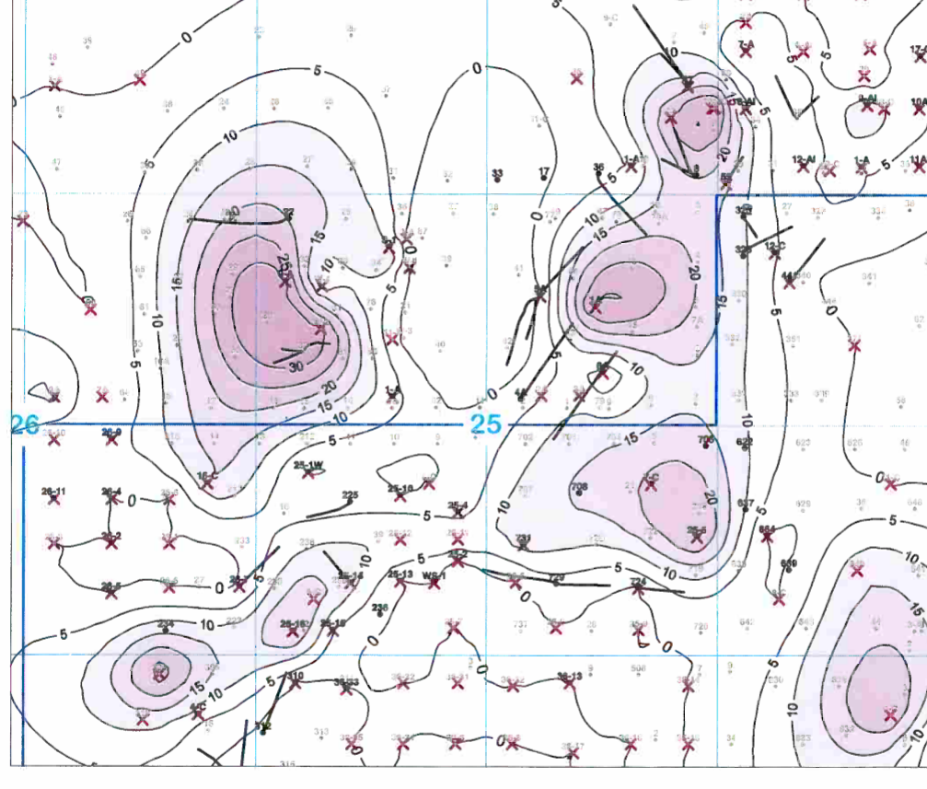
Background and Motivation
Time Series Fits: Trials (gray & blue) and best (green)
Geometry
Location
Size
  Permeability tradeoff

Slide 7
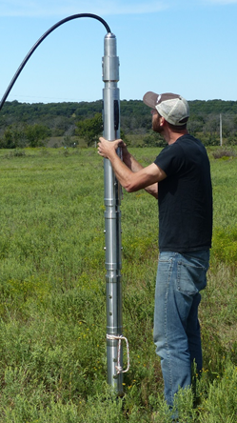
Background and Motivation
PROBLEM:
Borehole strainmeters are (practically) obsolete!
SOLUTION?
New electromagnetic
  Using commercial sensors
New optical fiber
  Short baseline sensing elements
  Long lengths of fiber with novel embedding geometries
Gladwin borehole strainmeter

Slide 8
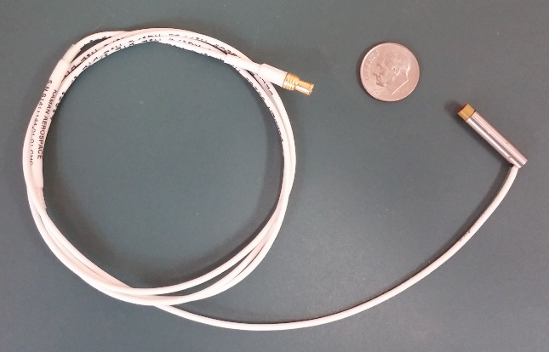
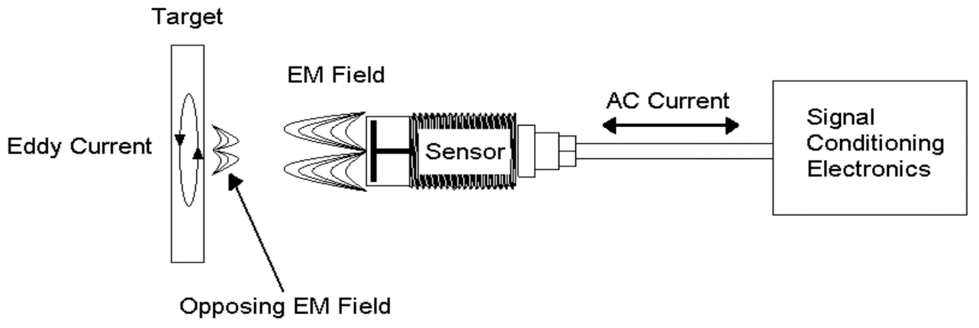
Instrument Development: Electromagnetic
Eddy current displacement transducers
Non-contact
  Requires conductive target
High resolution
  1 nm single-ended
  0.1 nm differential
$5,000 for 3 singles or 2 differentials

Slide 9
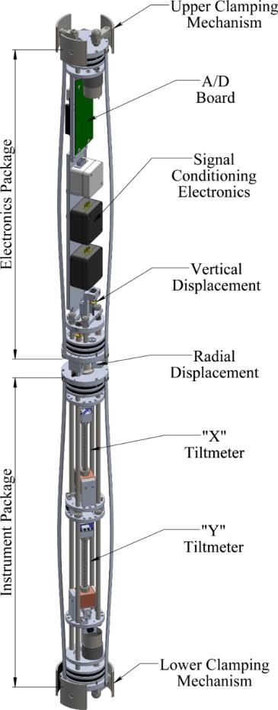
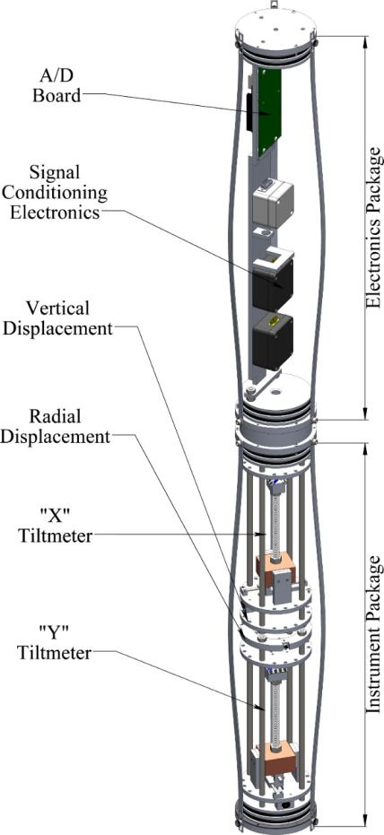
Instrument Development: Electromagnetic
Eddy Current Systems
Commercial eddy current sensor integration
Removable and expendable (grout-in) configurations
4 strain components
  3 horizontal
  1 vertical
2 tilt components
~1 part-per-billion resolution
Removable
Grout-in

Slide 10
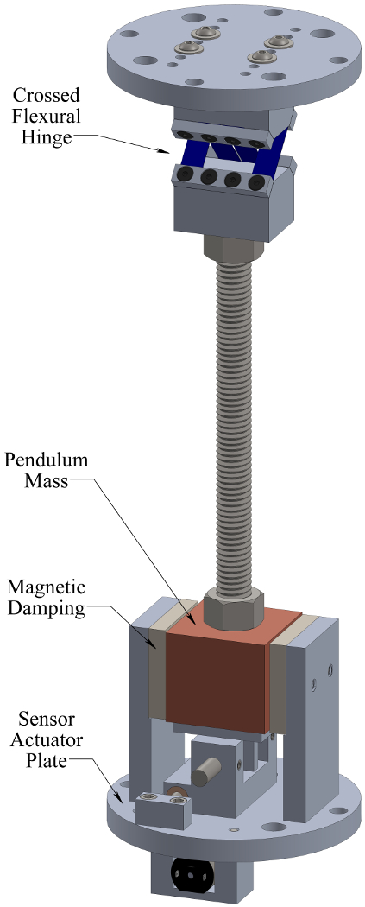
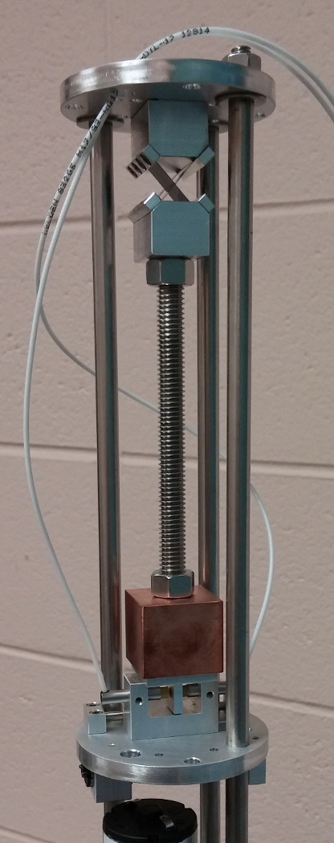
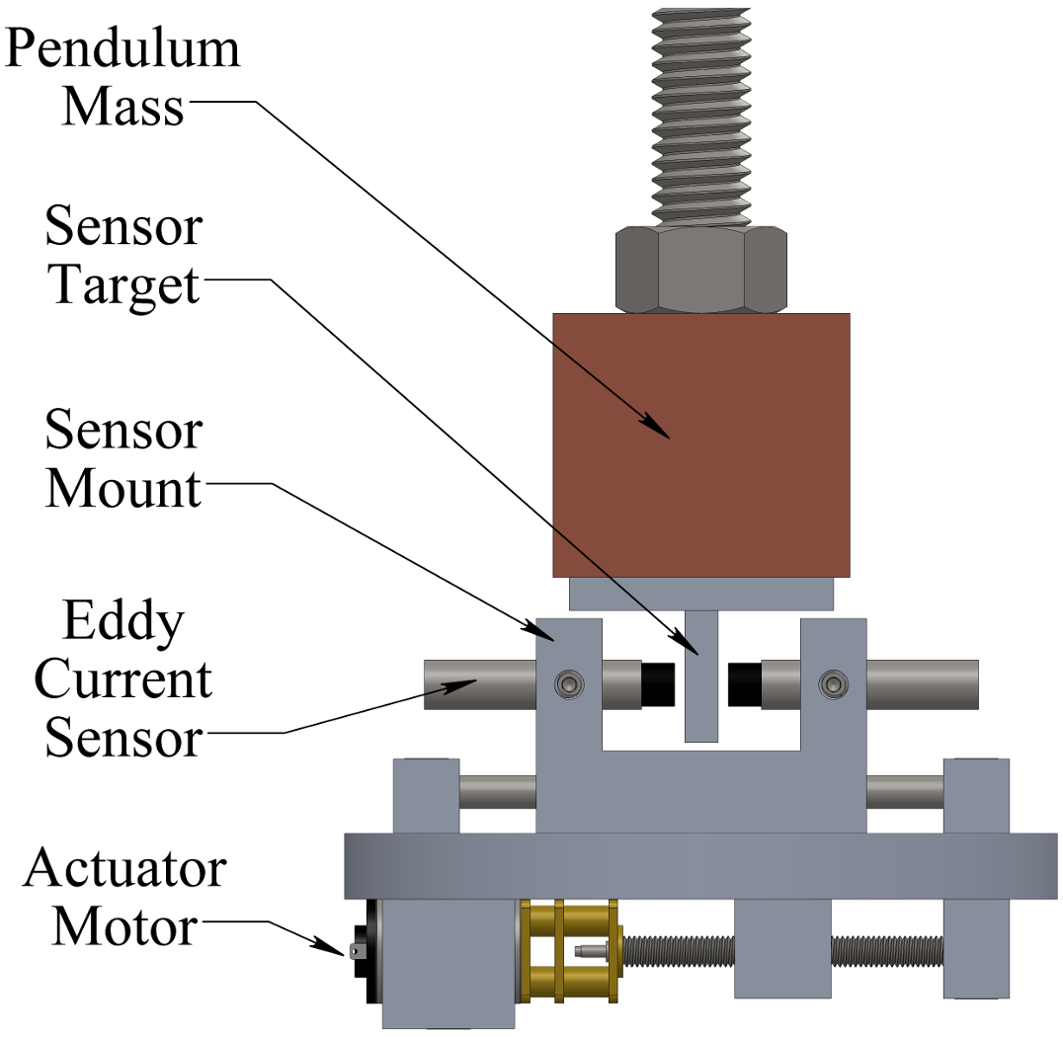
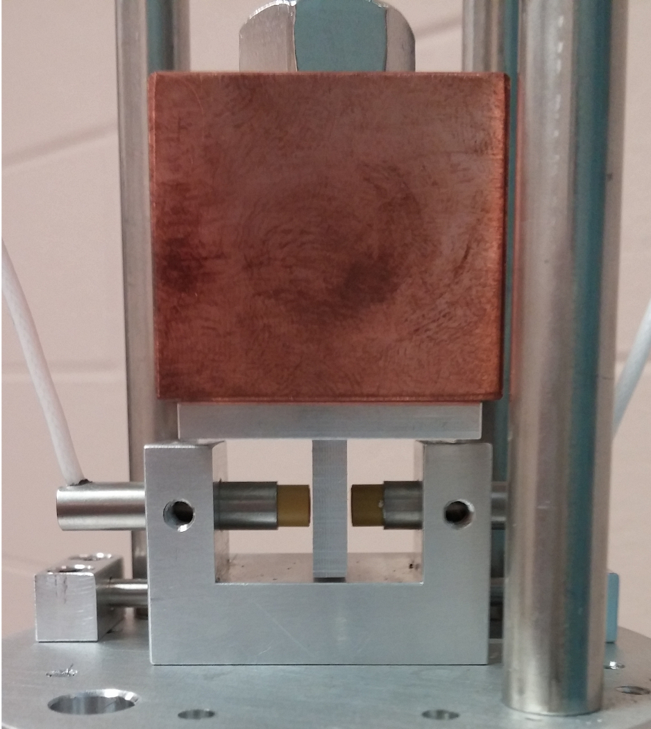
Instrument Development: Electromagnetic
Eddy Current Tiltmeters
Differential measurement
  Better than 10⁻¹⁰ resolution
Magnetic damping
Releveling
  Grout-in: ± 8.5°
  Removable: ± 2.5°

Slide 11
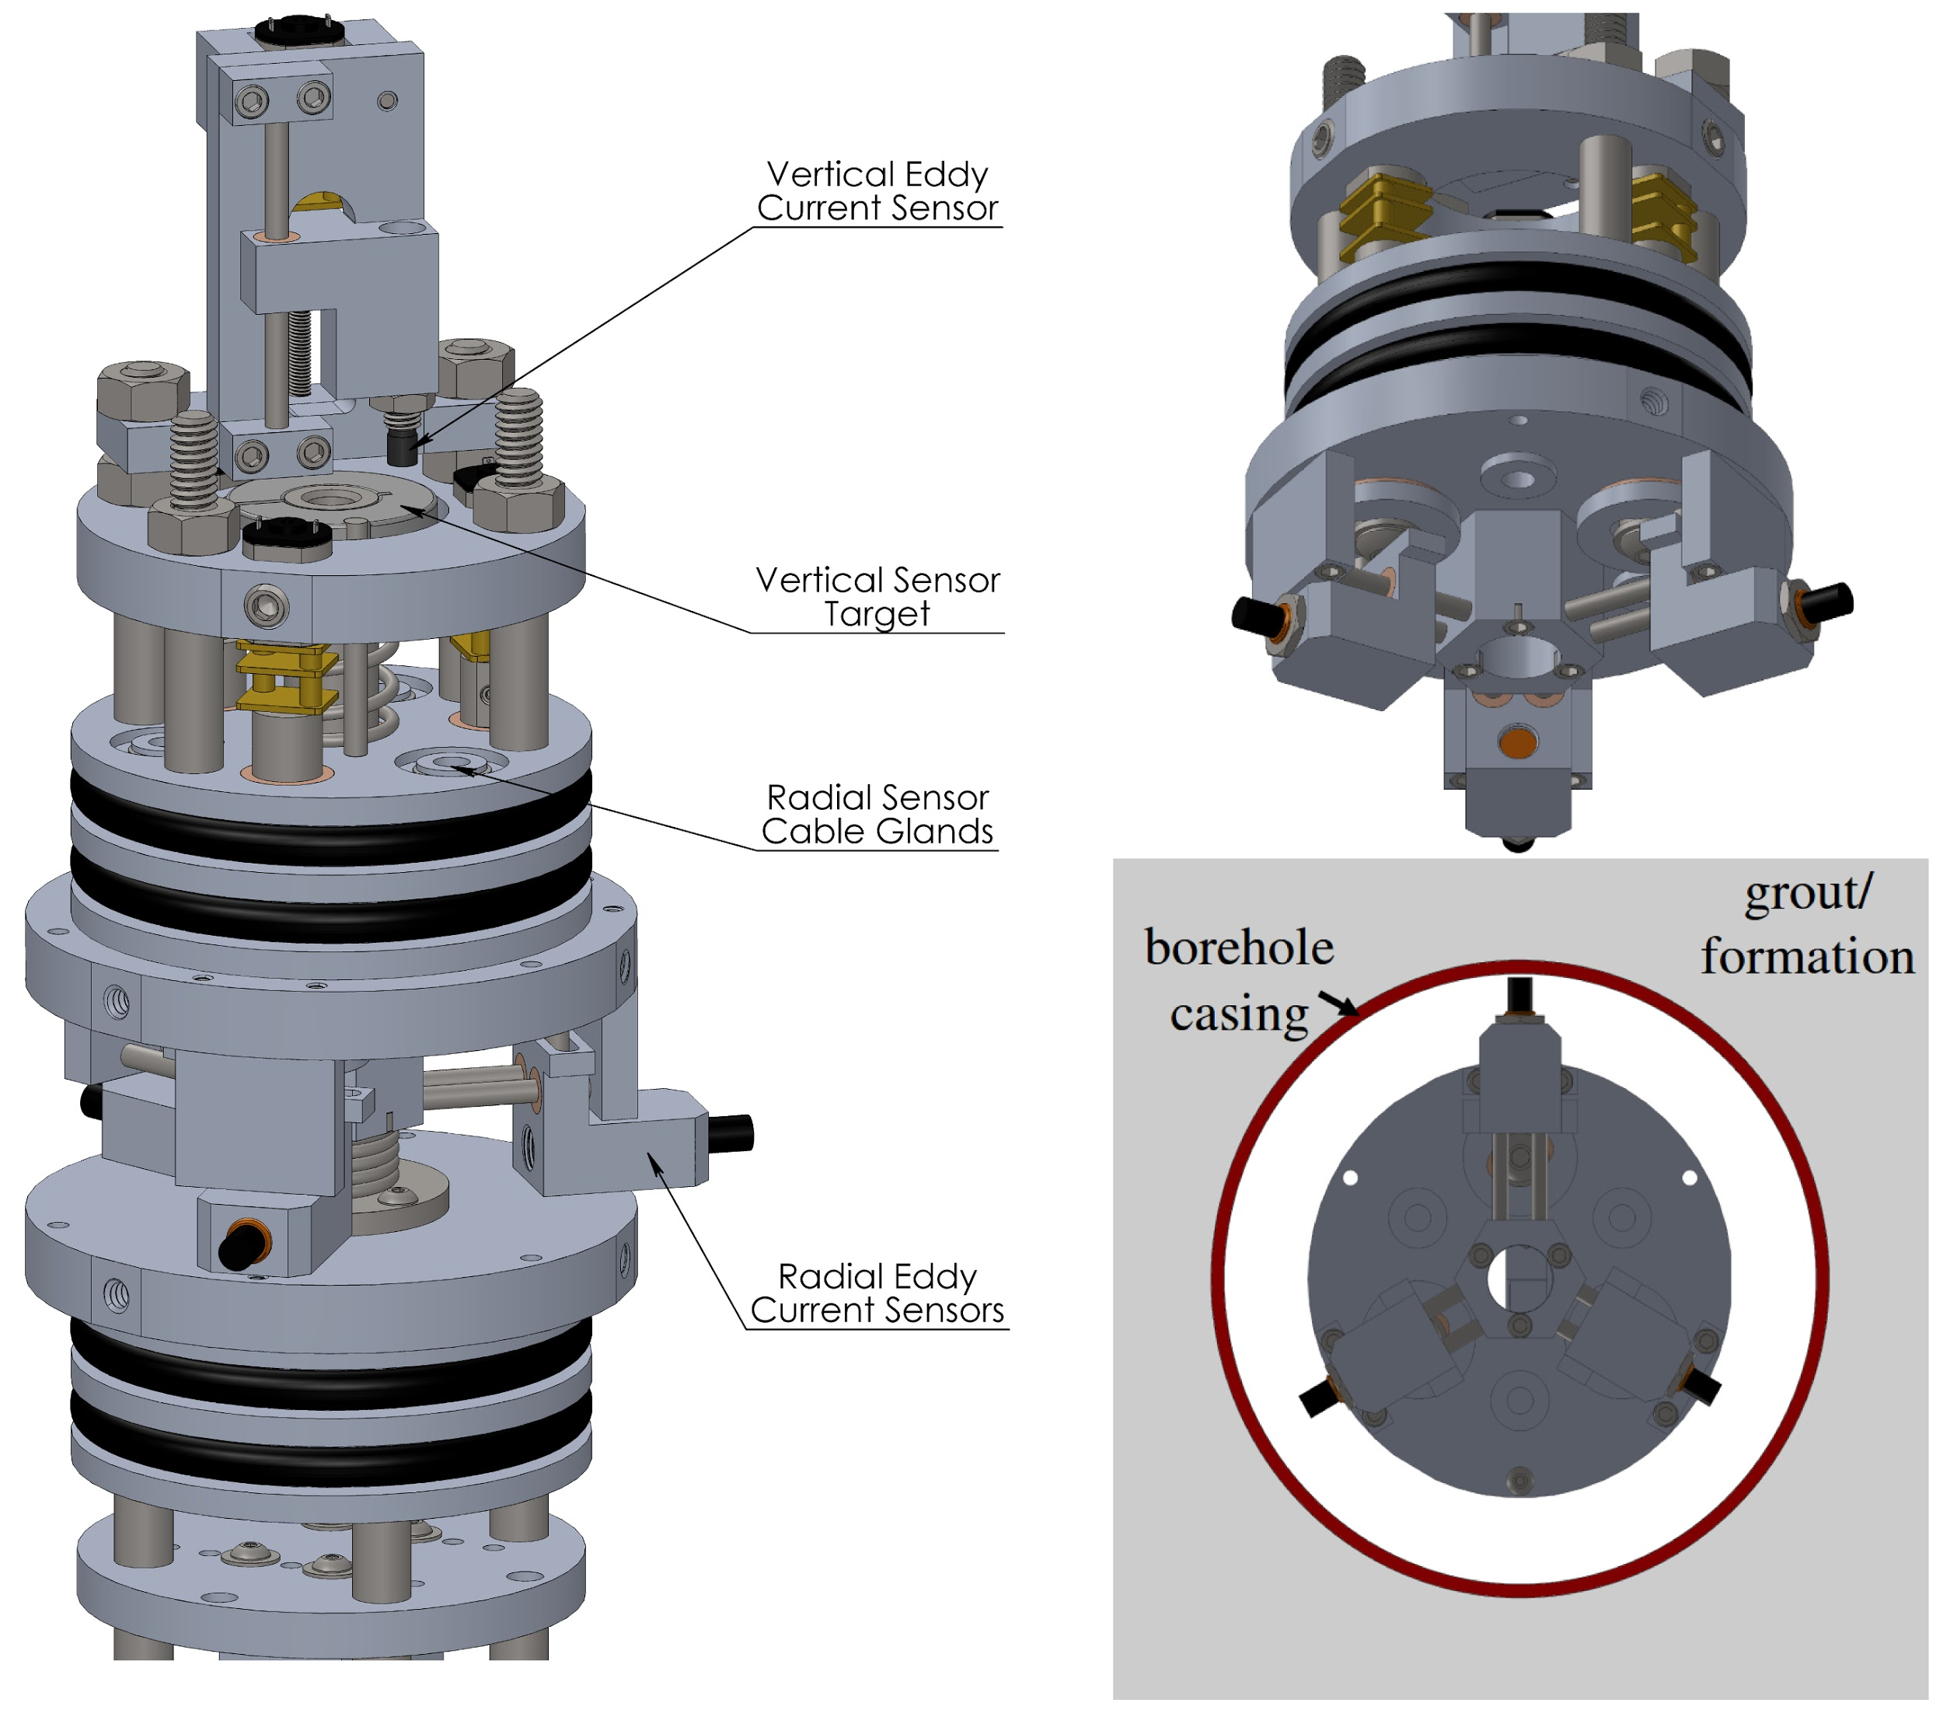
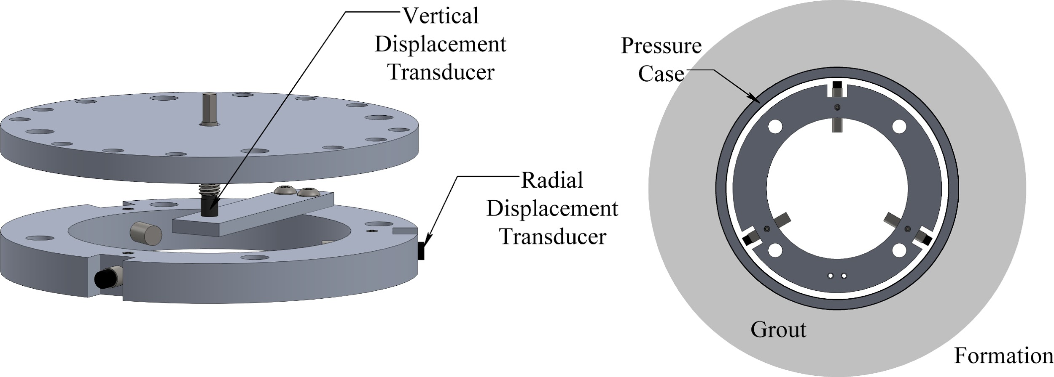
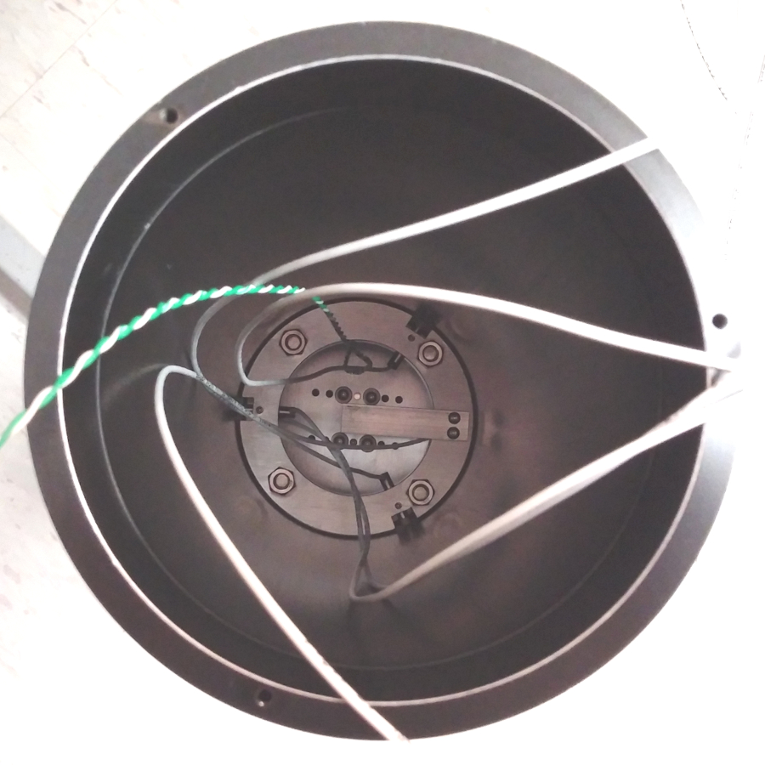
Instrument Development: Electromagnetic
Eddy Current Strainmeters
Single-ended measurement
  ~10⁻⁹ resolution
Axially collocated horizontals
Retractable sensors (removable)

Slide 12
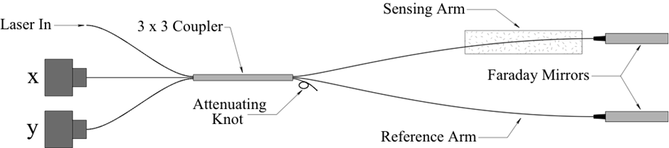
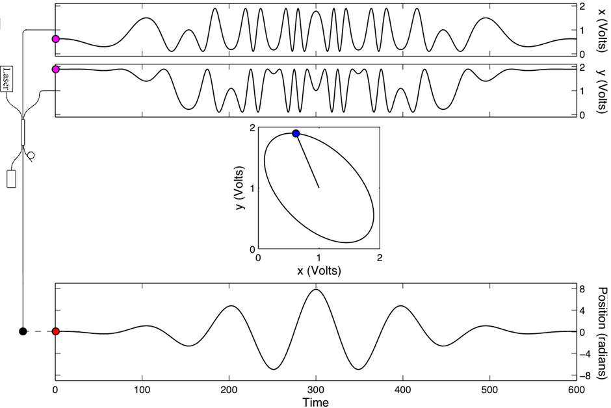
Instrument Development: Optical Fiber
Coherent light source (laser) input
3x3 splitter to divide input light
Faraday mirrors
  Polarization insensitive
Phase-shifted interference fringes
  Directional fringe information
Real-time digital demodulation

Slide 13
Instrument Development: Optical Fiber
System components
Sensing head is exposed to environment (strain, temperature)
Optical Fiber cable communicates between interrogator and sensing head
Interrogator reads signal from sensing head
Sensing Head
Fiber Cable
Interrogator

Slide 14
Instrument Development: Optical Fiber
Optical Fiber Sensor Interrogator
Light source to illuminate sensing head
Photodetector to convert returning light to voltage
Signal processor to convert detected light into electronic output proportional to desired measurement (strain, temperature)
Signal processing /
Data acquisition
Light source
(Laser, SLED)
To sensing head
(via fiber cable)
Feedback
(some applications)
DATA
Light detection
(photodiode)
Detector output
From sensing head
(via fiber cable)

Slide 15
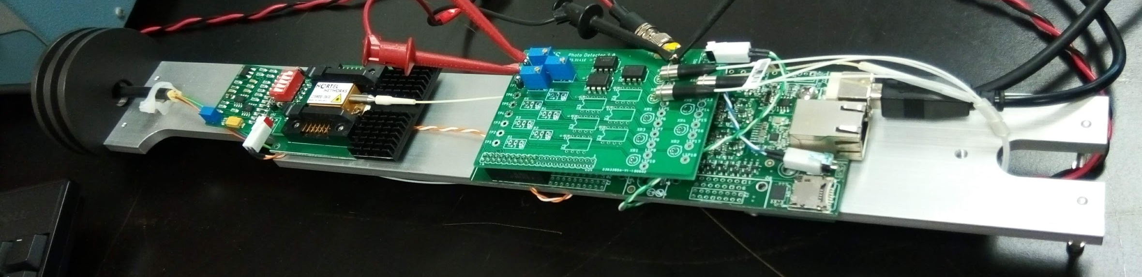
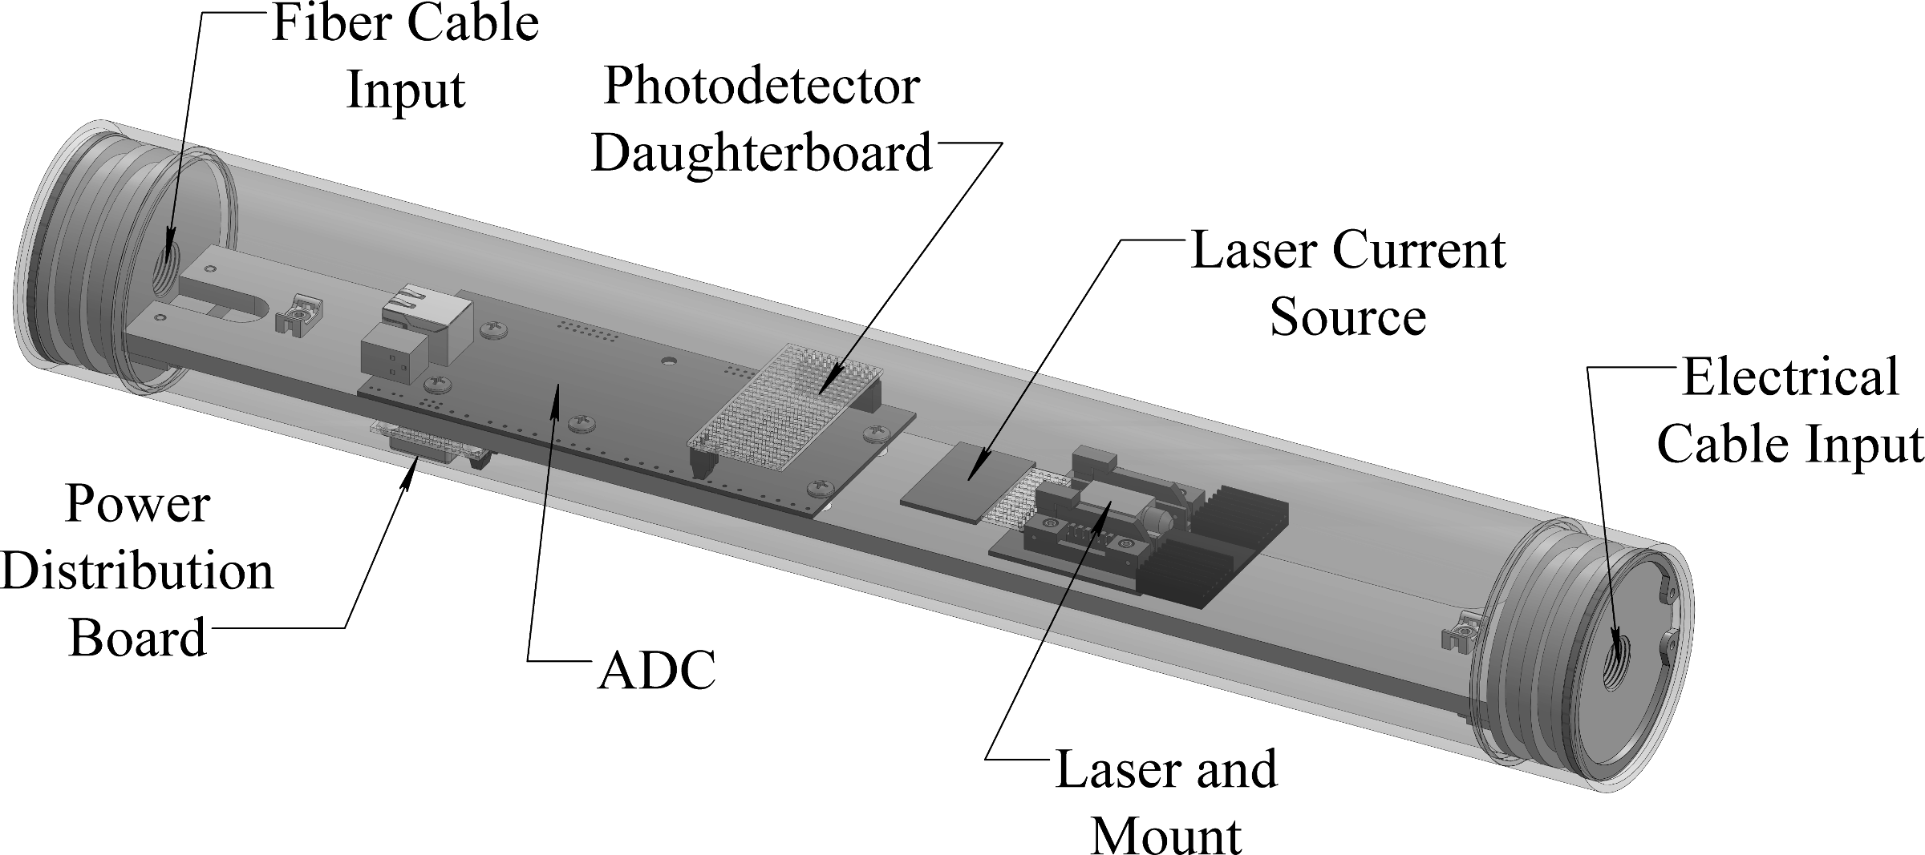
Instrument Development: Optical Fiber
Optical Fiber Michelson Interrogator
9-36 Volt operation, ~2.5 Watt
3” diameter pressure case

Slide 16
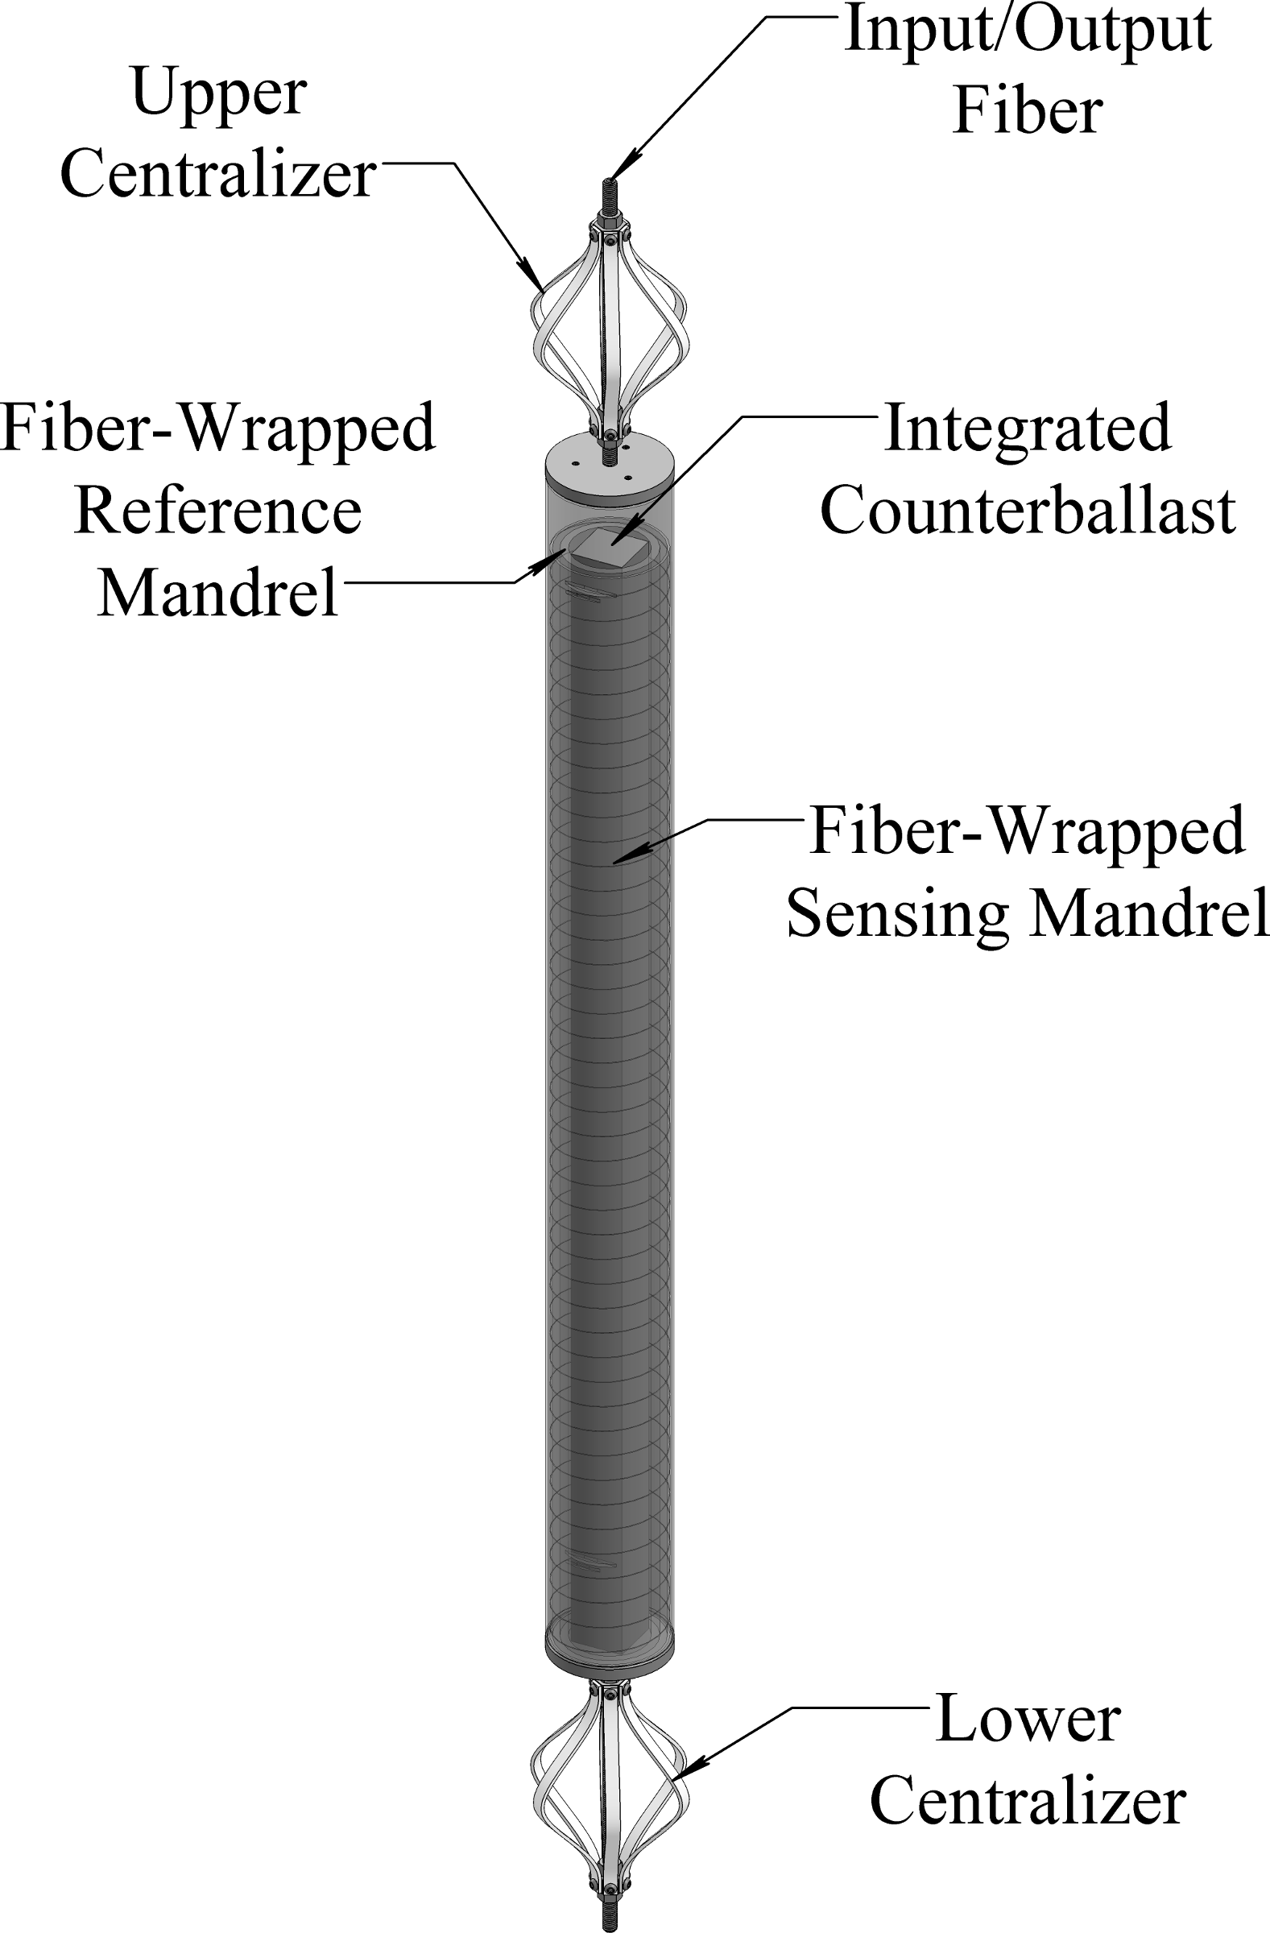
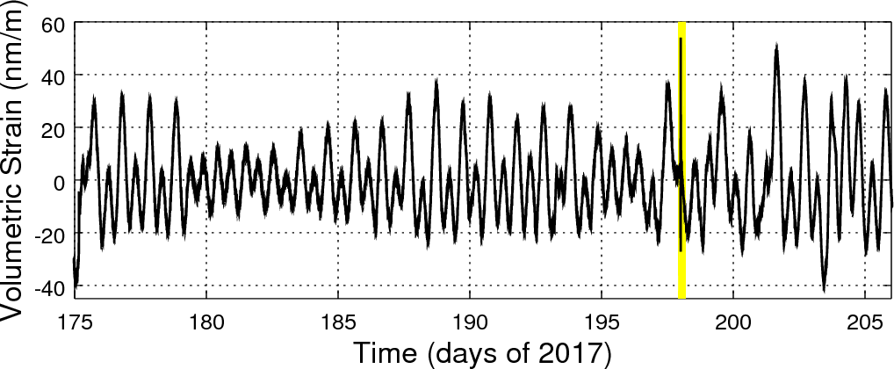
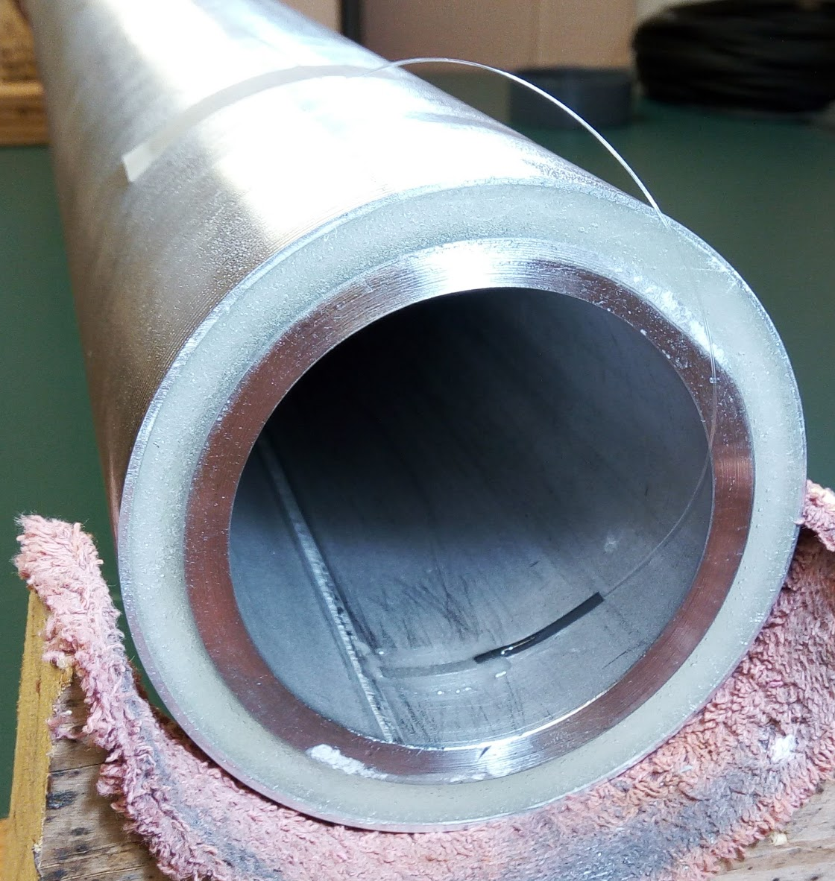
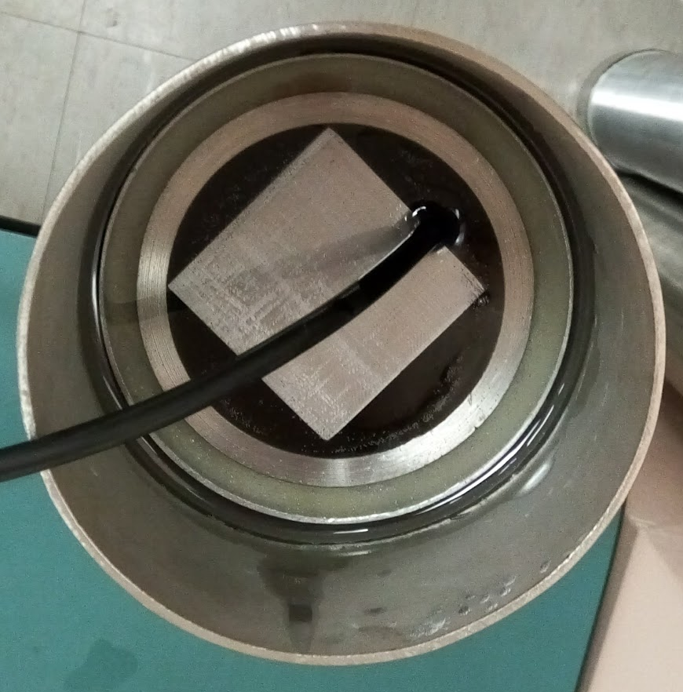
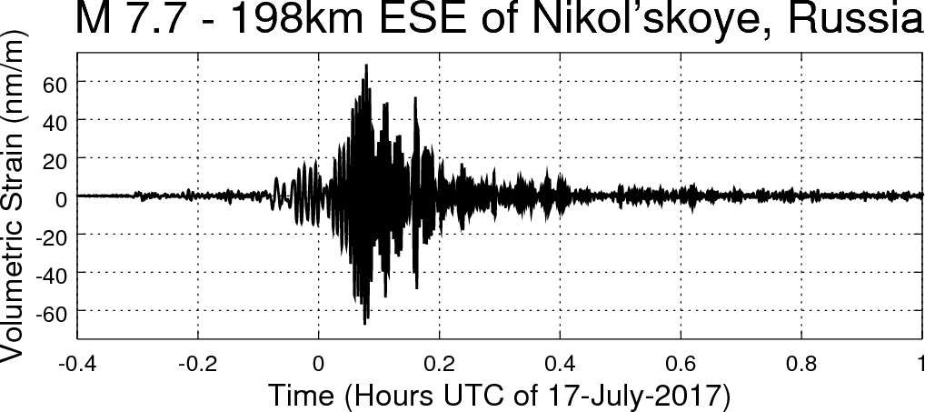
Instrument Development: Optical Fiber
Areal Optical Interferometer
Pair of 220 m wrapped fibers
Welded exterior, potted interior
~1 part-per-trillion resolution

Slide 17
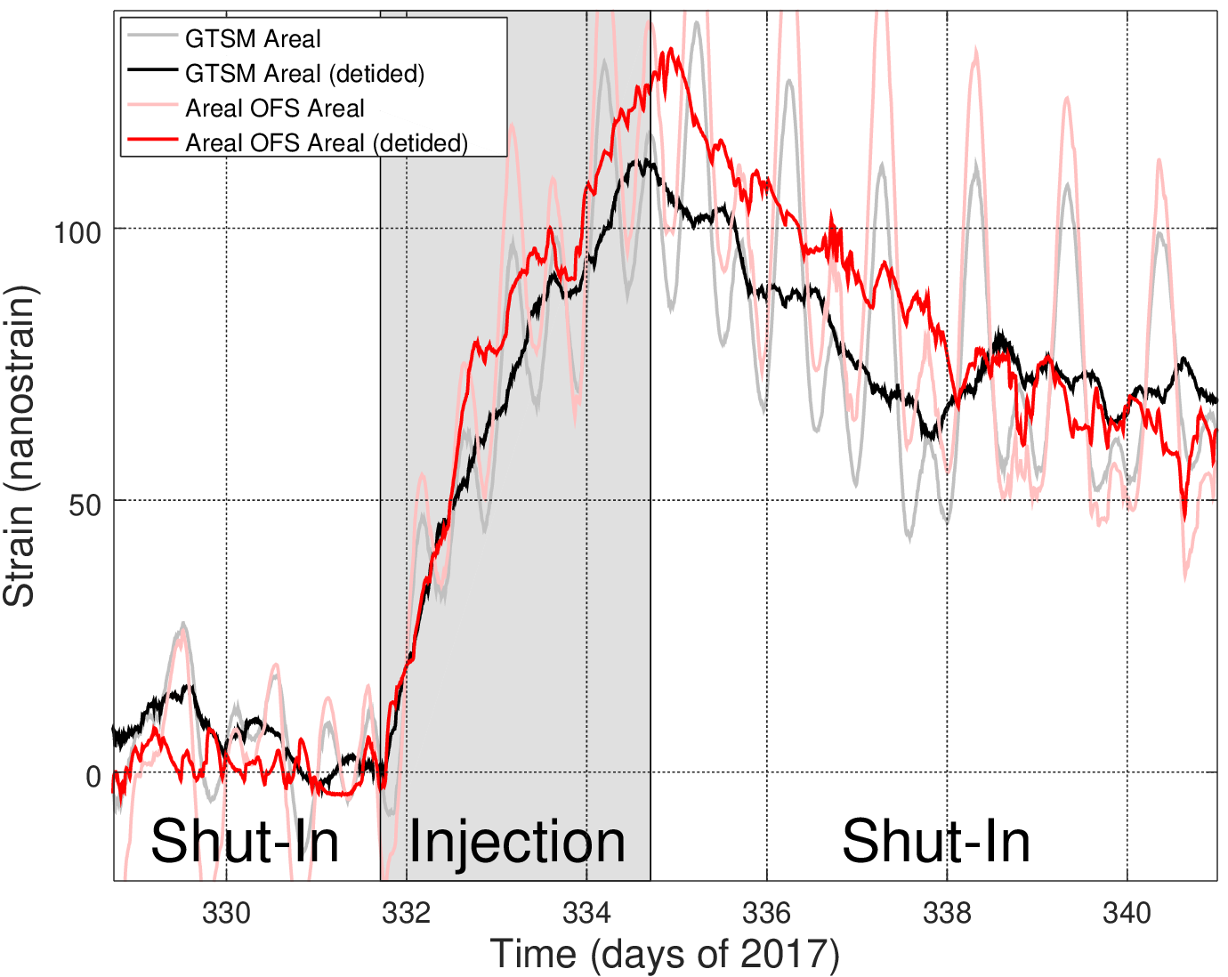
Instrument Development: Optical Fiber

Slide 18
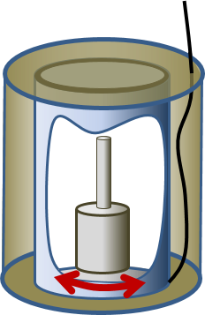
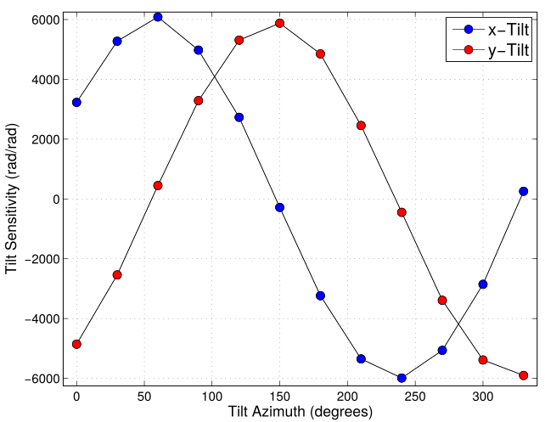
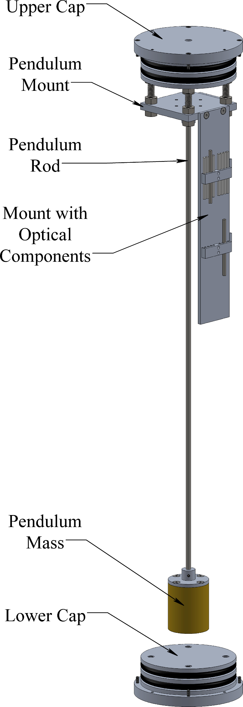
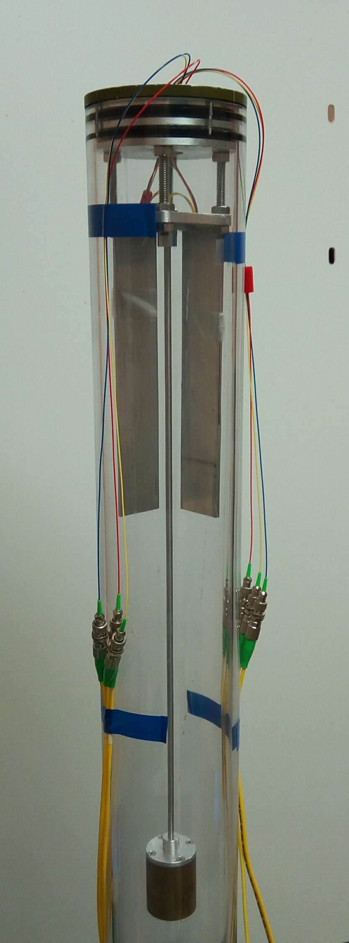
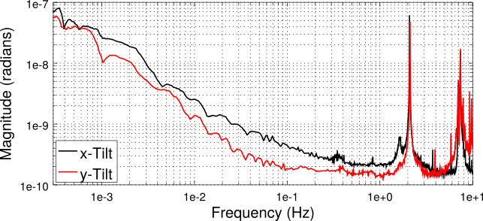
Instrument Development: Optical Fiber
Monolithic Tiltmeter
Passive, no leveling
Full vector
Free Period
Design
Prototype

Slide 19
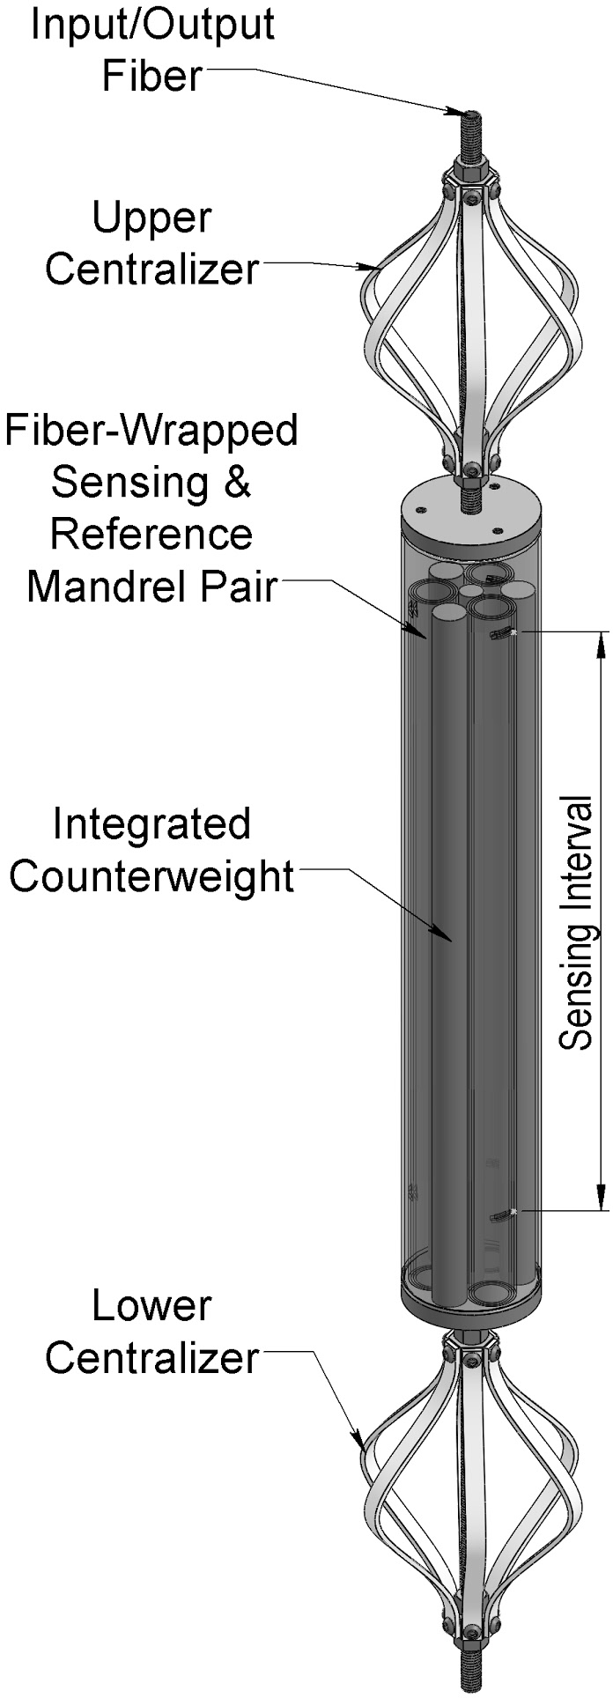
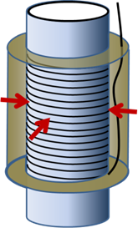
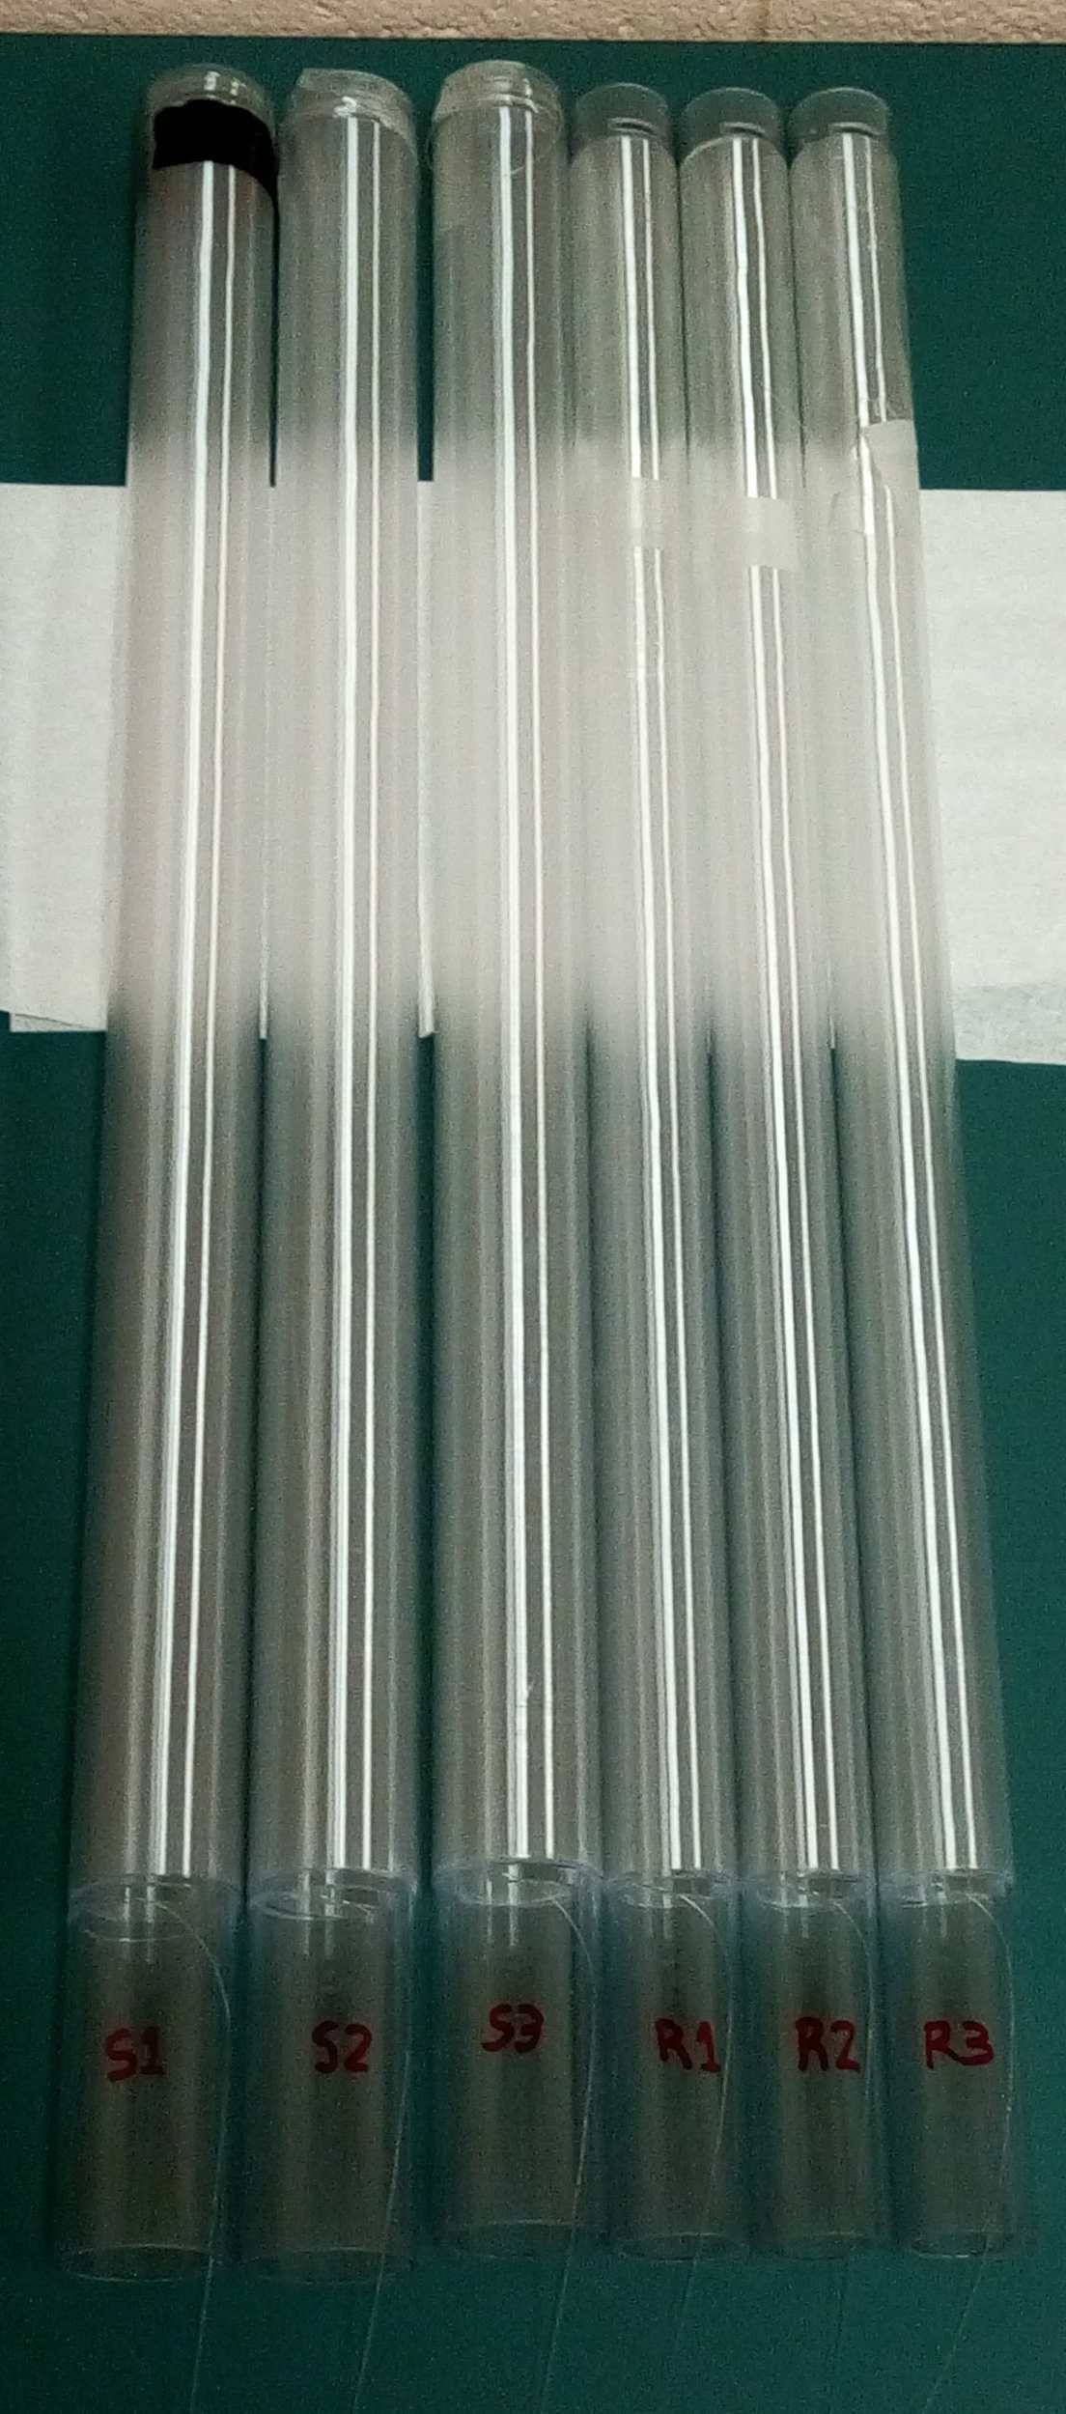
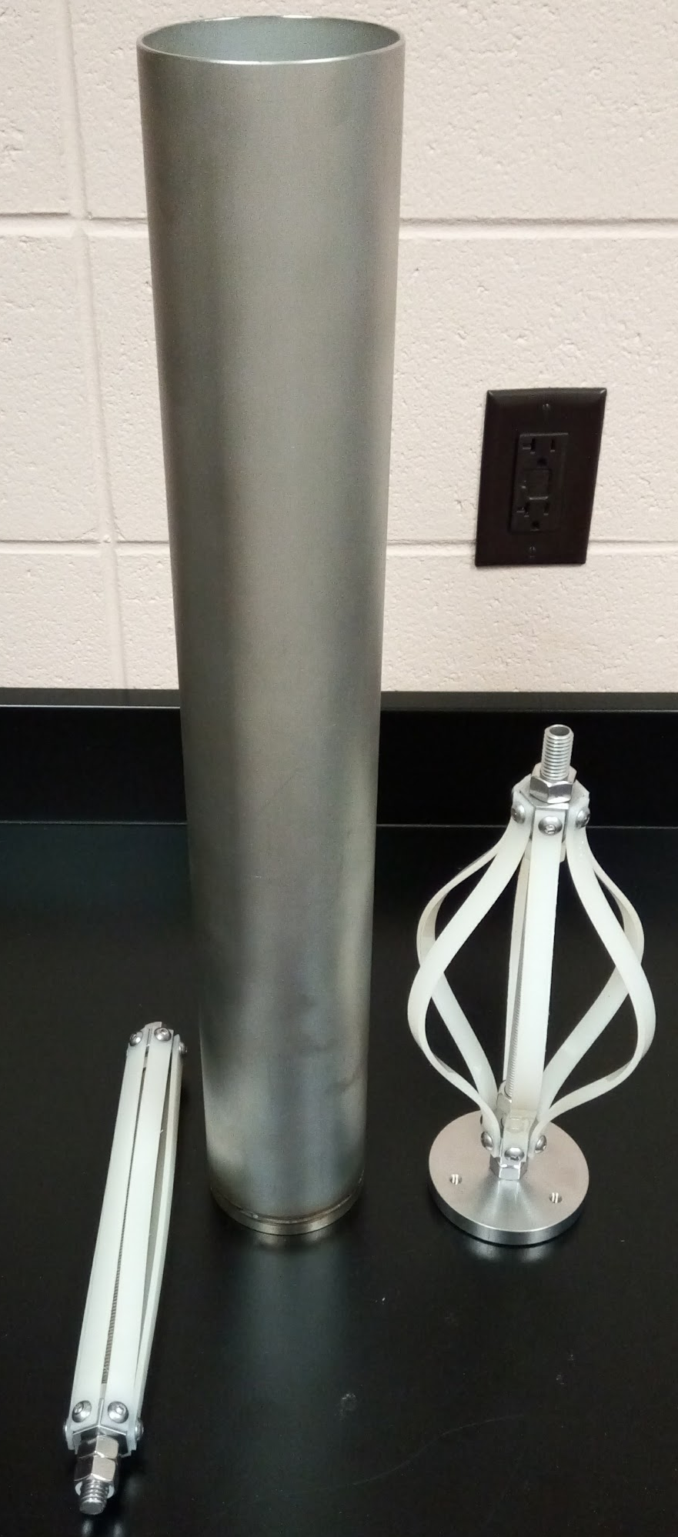
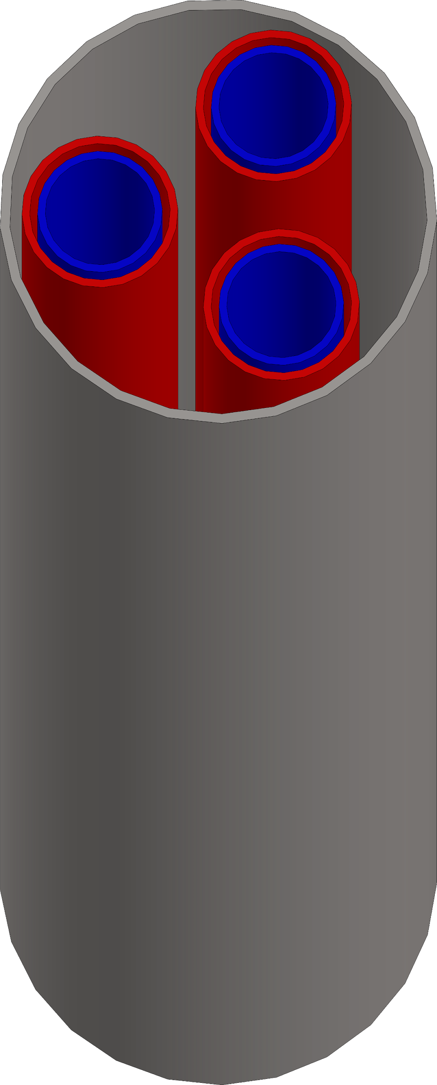
Instrument Development: Optical Fiber
Horizontal tensor strainmeter (nested areal)
Closed downhole package
Fully potted interior, welded exterior
Sensing element
Reference element
Design
Fiber-wrapped tubes
Prototype

Slide 20
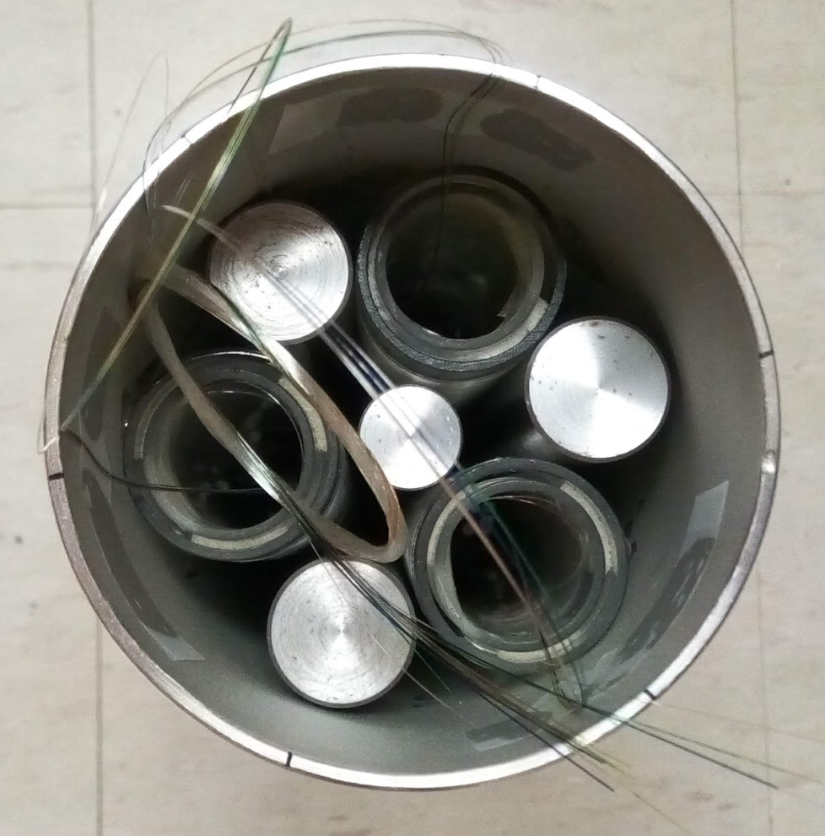
Instrument Development: Optical Fiber
Horizontal tensor strainmeter (nested areal)
Closed downhole package
Fully potted interior, welded exterior
Counterballast
Sensing element
Reference element
Design
Fiber-wrapped tubes
Prototype

Slide 21
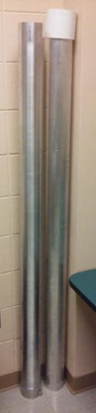
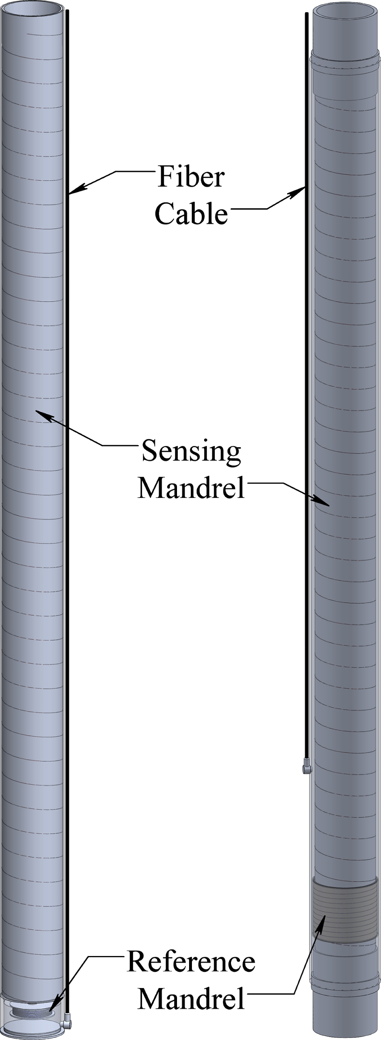
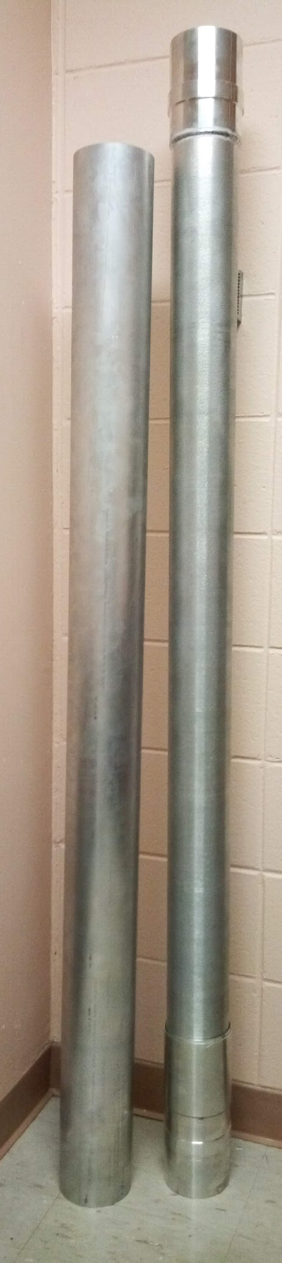
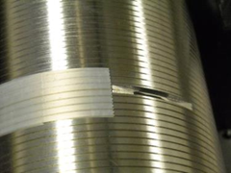
Instrument Development: Optical Fiber
Embedded Areal Strainmeter
“Smart Casing”
Integrated reference
Adapts to standard pipe
“Open-Closed” design
  Open at top
  Closed at bottom
“Open-Open” design
  Open at both ends
Open top
Fully open
Fiber-wrapped casing

Slide 22

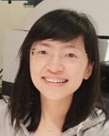
Instrument Development: Optical Fiber
  Coherent Microwave Photonics Interferometry (CMPI) for DAS
Hai Xiao
Liwei Hua
Exploits incoherent (location) and coherent (phase) of light
~1 nm resolution, DC to 20 kHz
Non-proprietary hardware
Microwave
source
Microwave
Laser
Sync
Modulator
Frequency response S₂₁(Ω)
Vector
Microwave
Detector
Reflector pair
Photo detector
Lightwave

Slide 23
Conclusions
New strainmeter designs that will reduce the cost of deployment compared to the current state-of-the-art.
Electromagnetic based on commercial sensors
    Grout-in (expendable)
    Removable (not yet…)
  Embedded optical fiber Michelson
    Single-component (areal)
    Mulit-component (horizontal tensor)
    Smart casing!
  Microwave photonics for DAS

