Slide 1
Long-range
RF Links
Advancements in enabling technology
Diana Ghenno Barajas

Slide 2
AMPERE Simonett W
AGENDA
Mexican Company with more than 50 years supplying to the industry, infrastructure and investigation.
Proud representative and dealer from foreign Companies in Latin-America.
More than 900 regular customers.
30 people qualified staff.
Head quarters in México City with presence in Chile, Colombia, Peru, Argentina.

Slide 3
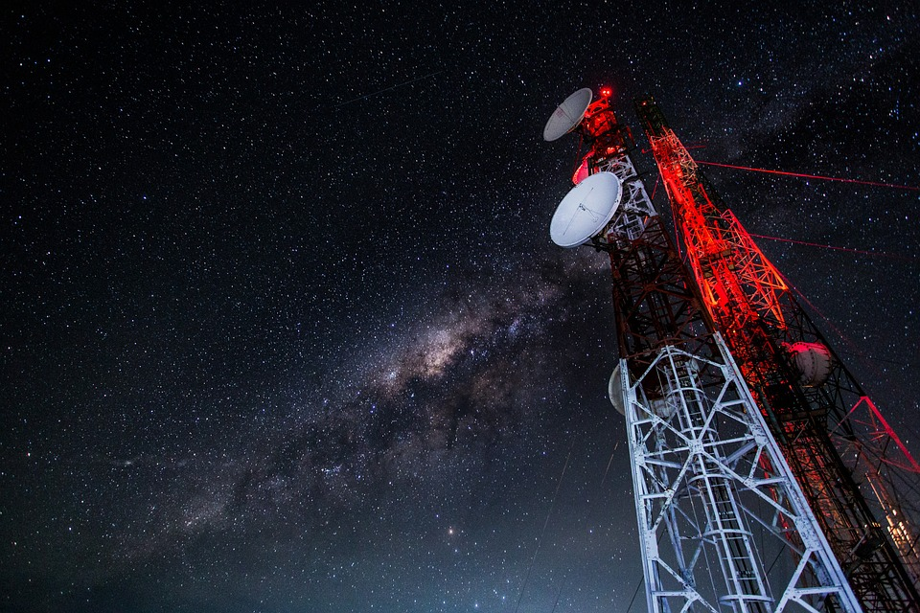
IRIS Workshop
AGENDA
Long-range RF Communication
A key parameter for a wireless communication system is the communication range. In many cases the range application requirements will be the deciding factor when choosing an RF solution.

Slide 4
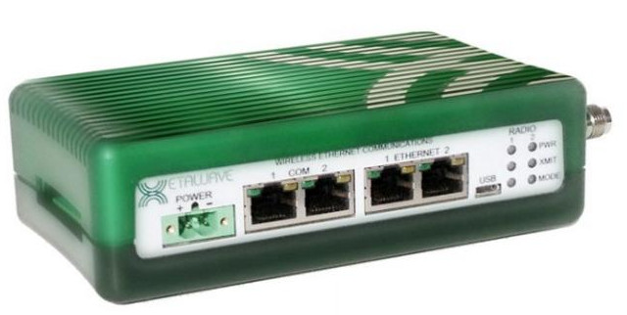
Long-range RF Links
Xetawave products
Key features:
Unlicensed & Licensed radios that features Dynamic Modulation.
MultiSpeed Multipoint capability with a single Access Point.
Multi-Master Sync (MMS) network synchronization.
Lower power consumption:
Transmit : 335mA
Receive: 290mA
Idle: 270mA
Link range 70+ miles
IP routing
IO Services
Onboard Diagnostics
Store & Forward Repeaters capabilities.

Slide 5
IRIS Workshop
EL SALVADOR PROJECT
83 Km
56 Km

Slide 6
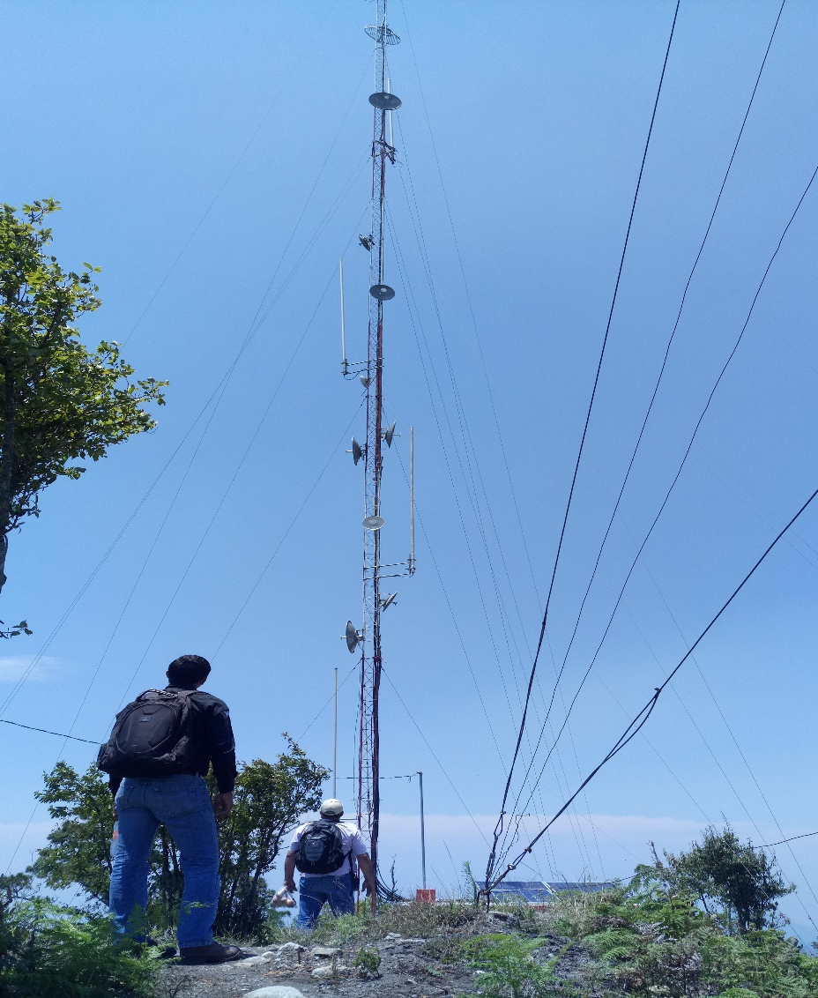
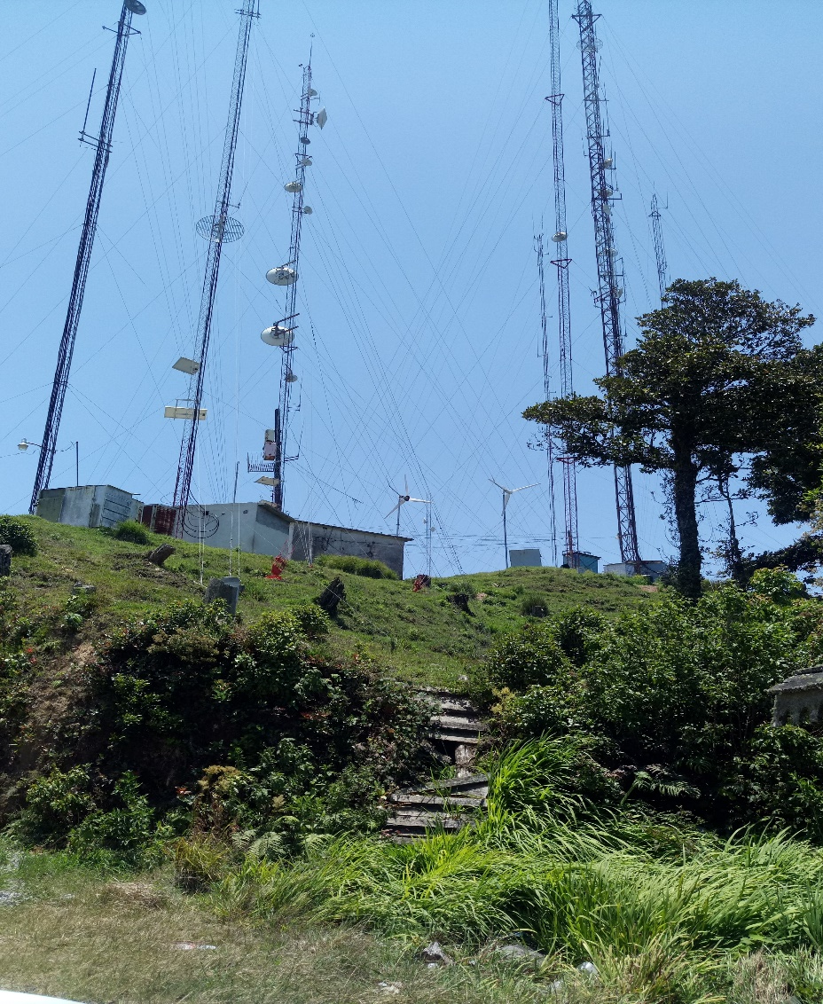
IRIS Workshop
MÉXICO PROJECT
IN TABASCO
83 Km
56 Km

Slide 7
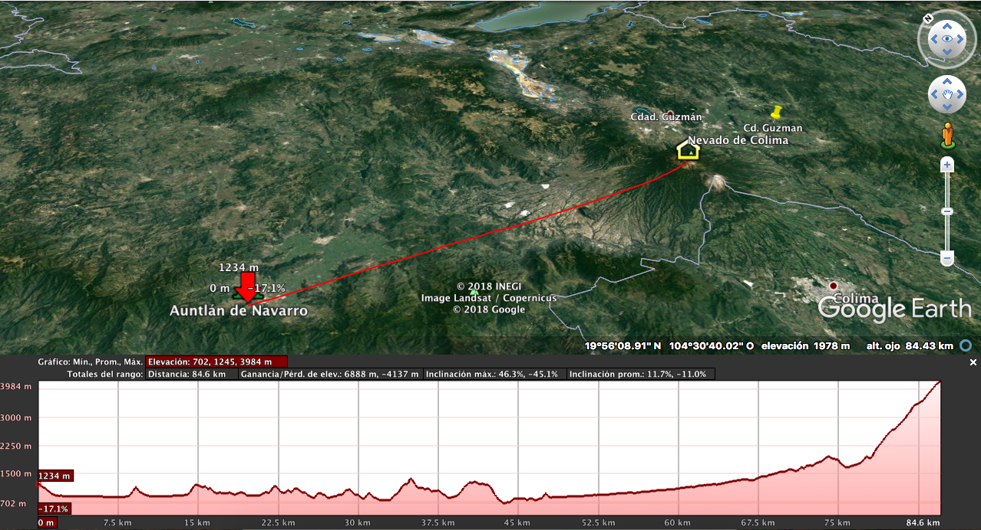
IRIS Workshop
MÉXICO PROJECT
IN JALISCO
83 Km
56 Km

Slide 8
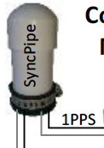
IRIS Workshop
ALMACÉN NETWORK
End points
CACTUS 1045
192.168.12.113
CACTUS 1004
192.168.12.114
CACTUS 1006
192.168.12.121
NISPERO 90
192.168.12.116
RED ALMACEN
192.168.12.1
NISPERO 96
192.168.12.117
Access Point
NISPERO 98
192.168.12.118
NISPERO 86
192.168.12.112
CACTUS 1003
192.168.12.119

Slide 9
IRIS Workshop
COMOAPA 2A
192.168.2.118
COMOAPA 21
192.168.2.119
COMOAPA 2B
192.168.2.192
Repetidor 2 (B2B)
TAPALAPA 1 NETWORK
COPANO 32
192.168.2.126
COPANO 41
192.168.2.127
COPANO 23A
192.168.2.124
COPANO 23B
192.168.2.125
Repetidor 3 (B2B)
RED TAPALAPA 1
192.168.2.139
TAPALAPA 1
192.168.2.138
COPANO 45
192.168.2.128
Repetidor 1 (B2B)
GAUCHO 23
192.168.2.122
GAUCHO 25
192.168.2.123
MUSAC 2
192.168.2.120
MUSPAC 14
192.168.2.121
CACTUS 302
192.168.2.129

Slide 10
IRIS Workshop
ARTESA 358
192.168.22.143
ARTESA 362
192.168.22.130
TAPALAPA 2 NETWORK
Repetidor 2 (B2B)
ARTESA 367
192.168.22.195
ARTESA 368
192.168.22.144
ARTESA 374
192.168.22.174
ARTESA 380
192.168.22.121
ARTESA 381
192.168.22.119
RED TAPALAPA 2
192.168.22.2
TAPALAPA 2
192.168.22.1
ARTESA 393
192.168.22.180
Repetidor 1 (B2B)
Repetidor 3 (B2B)
SHISHITO 2
192.168.22.132
SHISHITO 6
192.168.22.120
REP SHISHITO 2
192.168.22.195
SHISHITO 12
192.168.22.118

Slide 11
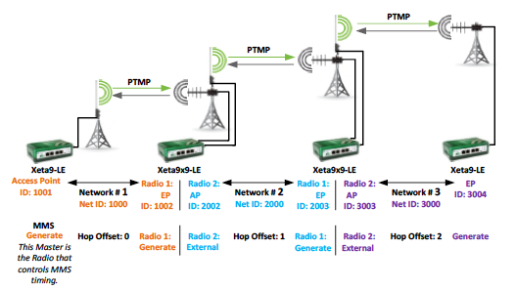
IRIS Workshop
MULTI MASTERSYNC

Slide 12
IRIS Workshop
ADDED VALUES
Technical support
Design and feasibility studies
Training in site
DEMO projects
Expertise
Personalized attention
ACCOUNTABILITY!

Slide 13
Datos de Contacto.
AMPERE Instrumentación y Telemetría
www.ampere.lat
solicitudes@ampere.lat
México +52(55) 8421-2607 Chile +56(22) 570-9442 Perú +51(1) 705-2216 Argentina +54(11) 5168-5857 Colombia +57(1) 508-6969 EUA +1(720) 243-5779
Diana G. Ghenno Barajas Telemetry Division
dghenno@ampere.com.mx dghenno@ampere.lat
+52 1 5531275859
Ext. 1332

