Slide 1
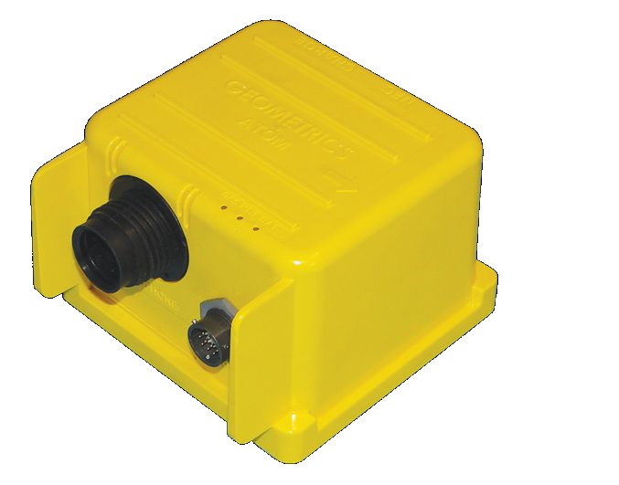
Cableless Seismograph Atom for engineering site investigation
Koichi Hayashi
Geometrics/OYO Corporation

Slide 2
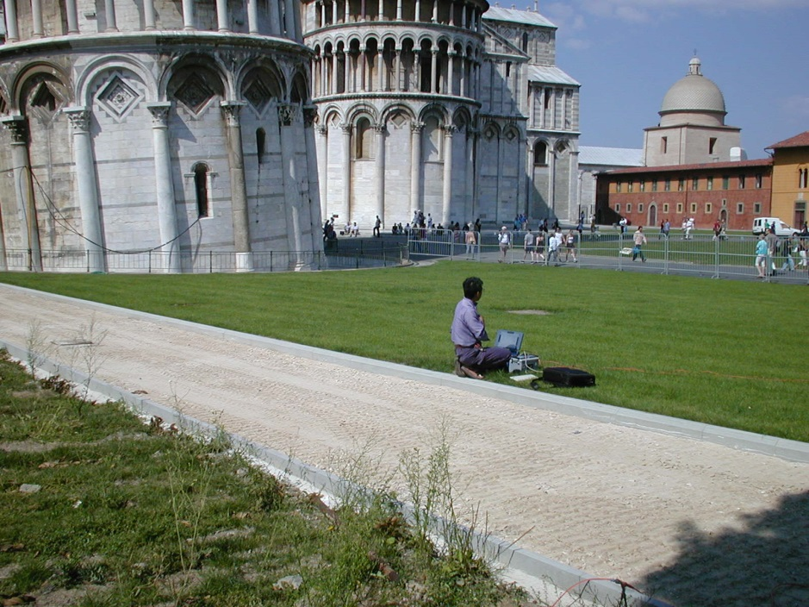
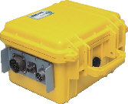
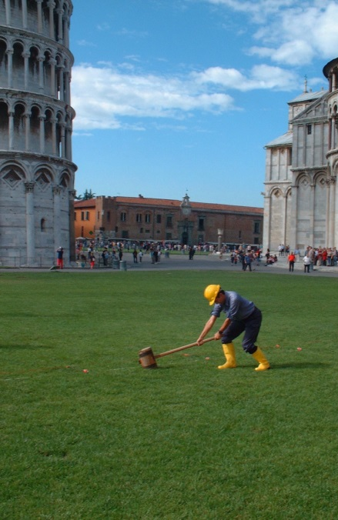
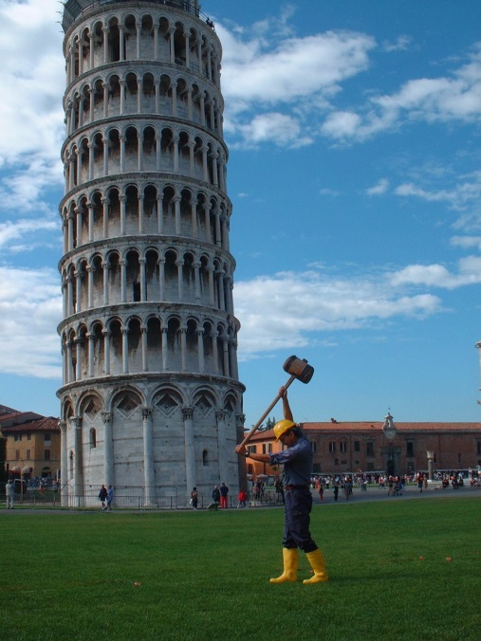
Cableless Seismograph Atom for engineering site investigation
Conventional seismograph
Cableless seismograph

Slide 3
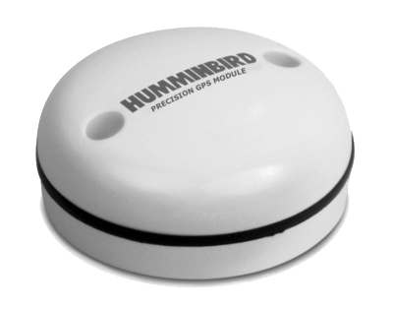
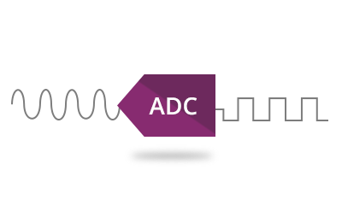


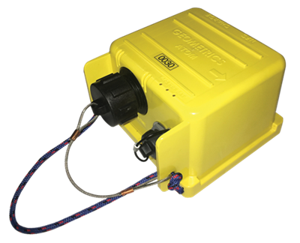
Cableless seismograph Atom
Battery
GPS
A/D
SD card
Specification
Preamp gain | 0db, 12db, 24db, 36db
Distortion | < 0.0001 %
Data storage | 4GB
Frequency response | 0.2 – 200Hz
Dynamic range | 124 dB (measured)
A/D converter | 24 bits
Sampling time | 0.25, 0.5, 1, 2, 4 msec
Dimension | 142×140×102 mm
Weight | Approx. 1.6 kg
Channel number | 1 or 3

Slide 4
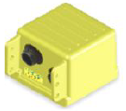
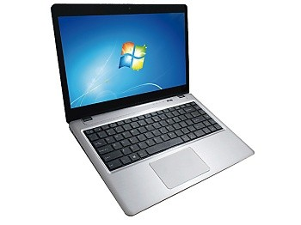

Downloading waveform data using Wi-Fi
Wi-Fi
Wi-Fi
Access point

Slide 5
Conventional ambient noise tomography based on Seismic Interferometry
Dispersion curves (group velocity) are calculated from different pairs of receivers by Seismic Interferometry
Receiver
Receiver
Receiver

Slide 6


Ambient noise tomography based on CMP-SPAC
Many dispersion curves (phase velocity) are calculated from different portions of the large array by CMP-SPAC

Slide 7
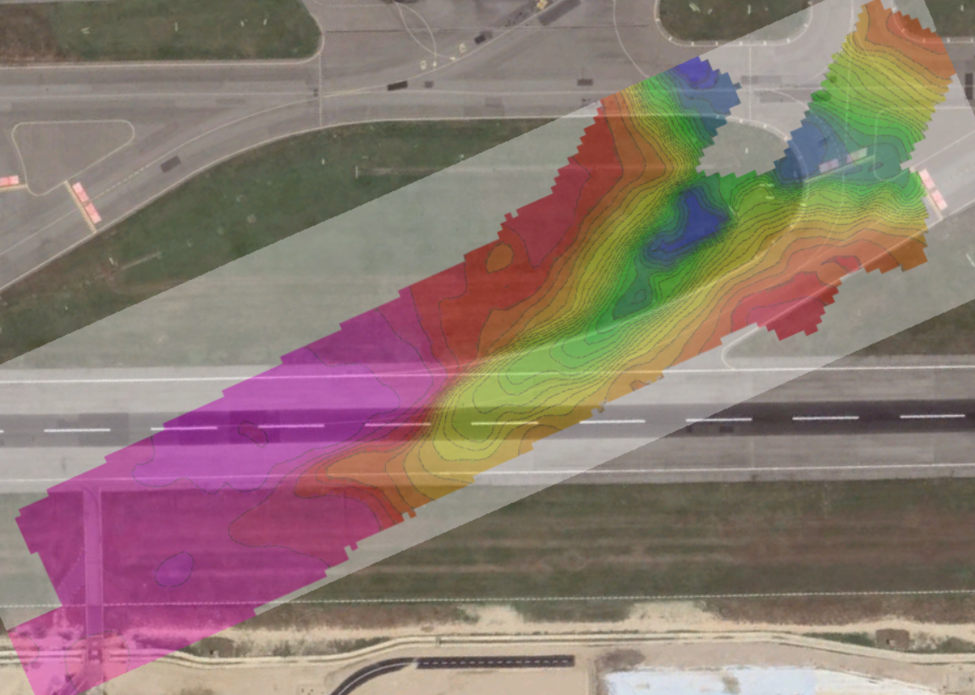
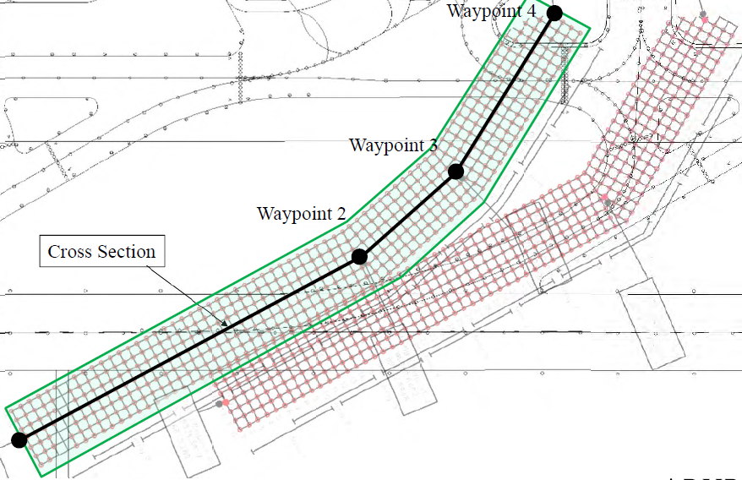
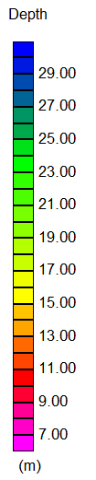
Example of 3D ambient noise tomography
Sensor distribution
Bedrock depth
100 m

Slide 8
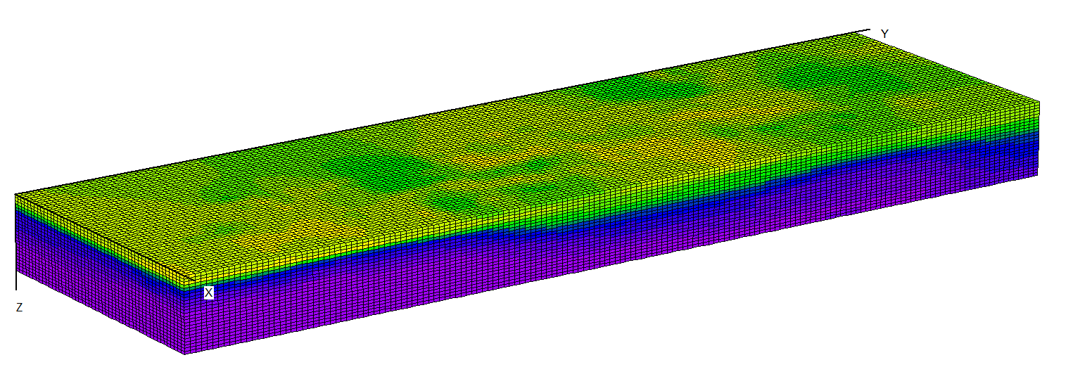
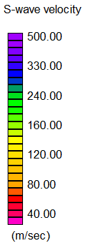
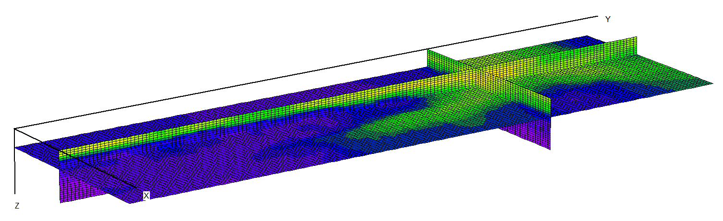
Example of 3D ambient noise tomography

