Slide 1
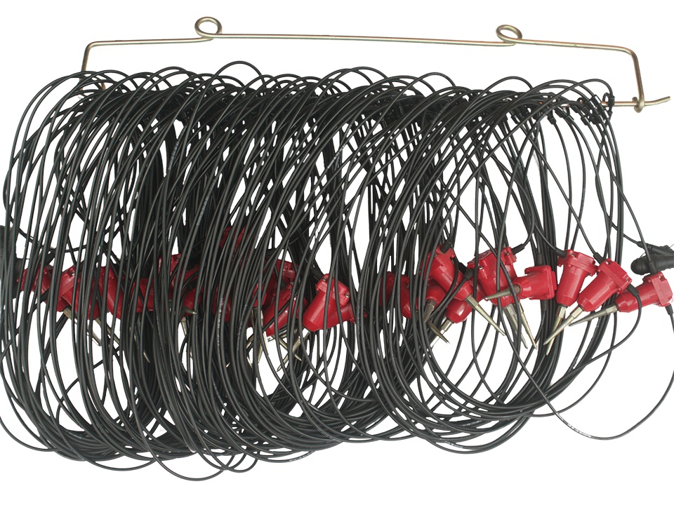
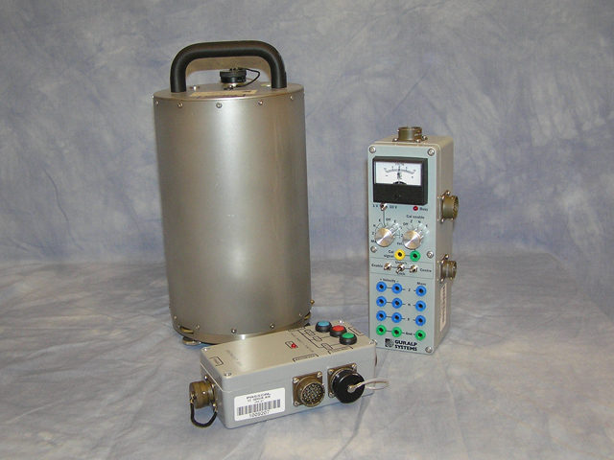
Quantitative Comparison of Real Data
For Dense Geophone Arrays and Sparser Broadband Stations
Inferences for Instrument Choice
many geophones
1 broadband
John A. Hole
G. D. Beskardes Q. Wu T. W. Rasmussen
M. C. Chapman K. K. Davenport
Virginia Tech
L. D. Brown D. A. Quiros R. M. Russo A. C. Stanciu
Cornell University University of Florida
John Hole, IRIS Seismic Instrumentation Technology Symposium, Tucson AZ, Oct. 2018

Slide 2
Aftershock sequence of the 2011 Virginia earthquake
derived from
the dense AIDA array and backprojection
Beskardes et al., accepted
Beskardes et al., 2018 Davenport et al., 2015
Comparison of
4.5 Hz geophones to broadband seismometers
from a real deployment
Rasmussen et al., in progress
Davenport et al., 2017 Stanciu et al., 2016
John Hole, IRIS Seismic Instrumentation Technology Symposium, Tucson AZ, Oct. 2018

Slide 3
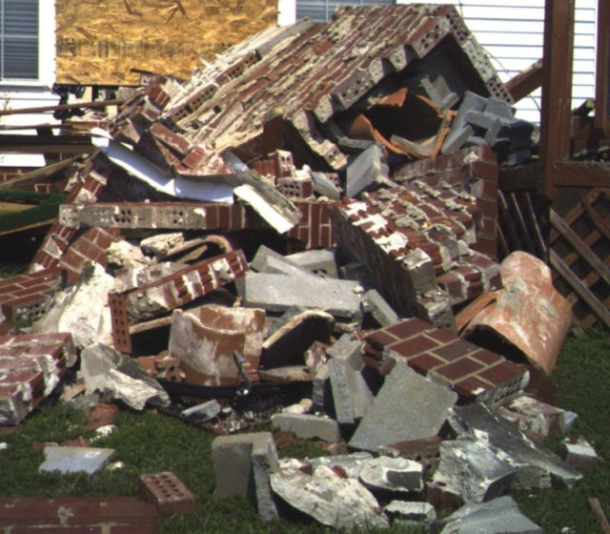
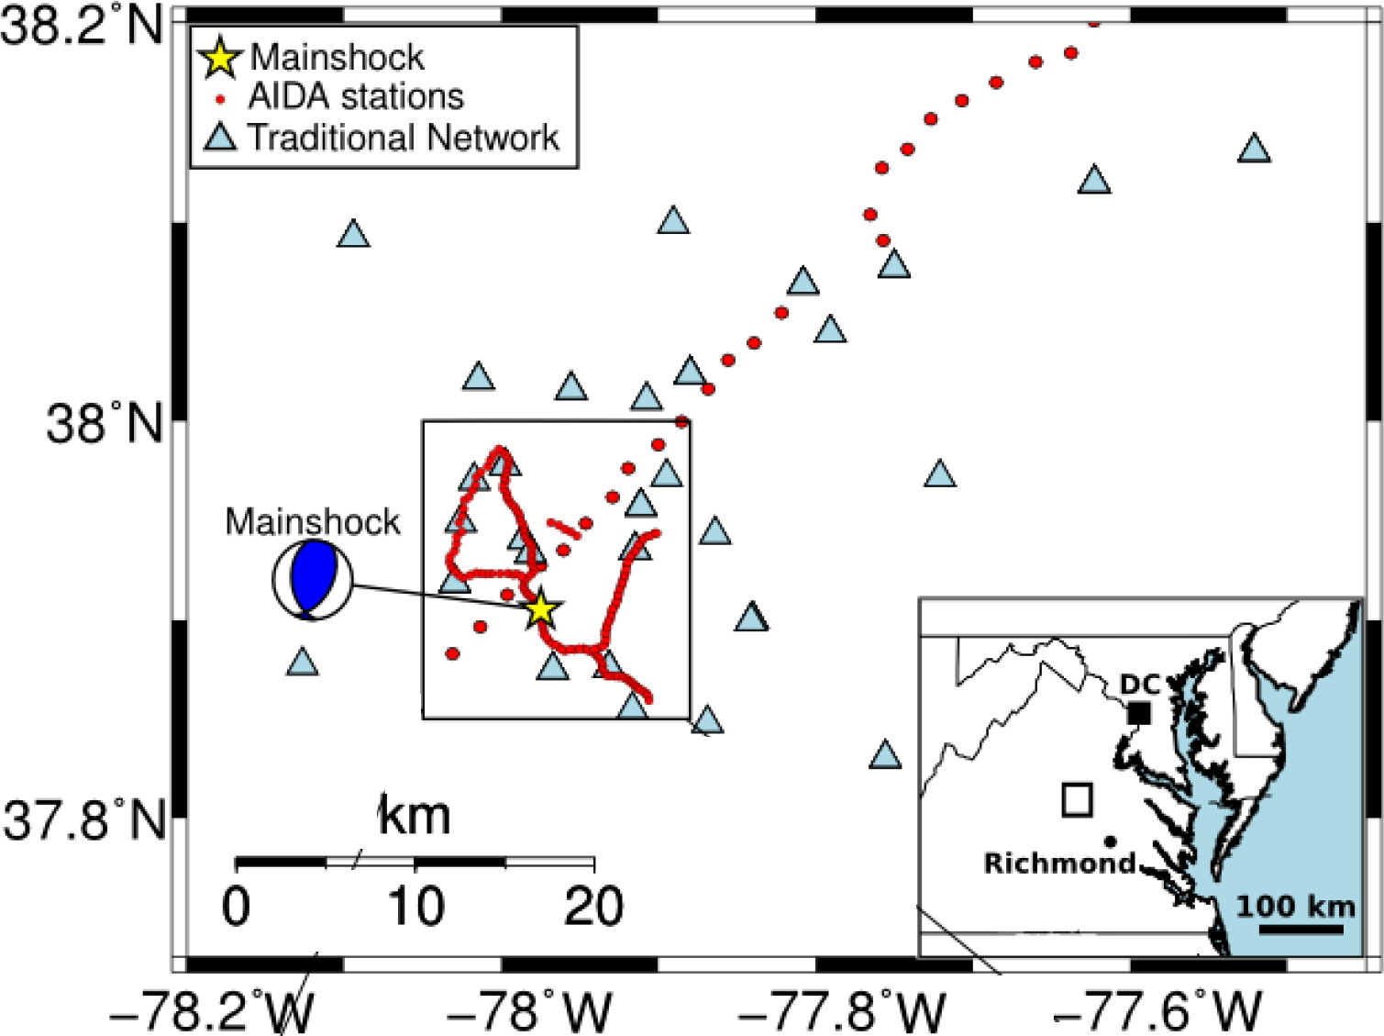
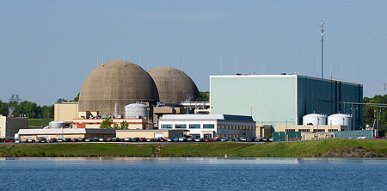
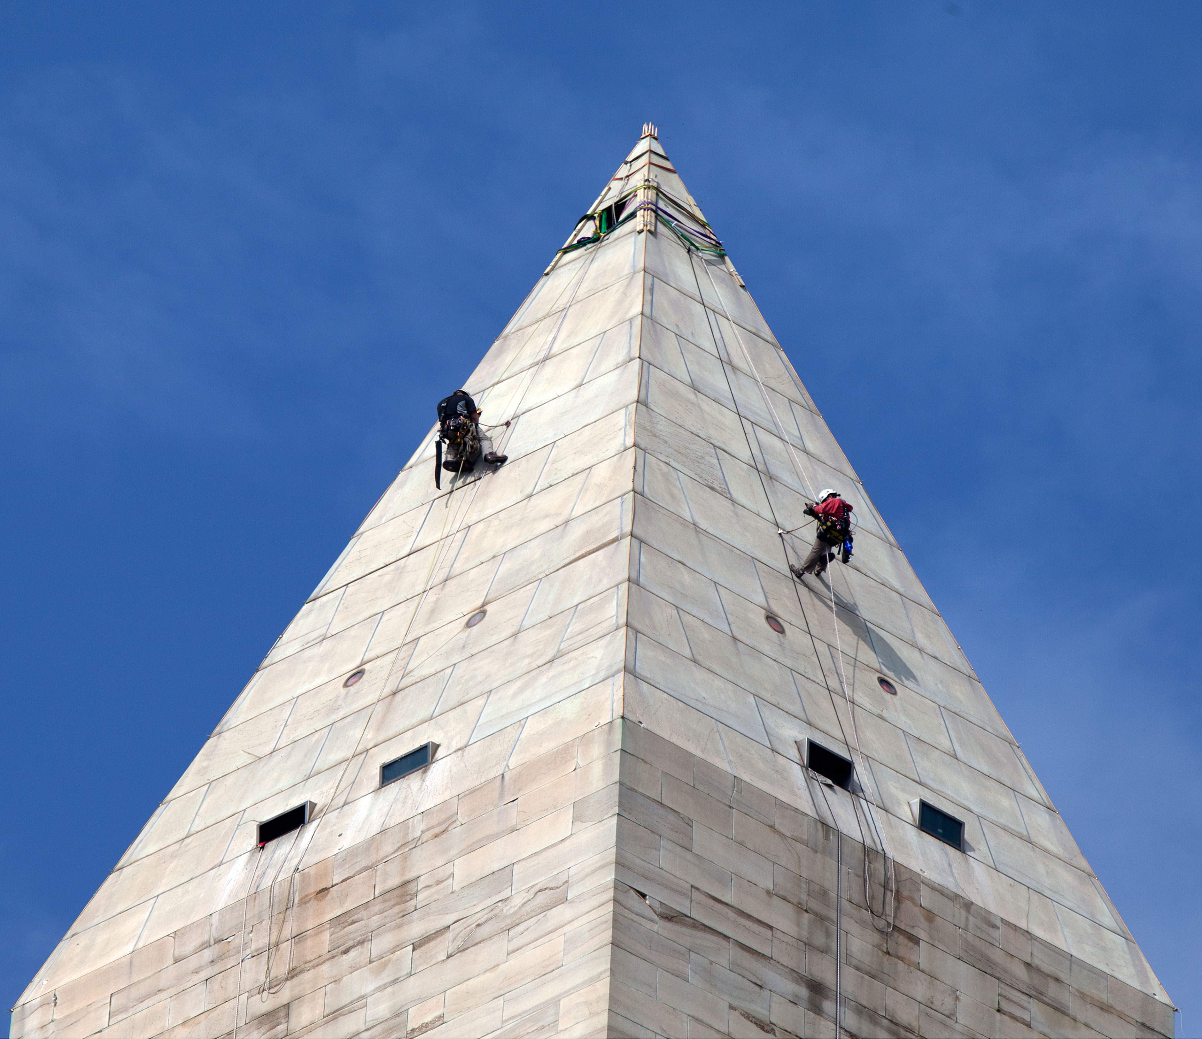
2011 Mw 5.7 Mineral, Virginia, Earthquake
Louisa county
nuclear power plant
Washington Monument
Davenport et al., 2015; Beskardes et al., 2018
large traditional aftershock array
36 stations
@ 2-10 km spacing
John Hole, IRIS Seismic Instrumentation Technology Symposium, Tucson AZ, Oct. 2018

Slide 4
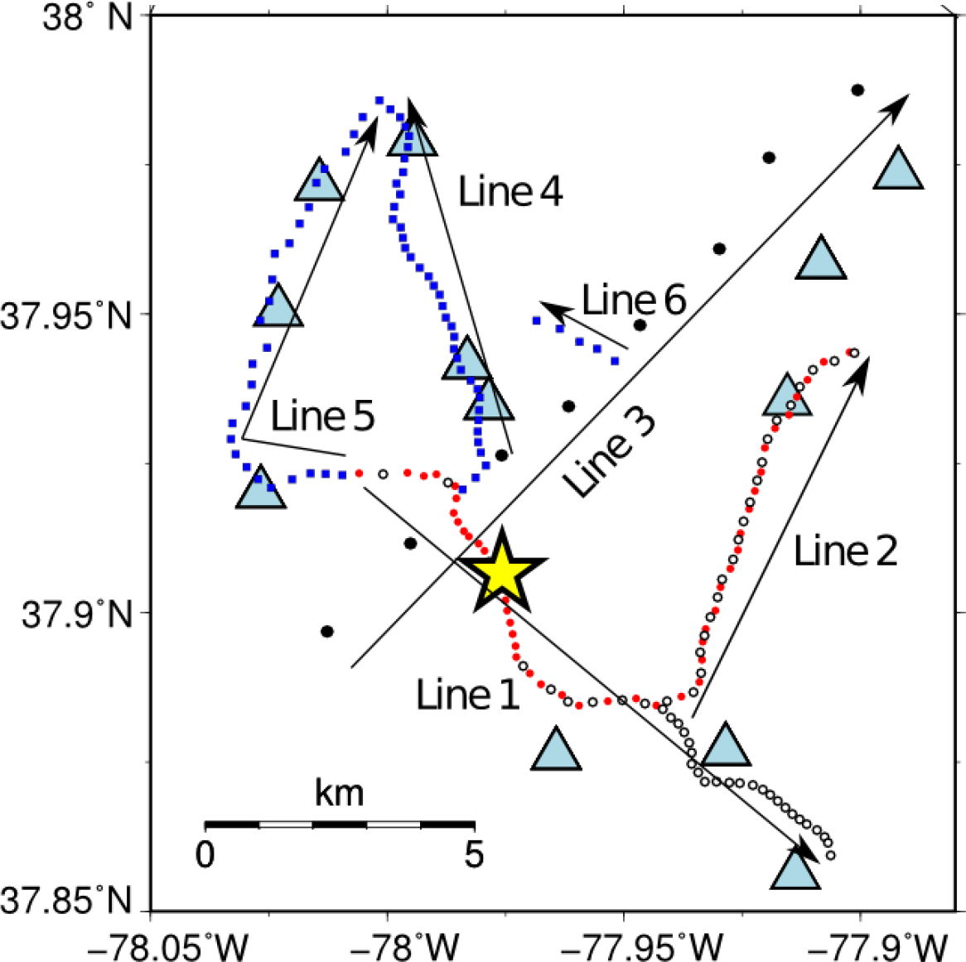
AIDA
(Aftershock Imaging with Dense Arrays)
148 1-component stations
@ 200-400 m spacing
in two 6-day phases
30 3-component stations
@ 2 km spacing
3 days
Davenport et al., 2015; Beskardes et al., accepted
John Hole, IRIS Seismic Instrumentation Technology Symposium, Tucson AZ, Oct. 2018

Slide 5
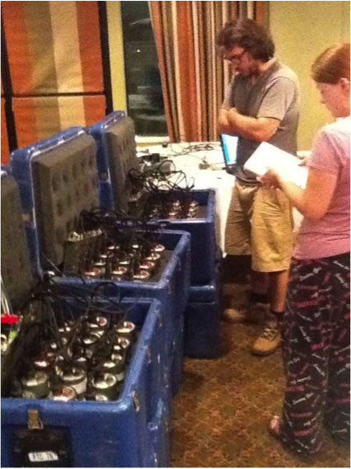
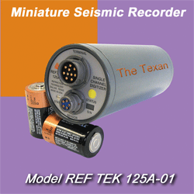
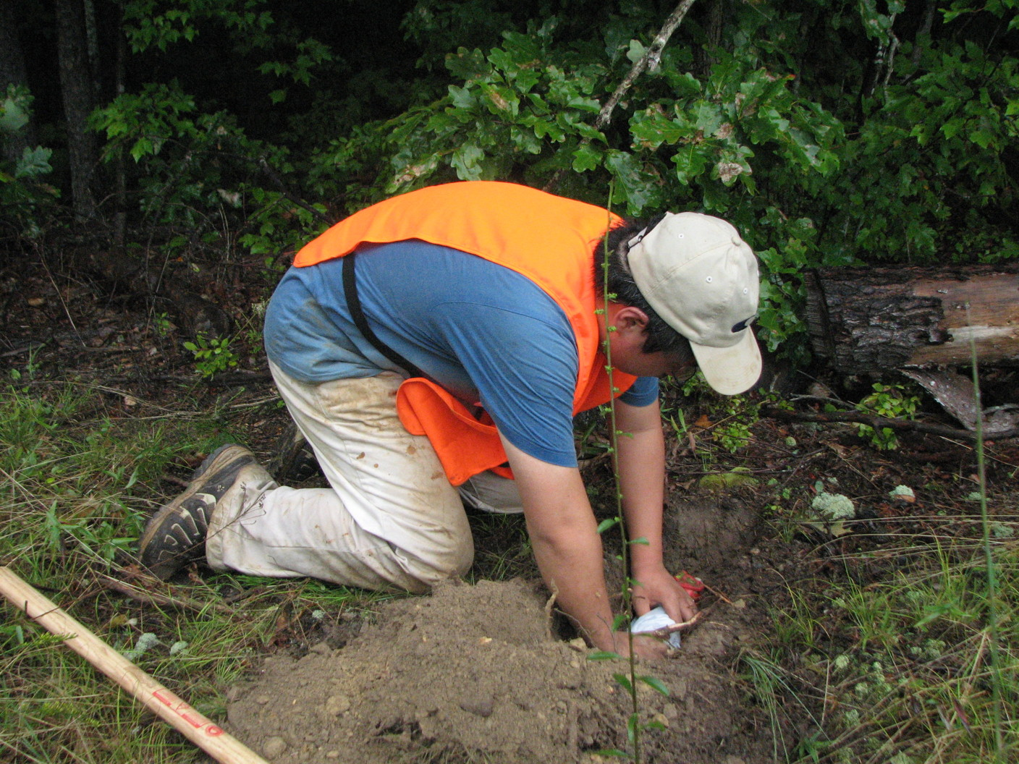
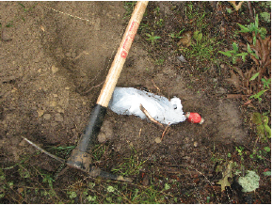
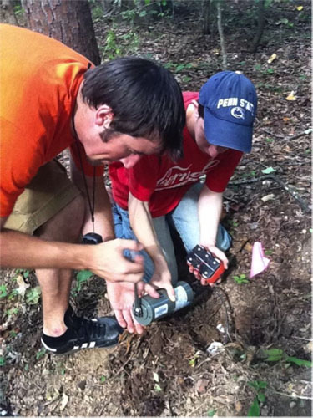
AIDA
(Aftershock Imaging with Dense Arrays)
1990’s “nodes”
4.5 Hz vertical component geophone
3 nodes with 3-component geophone
148 stations
6 people, 3 hours
7-10 stations per hour per person
1990’s electronics
limited power
batteries 3 days
limited memory
100 samples/second
data 6 days
➔ 12 days deployment
John Hole, IRIS Seismic Instrumentation Technology Symposium, Tucson AZ, Oct. 2018

Slide 6
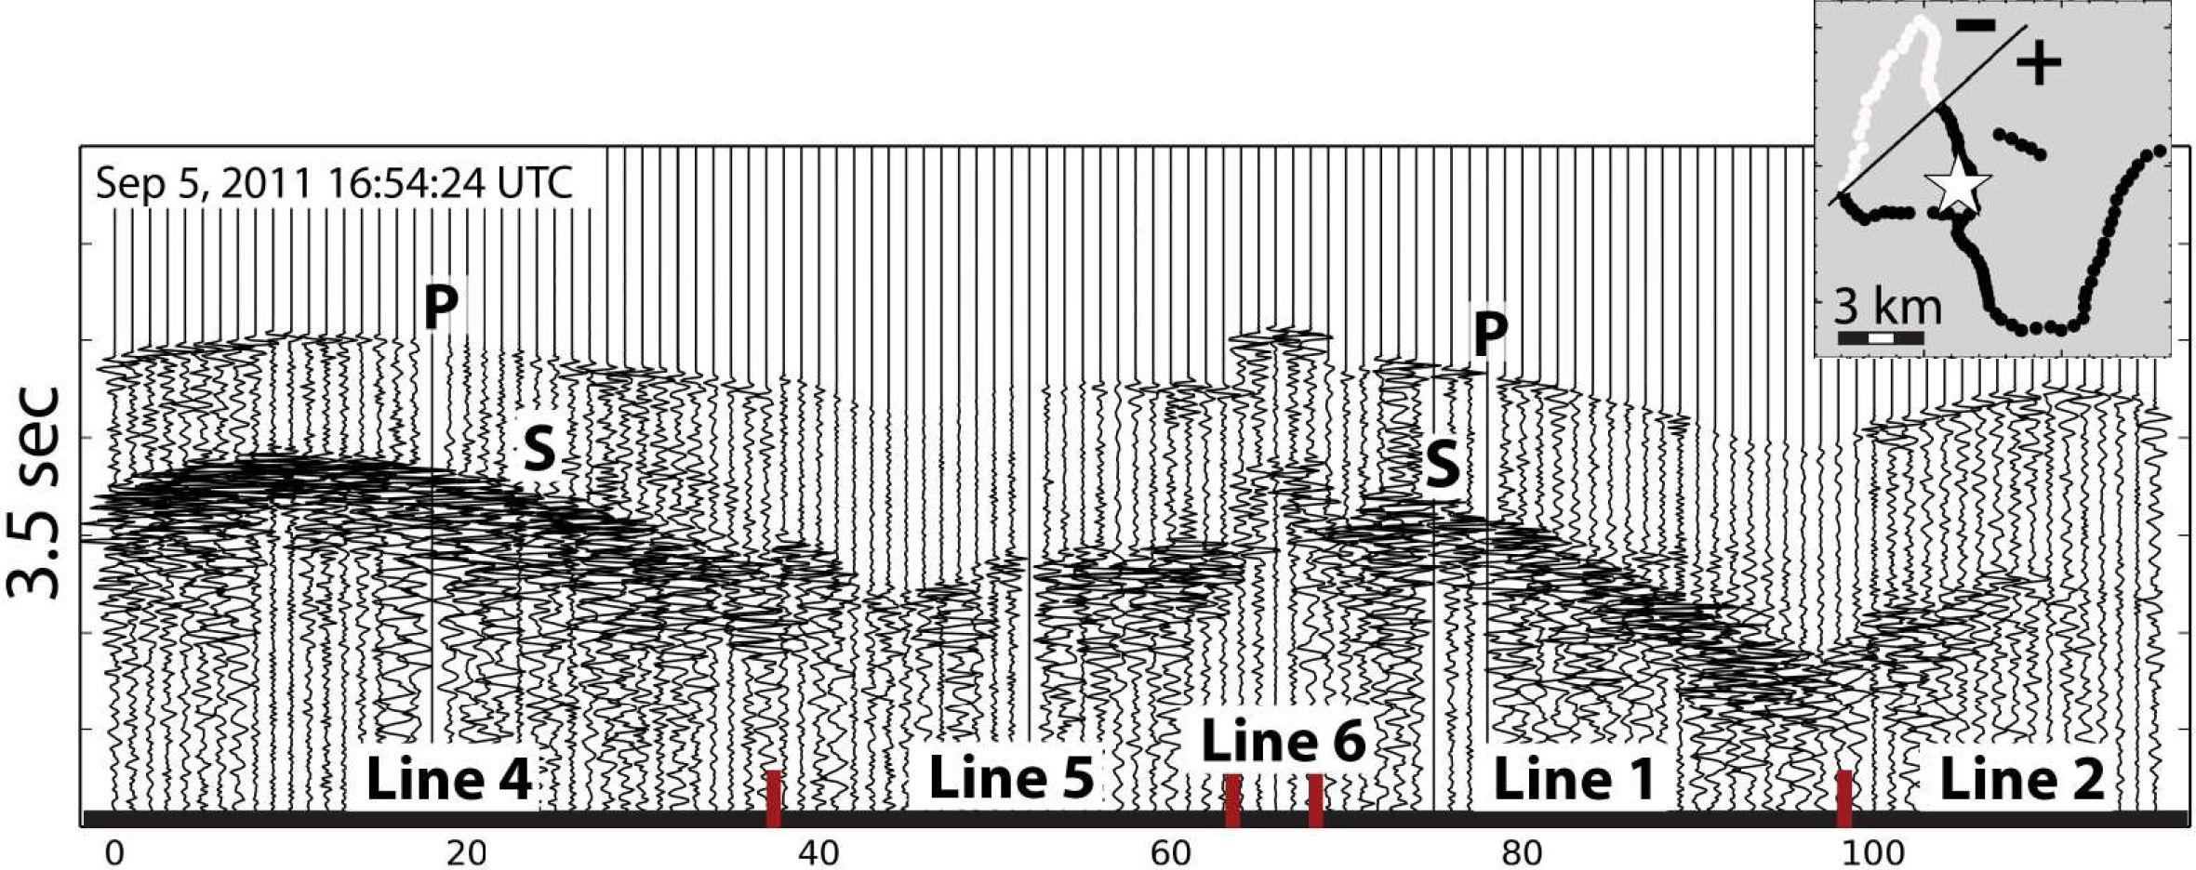
Data
first motions
focal plane
magnitude 2.5, 5.5 km depth
all aftershocks: signal up to 50 Hz Nyquist
Beskardes et al., 2018
John Hole, IRIS Seismic Instrumentation Technology Symposium, Tucson AZ, Oct. 2018

Slide 7
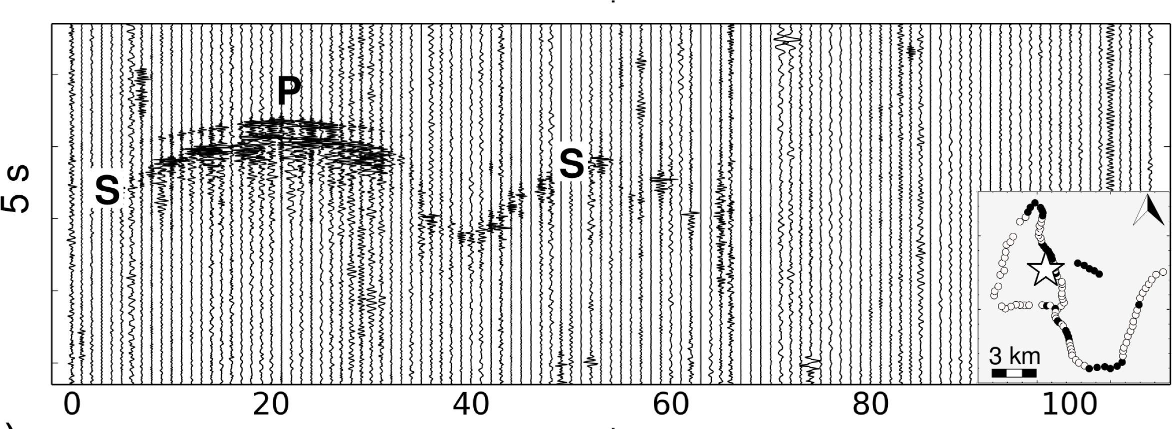
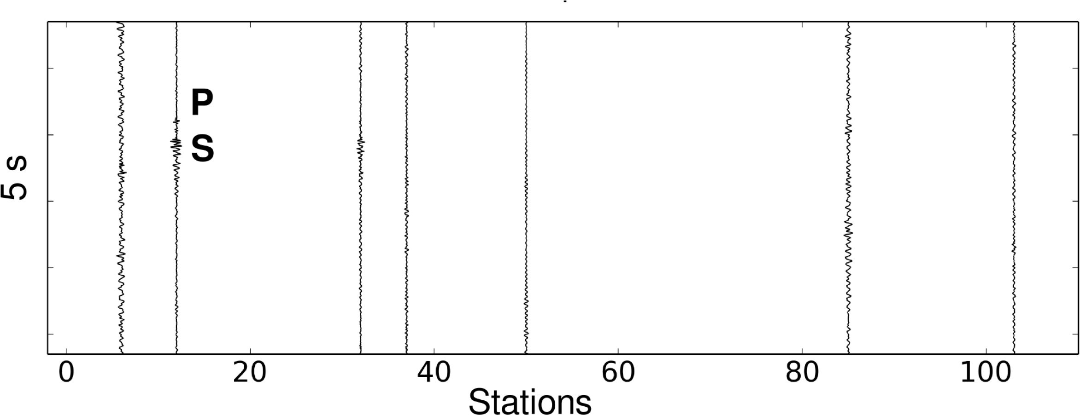
Data
magnitude –1.2
1.5 km depth
AIDA
400 m spacing
traditional
network
2-10 km spacing
not detected
Beskardes et al., accepted
John Hole, IRIS Seismic Instrumentation Technology Symposium, Tucson AZ, Oct. 2018

Slide 8
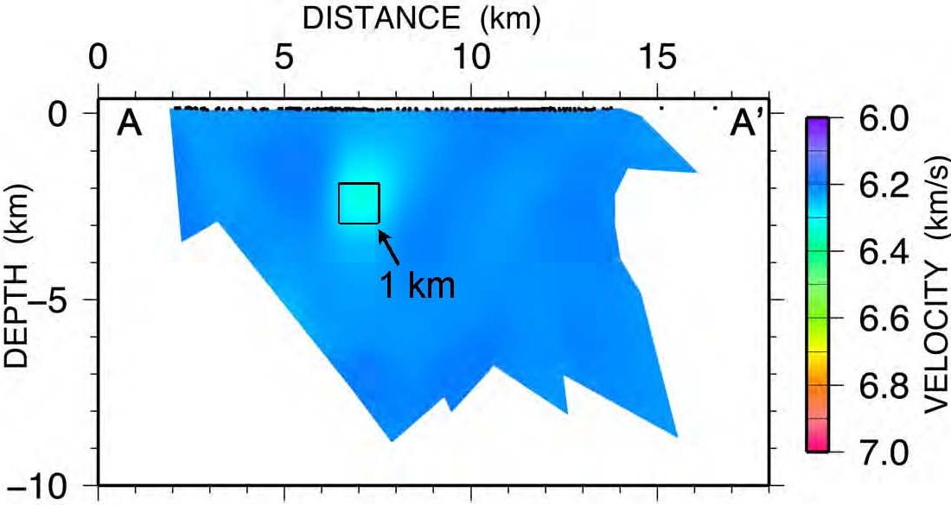
Tomography
>300 event tomography
spatial resolution ~1 km
limited mainly by line spacing
P & S velocity is ~constant (to 0.05 km/s)
to 16 ms (P), 60 ms (S)
V_{P} 6.2 km/s, V_{S} 3.6 km/s, V_{P}/V_{S} = 1.72
➔ felsic crystalline rocks within an accreted Piedmont terrane
resolution test
Davenport et al., 2015
John Hole, IRIS Seismic Instrumentation Technology Symposium, Tucson AZ, Oct. 2018

Slide 9
Backprojection
M2.5, 5.5 km depth backproject raw seismograms 1-45 Hz
Beskardes et al., 2018
spatial resolution: 75 m horizontal, 225 m vertical
detected & located events with S/N ≥ 0.6
John Hole, IRIS Seismic Instrumentation Technology Symposium, Tucson AZ, Oct. 2018

Slide 10
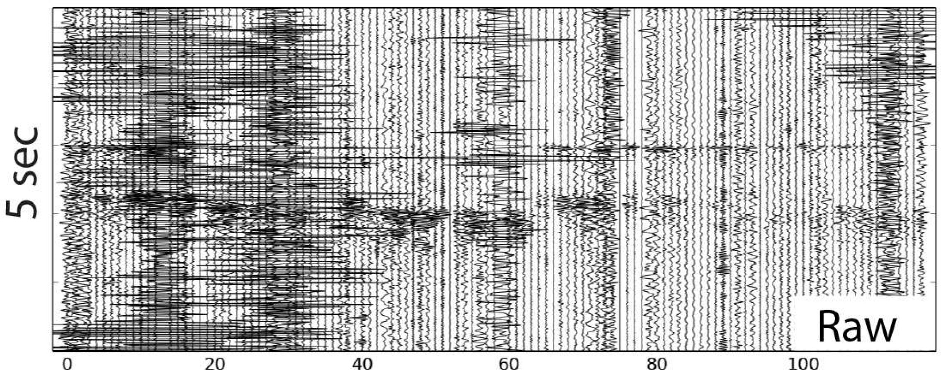
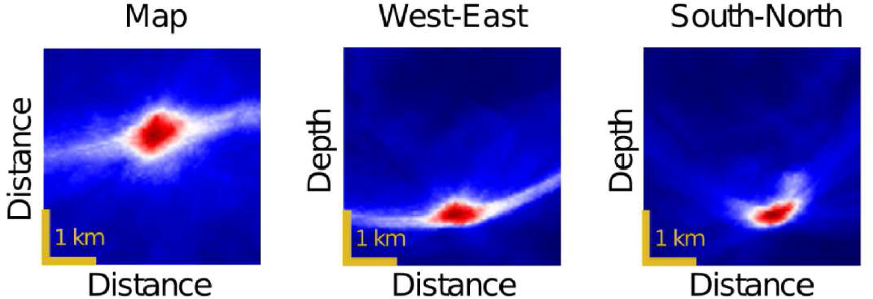
Backprojection
M –0.7
bad noise bursts (cars)
Beskardes et al., 2018
robust autodetection: backproject the kurtosis of the waveforms
then improve resolution: backproject raw data with diversity stack
John Hole, IRIS Seismic Instrumentation Technology Symposium, Tucson AZ, Oct. 2018

Slide 11
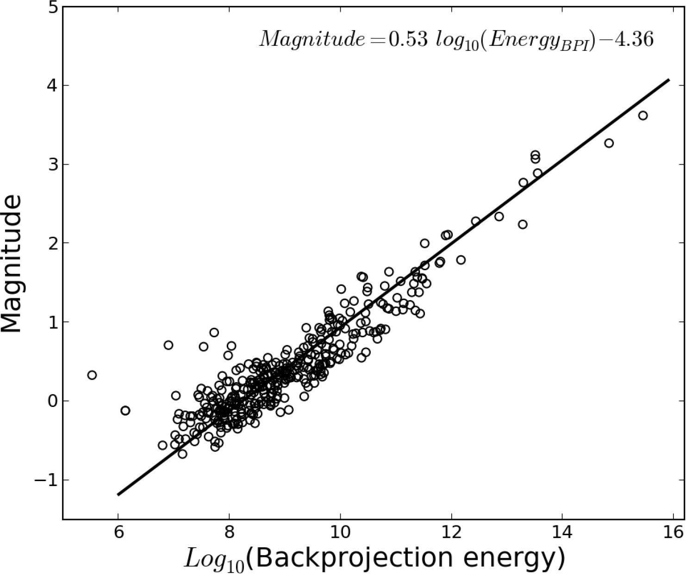
Backprojection Magnitude
Beskardes et al., accepted
magnitudes from Wu et al., 2015
calibrate backprojection energy with
traditional event magnitude of larger events
John Hole, IRIS Seismic Instrumentation Technology Symposium, Tucson AZ, Oct. 2018

Slide 12
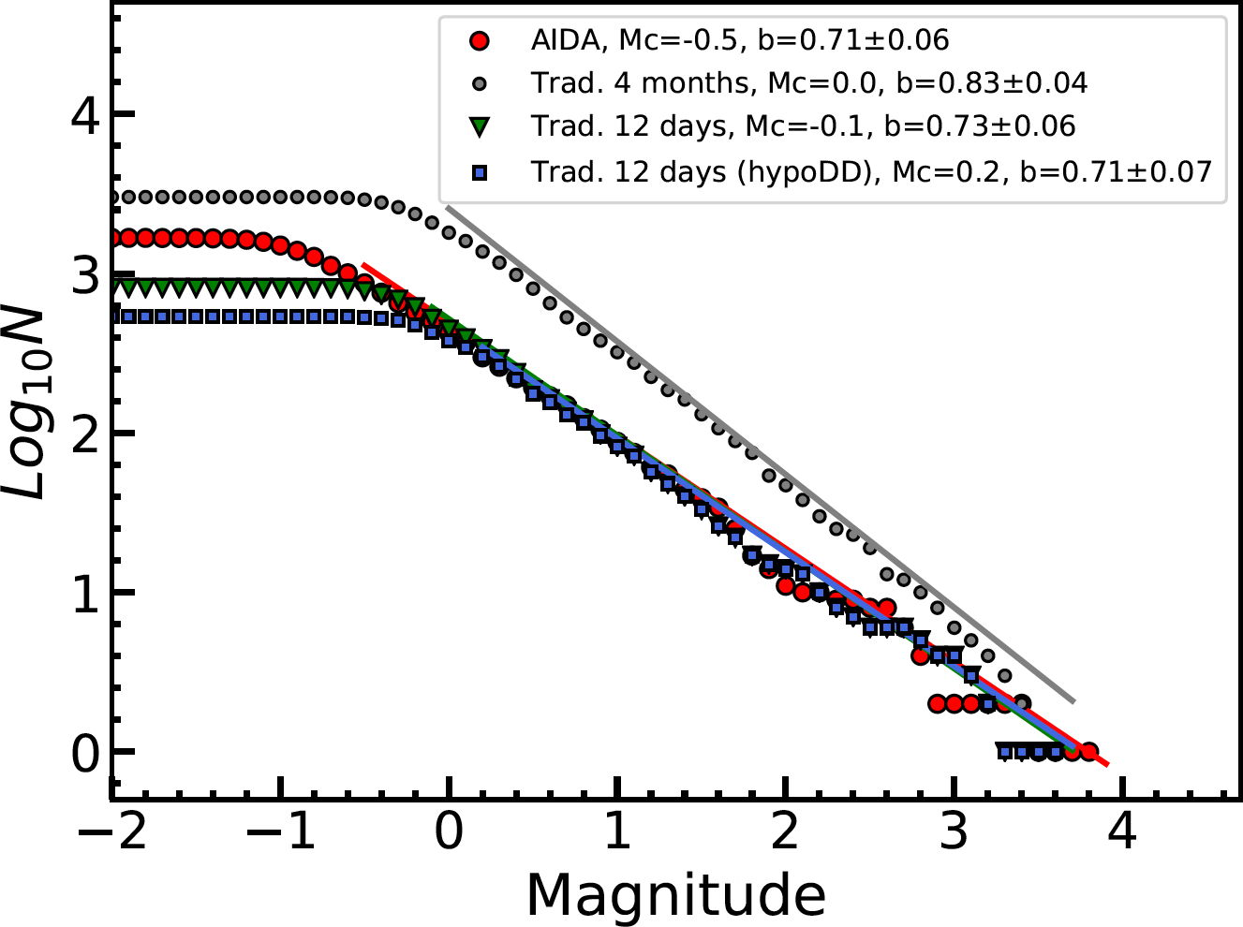
Catalog
Beskardes et al., accepted
traditional from Wu et al., 2015
# events:
AIDA backproj.: 1673
traditional: 813
trad. double-diff.: 494
completeness:
AIDA backproj: M –0.5
traditional: M –0.1
trad. double-diff.: M +0.2
John Hole, IRIS Seismic Instrumentation Technology Symposium, Tucson AZ, Oct. 2018

Slide 13
Catalog
Beskardes et al., accepted
traditional from Wu et al., 2015
# events:
AIDA backproj.: 1673
traditional: 813
trad. double-diff.: 494
completeness:
AIDA backproj: M –0.5
traditional: M –0.1
trad. double-diff.: M +0.2
b-value is low (0.71)
(high stress)
John Hole, IRIS Seismic Instrumentation Technology Symposium, Tucson AZ, Oct. 2018

Slide 14
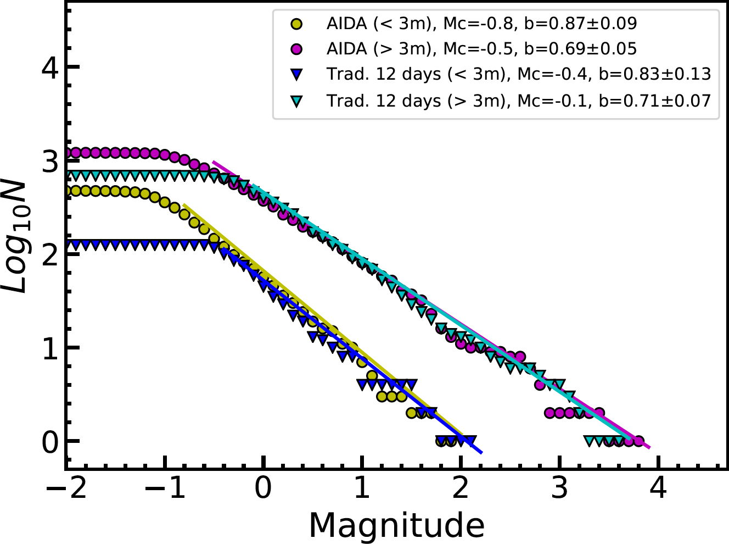
Gutenberg-Richter
b-value is low (0.71)
(high stress)
Beskardes et al., accepted
traditional from Wu et al., 2015
new result: b-value <3 km depth: 0.87
>3 km depth: 0.69
(higher stress)
John Hole, IRIS Seismic Instrumentation Technology Symposium, Tucson AZ, Oct. 2018

Slide 15
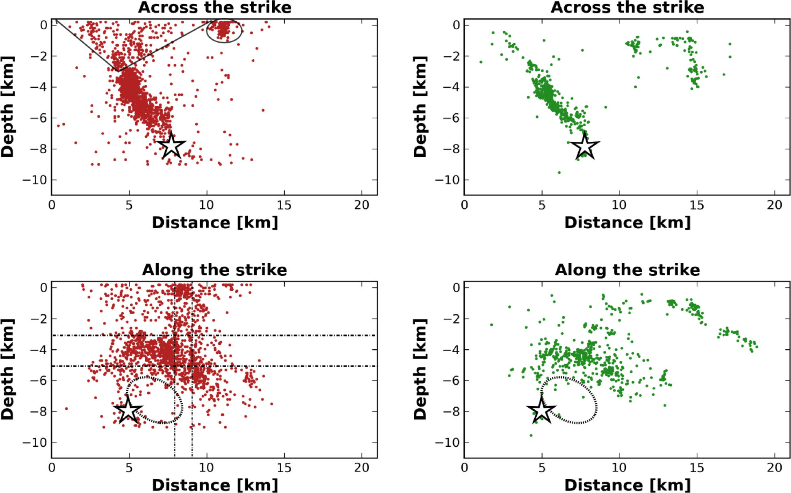
Hypocenters
AIDA backprojection
traditional network
same major patterns
Beskardes et al., accepted
traditional from Wu et al., 2015
newly discovered
observed,
but not located
by AIDA
(outside array)
John Hole, IRIS Seismic Instrumentation Technology Symposium, Tucson AZ, Oct. 2018

Slide 16
Hypocenters
AIDA backprojection
traditional network
newly
discovered
Beskardes et al., accepted
traditional from Wu et al., 2015
John Hole, IRIS Seismic Instrumentation Technology Symposium, Tucson AZ, Oct. 2018

Slide 17
Hypocenters
AIDA backprojection
traditional network
newly
discovered:
not
a single
fault
➔ multiple
small
faults
Beskardes et al., accepted
traditional from Wu et al., 2015
John Hole, IRIS Seismic Instrumentation Technology Symposium, Tucson AZ, Oct. 2018

Slide 18
AIDA Backprojection
for the cost of ~3 traditional stations…
3D velocity model
2.1 times as many events detected & located
3.3 times as many events located with <200 m accuracy
newly discovered
- statistics
- event clusters
- internal structure of main zone (small faults)
John Hole, IRIS Seismic Instrumentation Technology Symposium, Tucson AZ, Oct. 2018

Slide 19
AIDA Backprojection
for the cost of ~3 traditional stations…
3D velocity model
2.1 times as many events detected & located
3.3 times as many events located with <200 m accuracy
newly discovered
- statistics
- event clusters
- internal structure of main zone (small faults)
AIDA is not “Large N”
for same magnitude event in CA
more complicated velocity structure ➔ denser lines
larger rupture ➔ larger map area
➔ 1000+ stations… but this is done routinely with geophones
John Hole, IRIS Seismic Instrumentation Technology Symposium, Tucson AZ, Oct. 2018

Slide 20
Aftershock sequence of the 2011 Virginia earthquake
derived from
the dense AIDA array and backprojection
Beskardes et al., accepted
Beskardes et al., 2018 Davenport et al., 2015
Comparison of
4.5 Hz geophones to broadband seismometers
from a real deployment
Rasmussen et al., in progress
Davenport et al., 2017 Stanciu et al., 2016
John Hole, IRIS Seismic Instrumentation Technology Symposium, Tucson AZ, Oct. 2018

Slide 21
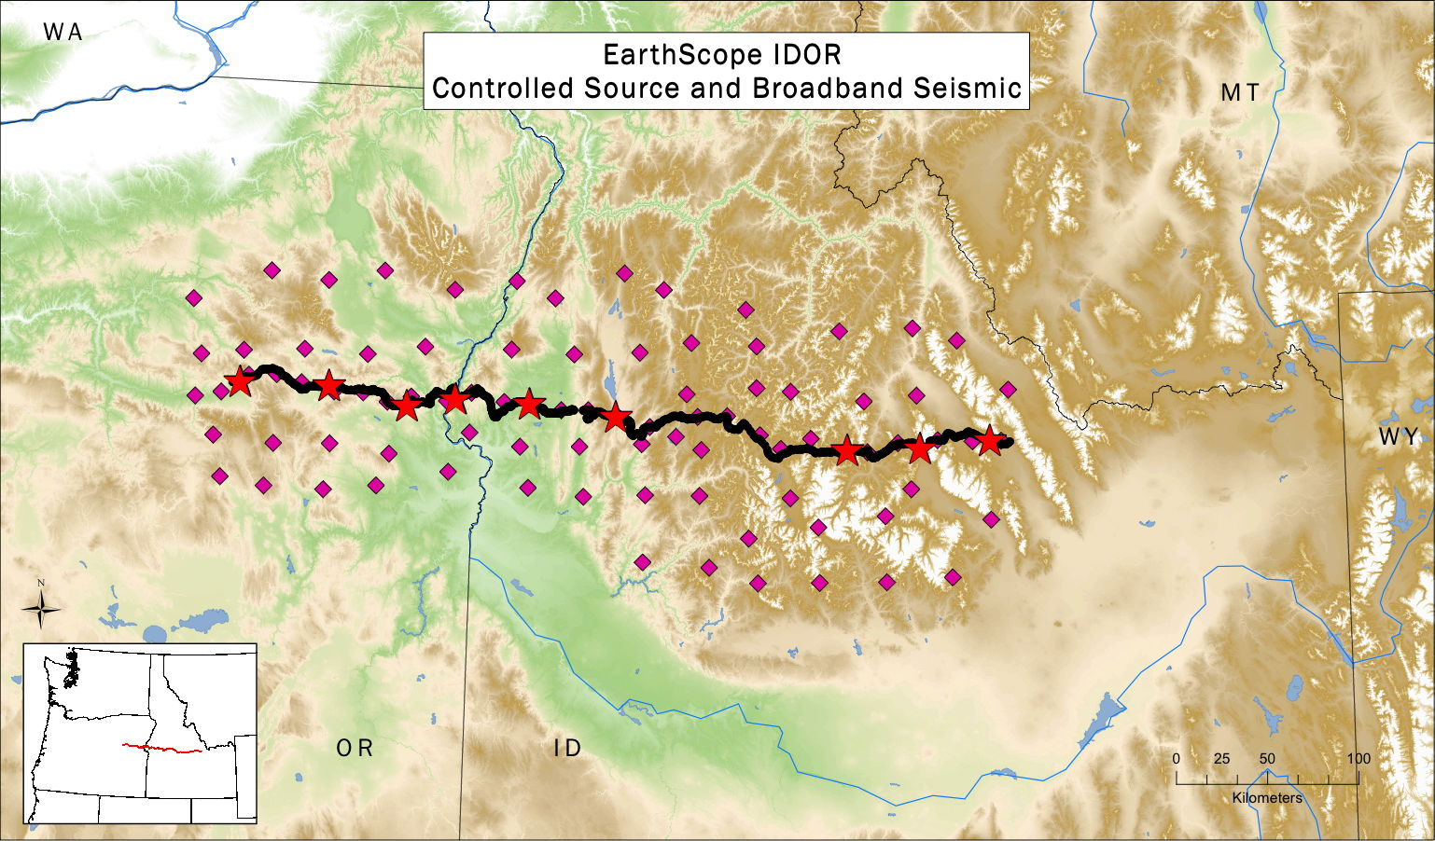
IDOR: EarthScope Idaho-Oregon 2011-2013
Stanciu et al., 2016; Davenport et al., 2017
broadband: 15 km spacing inline map: 30 km
controlled source: 0.2 km spacing shots: 50 km
& structural geology, petrology, geochemistry
John Hole, IRIS Seismic Instrumentation Technology Symposium, Tucson AZ, Oct. 2018

Slide 22
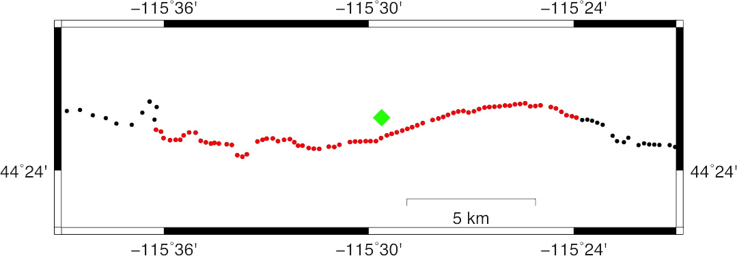
IDOR Stations
T. Rasmussen
15 km: 1 broadband, 77 geophones
broadband station 0.7 km off geophone line
John Hole, IRIS Seismic Instrumentation Technology Symposium, Tucson AZ, Oct. 2018

Slide 23
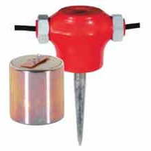
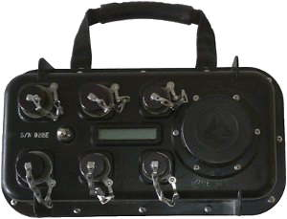
IDOR Seismometers
4.5 Hz
Geospace GS-11
Guralp CMG-3T
Reftek RT125
Reftek RT130
John Hole, IRIS Seismic Instrumentation Technology Symposium, Tucson AZ, Oct. 2018

Slide 24
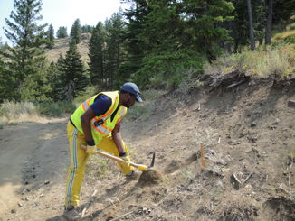
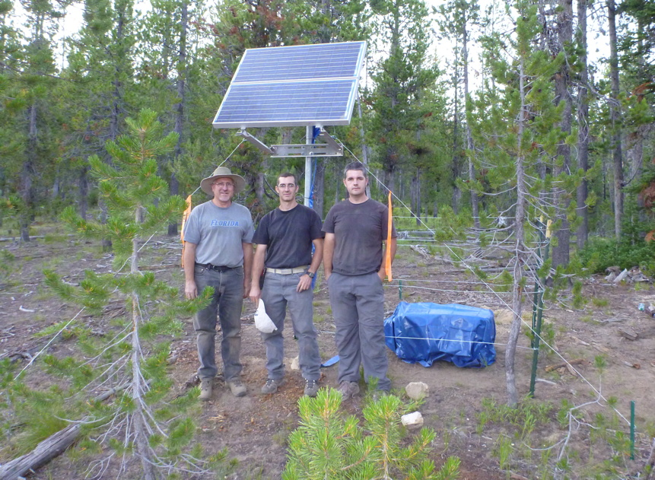
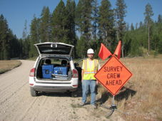
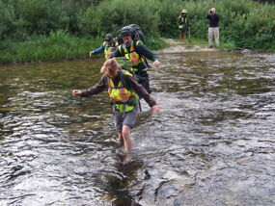
IDOR Deployment
1 half day (plus drive)
2 novices
50 geophone nodes
roadside, direct buried 0.05 m
1 half day (plus drive)
3 experienced people
1 broadband station, solar
quiet site, direct buried 2 m
10 nodes per backpack
John Hole, IRIS Seismic Instrumentation Technology Symposium, Tucson AZ, Oct. 2018

Slide 25
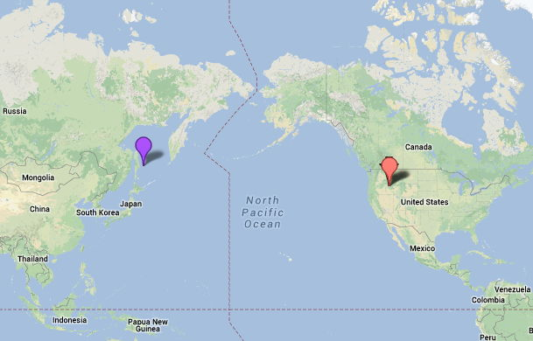
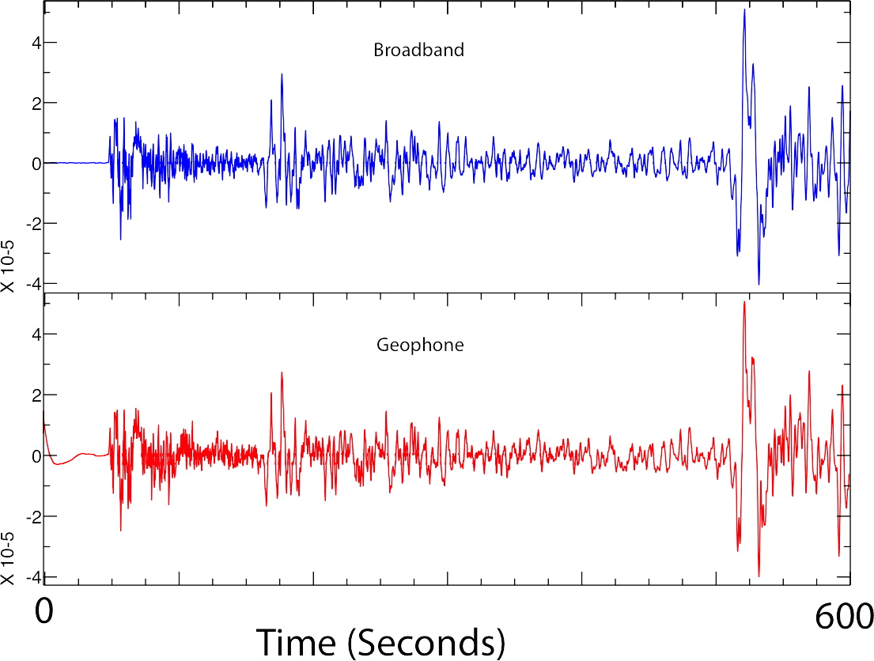
M7.7, 625 km depth, Δ=62˚
Teleseismic Event
0.03 to 20 Hz (0.05 to 32 s)
broadband
P
pP
sP
S
PcP
corrected
instrument
response
geophone
filter
error
T. Rasmussen
John Hole, IRIS Seismic Instrumentation Technology Symposium, Tucson AZ, Oct. 2018

Slide 26
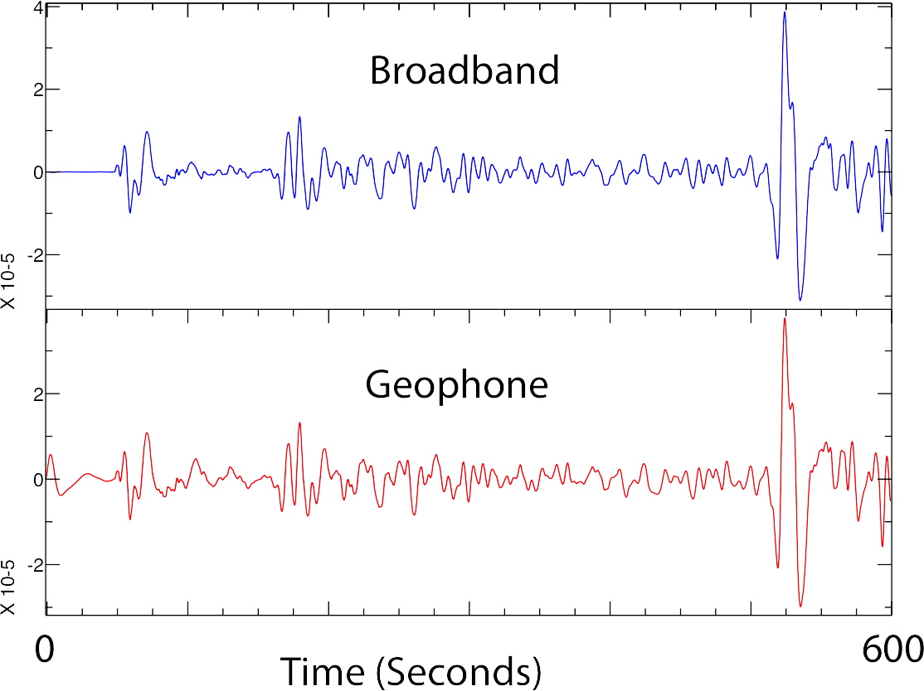
M7.7, 625 km depth, Δ=62˚
Teleseismic Event
0.03 to 0.12 Hz (8 to 32 s)
broadband
P
pP
sP
S
PcP
corrected
instrument
response
geophone
filter
error
2 decades below the geophone corner frequency
T. Rasmussen
John Hole, IRIS Seismic Instrumentation Technology Symposium, Tucson AZ, Oct. 2018

Slide 27
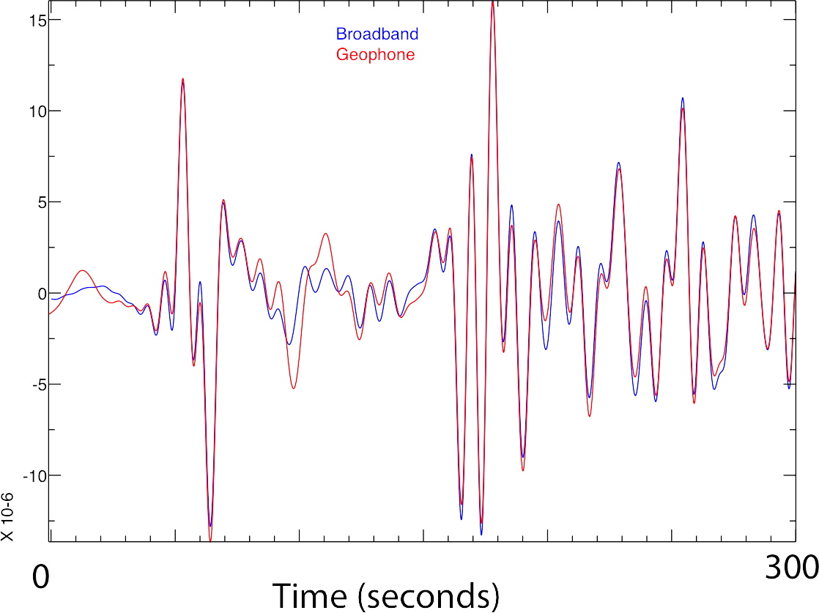
M7.7, 625 km depth, Δ=62˚
Teleseismic Event
0.03 to 0.12 Hz (8 to 32 s)
broadband
geophone
pP
P
corrected
instrument
response
filter
error
PcP
sP
2 decades below the geophone corner frequency
T. Rasmussen
John Hole, IRIS Seismic Instrumentation Technology Symposium, Tucson AZ, Oct. 2018

Slide 28
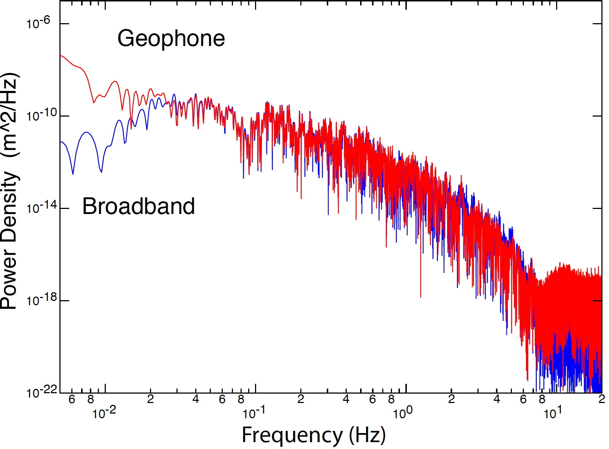
M7.7, 625 km depth, Δ=62˚
Teleseismic Event
600 s window (P to S arrivals)
geophone
corrected
instrument
response
broadband
match
corner
2 decades below the geophone corner frequency
T. Rasmussen
John Hole, IRIS Seismic Instrumentation Technology Symposium, Tucson AZ, Oct. 2018

Slide 29
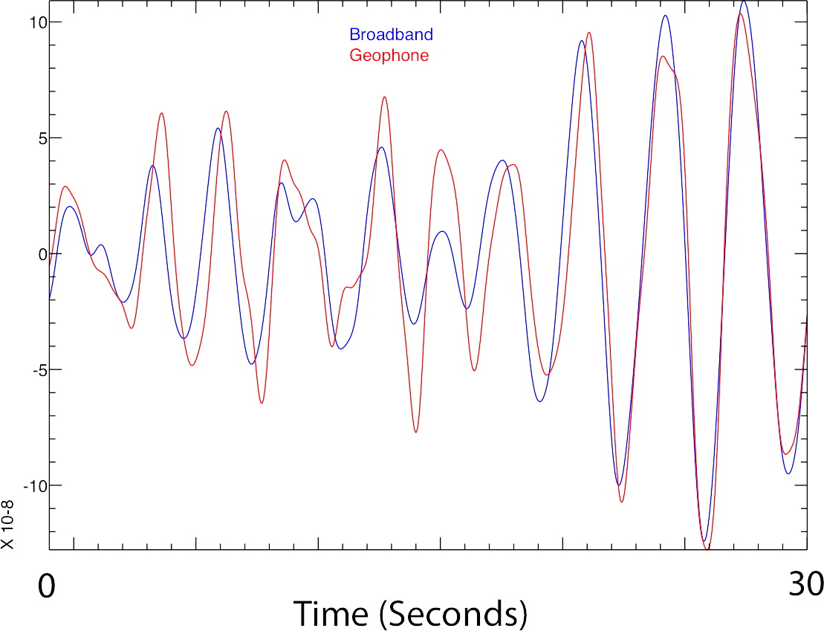
Low Ambient Noise
0.3 to 1.2 Hz (0.8 to 3.2 s)
corrected
instrument
response
broadband
geophone
1 decade below the geophone corner frequency
T. Rasmussen
John Hole, IRIS Seismic Instrumentation Technology Symposium, Tucson AZ, Oct. 2018

Slide 30
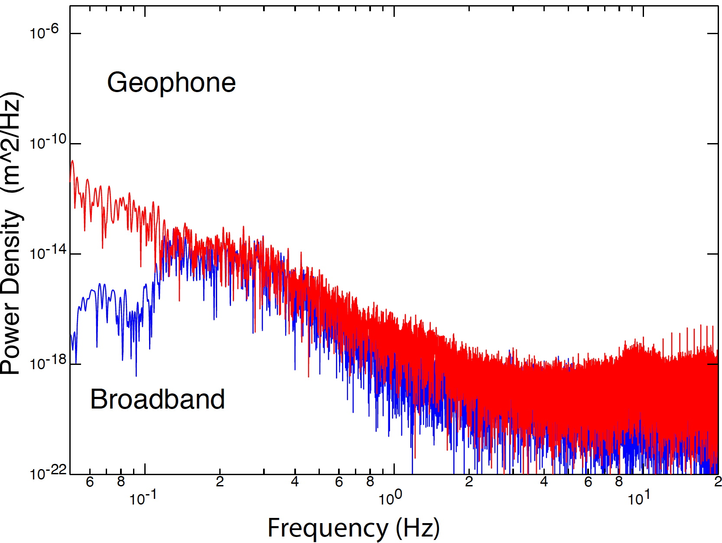
Low Ambient Noise
600 s window
geophone
corrected
instrument
response
match
trace
match
spectra
broadband
corner
1 decade below the geophone corner frequency
T. Rasmussen
John Hole, IRIS Seismic Instrumentation Technology Symposium, Tucson AZ, Oct. 2018

Slide 31
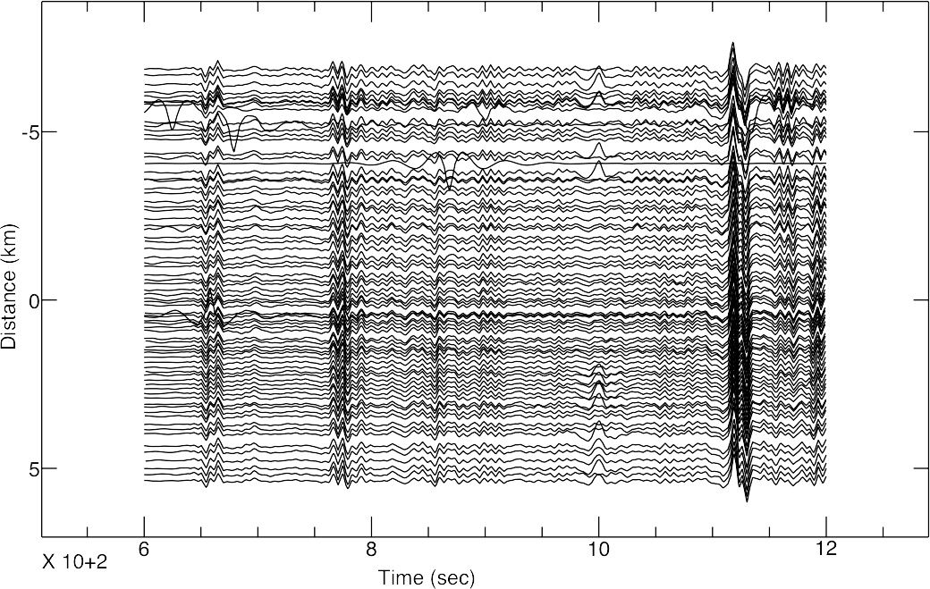
M7.7, 625 km depth, Δ=62˚
Teleseismic Event
0.03 to 0.12 Hz (8 to 32 s)
77 geophones
corrected
instrument
response
P
pP
sP
S
600 s
2 decades below the geophone corner frequency
T. Rasmussen
➔ stack to improve S/N
John Hole, IRIS Seismic Instrumentation Technology Symposium, Tucson AZ, Oct. 2018

Slide 32
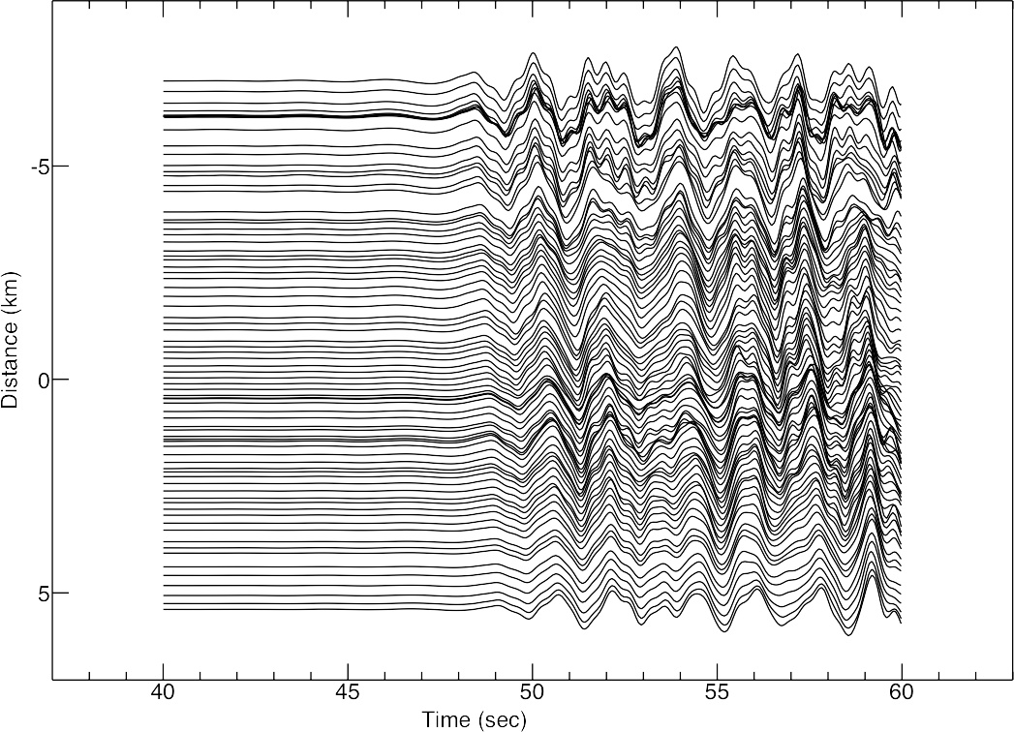
M7.7, 625 km depth, Δ=62˚
Teleseismic Event
0.5 to 2 Hz (0.5 to 2 s)
77 geophones
corrected
instrument
response
13 km/s
P
20 s
2 decades below the geophone corner frequency
T. Rasmussen
beam-form to measure apparent velocity
and backazimuth
John Hole, IRIS Seismic Instrumentation Technology Symposium, Tucson AZ, Oct. 2018

Slide 33
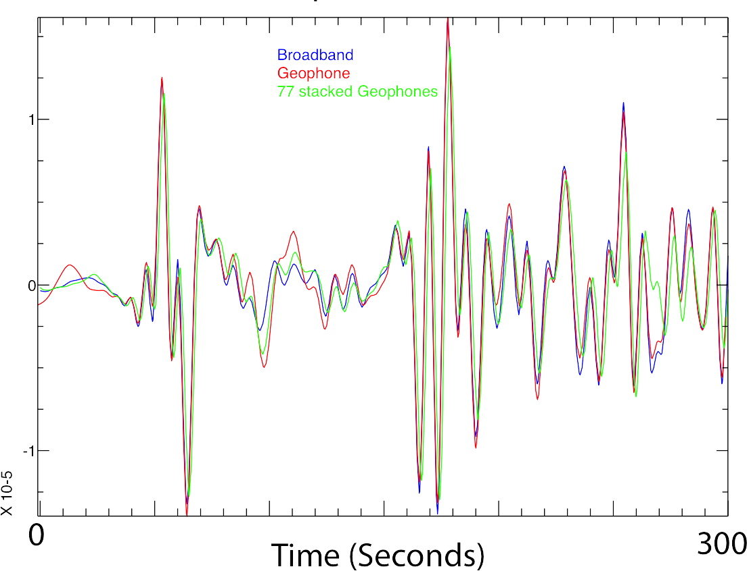
M7.7, 625 km depth, Δ=62˚
Teleseismic Event
0.03 to 0.12 Hz (8 to 32 s)
pP
corrected
instrument
response
P
PcP
broadband
geophone
sP
77 geophones
T. Rasmussen
2 decades below the geophone corner frequency
John Hole, IRIS Seismic Instrumentation Technology Symposium, Tucson AZ, Oct. 2018

Slide 34
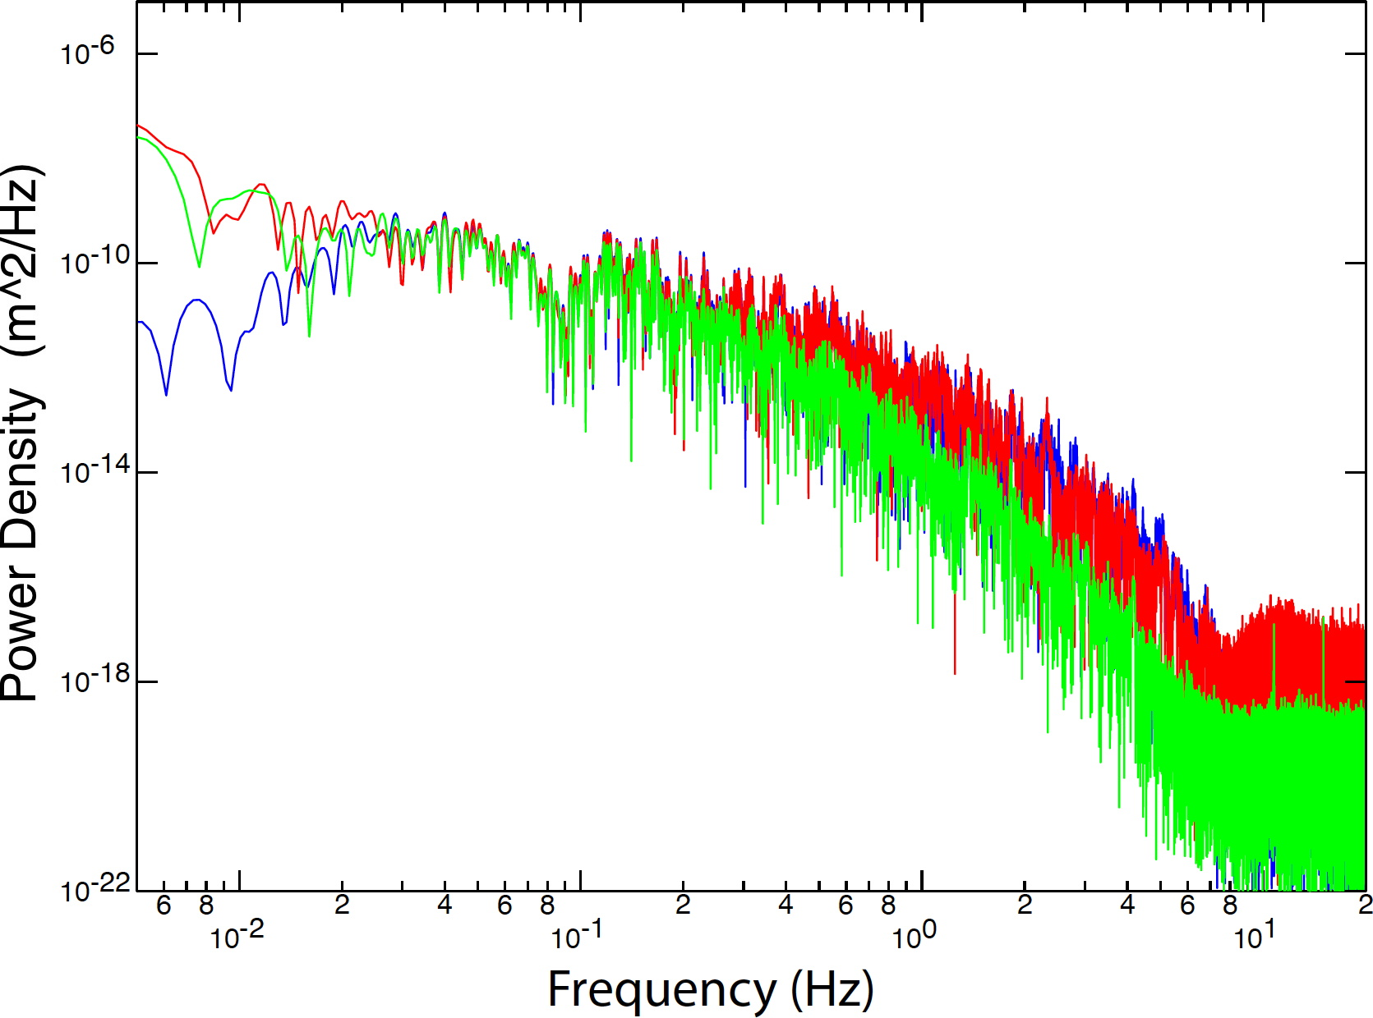
M7.7, 625 km depth, Δ=62˚
Teleseismic Event
600 s window (P to S arrivals)
geophone
corrected
instrument
response
broadband
77 geophones
match
stacked
match
unstacked
corner
2 decades below the geophone corner frequency
T. Rasmussen
John Hole, IRIS Seismic Instrumentation Technology Symposium, Tucson AZ, Oct. 2018

Slide 35
Low Ambient Noise
600 s window
in progress: beamform noise
at all velocities & backazimuths, then stack
expected result: good to microseismic peak
geophone
corrected
instrument
response
expected
match
stacked
match
trace
broadband
corner
1 decade below the geophone corner frequency
T. Rasmussen
John Hole, IRIS Seismic Instrumentation Technology Symposium, Tucson AZ, Oct. 2018

Slide 36
Cost
2 orders of magnitude less expensive
many geophones
1 broadband
John Hole, IRIS Seismic Instrumentation Technology Symposium, Tucson AZ, Oct. 2018

Slide 37
Power
zero power
solar power required
many geophones
1 broadband
X
SWaP
power electronics only
next year’s tech:
➔ 1 year, no solar
John Hole, IRIS Seismic Instrumentation Technology Symposium, Tucson AZ, Oct. 2018

Slide 38
Field Effort (Field Cost)
2 orders of magnitude easier to deploy
XX
SWaP
1 half day (plus drive)
2 novices
50 geophone nodes
roadside, buried 0.05 m
1 half day (plus drive)
3 experienced people
1 broadband station, solar
quiet site, buried 2 m
10 nodes per backpack
John Hole, IRIS Seismic Instrumentation Technology Symposium, Tucson AZ, Oct. 2018

Slide 39
Instrument Recommendations
geophones record high-quality signal far below the corner frequency
SWaP! see also: Rodgers, 1994; Chapman 2009
to avoid spatial aliasing; to record the full wavefield
use low-frequency geophones at >0.15 Hz (<7 s)
better: 2 Hz geophones
2 orders of magnitude more stations at same cost
use broadband seismometers at <0.15 Hz (>7 s)
embedded deployments (full wavefield 10’s of s to 10’s of Hz)
arrays of arrays
applications that could benefit:
5 Hz to 5 s is spatially aliased with powered seismometers
earthquake hazards
volcanoes
source studies (nuclear)
➔ 10⁴ low-frequency geophone nodes
John Hole, IRIS Seismic Instrumentation Technology Symposium, Tucson AZ, Oct. 2018

Slide 40
References
AIDA:
Davenport, K. K., Hole, J. A., Quiros, D. A., Brown, L. D., Chapman, M. C., Han, L., and Mooney, W. D., (2015).
Aftershock imaging using a dense seismometer array (AIDA) after the 2011 Mineral, Virginia, earthquake.
In Horton, J. W., Jr., Chapman, M. C., and Green, R. A., eds., The 2011 Mineral, Virginia, Earthquake, and
Its Significance for Seismic Hazards in Eastern North America: Geol. Soc. Amer. Special Paper 509,
273-283. doi:10.1130/2015.2509(15) .
Wu, Q., Chapman, and Beale, J. N., (2015). The aftershock sequence of the 2011 Mineral, Virginia, earthquake:
Temporal and spatial distribution, focal mechanisms, regional stress, and the role of Coulomb stress transfer.
Bull. Seismol. Soc. Amer., 105, 2521-2537.
Beskardes, G. D., Hole, J. A., Wang, K., Michaelides, M., Wu, Q., Chapman, M. C., Davenport, K. K., Brown, L. D.,
and Quiros, D. A., (2018). A comparison of earthquake backprojection imaging methods for
dense local arrays. Geophy. J. Int., 212, 1986-2002. doi:10.1093/gji/ggx520 .
Beskardes, G. D., Wu, Q., Hole, J. A., Chapman, M. C., Davenport, K. K., Brown, L. D., and Quiros, D. A., (accepted).
Aftershock sequence of the 2011 Virginia earthquake derived from the dense AIDA array and backprojection.
Bull. Seismol. Soc. Amer., accepted.
IDOR:
Stanciu, A. C., Russo, R. M., Mocanu, V. I., Bremner, P. M., Hongsresawat, S., Torpey, M. E., VanDecar, J. C., Foster,
D. A., and Hole, J. A., (2016). Crustal structure beneath the Blue Mountains terranes and cratonic
North America, Eastern Oregon and Idaho, from teleseismic receiver functions. J. Geophys. Res.,
121, 5049-5067, doi:10.1002/2016JB012989 .
Davenport, K.K., Hole, J. A., Tikoff, B., Russo, R. M., and Harder, S. H., (2017). A strong contrast in crustal architecture
from accreted terranes to craton, constrained by controlled-source seismic data in Idaho and eastern Oregon.
Lithosphere, 9, 325-340. doi:10.1130/L553.1 .
Rasmussen, T., W., (in progress). Comparison of 4.5 Hz geophones to broadband seismometers from a real deployment.
M.S. Thesis, Virginia Tech. [intention is to submit to SRL or BSSA in early 2019; please respect work in progress]
Other work documenting the geophone response below the corner frequency:
Rodgers, P. W., (1994). Self-noise spectra for 34 common electromagnetic seismometer/preamplifier pairs.
Bull. Seismol. Soc. Amer., 84, 222-228.
Chapman, M., (2009). A comparison of short-period and broadband seismograph systems in the context of the
seismology of the eastern United States. Seismol. Res. Lett., 80, 1019-1034.
John Hole, IRIS Seismic Instrumentation Technology Symposium, Tucson AZ, Oct. 2018

