Slide 1
Drilling & Installs 2018
Order and method, and 'the little gray cells'
  Jeremy Miner
  Field Operations Manager
October 29th, 2018
SITS Meeting, Tucson, AZ

Slide 2
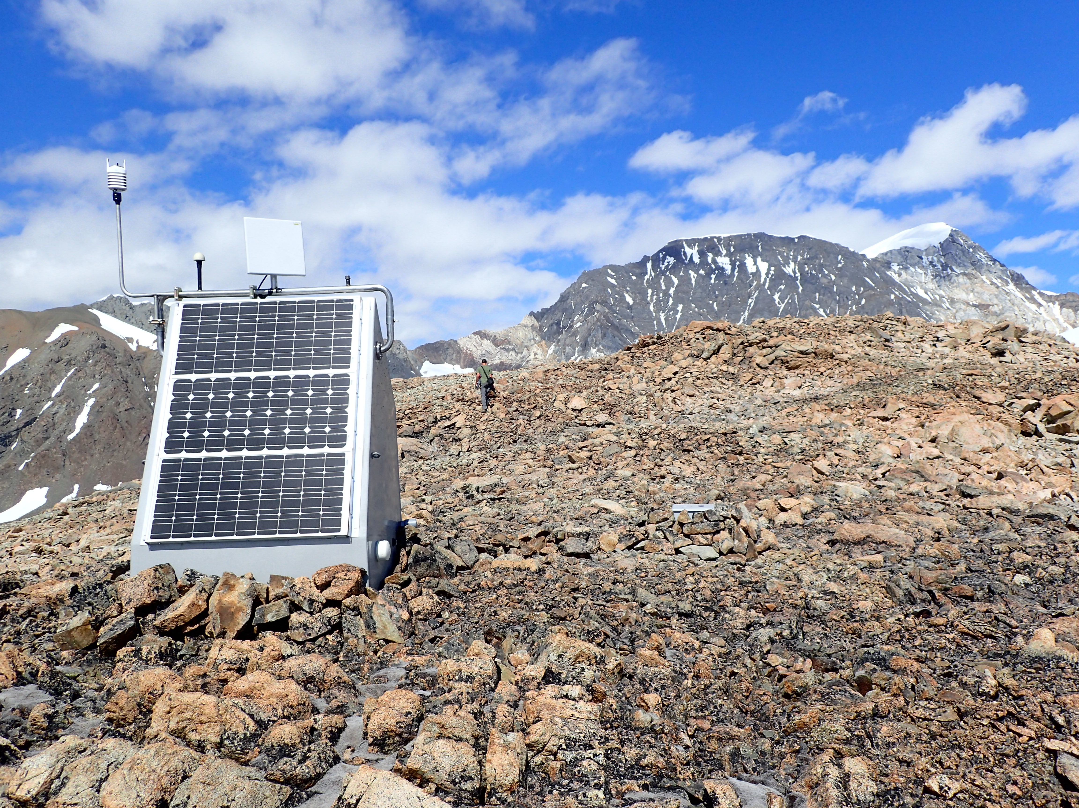
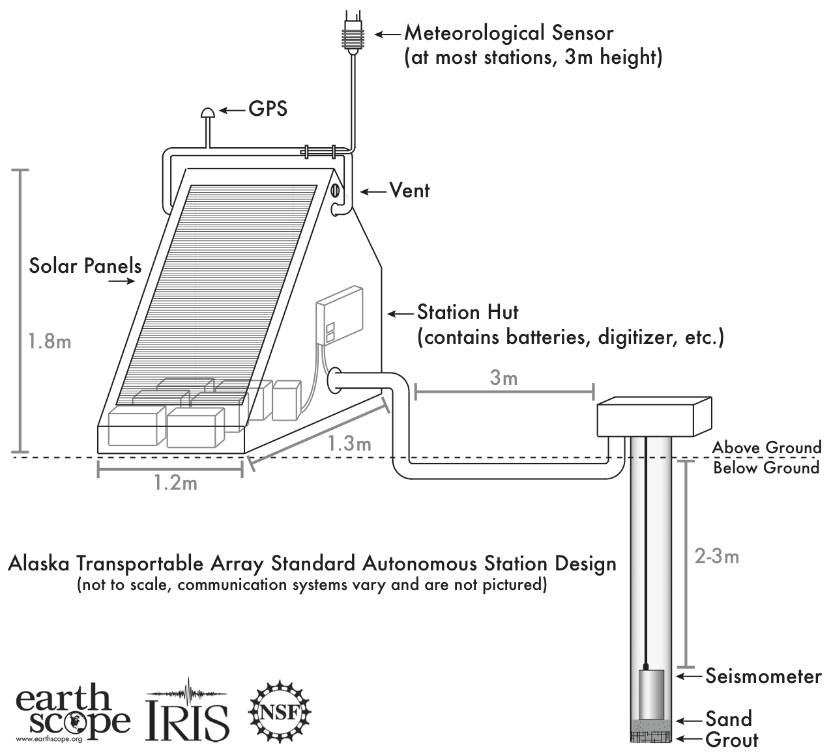
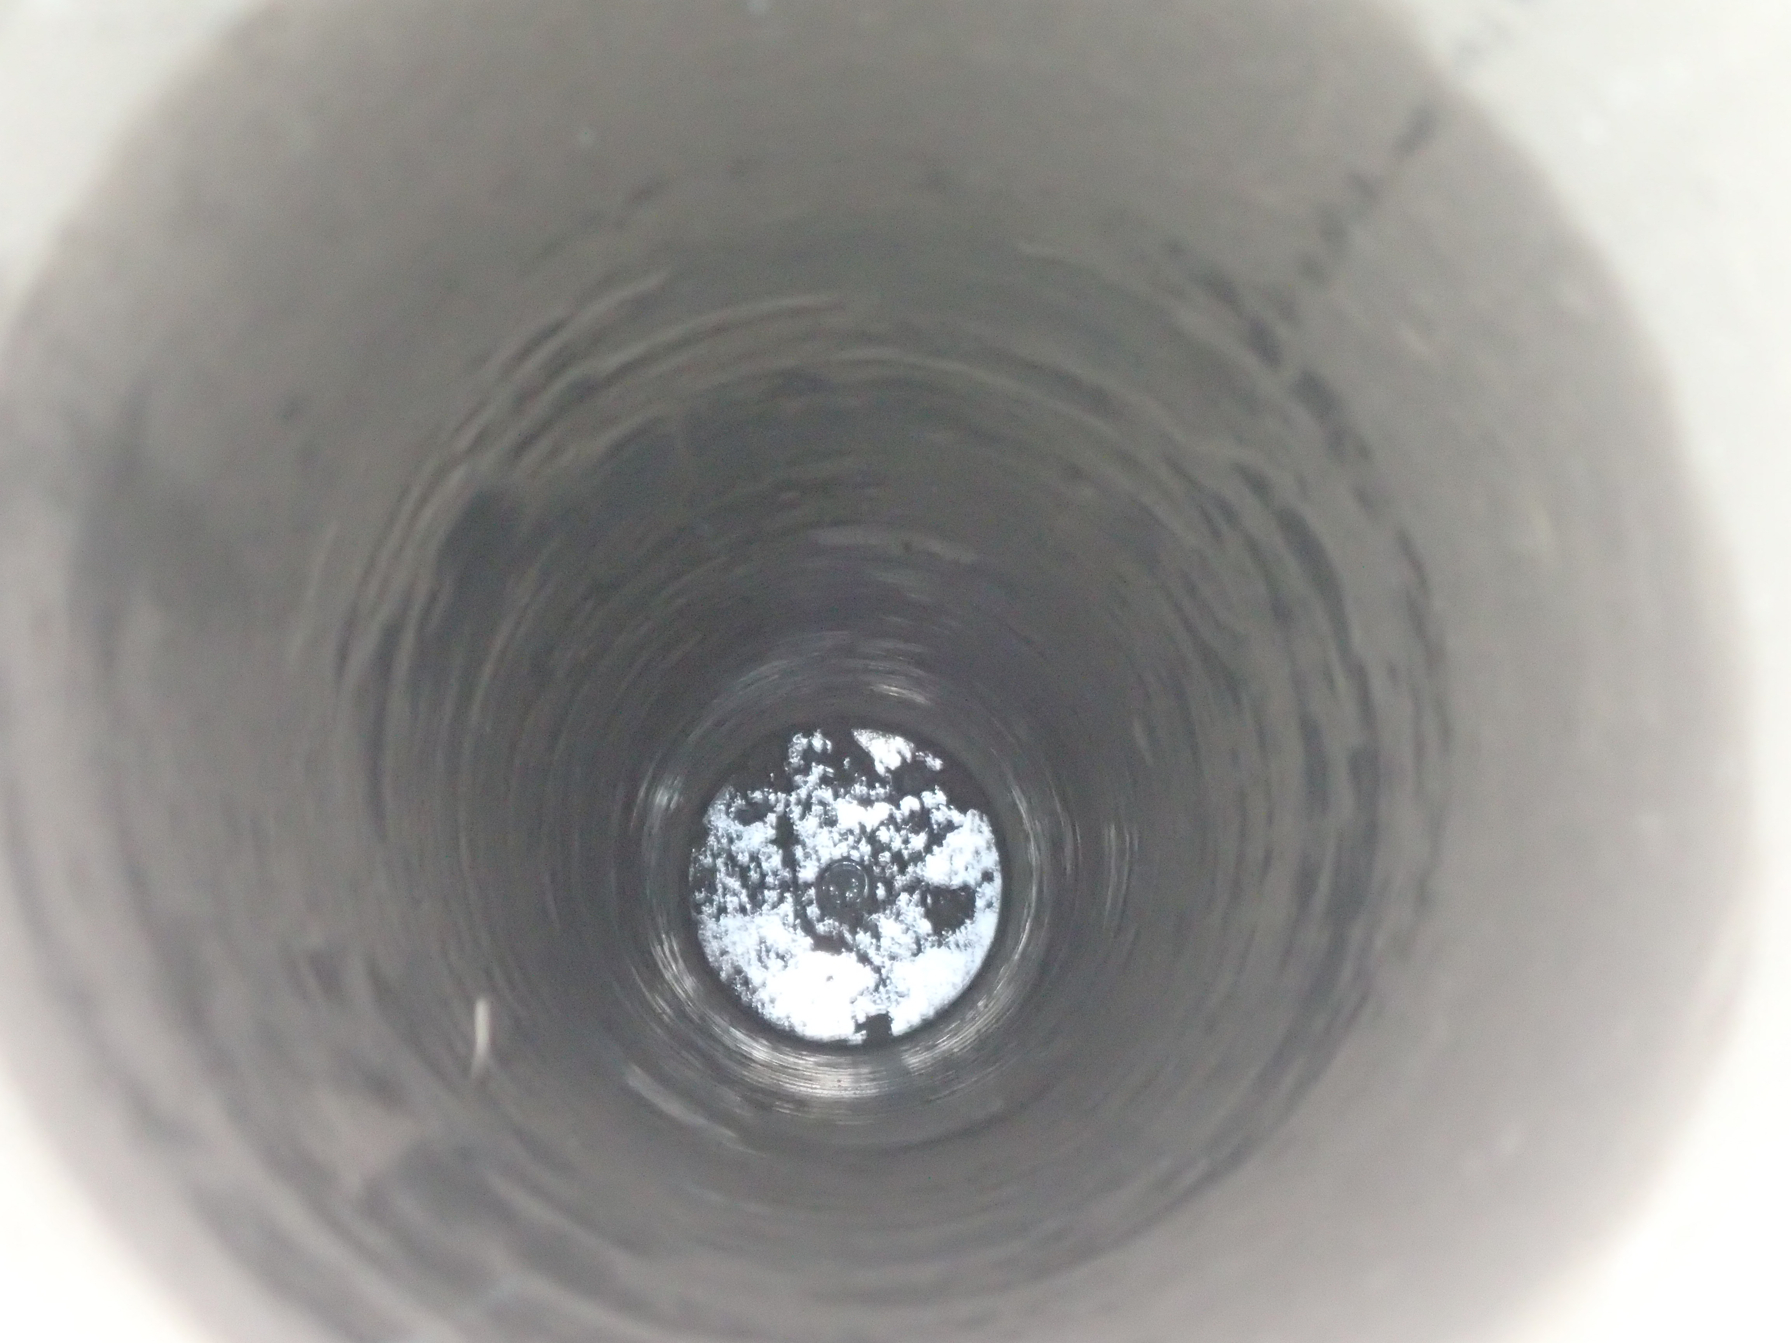
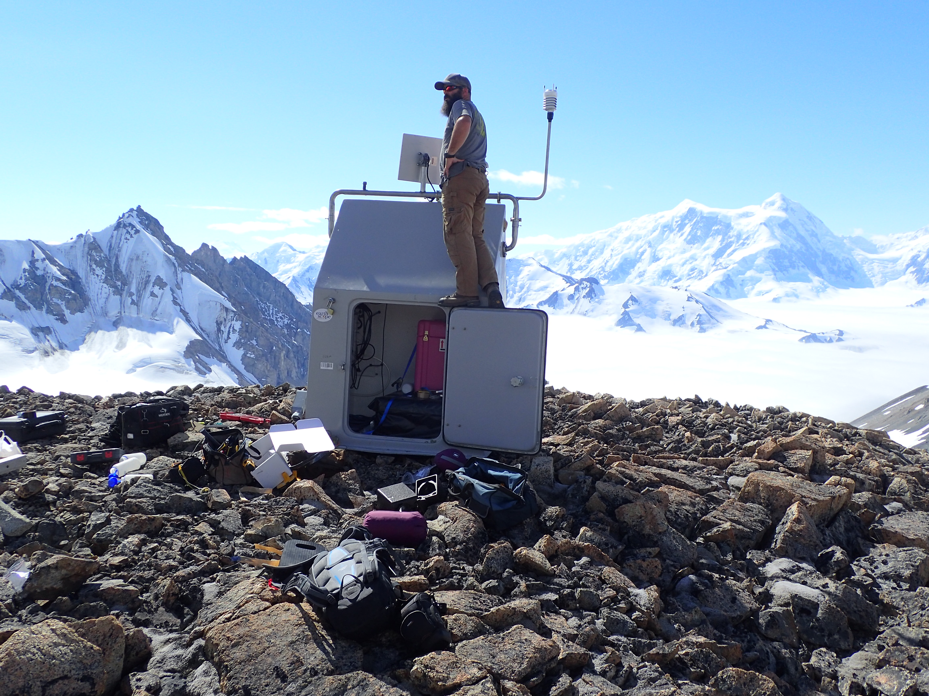
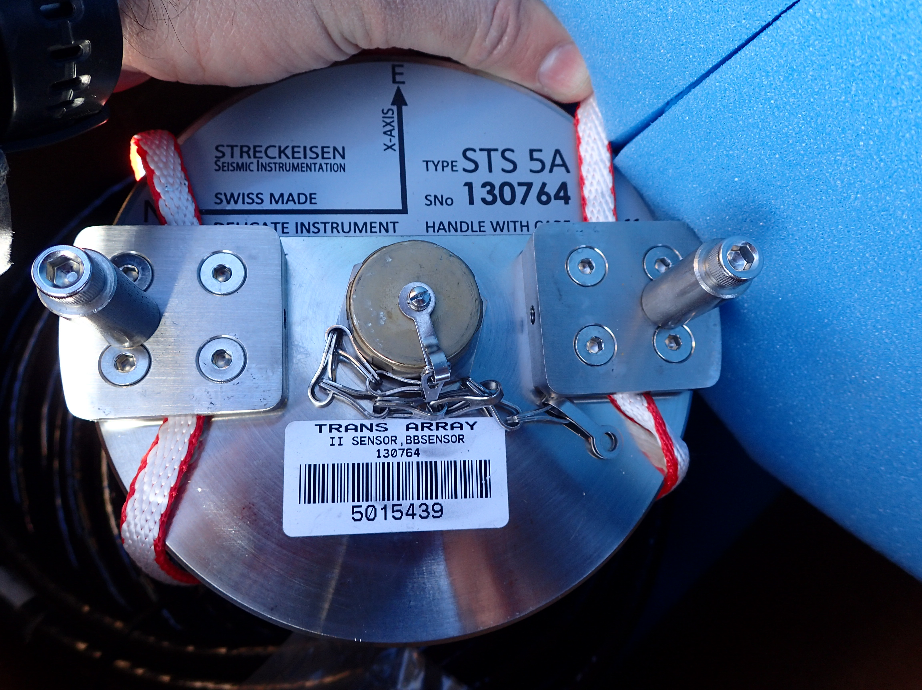
Borehole Station Design
Sensor(s): 3 component Broadband seismometer, Strong motion seismometer, Meteorological Sensor, Infrasound, and others
Datalogger and local data storage
Power and real-time/near real-time data telemetry
O28M Seismic Station

Slide 3
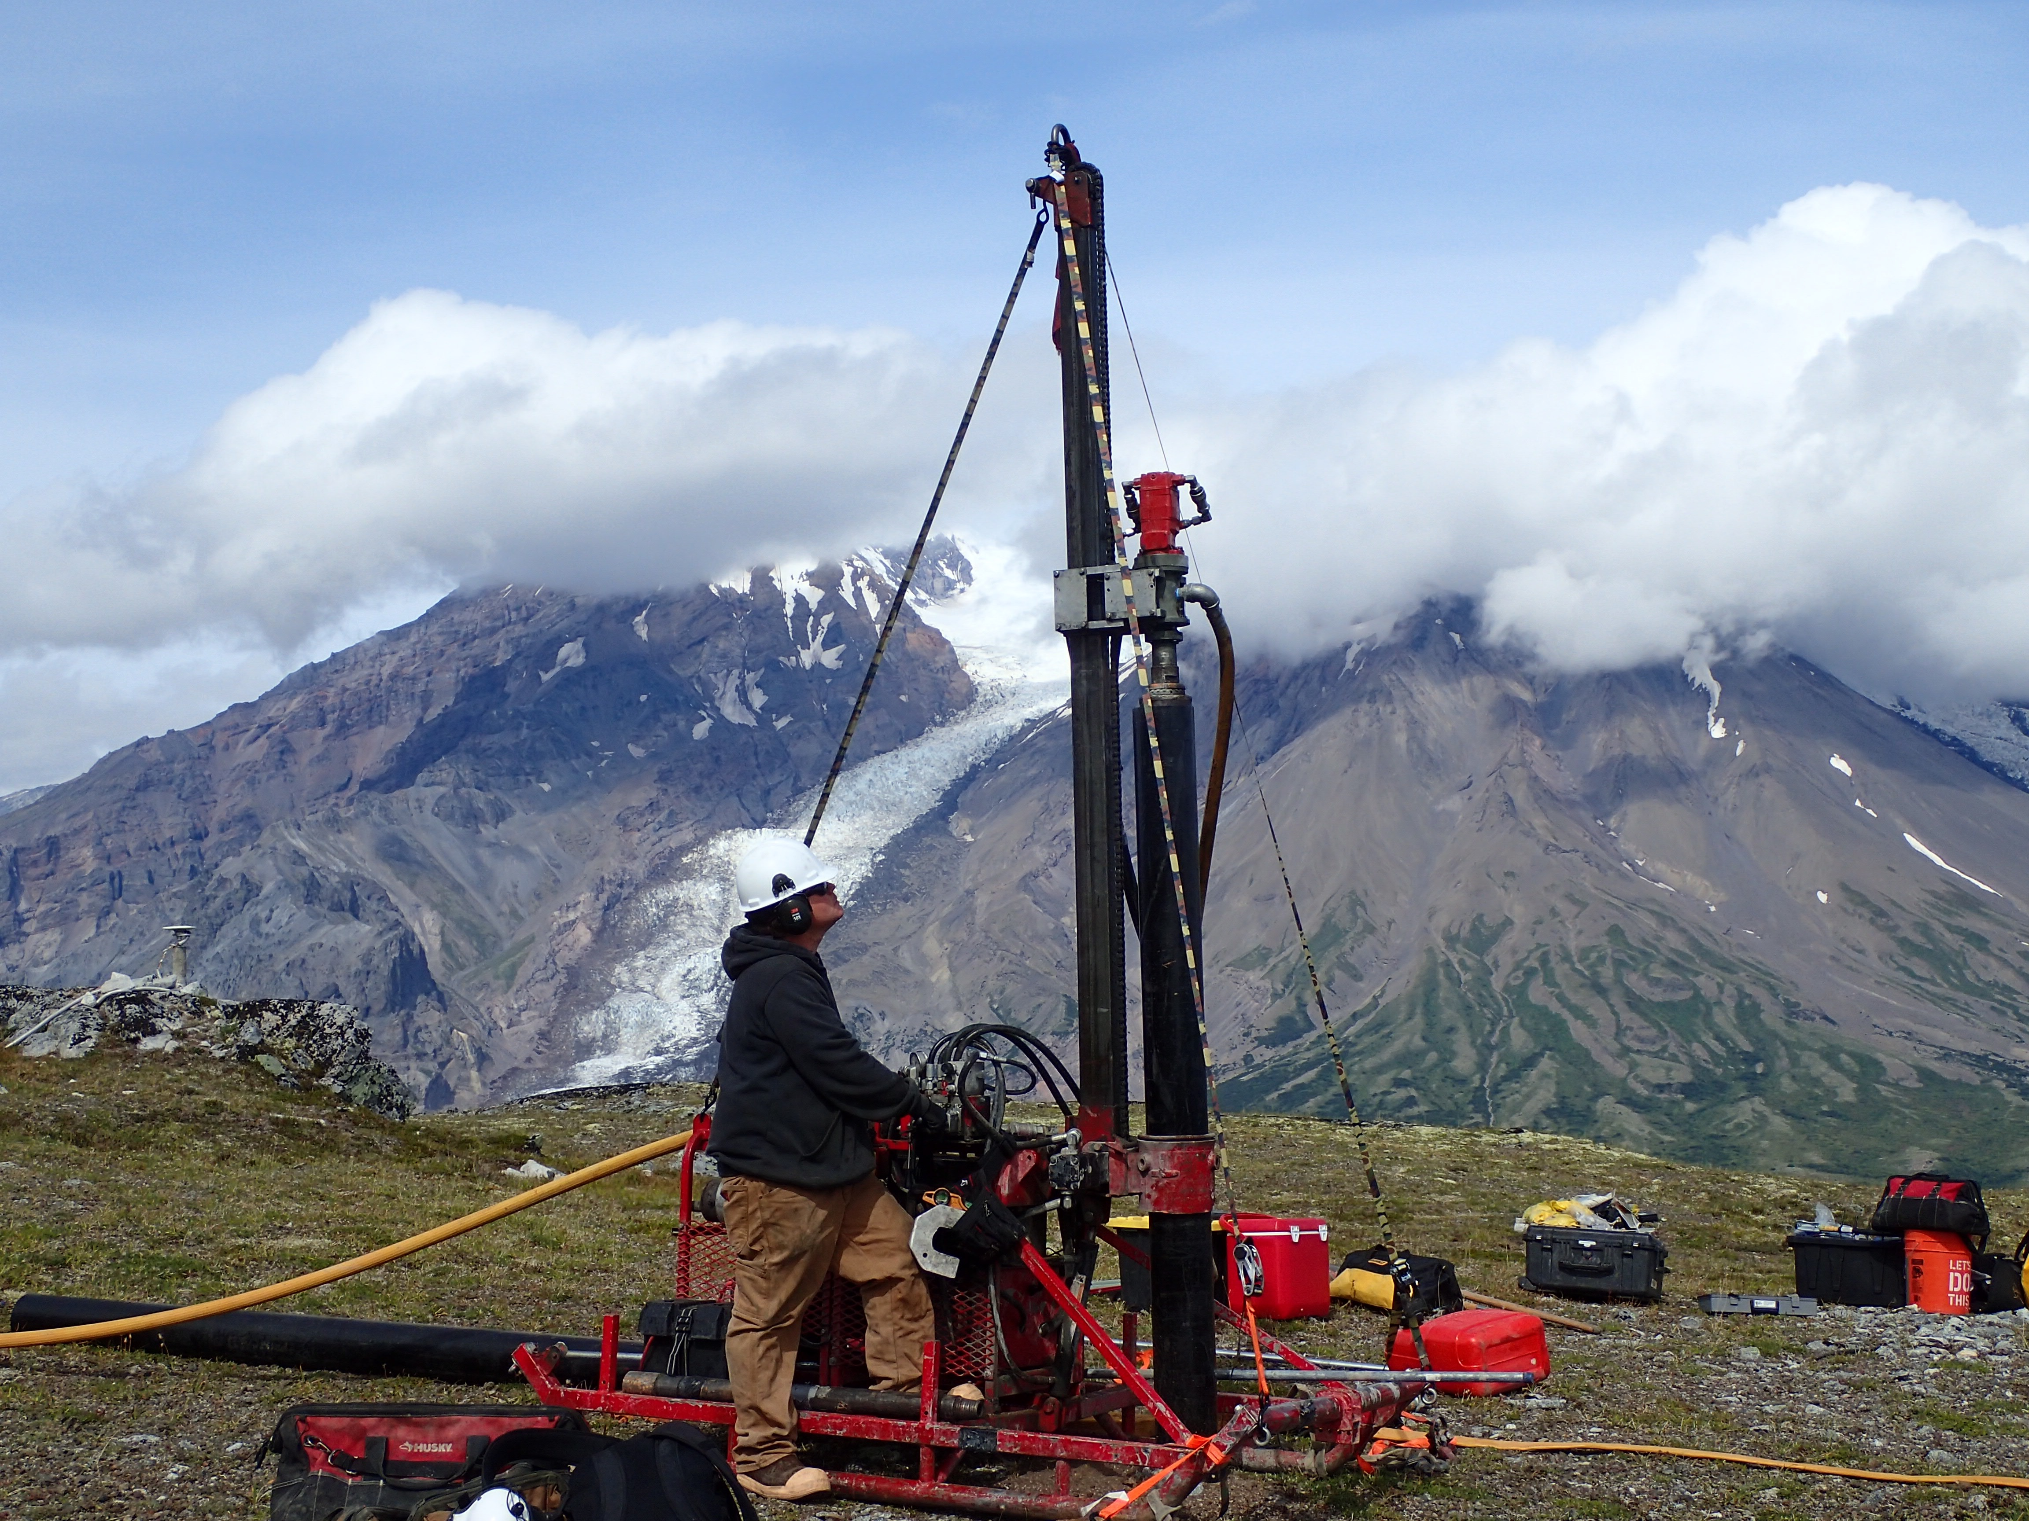
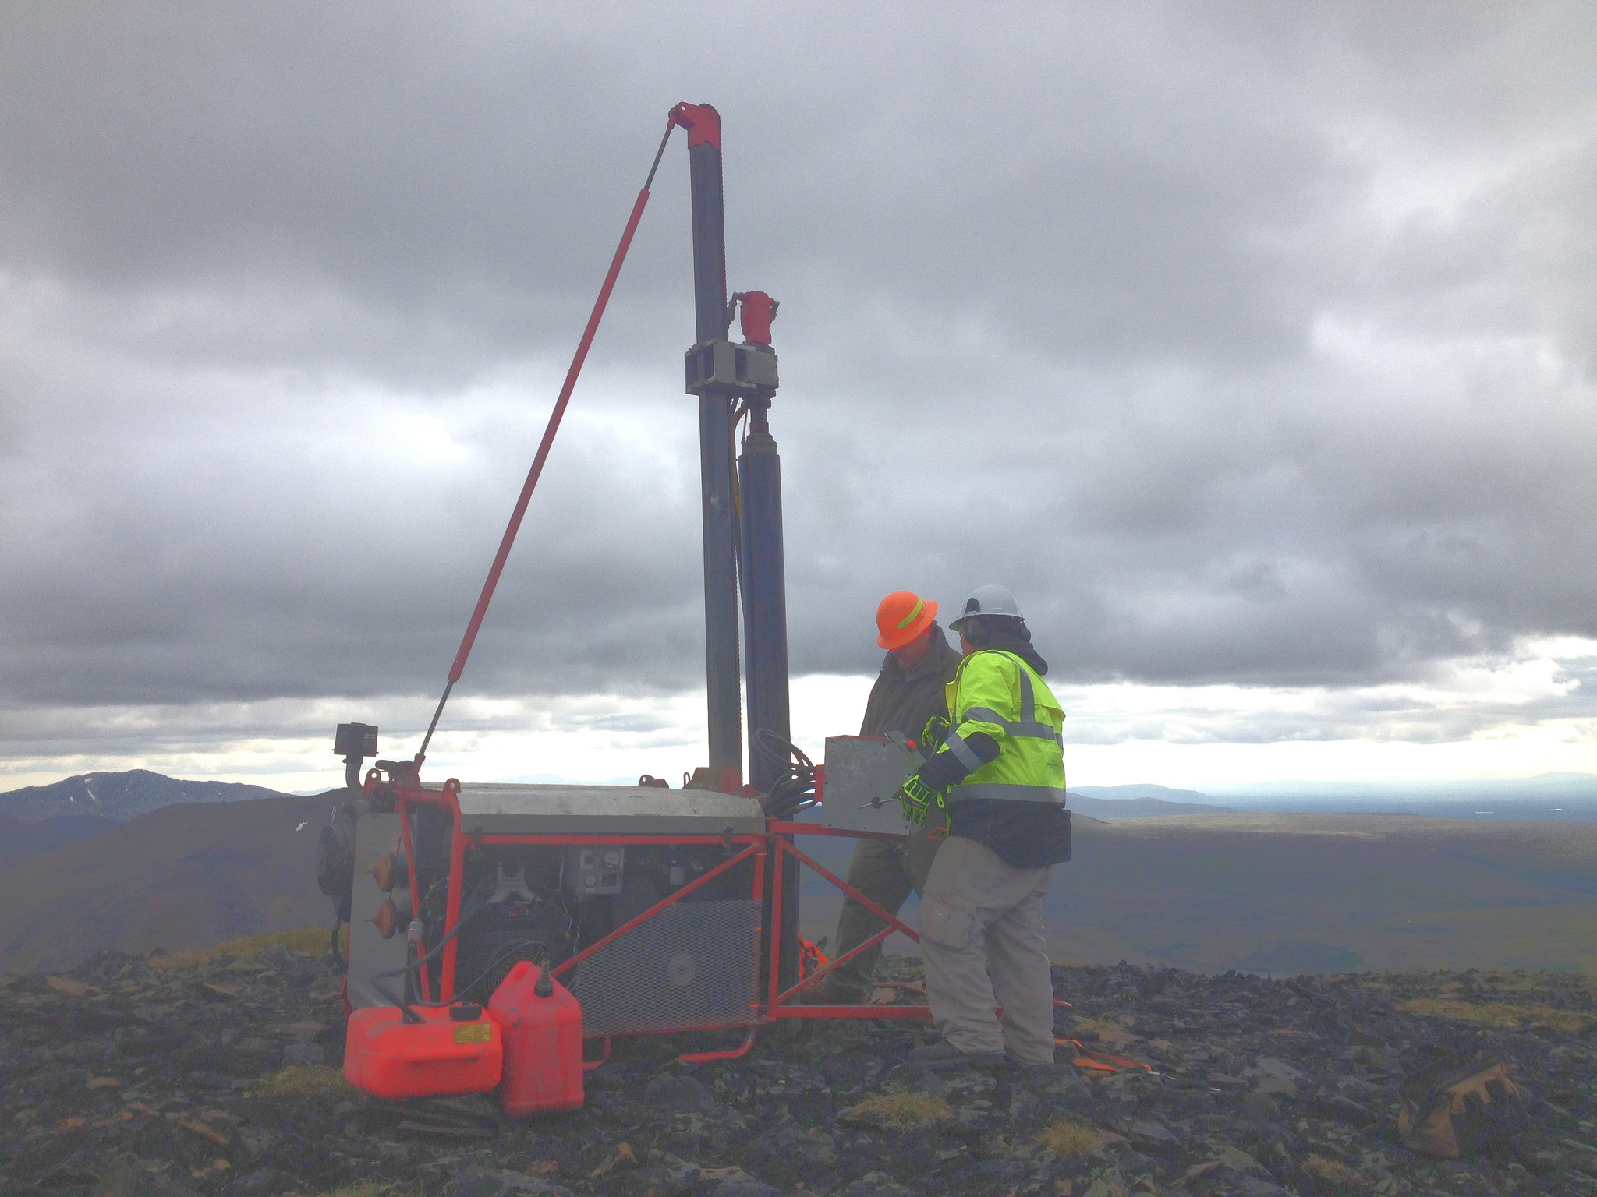
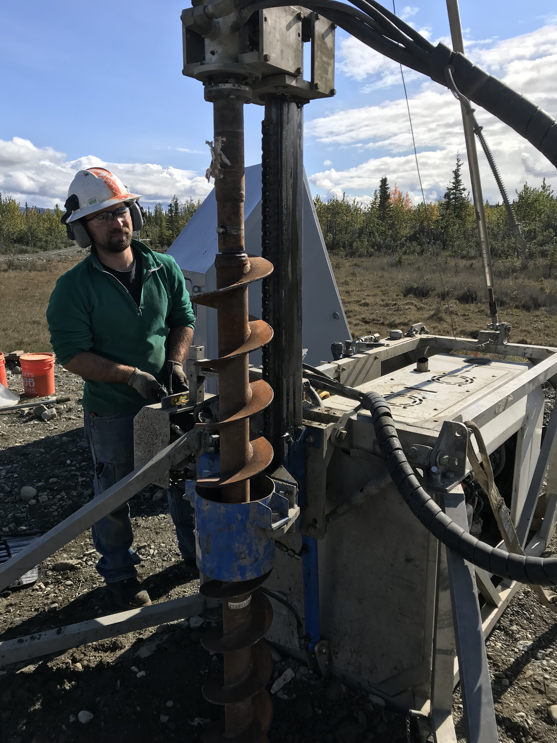
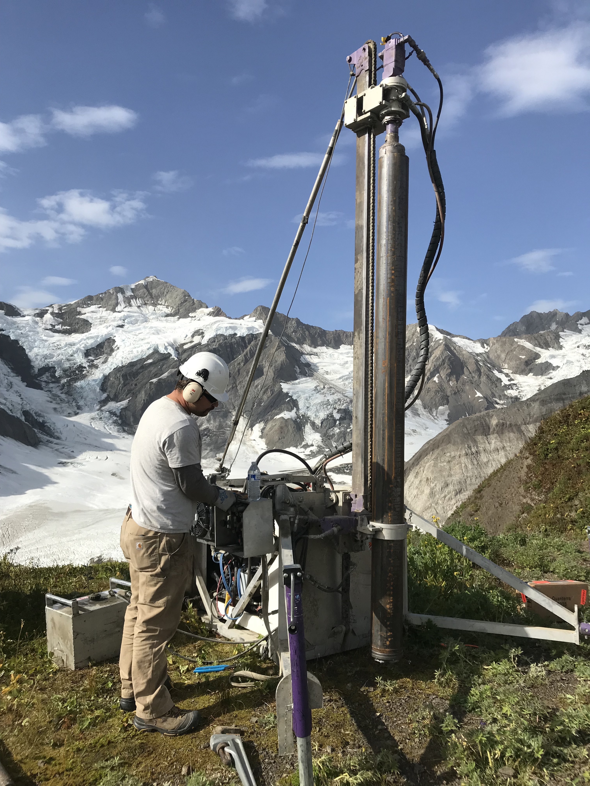
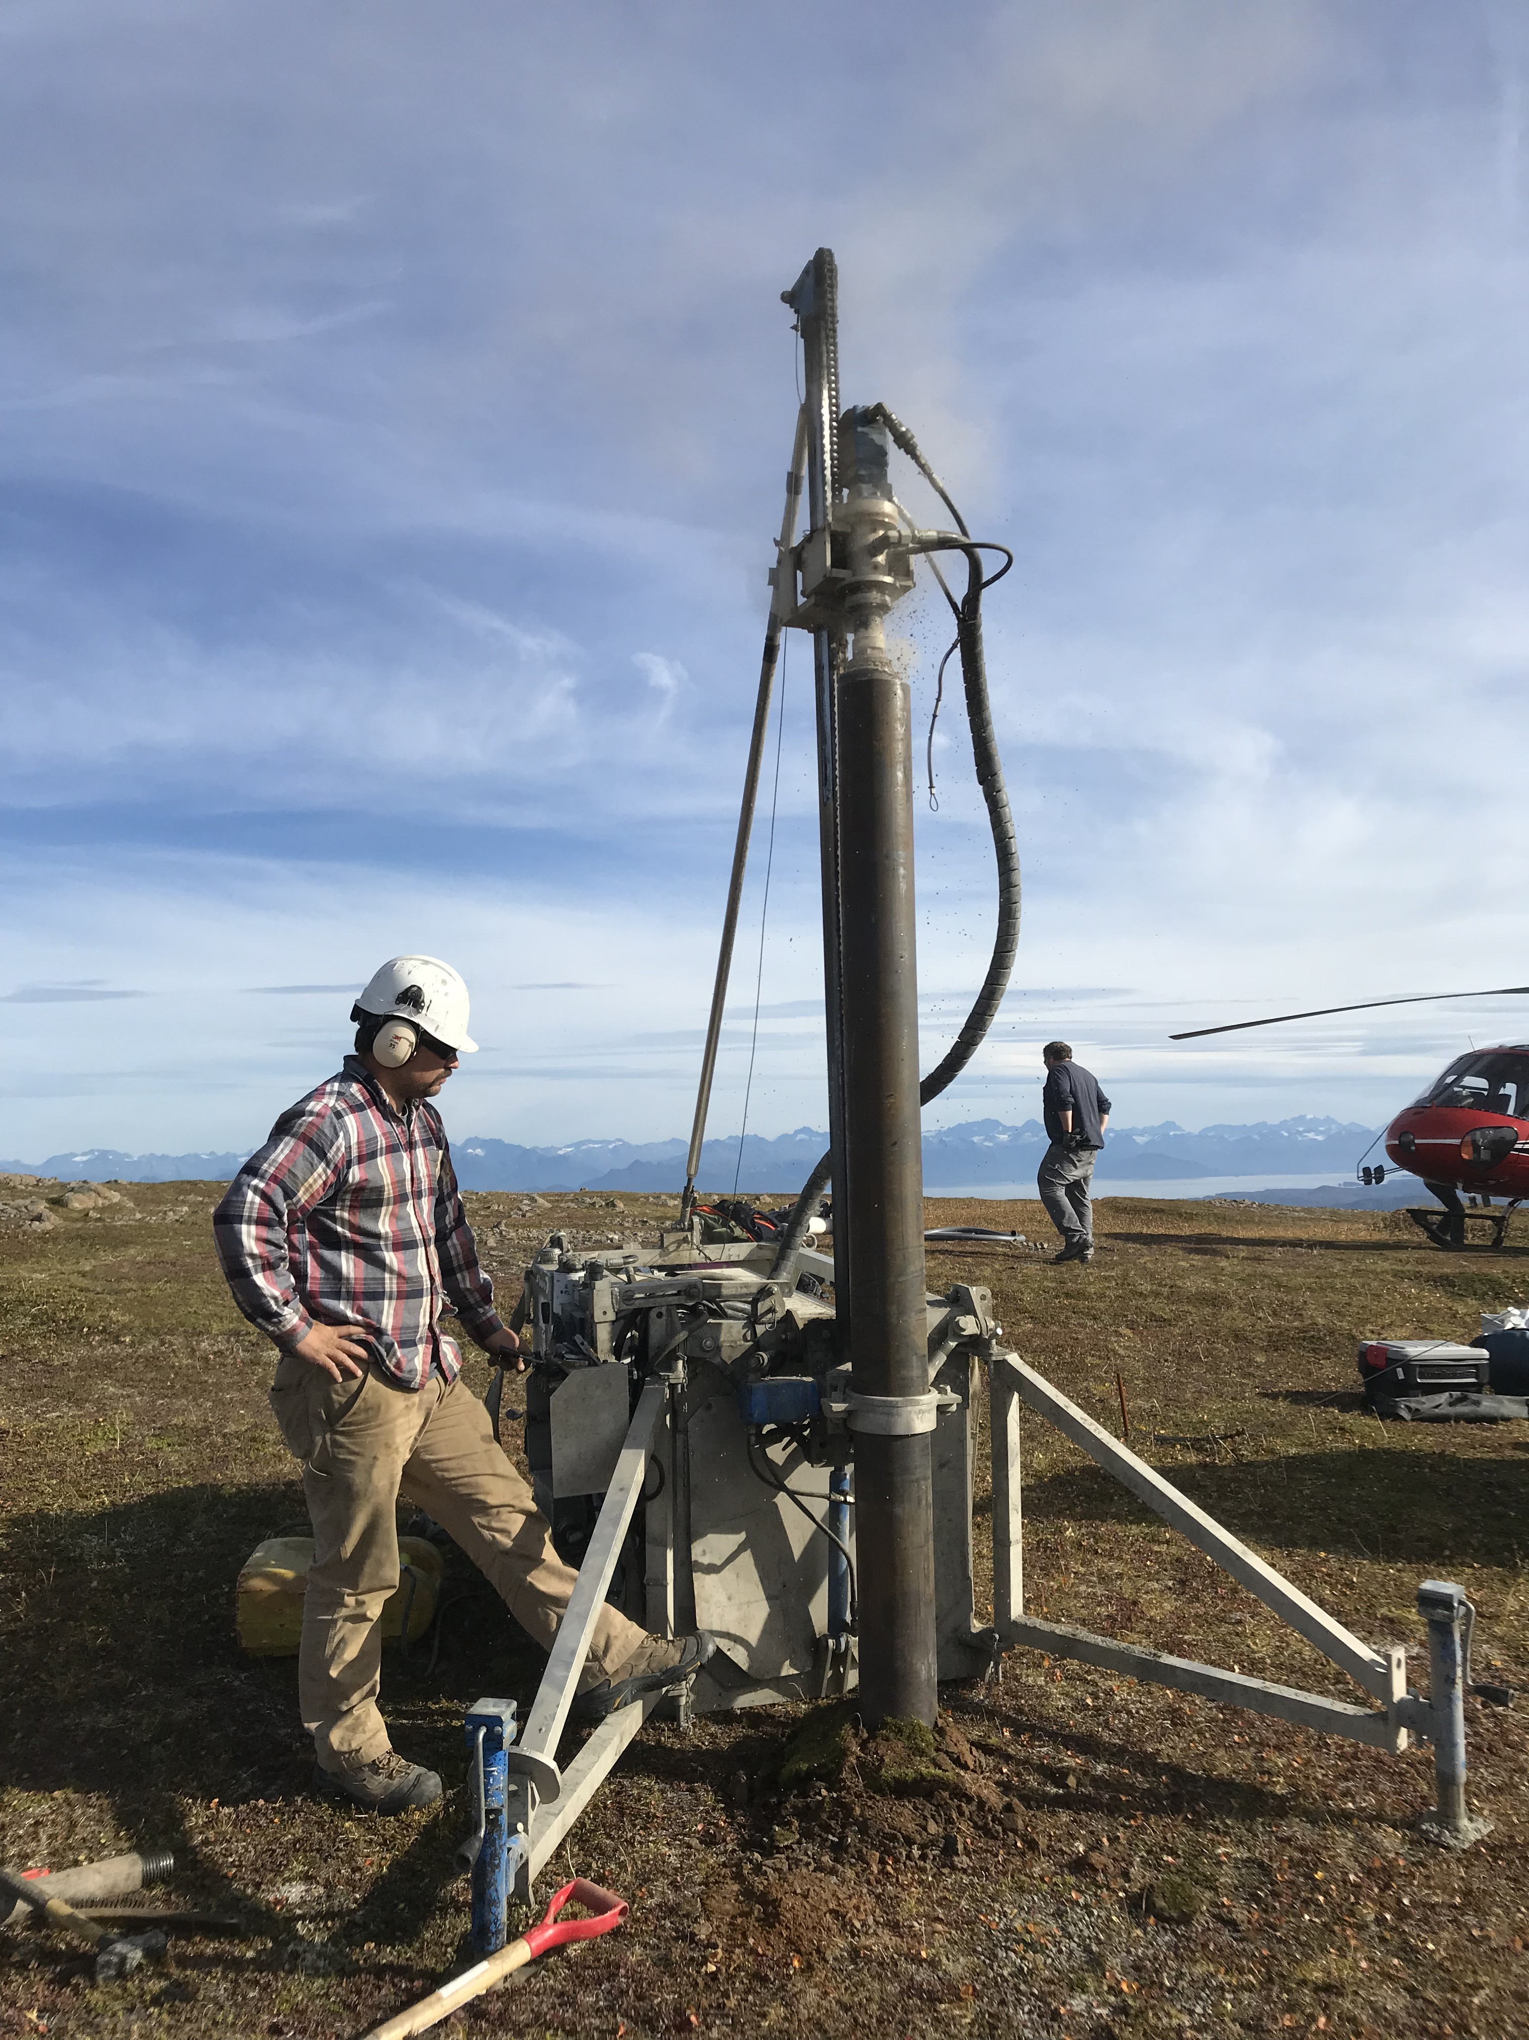
Drill Development
N20K
Down the Hole Hammer (DTH) primary drilling method all generations (best in bedrock)
Solid Stem Auger (SSA) secondary drilling method (best in soils)
Air Rotary drilling has potential in mixed media, needs developing for GEN 3
N19K
GEN 1
GEN 2
GEN 3
KLRS2
AK.PIN
AK.HIN

Slide 4
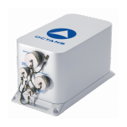
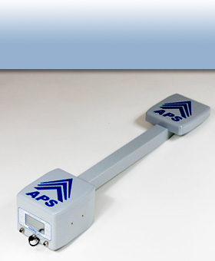
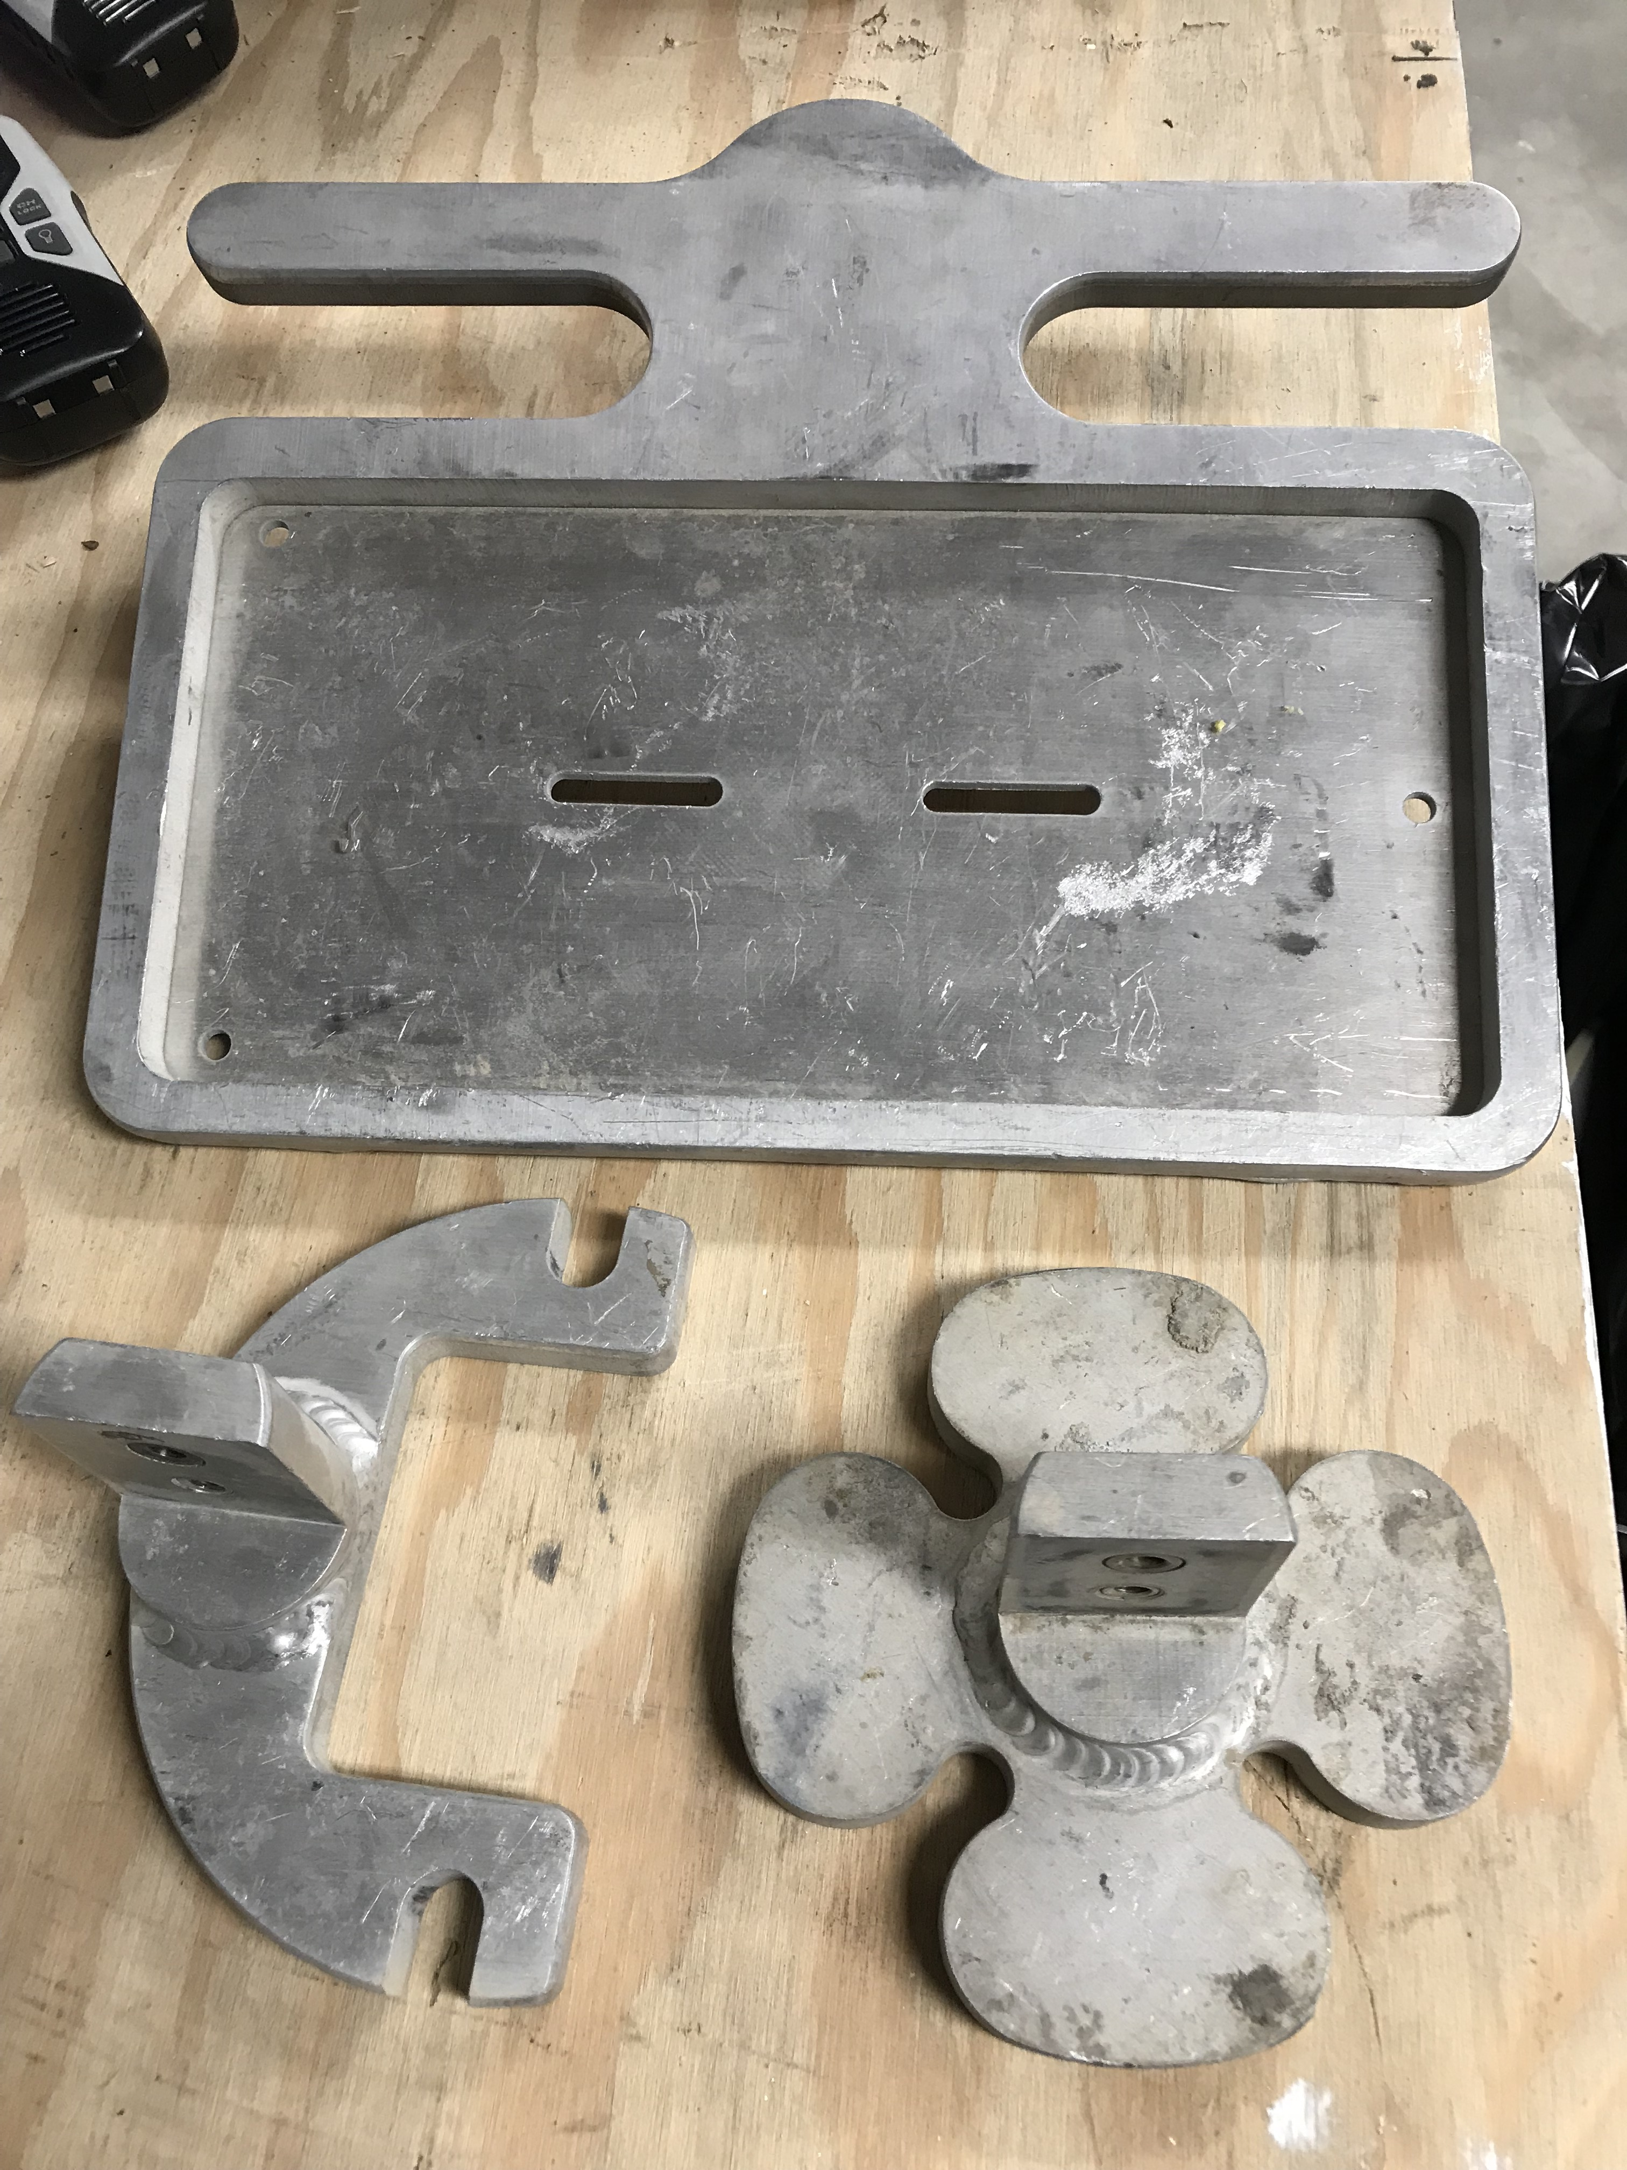
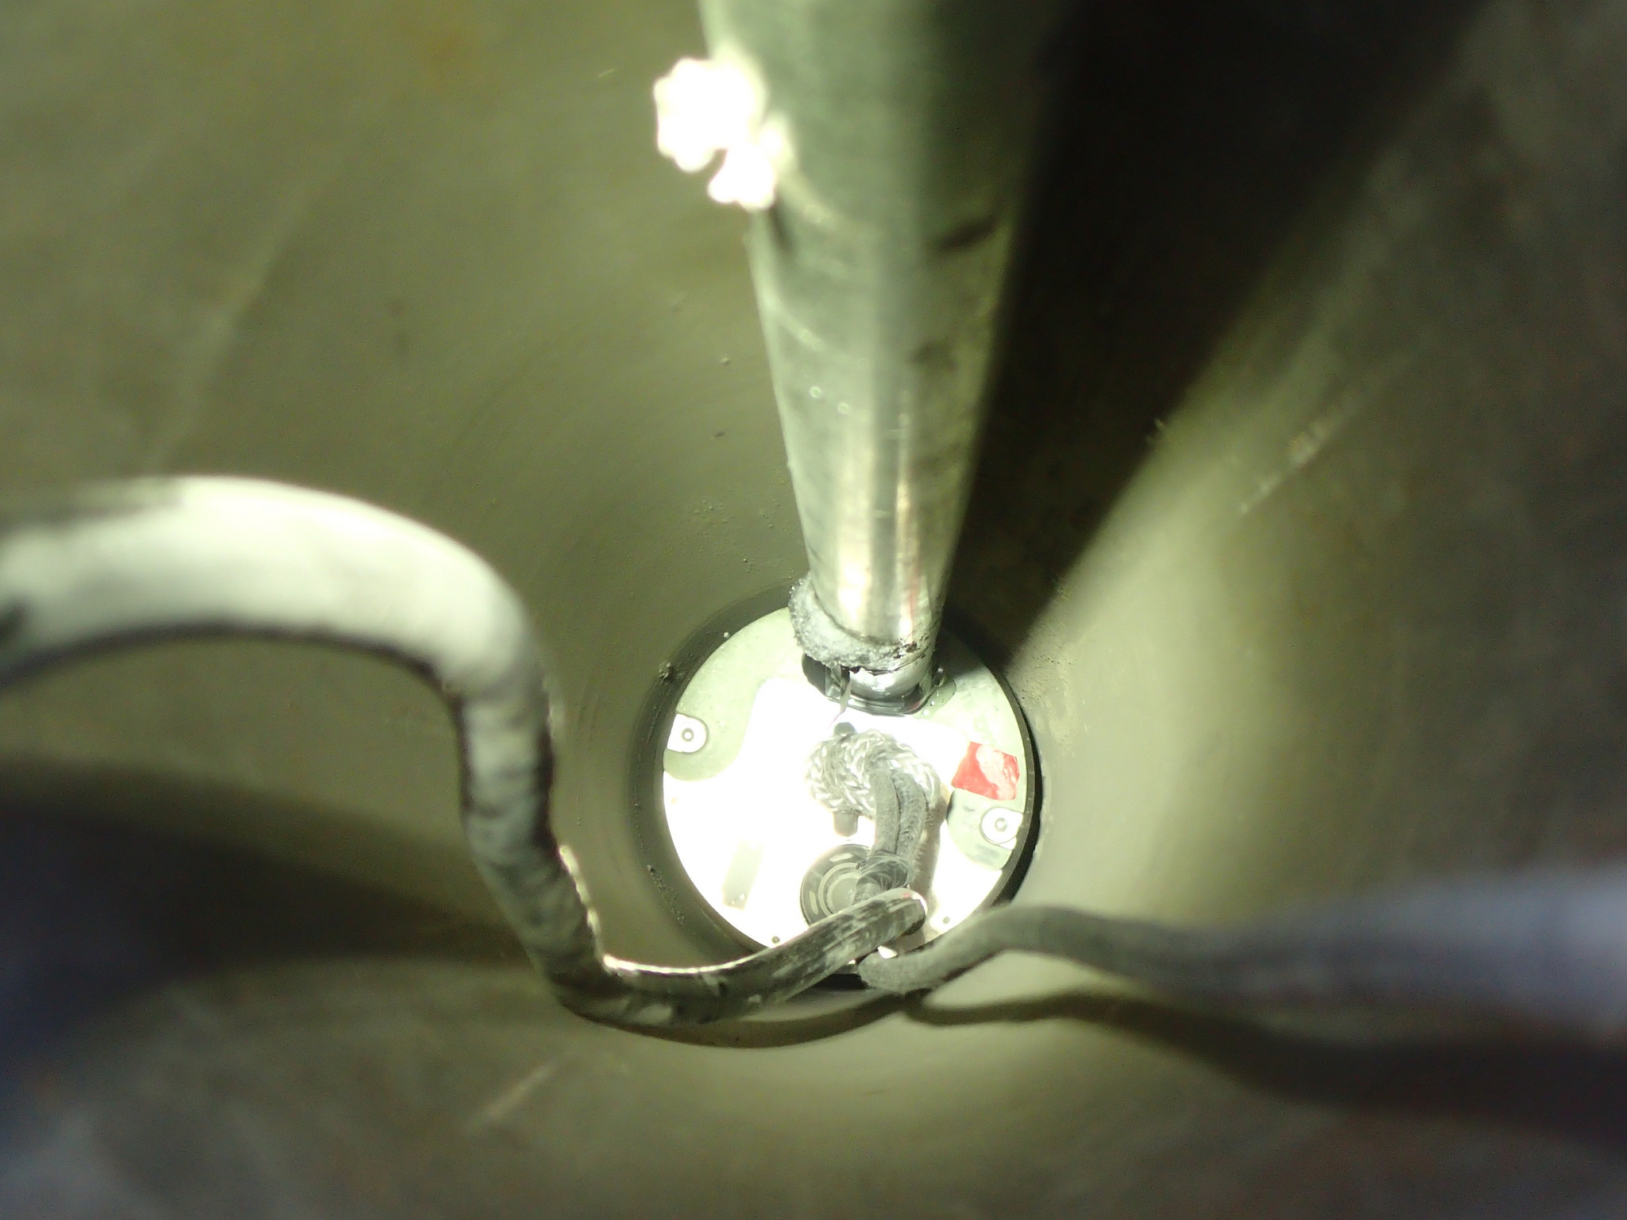
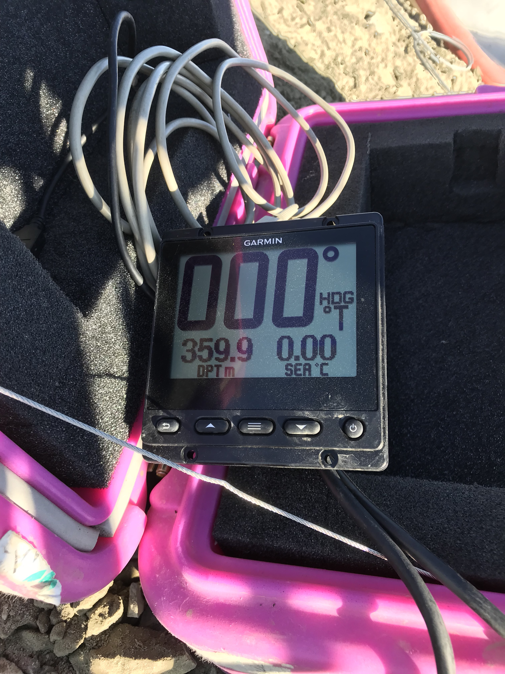
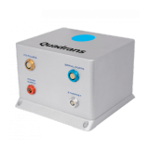
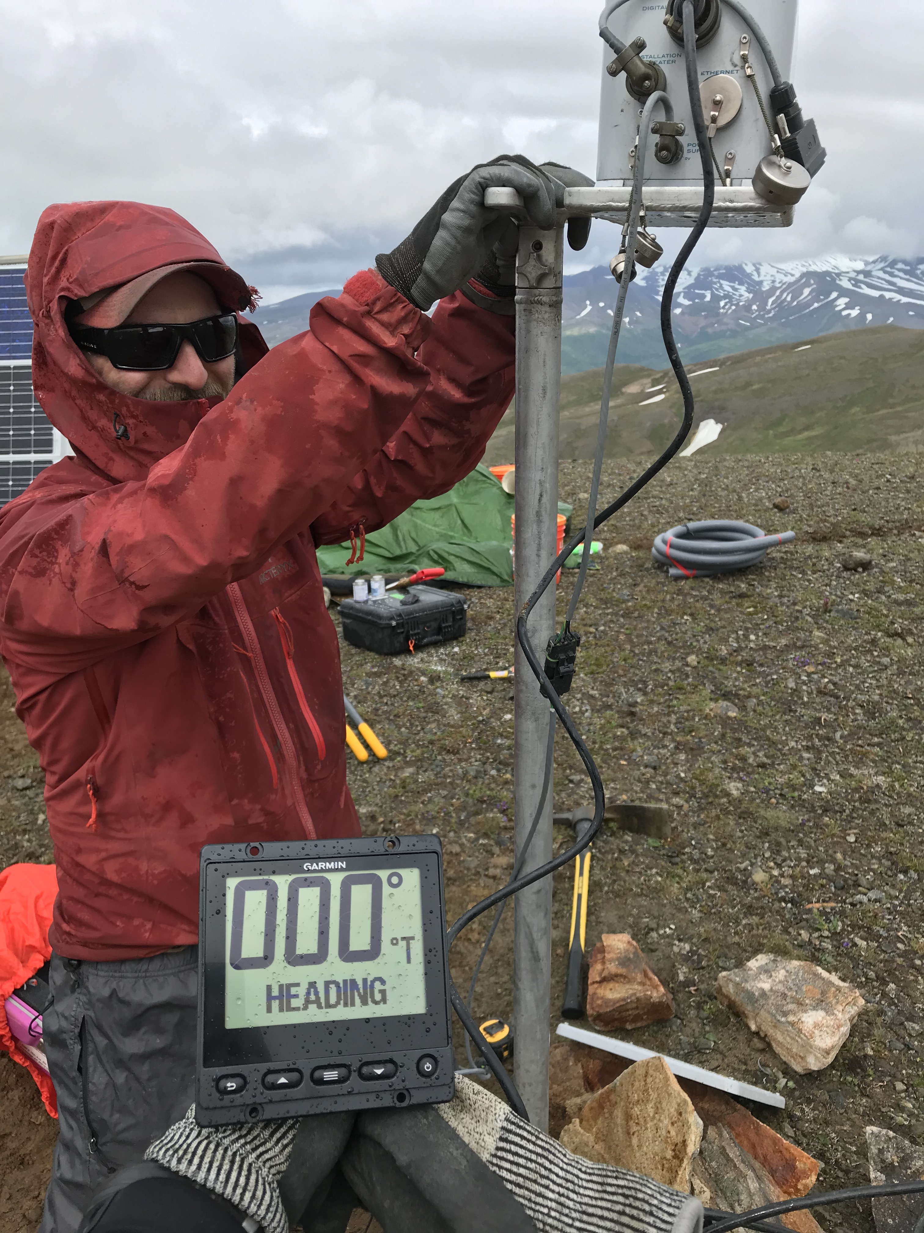
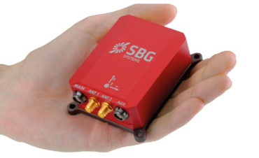
Sensor Placement
OCTANS gyrocompass primary orienting tool
Azimuthal Pointing System (APS) secondary
Developed new orienting rods and kit
Continued development on QUADRANS (fiber optic gyrocompass) and SBG Inertial Navigation Systems (INS)
R17L Station upgrade

Slide 5
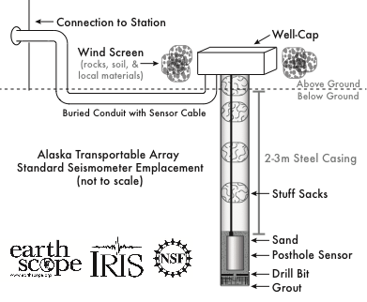
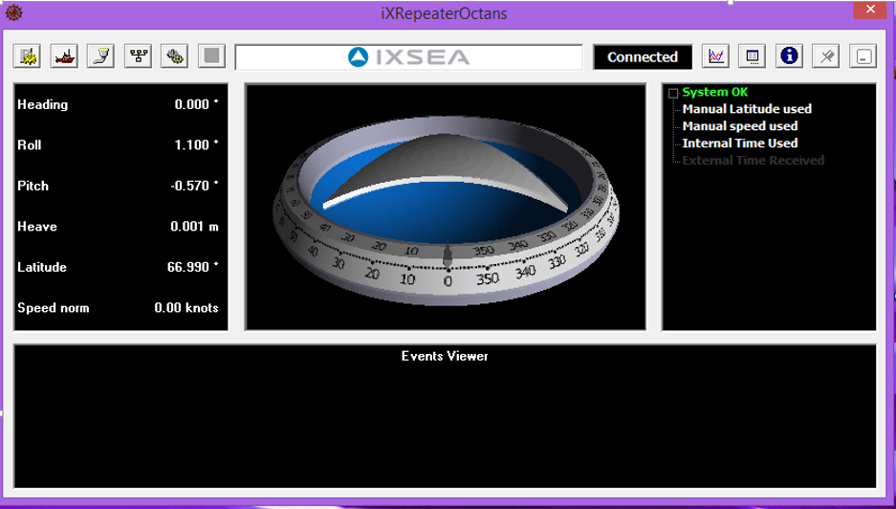
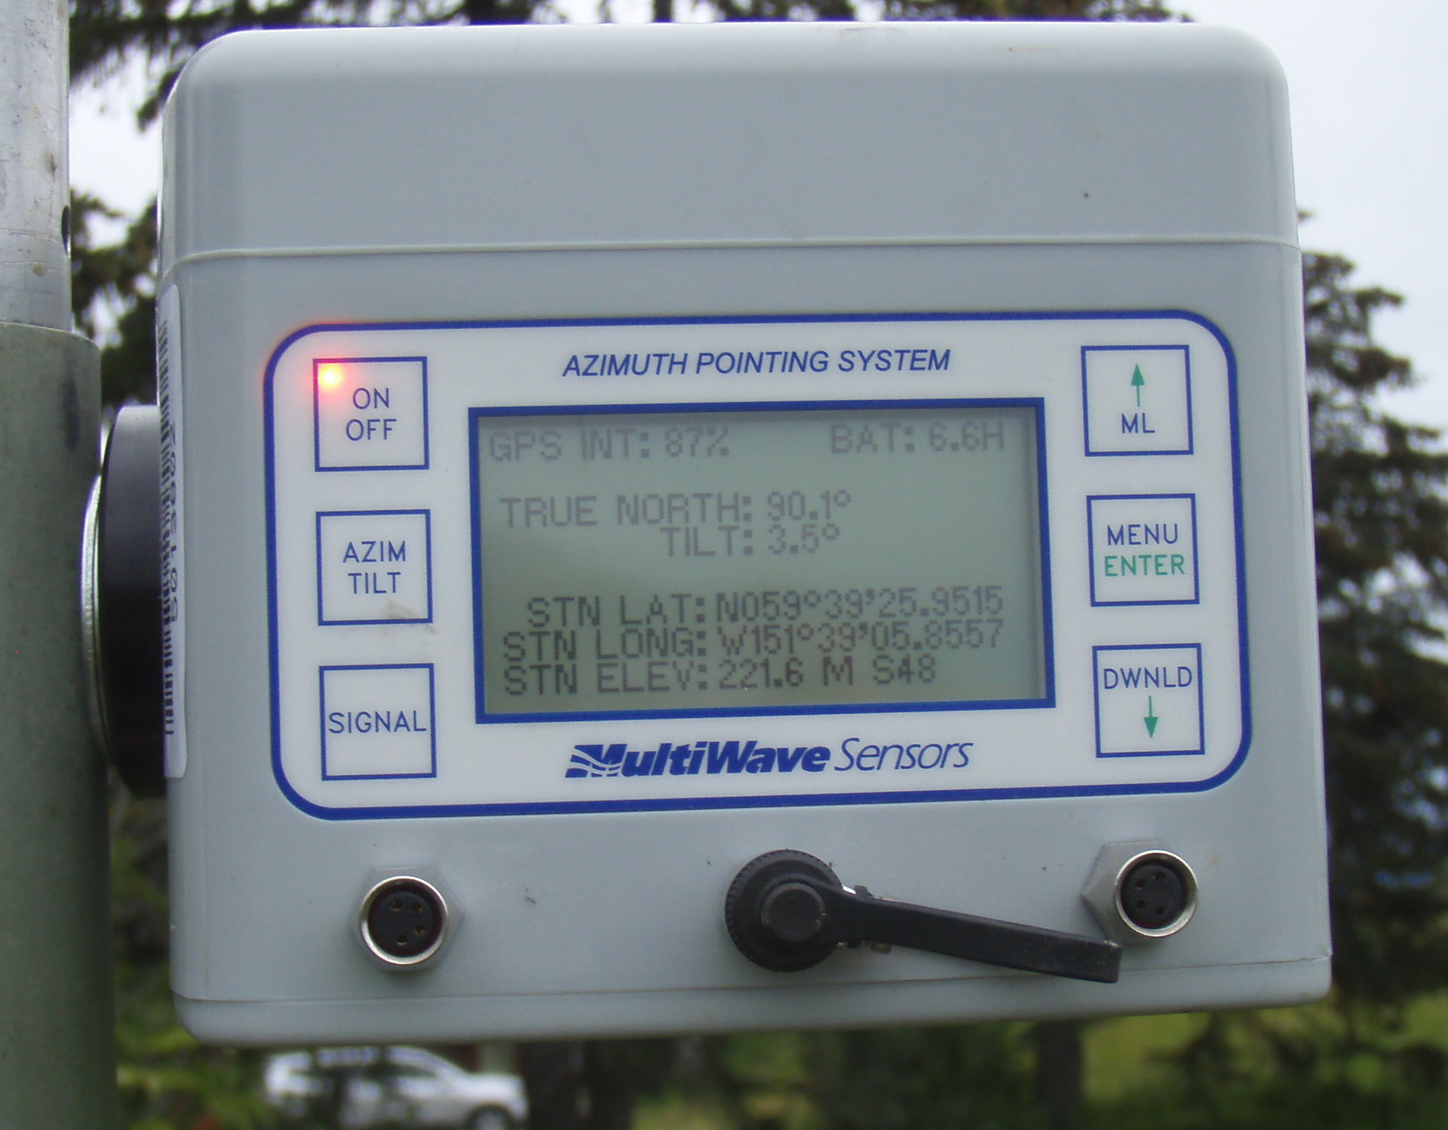
Sensor Orientation
Sensor Orientation with OCTANS with parallel mount
Seismometer is bedded in a level and sealed casing, then oriented
Bedding sand arrests ancillary movement of the sensor
The casing annulus is insulated to reduce thermal impacts
Sensor pointed with APS with a perpendicular mount

Slide 6
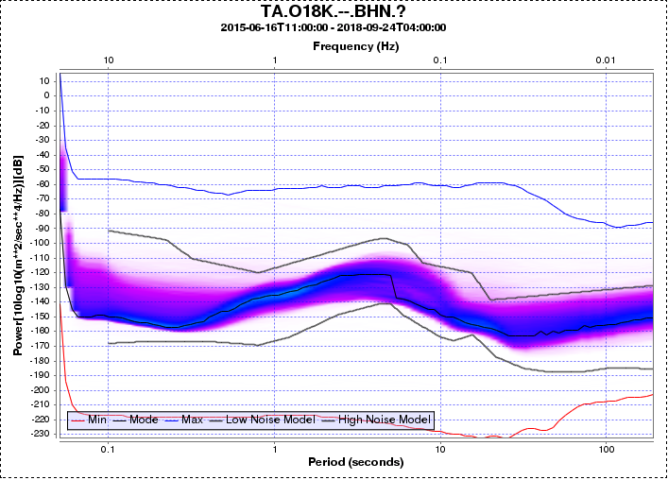
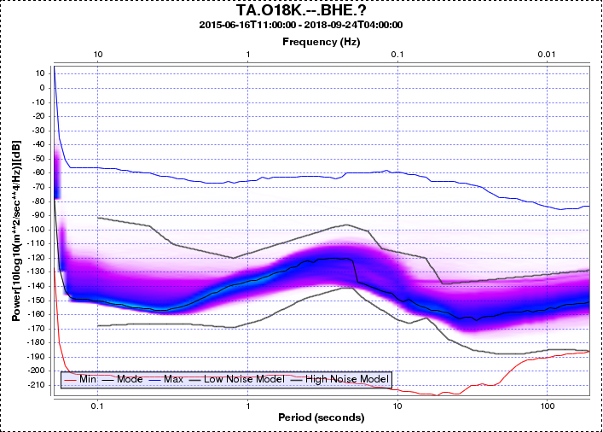
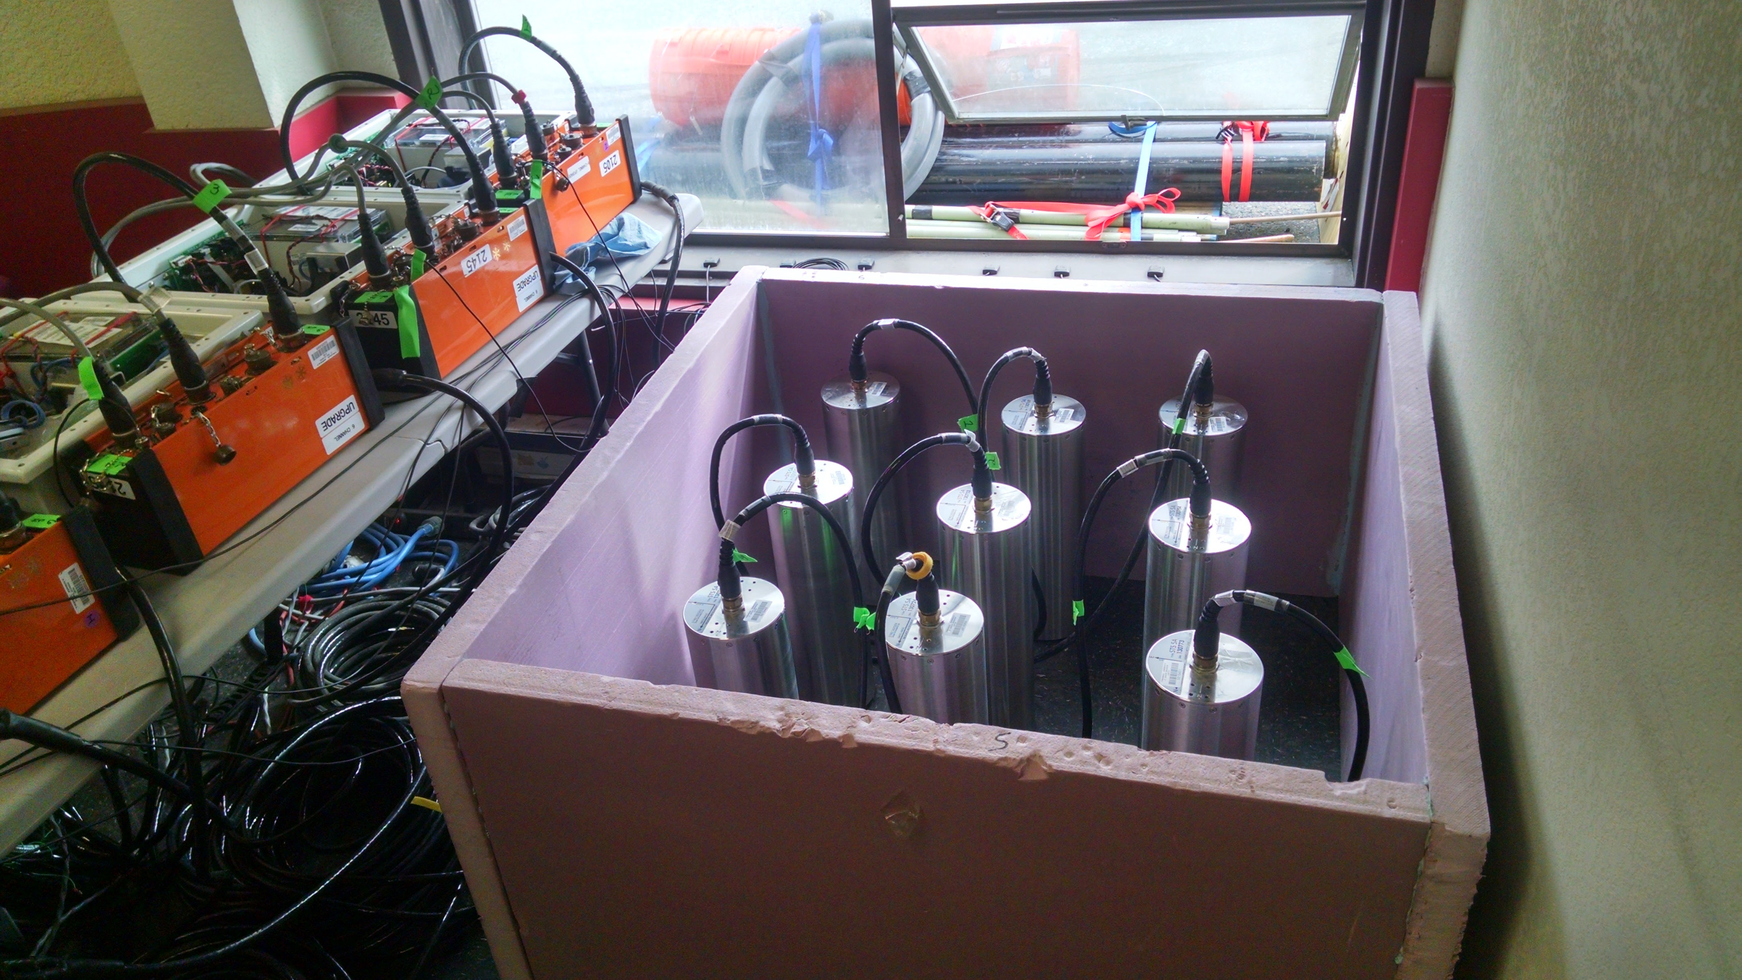
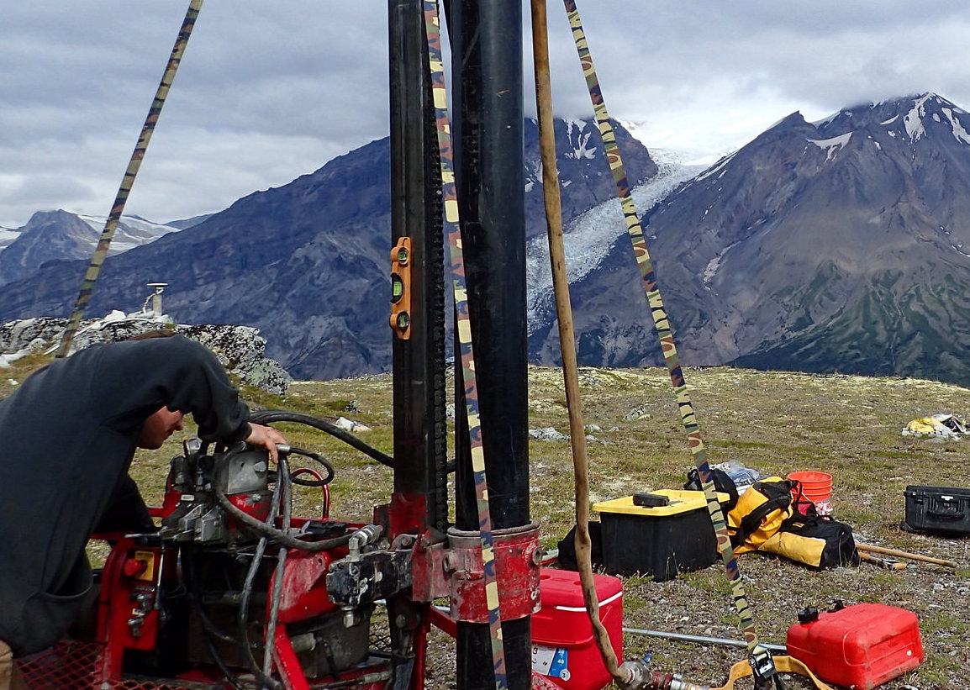
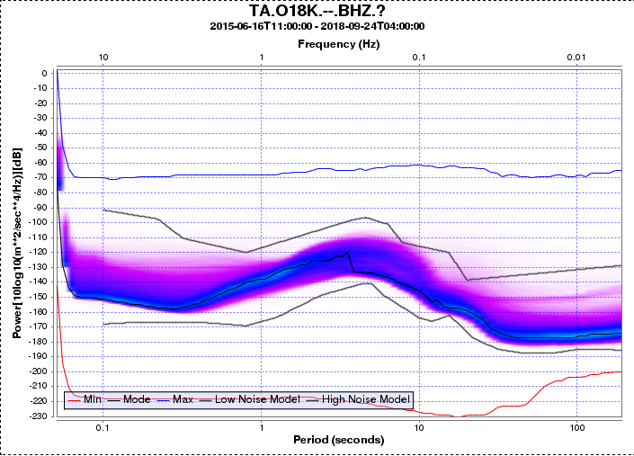
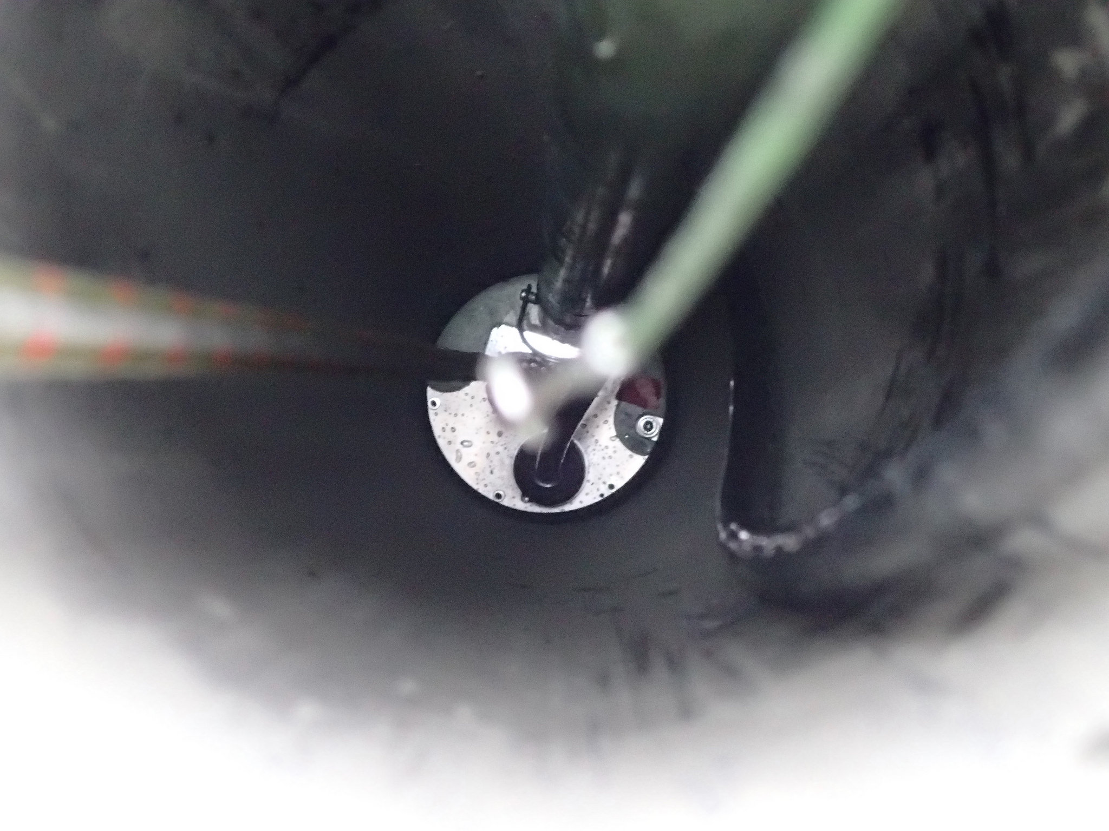
Recipe for Results
Detailed engineering of components
Thorough planning of pre-mobilization and mobilization time tables
Careful selection of subcontractors
Extensive testing of equipment
Excellent field execution
Pinch of good luck

