Slide 1
BC-Geophysics
Recording Earthquakes, Hurricanes, and Microseisms with Geophones and Period Extension Filters:
Comparing Seismic Source Company’s Sigma 4 Node to OSOP’s Raspberry Shake and Jam
Daniel Hardy and Jim O’Donnell of BC- Geophysics, Boulder City, Nevada
BC-Geophysics

Slide 2
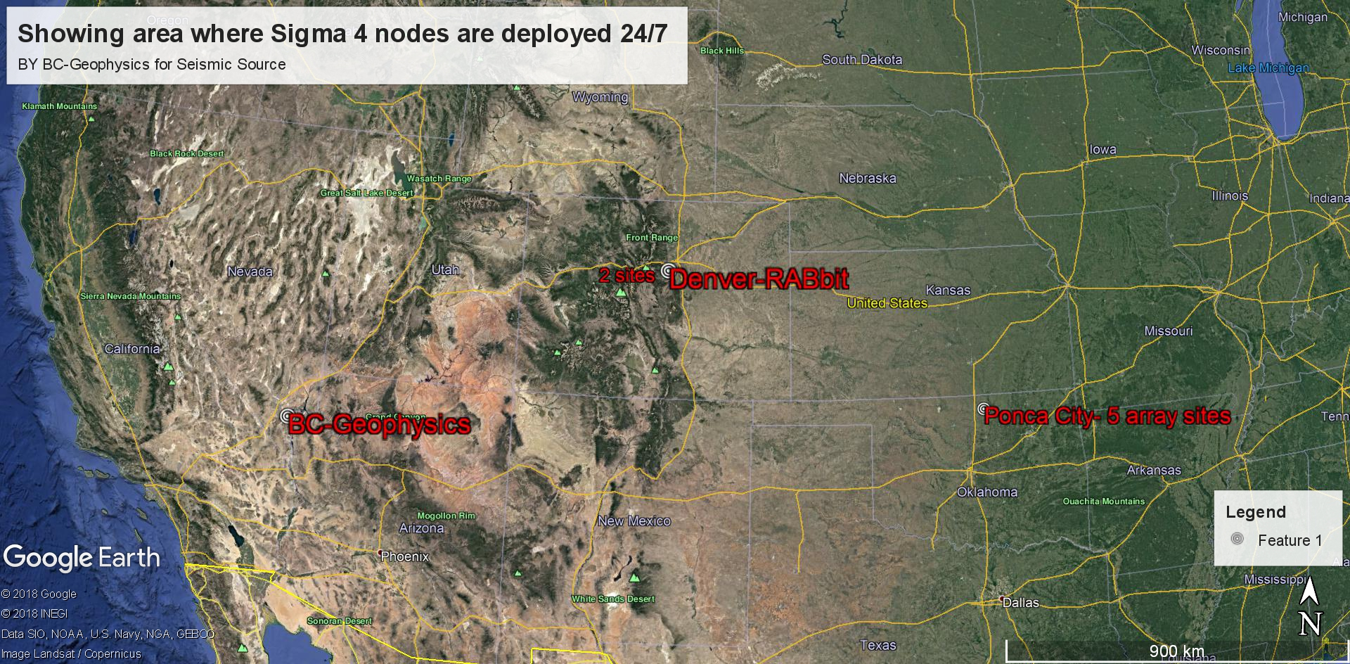

Slide 3
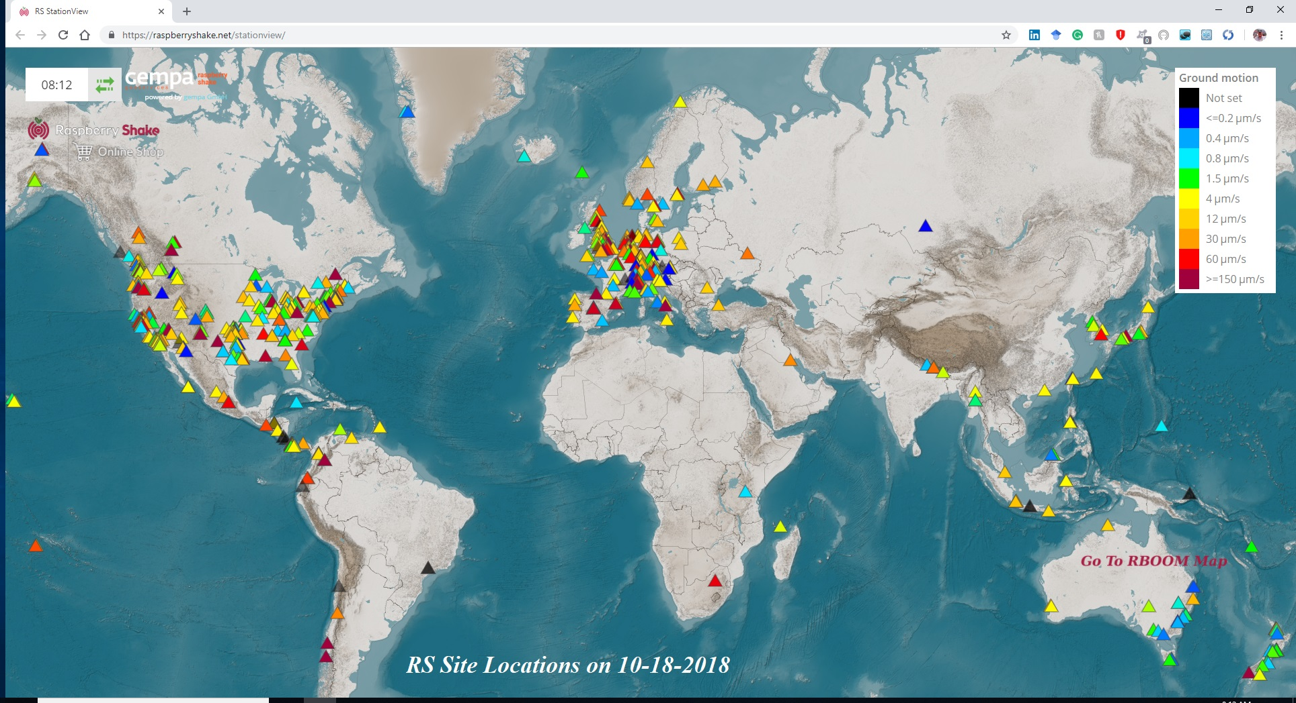

Slide 4
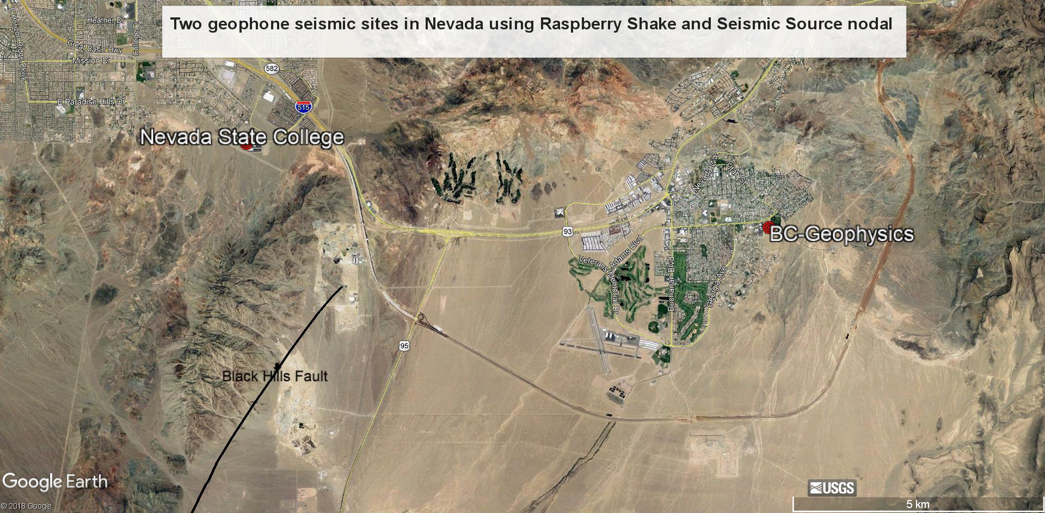

Slide 5
Recording Earthquakes, Hurricanes, and Microseisms with Geophones and Period Extension Filters:
Comparing Seismic Source Company’s Sigma 4 Node to OSOP’s Raspberry Shake and Jam
Comparing the SSC Sigma 4 node with the OSOP Shake and Jam
 | Locating System | Power | Data Storage | Sensor | Field ready | Applications
OSOP Raspberry Shake/Jam | Must be programed | 110V or 220V | IoT | fixed | No | Passive-Schools-Hobbyist
Seismic Source Sigma 4 | GPS | 110V or battery | Internal Memory | interchangeable | Yes | Passive/Active-Commercial

