Slide 5
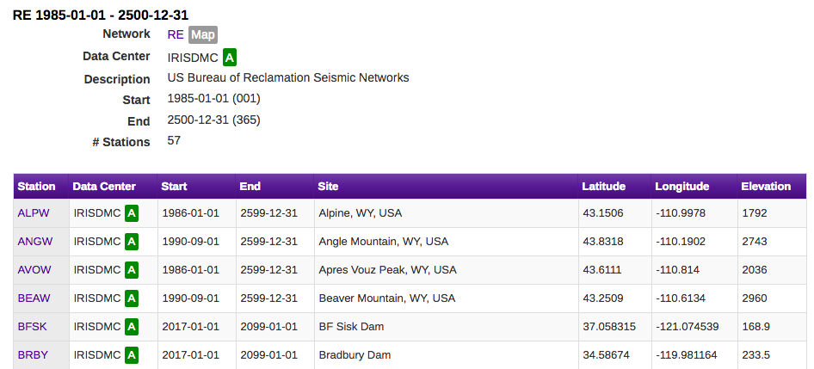
jball@usbr.gov
mmeremonte@usbr.gov

