Slide 1
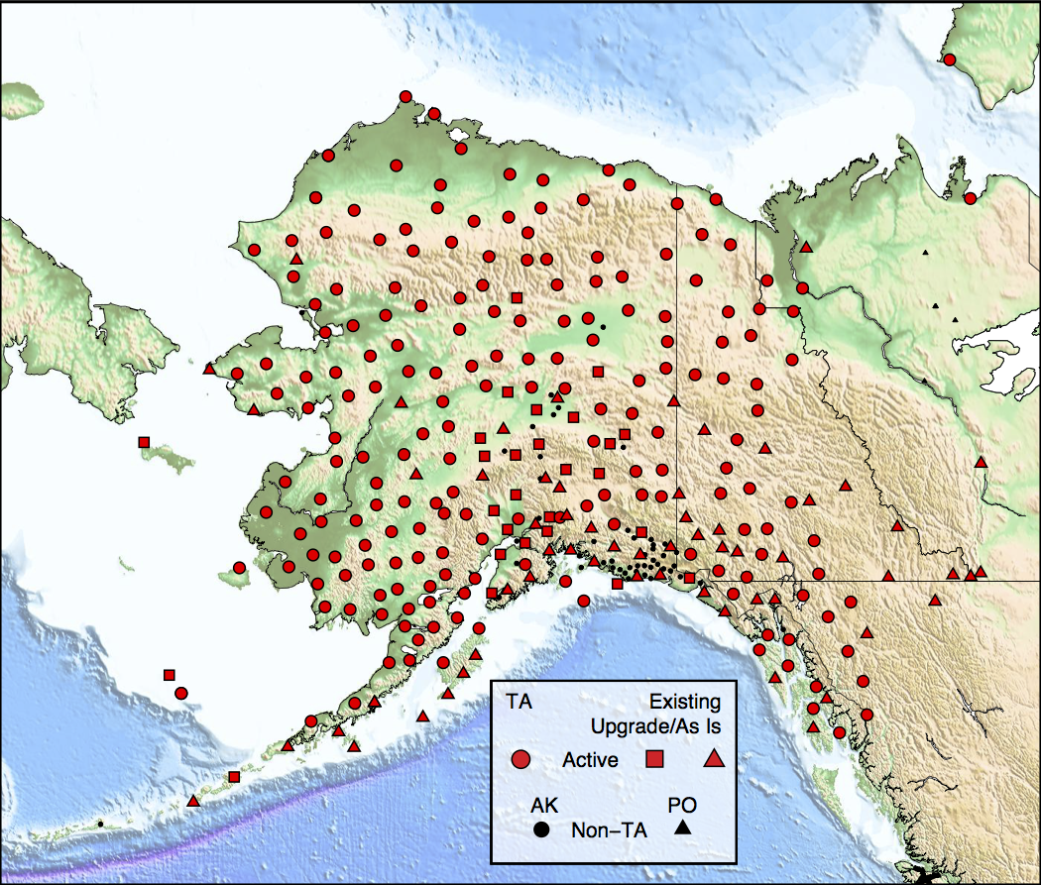
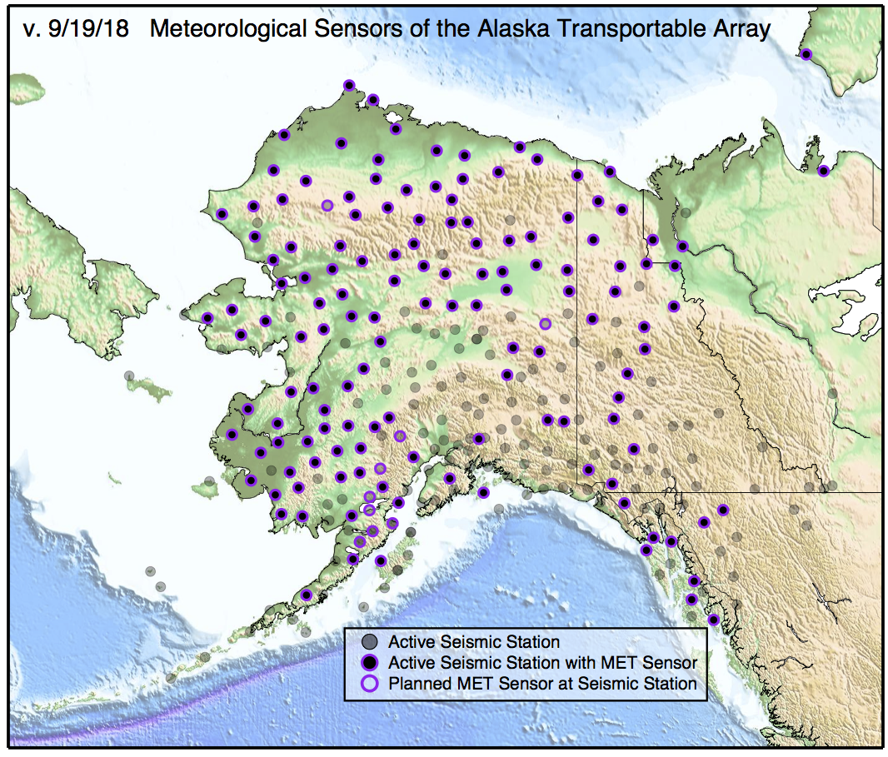
TA in Alaska / Yukon
280 stations (196 operated by IRIS)
85 km spacing
Broadband posthole seismometers, with infrasound, pressure, meteorological, soil temperature sensors
Fully deployed in 2017
Meteorological Sensors
www.usarray.org/alaska
Notes:
Introduction Slide to the Alaska TA (ATA) Project
294 is the SAGE proposed plan, due to budget this has been descoped to 262-278 stations per TA AC recommendation and Board Approval.
The seismicity pattern in AK is shown over five years. The Fairbanks to King Salmon is well instrumented from the road side. The distribution of Blue (existing) stations is typical of AK.
The TA project brings extensive geographic coveragewith dense station spacing, a technique that has proved to reveal detailed structure at range of scales from crustal to deep mantle, or about 4 miles to 1000 miles.

