Slide 1
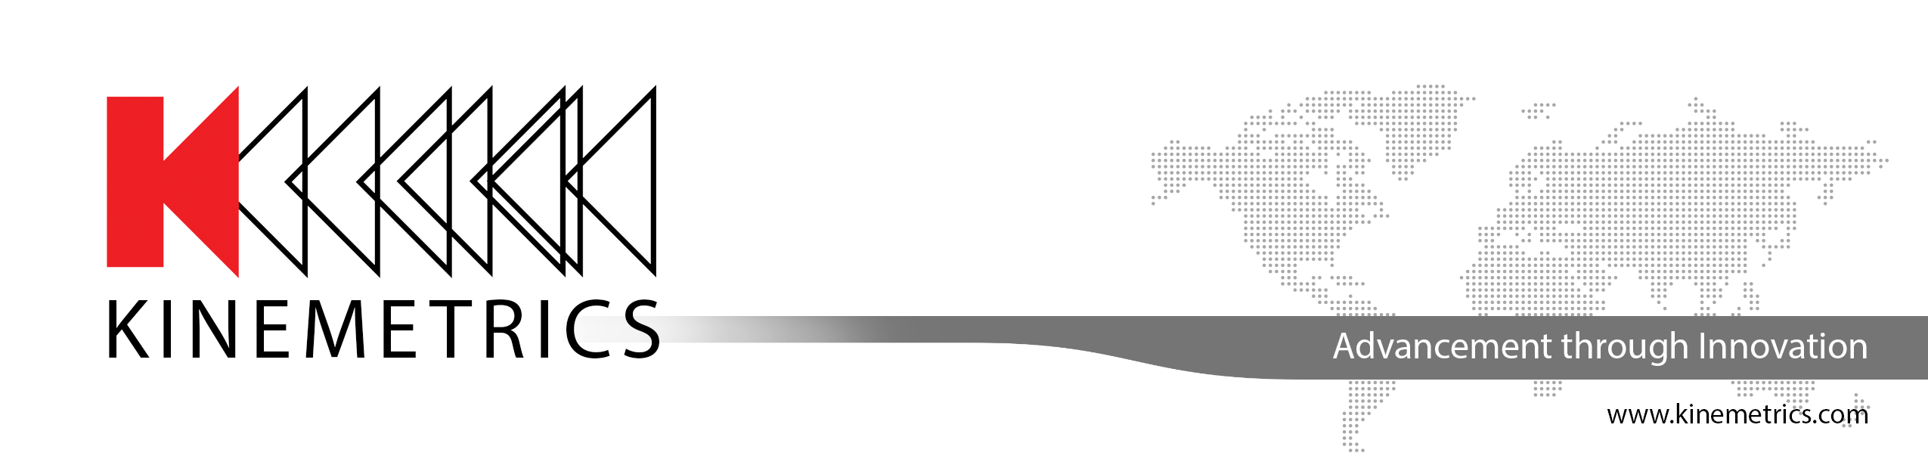
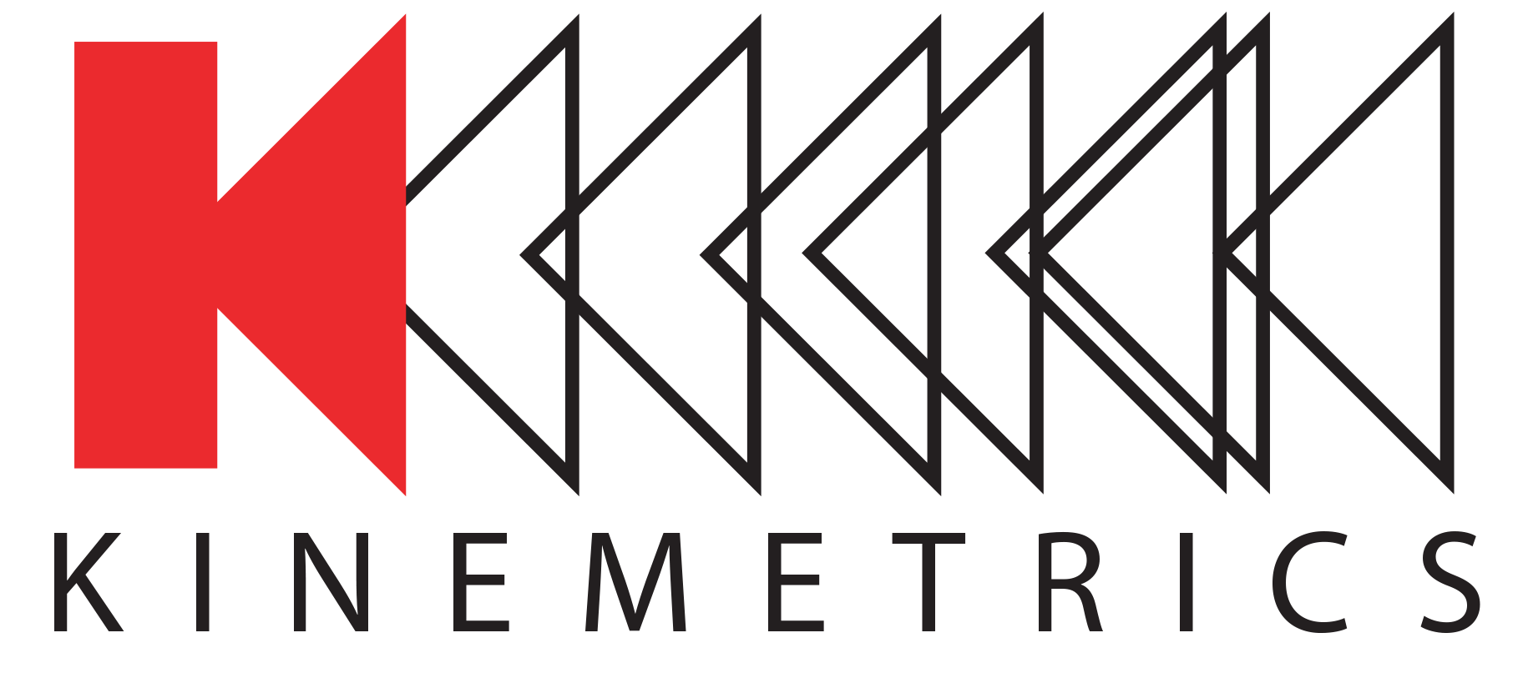
What we do….MATTERS.
KMI GROUP OF COMPANIES TECHNOLOGY DEVELOPMENTS TO SUPPORT advancements in Science and Engineering
Name: Ogie Kuraica, CEO
Date: Oct. 30, 2018

Slide 2
KMI Partners
Our success would be impossible without…
Civil Defense, DPC, Italy (KMI operator)
CTBTO
ORFEUS, Holland
Geophone, Germany
GeoScope IPGP, France
ZAMG, Austria
NEIP, Romania
Geological Survey, Slovenia
ERI, University of Tokyo
Malaysian TWS, Malaysia
JAMSTEC, Japan
KMA, Korea
KACST/KSU, Saudi Arabia
Aramco, Saudi Arabia
CAA, Qatar
SQU, Oman
GeoScience, Australia
….and many others…
IRIS (GSN, PASSCAL, DMC, EarthScope/USArray Programs)
USGS
AFTAC
California Geological Survey
UNAVCO (EarthScope – PBO)
Caltech, Pasadena
IGPP, UC San Diego
University of Alaska, Fairbanks
UC Los Angeles
UC Santa Barbara
UC Berkeley
University of Nevada, Reno
University of Colorado, Boulder
Advancement Through Innovation | Company Proprietary and Confidential

Slide 3
IRIS
Incorporate Research Institutions for Seismology
Non-profit consortium of US Universities that conduct research in seismology
Funded mainly by the US National Science Foundation
Most active and highly funded research venue in the US for passive seismology
University of Alabama
University of Alaska, Fairbanks
University of Arizona
Arizona State University
University of Arkansas at Little Rock
Auburn University
Boise State University
Boston College
Boston University
Brown University
California Institute of Technology
University of California, Berkeley
University of California, Los Angeles
University of California, Riverside
University of California, San Diego
University of California, Santa Barbara
University of California, Santa Cruz
Carnegie Institution of Washington
University of Colorado, Boulder
Colorado School of Mines
Columbia University
University of Connecticut
Cornell University
University of Delaware
Duke University
Florida International University
University of Florida
University of Georgia
Georgia Institute of Technology
Harvard University
University of Hawaii at Manoa
Idaho State University
IGPP/Lawrence Livermore National Laboratory
IGPP/Los Alamos National Laboratory
University of Illinois at Urbana Champaign
Indiana University
Indiana University/Purdue University at Fort Wayne
University of Kansas
Kansas State University
University of Kentucky
Lamar University
Lawrence Berkeley Laboratory
Lehigh University
Louisiana State University
Macalester College
Massachusetts Institute of Technology
University of Memphis
University of Miami
University of Michigan
Michigan State University
Michigan Technological University
University of Minnesota
University of Missouri
University of Montana
University of Nevada, Las Vegas
University of Nevada, Reno
University of New Orleans
New Mexico Institute of Mining & Technology
New Mexico State University
State University of New York at Binghamton
State University of New York at Stony Brook
University of North Carolina, Chapel Hill
Northern Illinois University
Northwestern University
The University of Oklahoma
Oklahoma State University
University of Oregon
Oregon State University
Pennsylvania State University
Princeton University
University of Puerto Rico at Mayagüez
Purdue University
Rensselaer Polytechnic Institute
Rice University
Rutgers
Saint Louis University
San Diego State University
San Jose State University
University of South Carolina
University of Southern California
Southern Methodist University
Stanford University
Syracuse University
University of Tennessee
Texas A&M University
Texas Tech University
University of Texas at Austin
University of Texas at Dallas
University of Texas at El Paso
University of Tulsa
University of Utah
Virginia Polytechnic Institute
Central Washington University
University of Washington
Washington University, St. Louis
West Virginia University
University of Wisconsin, Madison
University of Wisconsin, Milwaukee
University of Wisconsin, Oshkosh
Woods Hole Oceanographic Institution
Wright State University
University of Wyoming
Yale University
Thank you for being a Partner for last 49 years!
Advancement Through Innovation | Company Proprietary and Confidential

Slide 4
Our Background
Scientific Instrumentation, Application, Manufacturing, and Service Company
Founded in 1969
Headquarters, Streckeisen, Pfungen – Switzerland
Office in Japan
Office in Switzerland
Office in Serbia
Training Center: Vienna, Austria
Network Operation: Italy
Headquarters, Pasadena, California – USA
Headquarters, Quanterra, Harvard, Massachusetts – USA
Headquarters, BRTT, Boulder, Colorado – USA
Office in Chicago and Dallas
Office in Japan
Office in Dubai
Network Operation, Abu Dhabi
Network Operation, Saudi Arabia
Advancement Through Innovation | Company Proprietary and Confidential

Slide 5

Markets we Serve
Defining Instrumentation Standards for the Advancement in Earthquake Science and Engineering

Slide 6
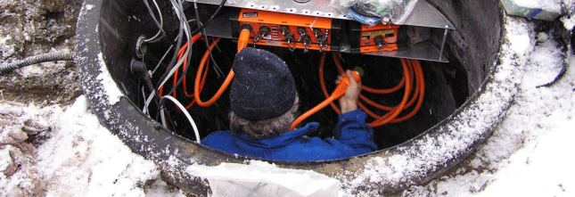
Who we are
Quanterra/Kinemetrics/Streckeisen/BRTT
All started as member of IRIS Community: Innovators of seismic digital very-broadband technology in early 80’
Designed world’s 1st digital very-broadband seismograph, early 80’
Designed world’s 1st true 24-bit seismic data acquisition system, early 80’s
Introduced “Steim” data compression, now a de-facto global standard in loss-free compression of earthquake research data
Designed the world’s first digital seismological system with 220dB dynamic range, minimum earth noise to 4g; ~1988
Designed world’s 1st ultra-low power (0.5W) 24-bit seismic data acquisition system, ~2001
Designed world’s 1st true 26-bit seismic data acquisition system, ~ 2005

Slide 7
Who we are, cont.,
Quanterra/Kinemetrics/Streckeisen/BRTT
Successfully demonstrated with Q330 and Antelope: “overall 98.9% USArray -TA station-days had 100% data availability” (1,800 installations over 10 years)
Designed world’s quietist very-broadband seismometers (STS-6), ~ 2017
Maintained leadership in ultra-low power (0.25W) 24-bit seismic data acquisition, Q8, ~2017
Codeveloped with Imperial College, Oxford University the MEMS-based seismometer, SEIS-SP, for the NASA InSight mission to Mars, 2018
In summary: Exemplary worldwide reputation in the design and manufacture of ultra-high resolution data acquisition systems, very broadband seismometers, strong motion instrumentation, data acquisition software and as seismic operator - largest network currently we run, ~500 stations

Slide 8
What are Kinemetrics Products?
Knowledge of 4 companies, with different skills, working together to deliver a SINGLE System Solution!
Open System Networking Group: to provide project management, integration/installation/operation/
support for Environmental Monitoring
Software Development Group: to provide system software design, support system integration, IT, communications, etc. for Environmental Monitoring
Open System Networking Group
Hardware Development Group
Software Development Group
Hardware Development Group: to provide design and manufacturing of ultra-high resolution data acquisition
systems and state-of-the-art sensors for Environmental Monitoring
Advancement Through Innovation | Company Proprietary and Confidential

Slide 9







“Inseparable right and left wheels”
Team Work Required to Deliver Exceptional Products
BRTT
System software, system design,
application, system integration,
IT, communication
KINEMETRICS, INC.
Sensor/digitizer manufacturing,
Services,
Project Management,
Lennartz
L
Lennartz GmbH
Short period and intermediate period Seismometers
.
ARRAY TECHNOLOGIES, INC.
DoD Installations, support
and operation
QUANTERRA, INC.
Design of ultra-high resolution
Instrumentation for environmental
monitoring
.
STRECKEISEN
Design of ultra-high performance Broadband (BB) seismometers
OYO
Parent Company
.
KINEMETRICS OPEN SYSTEMS & SERVICES
Development. Integration, Installations, support and network operations
Advancement Through Innovation | Company Proprietary and Confidential

Slide 10
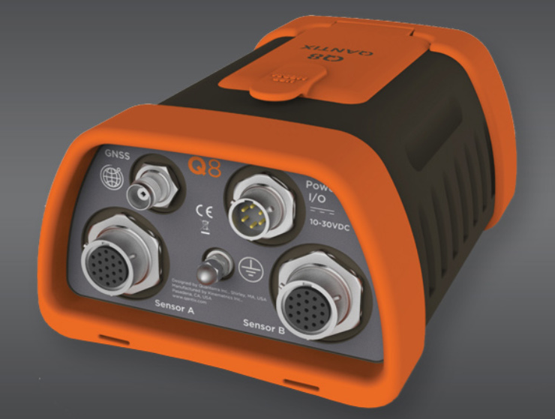
Q8 Introduction to Marketplace
  Introduced at AGU Conference – New Orleans December 2017.
  Ultra-Low Power as low as ~250 mW
  Ultra-portable: Exceptional small size and weight ➔ suitable for portable and/or OBS deployments.
  Q8 Advance Early Adoption Program: First delivery to IRIS Oct. 7, 2018.
Quanterra Q-8
Ultra-Low Power Data Acquisition System
Dynamic Range*
  Standard Mode: 142dB ratio Full Scale RMS sine wave to RMS noise, 0.01-7Hz band, 145dB zero-to-peak sine wave
  Enhanced Mode (3 channel): 145dB ratio Full Scale RMS sine wave to RMS noise, 0.01-7Hz band, 148dB zero-to-peak sine wave
Noise
  Standard Mode: typical -126 dB VPSD re 1 V²/Hz at gain 1, or as low as -164 dB at maximum gain
  Enhanced Mode: typical -129 dB VPSD re 1 V²/Hz at gain 1, or as low as -166 dB at maximum gain
Advancement Through Innovation | Company Proprietary and Confidential

Slide 11
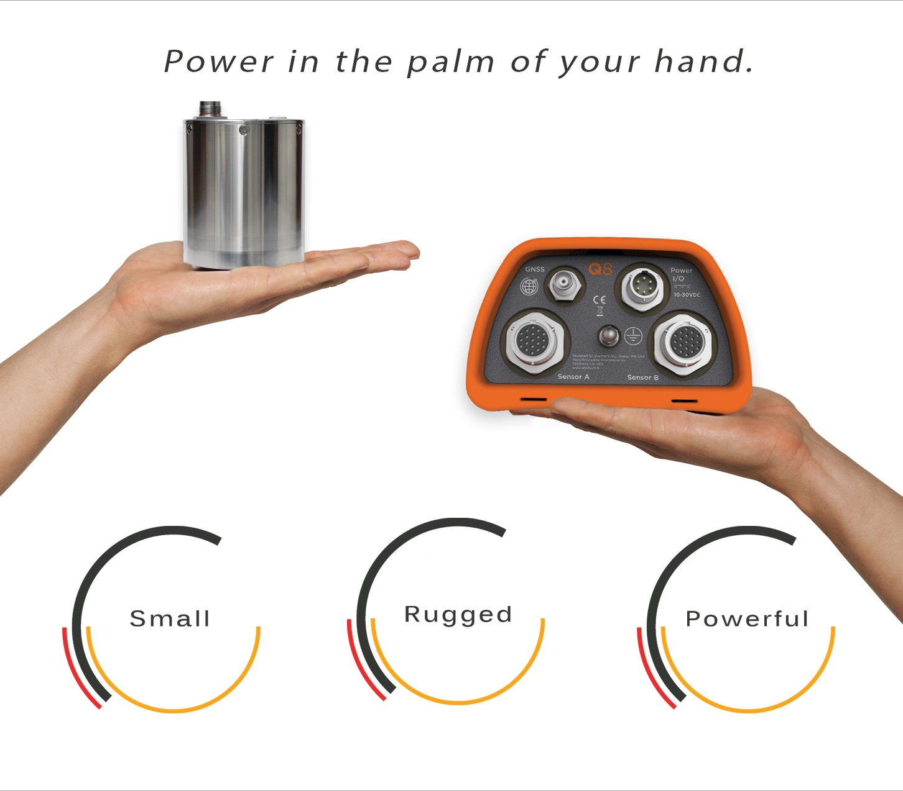
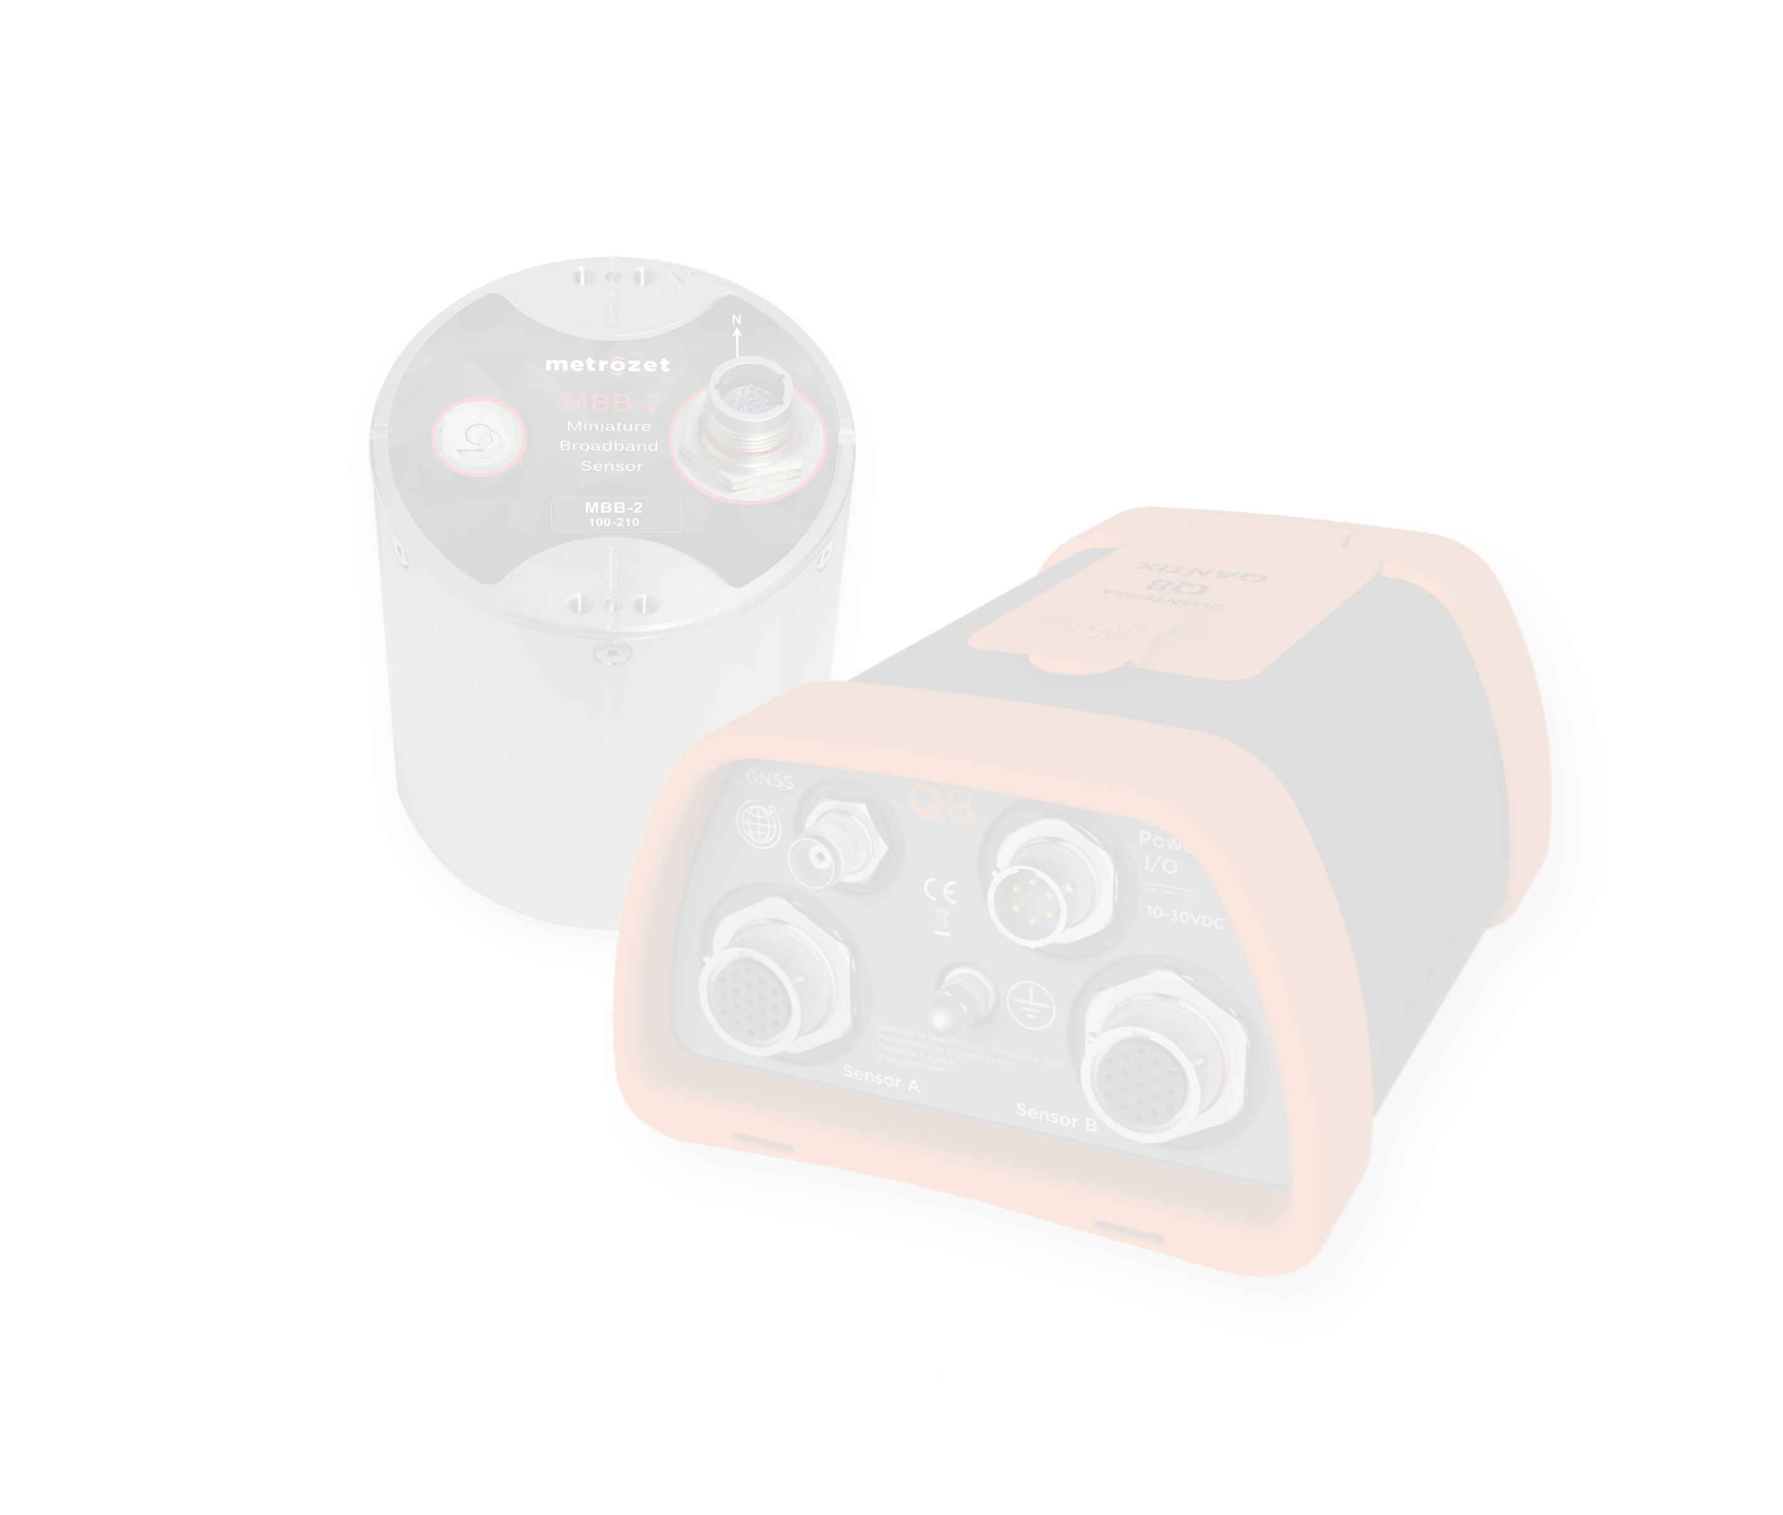
New: Qantix Q8 and MBB-2
Qantix Q8 and MBB-2
“The world’s only Broadband Seismic System under 0.5 W”
…and ALL under <4Kg
What we do….MATTERS.

Slide 12


News: CTBTO
Kinemetrics is selected to provide data acquisition system, auxiliary equipment, installations and technical support to the U.N. nuclear monitoring verification organization
New: Q330m+
Data Acquisition System Selected: Quanterra Q330M+
Advancement Through Innovation | Company Proprietary and Confidential

Slide 13
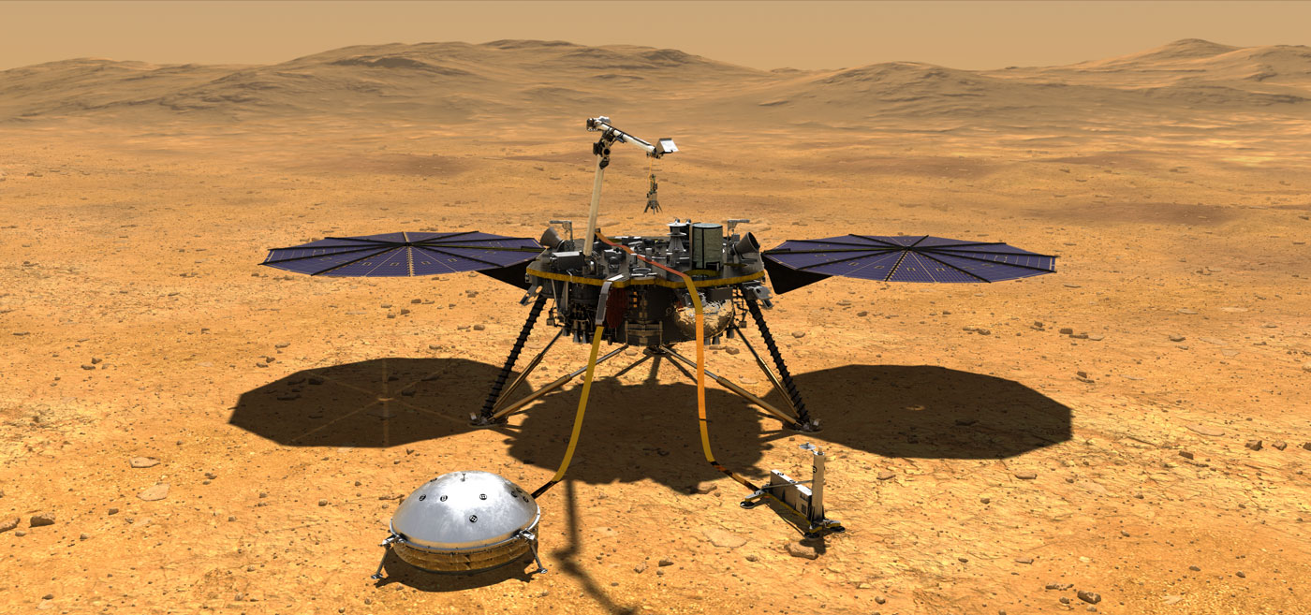
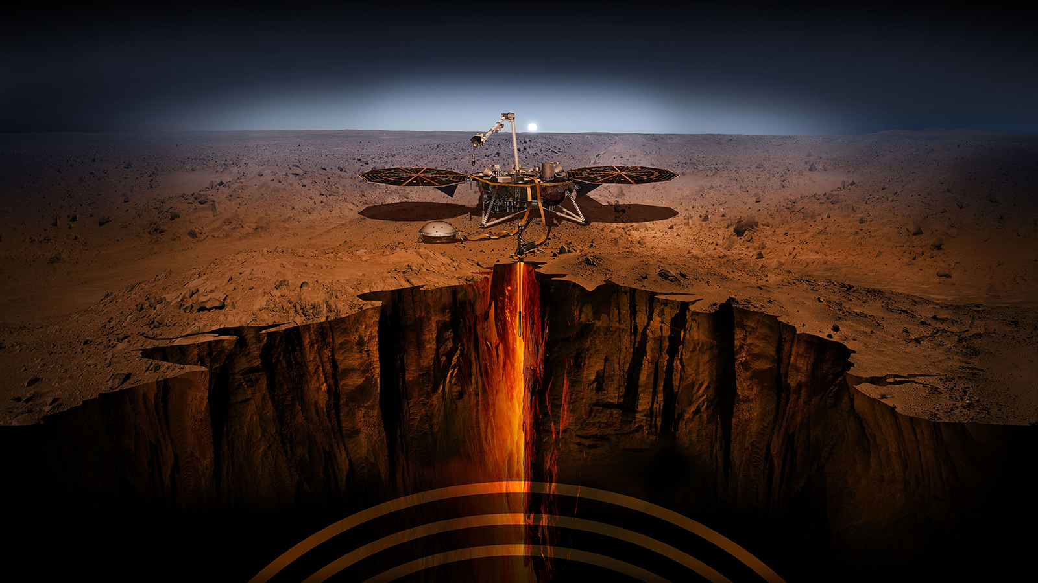
News: Out of This World!
NASA’s InSight Mission & SEIS-SP Sensor
Imperial College, Oxford University, and Kinemetrics developed the MEMS based SP seismometer for NASA’s InSight Mission
The SEIS-SP is a 3 component MEMS seismometer that provides response to higher frequencies than the lower noise SEIS-VBB very-broadband sensor.
The mission run by NASA JPL has multiple experiments - the SEIS experiment was contributed by the European Space Agency and comprised contributions from multiple countries to measure seismic activity on Mars.
The InSight Spacecraft was launched on May 5th 2018 from Vandenberg Air Force base in California to study the interior structure of Mars.
The space craft will land at ~ 12PM on November 26th 2018 if all goes well!
More details are available at: https://mars.nasa.gov/insight/
Advancement Through Innovation | Company Proprietary and Confidential

Slide 14










Kinemetrics: Be A Part of What Matters
Collaborate with Top Minds
Be Valued
Protect Lives
Protect Communities
Have a Global Reach
People
Purpose
YOU
Perks
Play
Competitive Salary
401k Match
Insurance
Generous Time Off
Tuition Reimbursement
Every-Other Friday Off
Southern California
Ocean, Skiing, Hiking
Pioneer
Cutting-Edge Technologies
Partner with Academia
Creating the Future Together

Slide 15

THANK YOU
Advancement Through Innovation
Address
Kinemetrics
222 Vista Avenue
Pasadena, CA 91107
Phone & Fax
Direct Line: +1-626-795-2220
Fax: +1-626-795-0868
sales@kmi.com
Social Media
facebook.com/osskinemetrics
twitter.com/osskinemetrics
linkedin.com/company/kinemetrics
Company Proprietary and Confidential

