Slide 1
Strain, Rotation, and Seismic Arrays
Charles Langston
University of Memphis
Iris SITs workshop October 30-31, 2018

Slide 2
Acknowledgements
National Science Foundation EAR-1460377, EAR-1723067; AFRL Contract FA9453-16-C-0015
Memphis Graduate Students
Chuntao Liang
Blaine Bockholt
Lauren Kendall-Barker
Elige (Buck) Grant
Yang Yang
Donny Dankua
S. Mostafa Mousavi
Oluwaseyi Bolarinwa
Jia Zhang
Frank Vernon, UCSD
IRIS
DMC
Wavefields Experiment: Kent Anderson, Justin Sweet, Bob Woodward, and a host of Co-investigators, PASSCAL Field Engineers, and Graduate Students.

Slide 3
Message
New measurements will drive new science

Slide 4
Roadmap
A new kind of array seismology – “Geodetic Arrays” and “Large N”
Waves in space and time: Spatial Gradients, Strains and Rotations
Arrays and Point Arrays
New Seismic Instruments
Where will it all go?

Slide 5
Geodetic Arrays

Slide 6
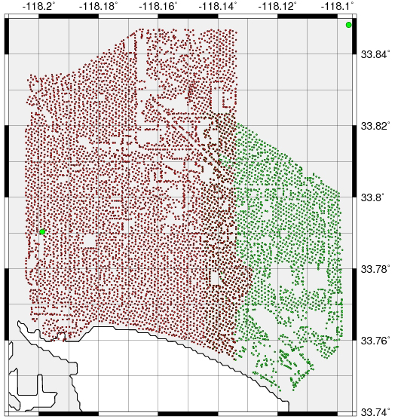
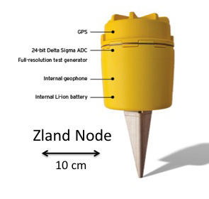
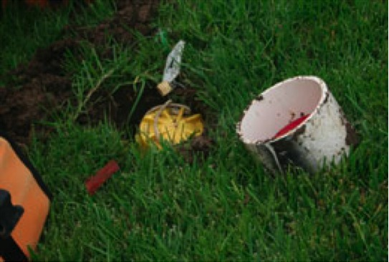
Large N – Long Beach (but not geodetic)
5300 + 2500 Vertical Sensors
http://web.gps.caltech.edu/~clay/LB3D/LongBeach_combined_detail.jpg

Slide 7
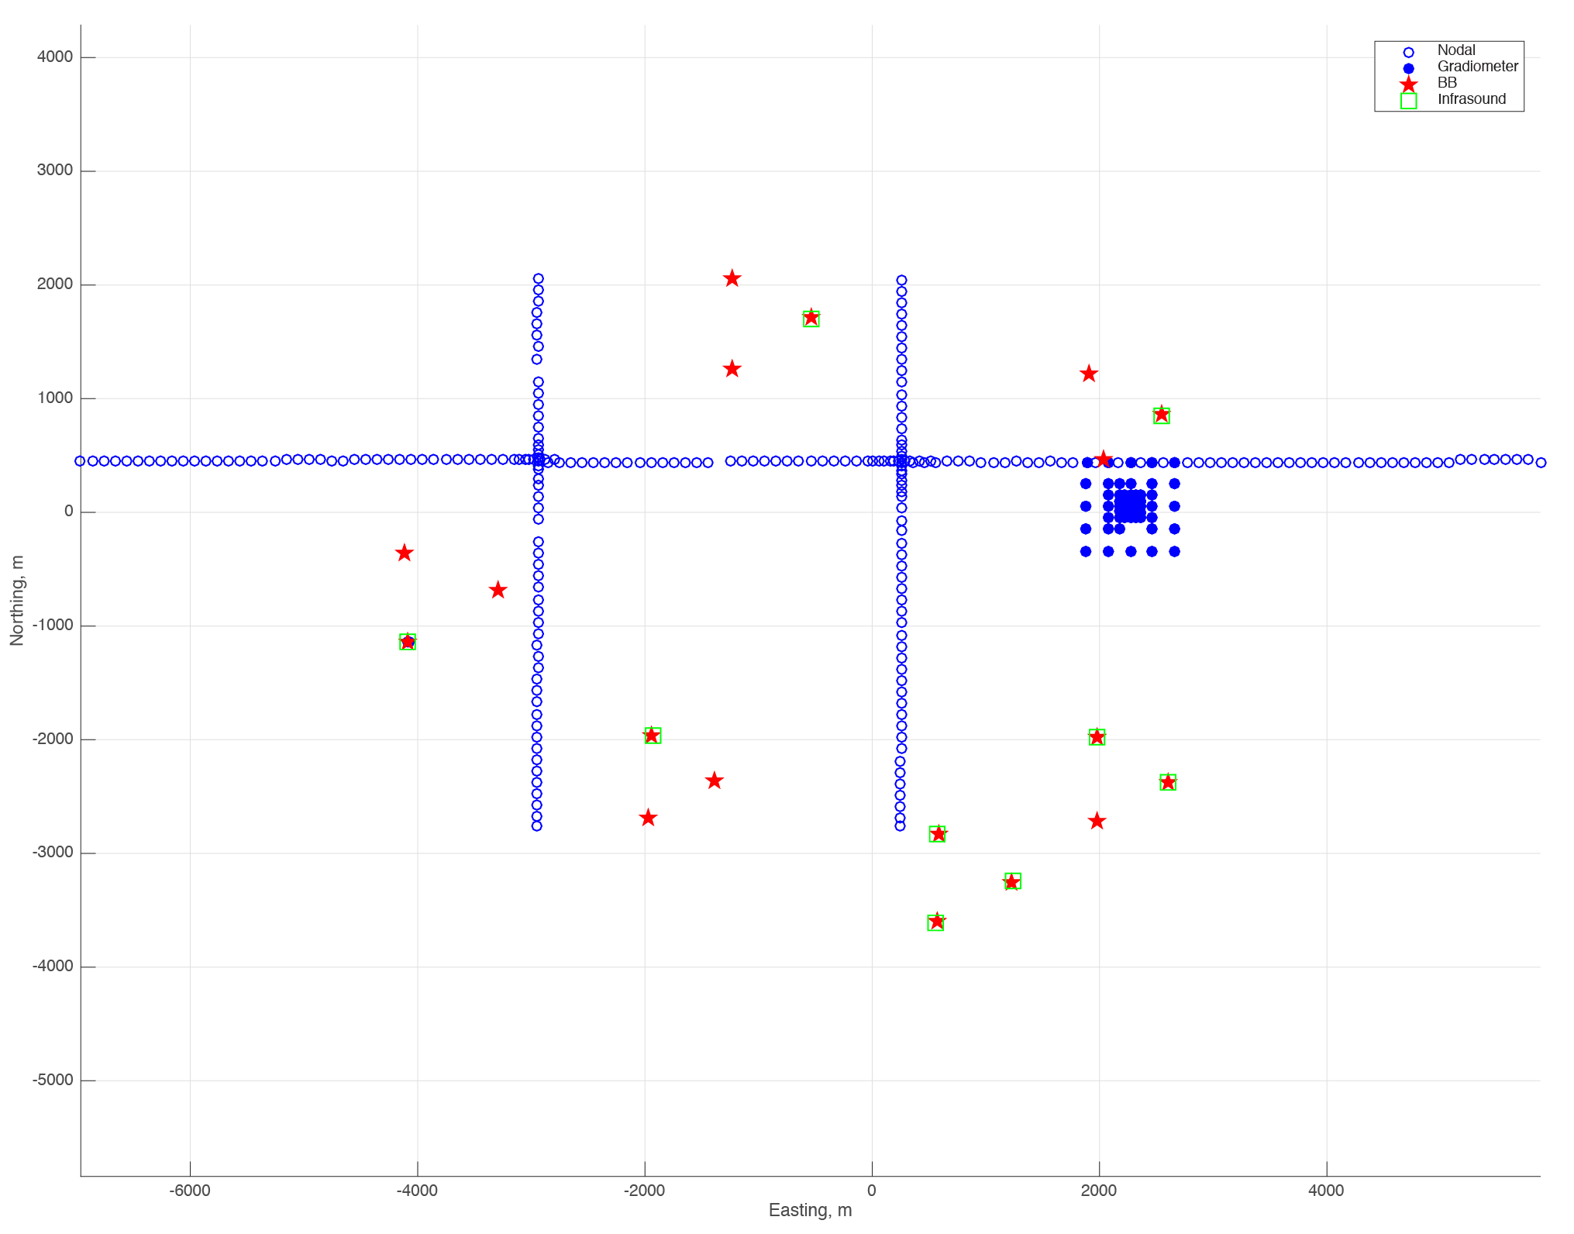
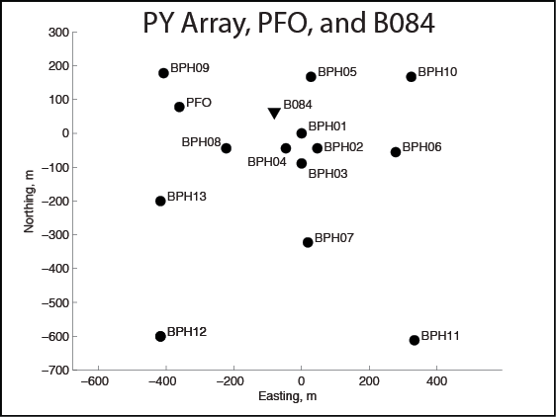
Geodetic
IRIS Wavefields Community Experiment
Cross arrays
112 3C element
7 Level
Recursive
Gradiometer

Slide 8
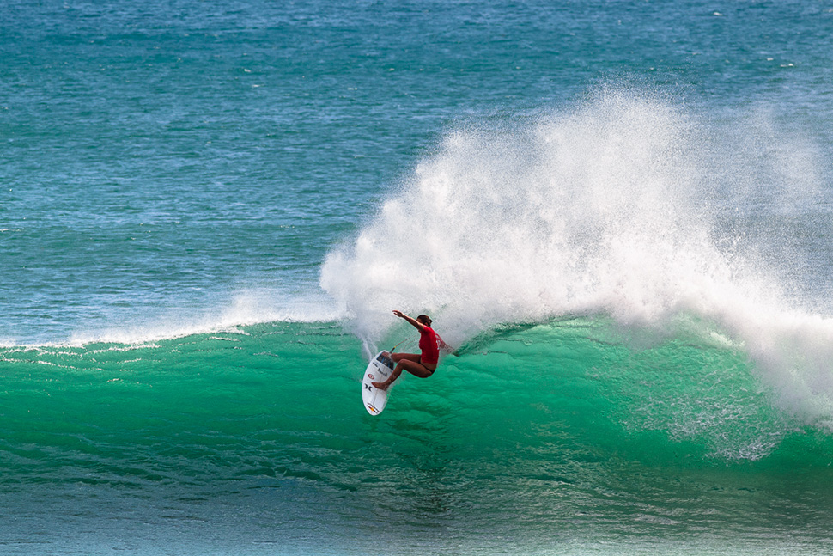
Wave Spatial Gradients, Strains and Rotations
surfer.com

Slide 9
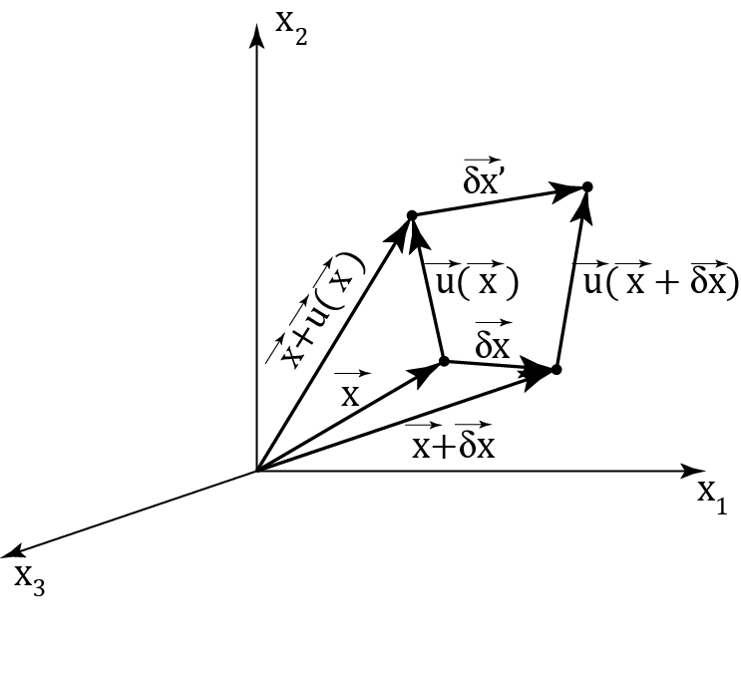
Strain and Rotation
Displacement gradient
tensor
Distortion Rigid Body Rotation
(strains) (rotations)

Slide 10
Strains at the Free Surface
Only strains in the horizontal plane need to be measured

Slide 11
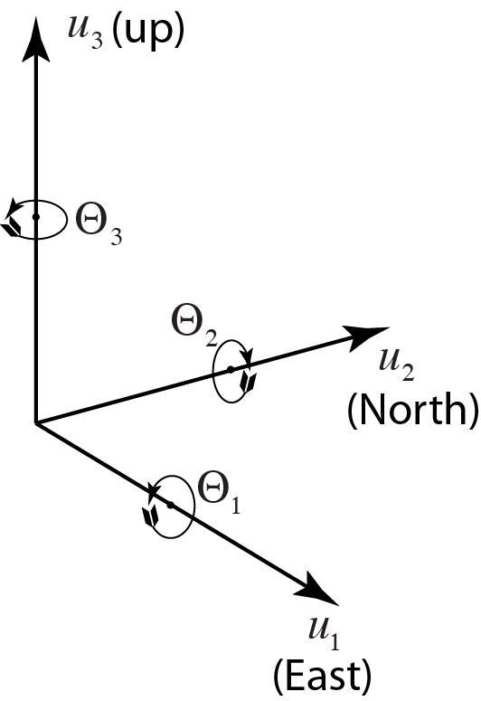
Rotations at the Free Surface
Surface Tilts
Rotation about the vertical
Only displacement gradients in the horizontal plane need to be measured

Slide 12
There is a Compatibility Relationship Between Displacement Gradient, Displacement, and Velocity Seismograms via the Chain Rule (1D):
Wave Field from field observation point
Wave Field Gradient obtained from finite difference estimate or strain/rotation observation
Time Derivative of Wave Field
Geometrical Spreading Change
Wave Slowness Change

Slide 13
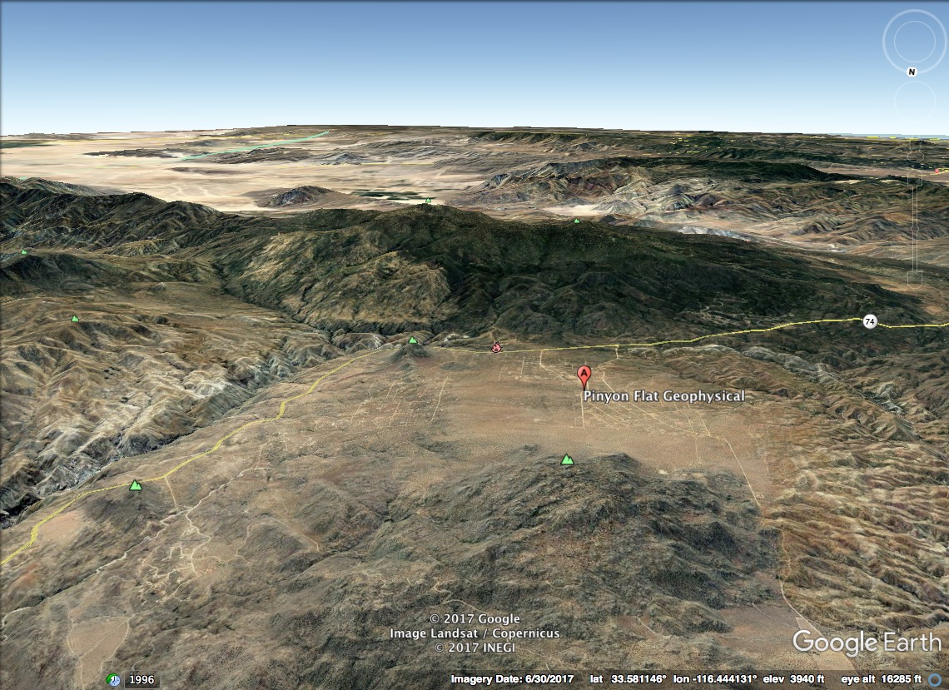
Pinyon Flat, California

Slide 14
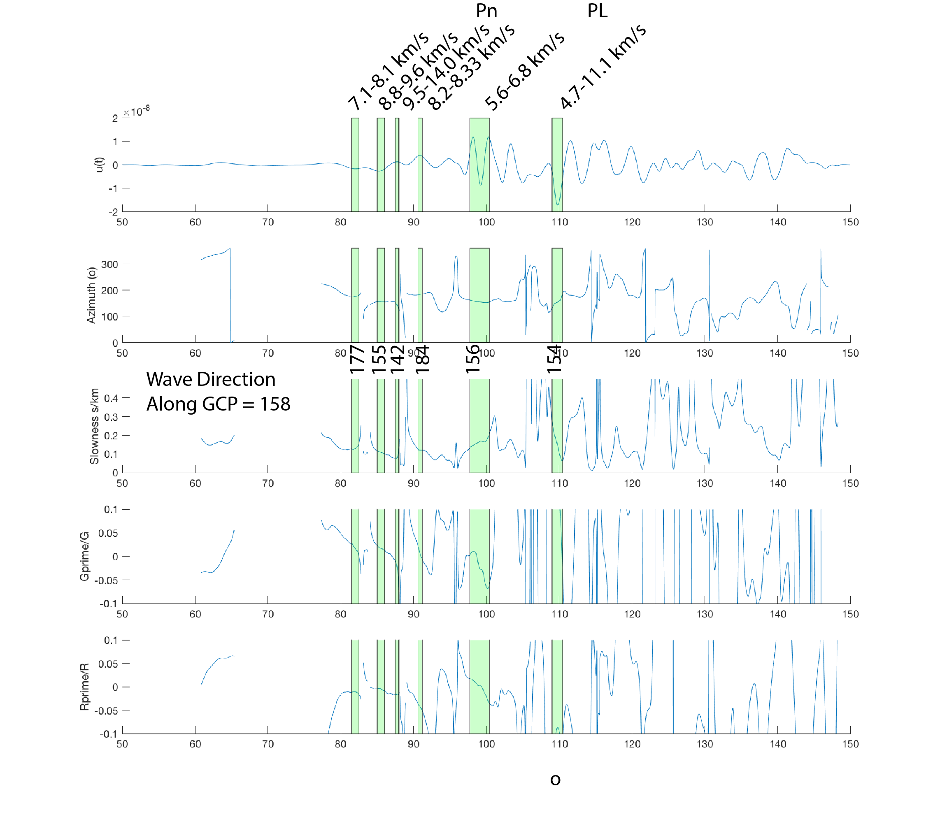
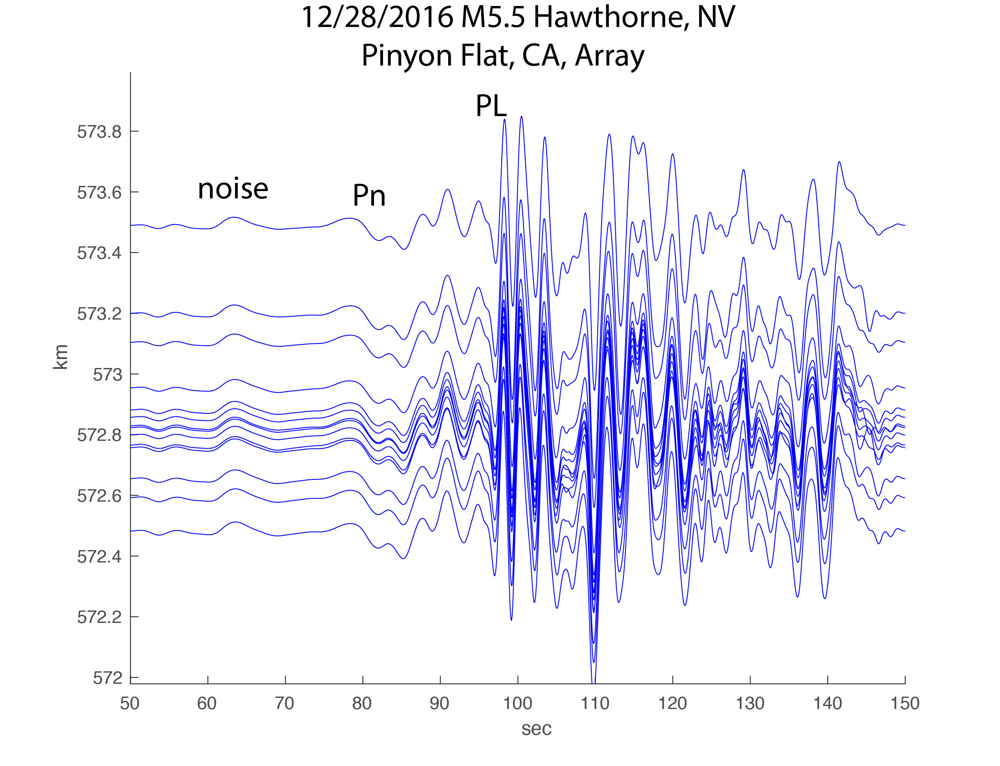
Peak amplitudes are most stable
Gradiometry also detects phase interference
Need gradiometry for multiple waves

Slide 15
Plate Boundary Observatory Gladwin Tensor Strain Meters
78 GTSM sites

Slide 16
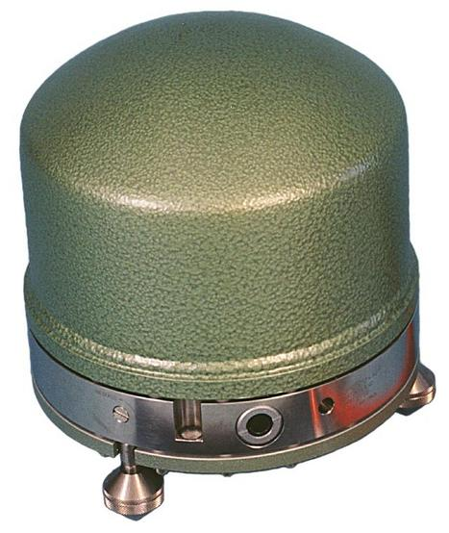
Two Arrays
+
Geodetic :N=14
(28 Channels)
“Point”: N=1
(6 Channels)

Slide 17
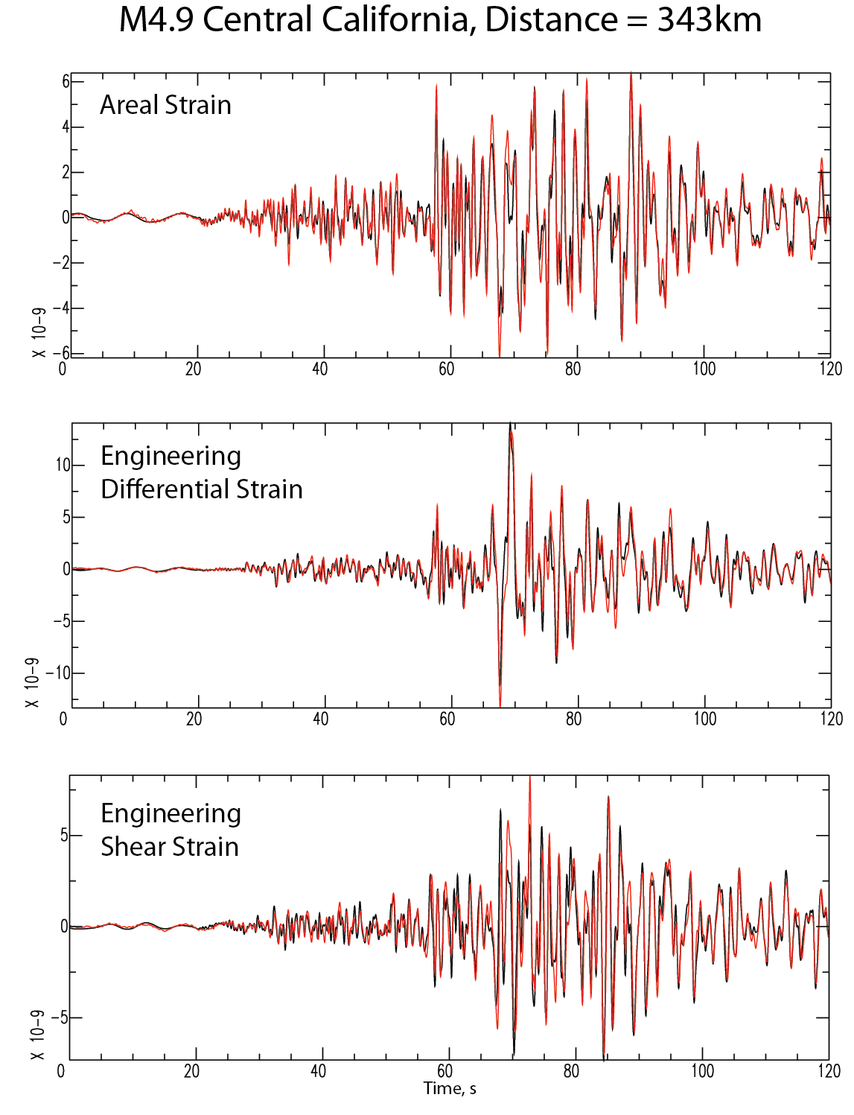
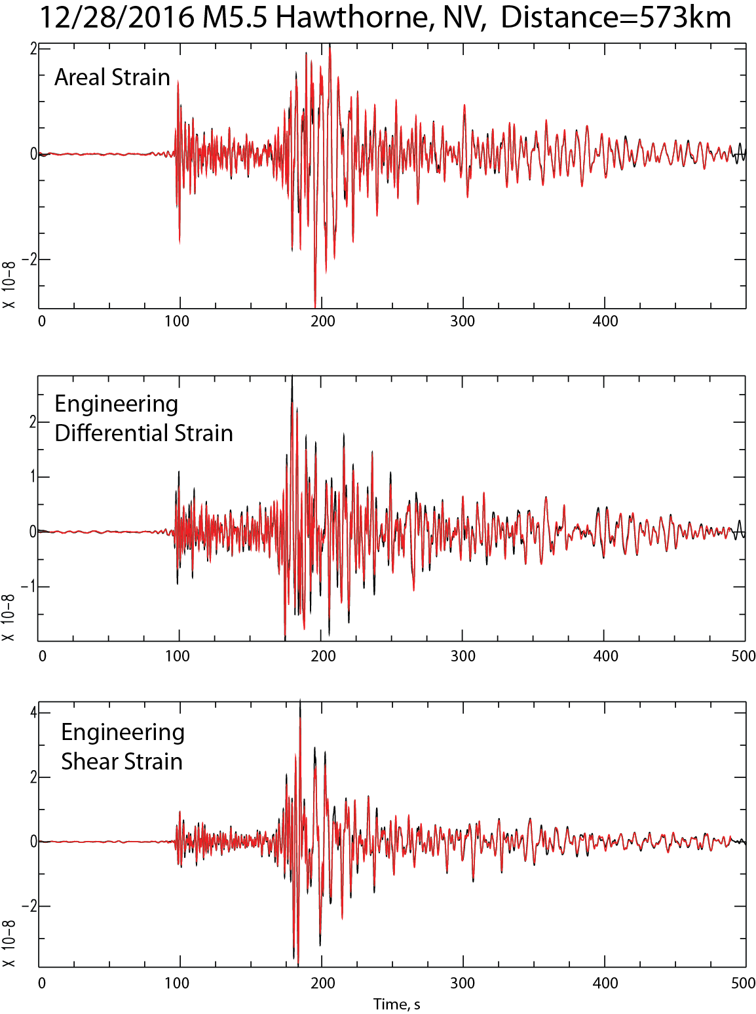
Strain Comparison 0.5 – 2 Hz
Red = Array
Black=GTSM

Slide 18
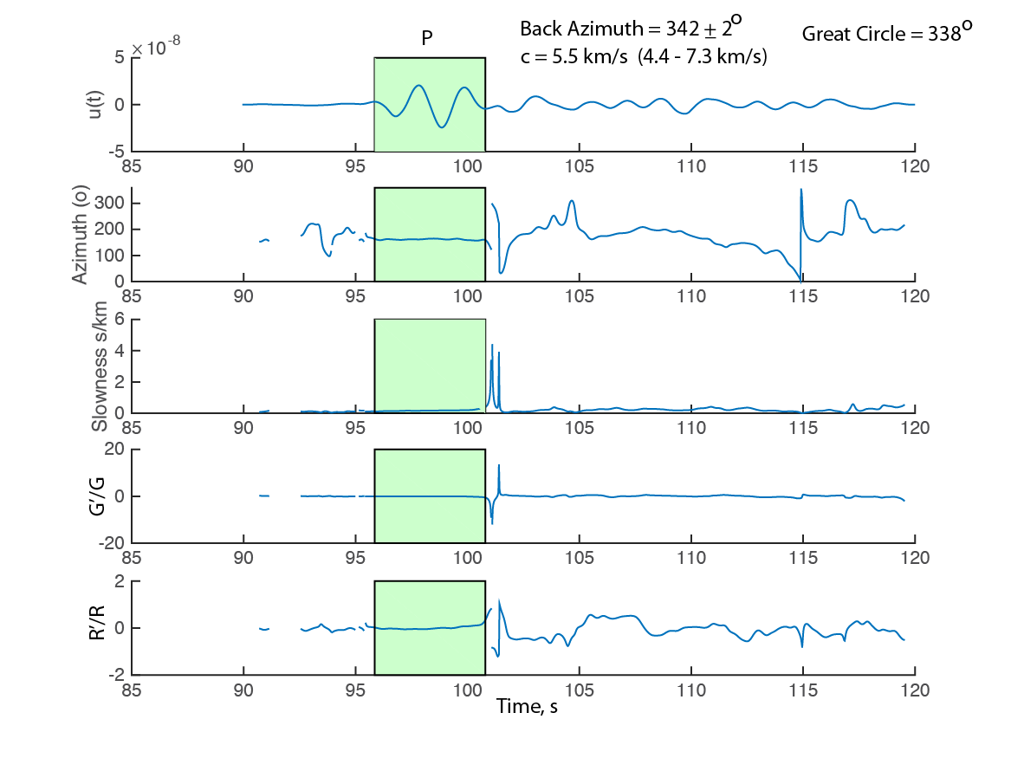
Radial P wave Gradiometry

Slide 19
What can you do with this stuff?

Slide 21
“Point” Seismic Arrays
(or borehole strain meter)

Slide 24
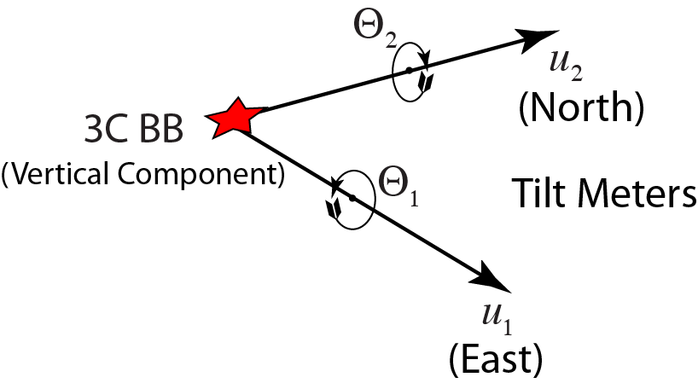
P-SV Rotational Gradiometer
Azimuth
P-SV Wave Composition

Slide 25
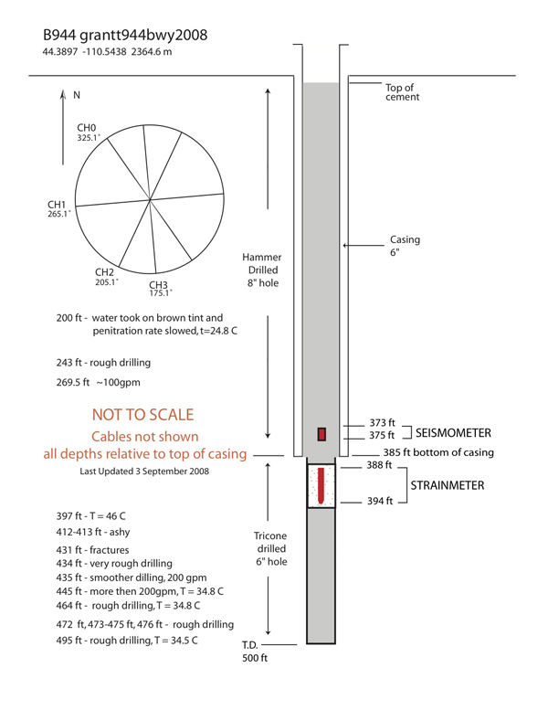
GTSM

Slide 26
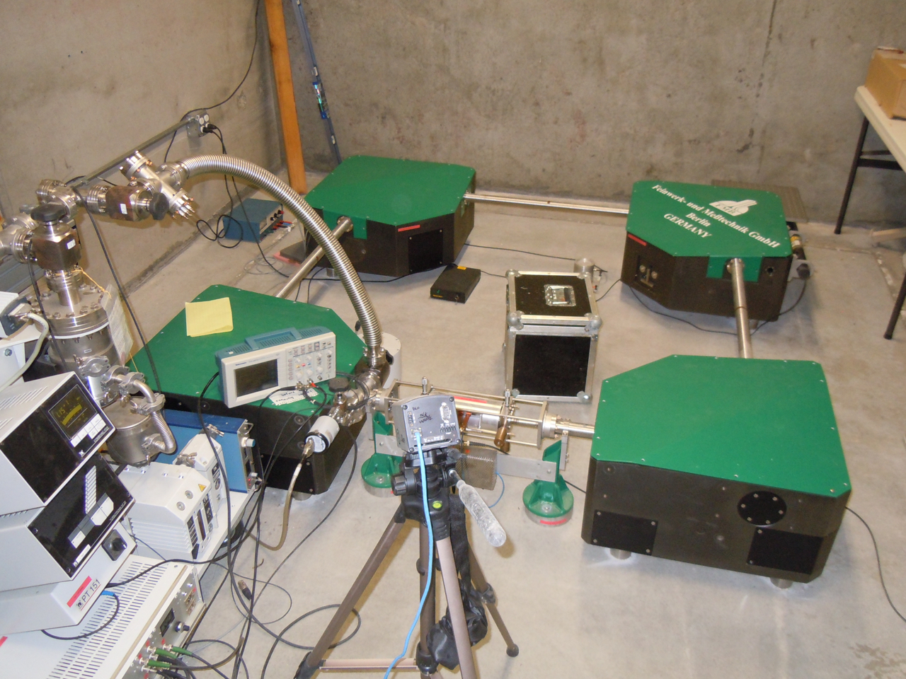
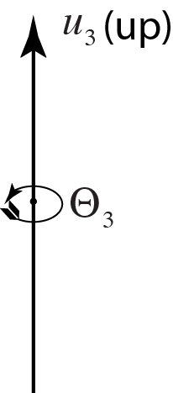
Instruments for Measuring Rotation
Sagnac Interferometer at Pinyon Flat, California

Slide 27
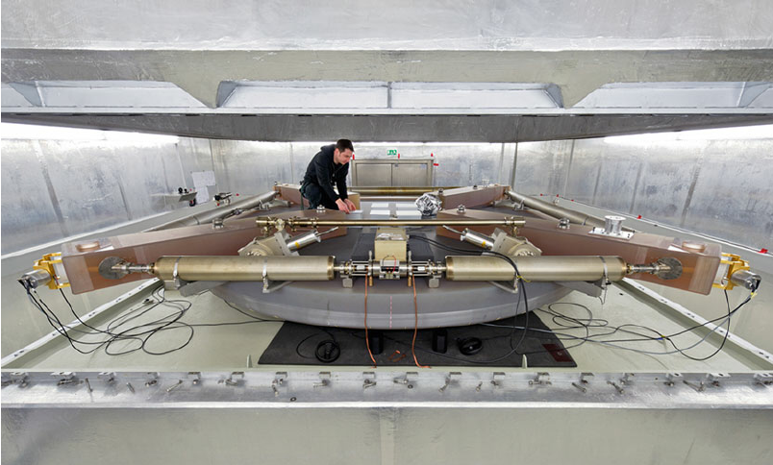
Geodetic Observatory Wettzell

Slide 28
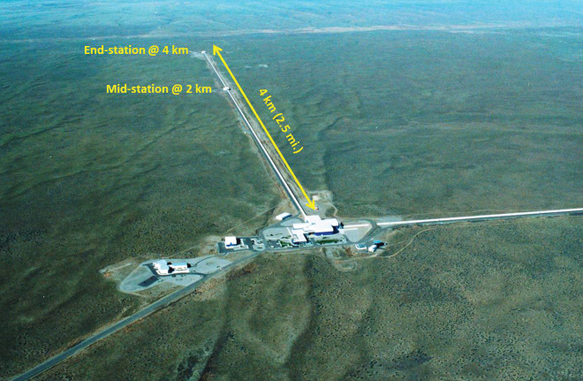
aLIGO
Hanford, WA

Slide 29
Basic Symmetric Chambers – Internal Seismic Isolation
Matichard et al 2015 Class. Quantum Grav. 32 185003

Slide 30
Horizontal Rotation Meter
Venkateswara et al., 2014

Slide 31
University of Washington Horizontal Rotation Meter
Venkateswara et al., 2014

Slide 32
A P-SV Rotational Point Array is Possible.

Slide 33
Where will it all go?
New strain and rotation instruments are being developed to drive new science:
Tomography as an observation rather than an inversion problem
Incorporate strain and rotation into structural inversions
Incorporate strain and rotation into near-source studies
Exploration Seismology uses – Borehole velocity structure, AVO
Earthquake Early Warning – an Array of Point Arrays in Southern California

Slide 34
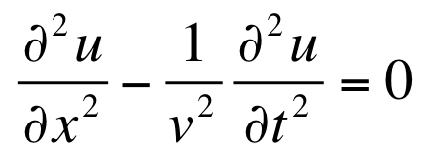
Thank you!
We shall not cease from exploration
And the end of all our exploring
Will be to arrive where we started
And know the place for the first time.
T.S. Eliot

