Slide 1
blueSeis-3A rotational seismometer
Tucson SITS 2018 – Theo Laudat – 30/10/2018
Notes:
Thank you mister Chairman for this kind introduction
I am theo Laudat, thechnical manager of blueSeis product line from iXblue , And I am pleased to be there to let you know more about our brand new rotational seismometer called blueSeis-3A

Slide 2
Outline 1. iXblue & Fog technology 2. blueSeis-3A rotational seismometer 3. Characterization of performances 4. Let’s get started!
Notes:
First let me introduce the company by telling who we are and where we come from (actually from navigation market where fiber optic gyroscopes are commonly used to build inertial navigation system)
Second I’ll explain what a rotational seismometer is and what is special in ours
Third , I’ll just briefly present you its performances, that are studied in more delails in several papers.
And finally, I’ll show you how it looks like from a practical point of view.

Slide 3
& FOG technology
Notes:
So, let’ now introduce our company and our technology

Slide 4
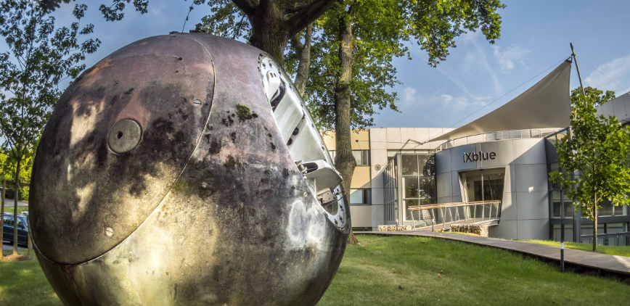
iXblue at a glance
iXblue is an independent French industrial group,
Recognized worldwide for high-tech equipment devoted to:
Navigation
Positioning
Acoustic imaging
600+ employees
80%
export
11 offices Worldwide
100+ M€
turnover
Notes:
iXblue is an independent French group , which is now recognized worldwide in the navigation, positioning and acoustic imaging fields.
It now employs 600 people and nearly 80% of its turnover is generated outside France thanks to its strong position in both civil markets (ocean and space exploration) and military markets (naval and land defense).
Created in 1998 the group has grown steadily and now possesses 11 support and sales offices worldwide, while all manufacturing and technical developments are made in our 6 sites in France (transition slide suivant)

Slide 5
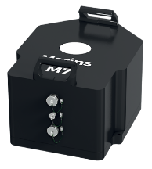
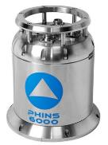
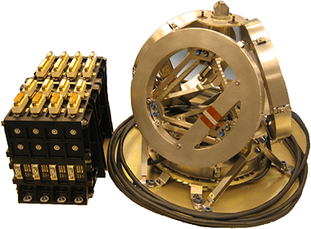
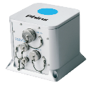
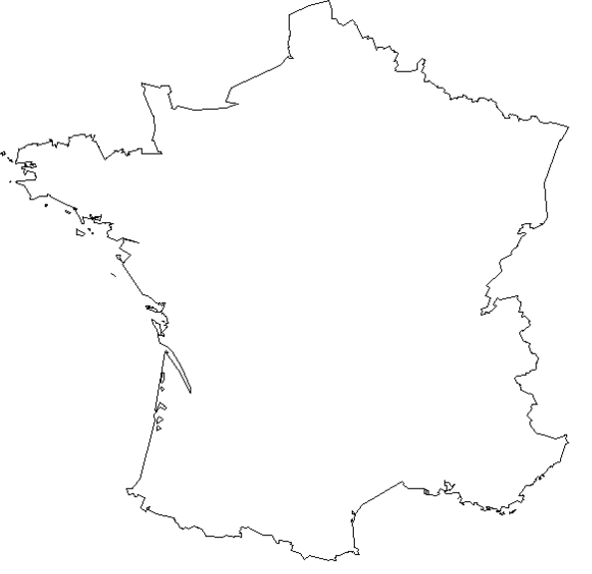
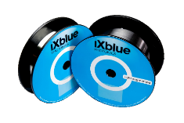
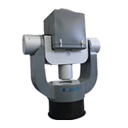
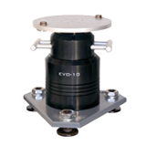
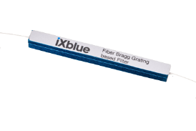
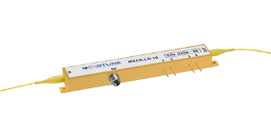
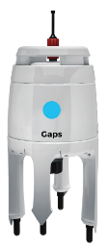
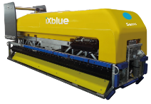
iXblue, from FOG to vertical and horizontal development
Complete mastery of technology through vertical integration
Navigation and positioning from submarine to satellite
Specialty fiber
Optical
components
Calibration table, pan-tilt
Optical circuit,
RF driver
Acoustic release, transponders, and positioning
Specialty sonars,
Underwater imaging
+
Shipyard and survey
6 centers of excellence in France
Notes:
Indeed the technical expertise and worldwide recognition that iXblue has gained over the years have only been made possible thanks to its vertical integration strategy that allows it to quickly evolve and address its customer’s needs.
This is the reason why the development and manufacturing of all our key components are distributed among our 6 factories in France and this includes the fabrication of optical fiber components, electronics, calibration tools and so on, while the assembly and tests of our final products are performed at Paris headquarter.
This illustrates well …
Horizontal developement :
acoustic (Brest) and imaging (LA Ciotat)
To adress 3 main markets,
Civil includes : survey, autonomous navigation, offshore, explortation
Science includes : hydrograhpy and geosciences

Slide 6
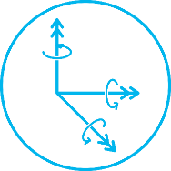
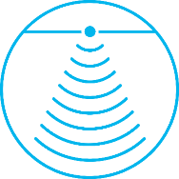
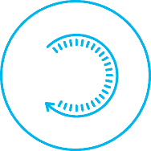
iXblue, between seas and space
Six core expertise for seven markets
Expertises
Inertial
solutions
Underwater
acoustics
Mechatronics
Photonics
Ship
building
Survey
operations
Markets
blueSeis rotational seismology solutions
Energy & Marine
Construction
Research Labs
Naval & Land
Defense
Aerospace
Commercial
shipping
Fishing
Geosciences
Notes:
This illustrates well that iXblue has key expertise in 6 domains:
In order to address 7 different markets: … and last but not least geosciences to which the Blueseis product line is dedicated.
And this is the one I’m going to focus on today, as iXblue is very happy to offer a brand new technical solution for rotational seismology: the Blueseis 3A which is made of our world class FOG that I am going to present now!

Slide 7
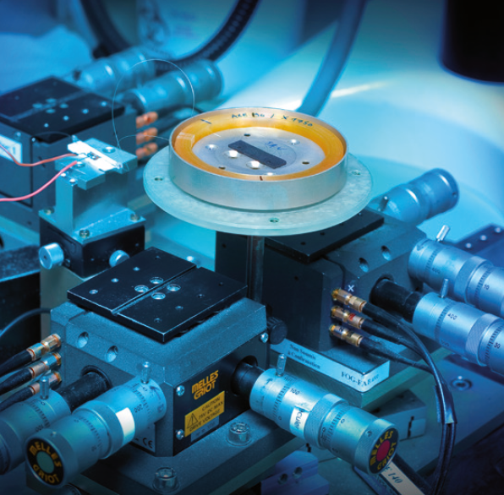
A unique expertise recognized worldwide for high grade FOG
Fiber-Optic Gyroscope (FOG)
Integrated optical circuit
Fiber coil
A
Optical source
Coupler
2X2
B
Relativistic Sagnac-Laue effect create a delay between clockwize and counter clockwise optical waves inside ring interferometer => modulation of optical intensity
Photodetector
x3
By using massless particles (photons) for the measurement, Fiber-Optic Gyroscope is entirely insensitive to linear accelerations and no cross coupling can happen.
Moreover, there is no moving part except photons, it allows maintenance free and small environment sensitivity
Notes:
The fiber optic gyroscope developed by the company’s founders is really the spearhead of iXblue as it is the central part of most of our products. It is a high technology device that uses light to measure rotation rates.
Its working principle is the following: An optical source emits light into a 2x2 coupler located at the input of an integrated optical circuit which plays the role of a phase modulator and Y junction that separate the light path into two. At its output, light propagate into a fiber coil in opposite directions and are recombined inside the IOC.
If there is a rotation, the relativistic Sagnac Laue effect will create a delay between the two counterpropagating waves which will cause a modulation of the light intensity received by the photodetector.
This way, measuring the returning light gives access to the rotation rate along the direction orthogonal the fiber coil..
And the Blueseis 3A is composed of three of these systems assembled along the three orthogonal axes.
This method actually presents several advantages such as being insensitive to inertia, since photons are massless particles, and we’ll see in a short while why this is particularly important. And I can also emphasize the absence of cross coupling between the three orthogonal axes.
Moreover, as a fiber-optic gyroscope is compact and has no moving parts: it is therefore extremely reliable and has a maintenance-free lifespan of over 15 years without any need of recalibration.

Slide 8
Rotational seismometer blueSeis-3A
Notes:
But first what is rotational seismology?

Slide 9
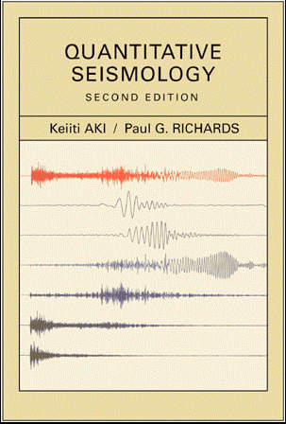
blueSeis, a turning point in rotational seismology
Why is rotational seismology so crucial?
“
(1980)
The state-of-the-art sensitivity of the general rotation sensor is not yet enough for a useful geophysical application.
”
(2002)
“
[...] note the utility of measuring rotation near a rupturing fault plane [...] but as of this writing seismology still awaits a suitable instrument for making such measurements.
Aki and Richards, Quantitative Seismology
”
(2017)
Rotational seismometer product line,
To make rotational seismology happen on the field,
To allow new sciences and discoveries in seism understanding
→ Every time an earthquake happens, the Earth rotates!
Notes:
The idea of measuring rotations in seismology is not new and as a matter of fact, Aki and Richards, who wrote the seismology bible, already identified almost 40 years ago the need of having a reliable and sensitive rotational sensor in seismology.
However such instrument didn’t exist at the time. And the need was still present when they wrote the 2nd edition in 2002!
With its new rotational sensor commercialized since las year, Blueseis aims at fulfilling this void by making rotational seismology happen on the field!
The reason why rotational seismology is so crucial is simply because every time a earthquake happens, the ground rotates, even though it was not directly measurable so far.
Indeed, any motion have 6 degrees of freedom :
–Linear motion (3-DoF)
–Angular rotation (3-DoF) But, we typically only measure linear motion
BlueSeis offers now the possibility to measure complete (=6) ground motion (linear with blueseis?)
Let’s now illustrate the benefit of having pure rotation sensor by looking at a standard linear seismometer:

Slide 10
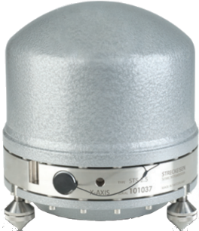
Standard seismometer measure TRANSLATION
But it is also sensitive to ROTATION
Signal = translation + rotation
Notes:
The key point to understand here is what is for, and how it changes the understanding of the data you get from your seismic station
Starting with what you have from standard seismometer, I mean a mix of translation measurement and disturbance from tilt/rotation of the ground

Slide 11
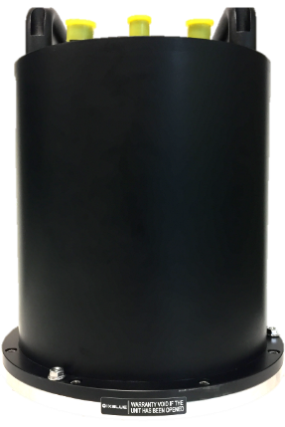
Rotation seismometer is NOT sensitive to TRANSLATION
But it is very sensitive to ROTATION
Signal = zero + rotation
Notes:
Whereas our rotational seismometer will give you pure rotation signal

Slide 12
Signal = measure + disturbance
Pure translation
Signal = nothing + measure
Pure rotation
6-component data merging
Notes:
At the end, by using these two sensors simultaneously, you build a 6 degrees of Freedom station, where you can really distinguish rotations and translations of the ground, leading to major improvments, so numerous that we cannot talk about all of them in this short talk.

Slide 13
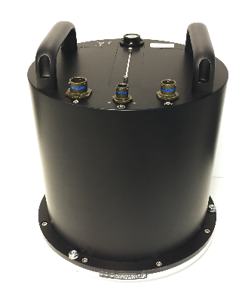
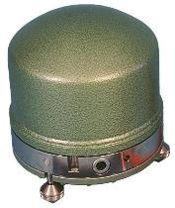
blueSeis, a revolution for rotational seismology
The key to point-measurement of phase velocity
Seismometer = $\frac{∂x}{∂t}$
Rotation/strain = $\frac{∂x}{∂s}$
translation
(time derivative of motion)
(spatial derivative of motion)
Phase velocities from point measurement of translations and rotations!
Combine both information of seismometer and rotation we get phase velocity
$$\frac{∂s}{∂t}$$
Notes:
I wil ljust illustrate it with the possibility to access something really new that is a point measurement of phase velocity !
Ideed while a translation is the time derivative of motion, a rotation is the spatial derivative of motion. Therefore by merging the data coming from these two devices, one can really get a point –measurment of phase velocity!
And this is only one example among many others…

Slide 14
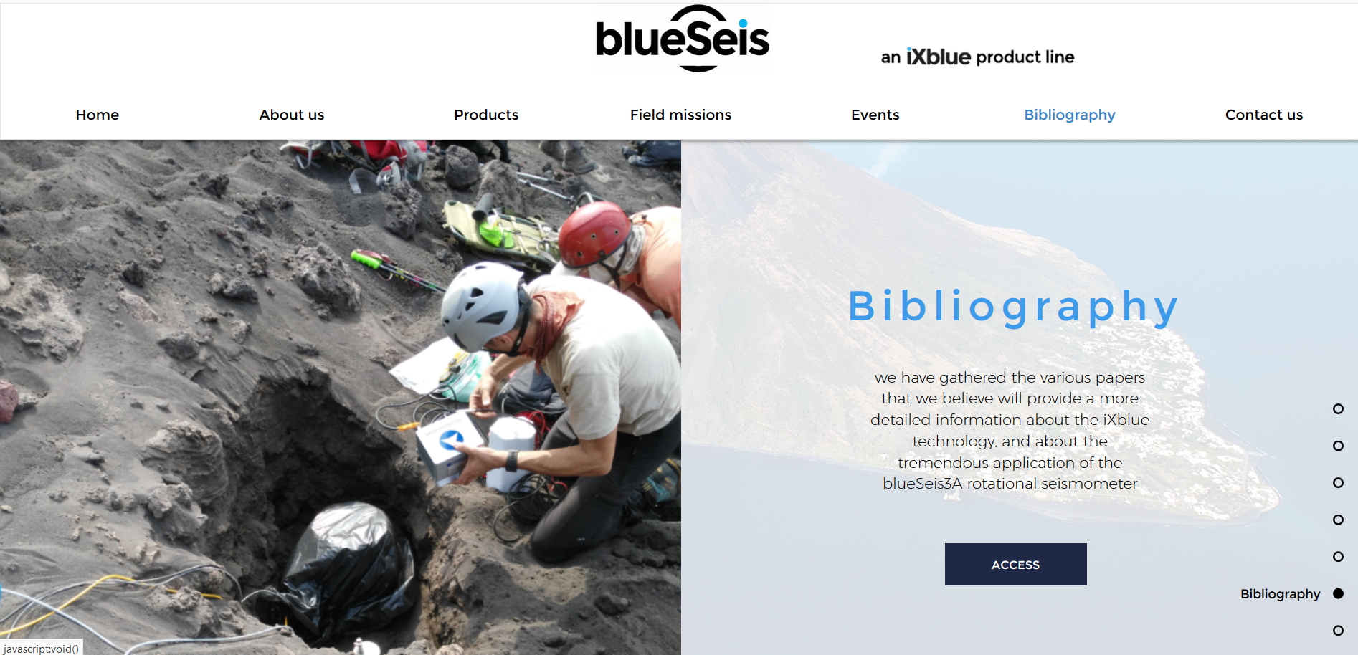
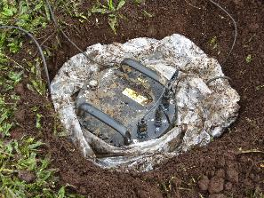
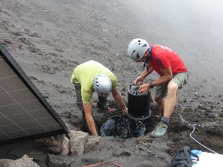
A rotational seismometer to do what ?
Bibliography available at: www.blueseis.com
Large bibliography about rotational seismology
Several demos and customer feed back on our website and litterature
Notes:
As a matter of fact, now many good science coming from 6 DoF (degrees of freedom) stations is being carried out by our customers, and the best to talk about this are seismologists which I’m not…
And I thus warmly encourage you to check out the bibliography available on our website www.blueseis.com if you wanna know more about rotational seismology and the possible applications related to it.
To sum up, here are the 6 key points to be remembered about the Blueseis 3A:

Slide 15
blueSeis-3A at a glance
Main features of the rotational seismometer
Absolute
Measure DC earth rotation rate => True North
Low-noise
20 nrad/s/√Hz
Relativistic
Not disturbed by translation, rotation about orthogonal axis, high dynamic
Broadband
[0.01 to 50 Hz]
Digital
Direct output of nrad/s values in miniSEED, no calibration needed
High dynamic range
Up to 0.5 rad/s (123 dB)
Notes:
It is an absolute rotational sensor, meaning that it is sensitive to all rotations, including the Earth rotation ! Which is nice becaue it allows to find the true North and strongly facilitates its alignment on the field!
Low noise
Relativistic?
Broadband
Another very nice feature is that the electronic signal coming out of the FOG is digitalized and calibrated in such a way that the output signal is directly expressed in nrad/s and does not need any additional calibration. The data are then directly transmitted using the standard miniSEED protocol
High dynamic range which corresponds to being at the epicenter of a magnitude 7 Earthquake.
Let’s now have a quick look at the technical performances of such device

Slide 16
Characterization of performances
Notes:
This sounds quite nice, but is it really working?

Slide 17
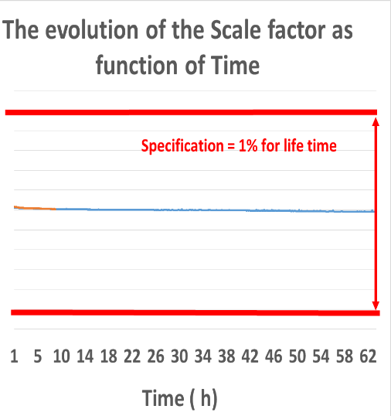
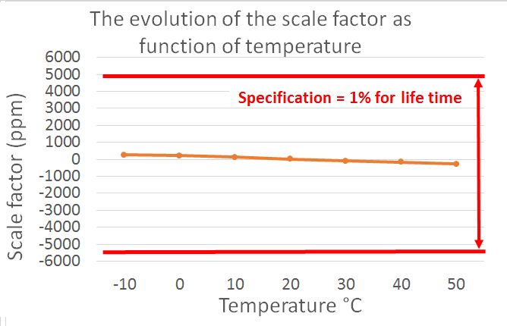
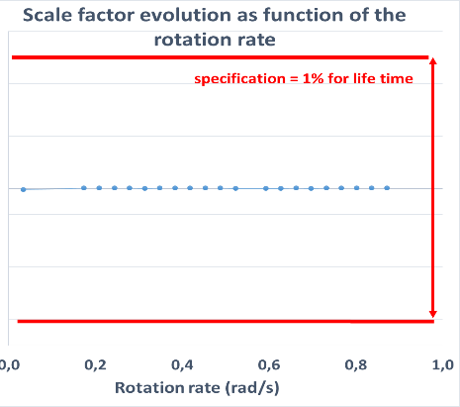
blueSeis-3A characterization
Scale factor 1% for life time at all frequencies
Courtesy of F.Bernauer : « Full characterization of a 3C rotational Seismometer » SRL 2018
Notes:
The answer is yes and here are the experimental data proving it! Felix Bernauer
The three graphs show the evolution of the scale factor, which makes the connection between the eletronic signal and the rotation rate in nrad/s, in ppm as a function of temperature, rotation rate and time, and these illustrate the very good stability of our device. Which is even better than initially specified so it appears that we were a bit too conservative about it and our specification will be updated accordingly next year.
Let’s now have a look at its frequency stability!

Slide 18
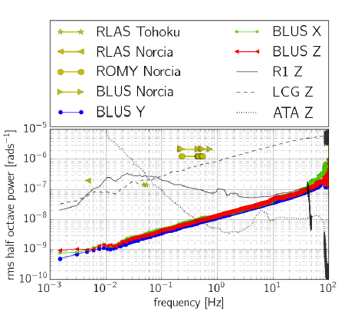
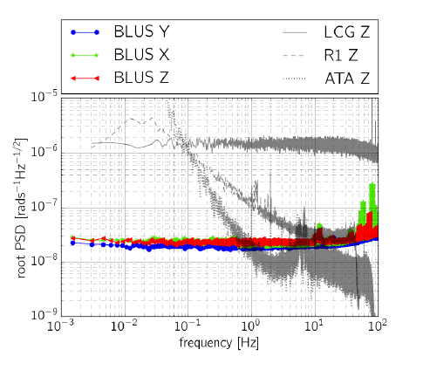
blueSeis-3A characterization
Flat and low self-noise over a wide frequency range
Courtesy of F.Bernauer : « Full characterization of a 3C rotational Seismometer » SRL 2018
Notes:
The frequency response of the PSD is displayed on the left graph, where the color lines correspond to the Blueseis 3A signals along the 3 orthogonal axes, and the grey curves come from other seismological devices:
LCG : is another FOG from Litton → same flat response which really comes from the technology
R1 : is hydrodynamic sensor from Eentec
ATA : is magnetohydrodynamic prototype from ATA
It is clear that compared to these sensors, ours presents a flat and low frequency response in the seismic band with a floor at 20 nrad/s/sqrt(Hz)
On the right rms amplitude you can measure with our sensor (you can measure it, if the signal is above the cuvre of the self noise of the sensor)
Norcia , Tohuku are seism in italy and in Japan measured in Italy (BLUS) and Germany (RLAS and ROMY)
It shows that we have some margin to detect these signals.
These measurements, performed by Dr Felix Bernauer are available among with many other details in this very recent paper.

Slide 19
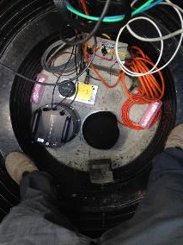
Nanao Array (南澳) Taïwan
blueSeis-3A characterization
Comparison with ArrayDerivativeRotation (ADR)
Courtesy of Dr.Lin (Academia Sinica)
110m
BlueSeis-3A
STS-2
Notes:
Maybe the simplest way to convince that our sensor actually works, is to see what you get when comparing to the only way one have to get rotation today : an array of standard seismometer with a given aperture. From Dr.Lin of Academia Sinica in Taiwan, you can see, actually hardy see, two curves from M5 seism here as they overlap almost perfectly.

Slide 20
Let’s get started!
Notes:
From a more practical point of view

Slide 21
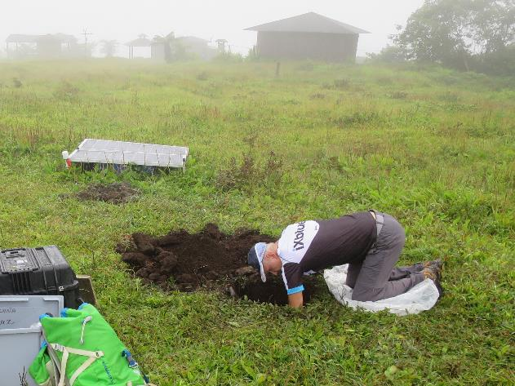
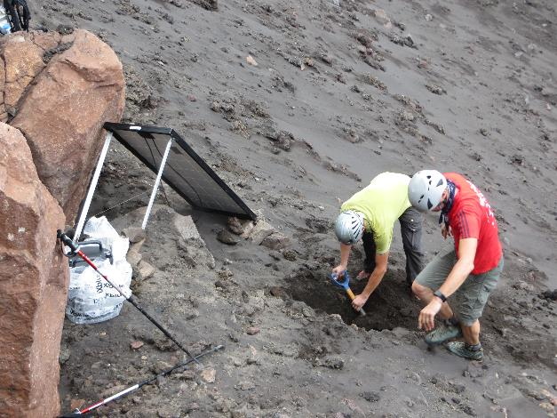
Installation
First, as always, dig a hole
Rotational seismometer and standard seismometer must share the same hard base plate
(bedrock, concrete, metallic plate…)

Slide 22
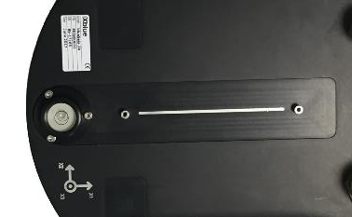
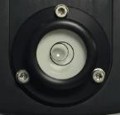
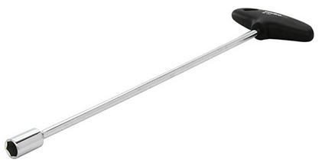
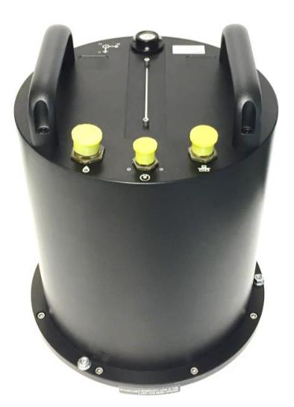
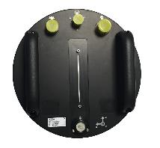
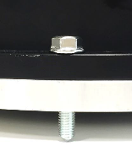
Installation
Alignment pins
Levelling tools
Cables, levelling and heading
Heading line
240V
Data logger
Battery
12V
Removable handles
Laptop
Config°
12V
GNSS antenna
Power supply
TCP/IP
Serial
Levelling foot

Slide 23
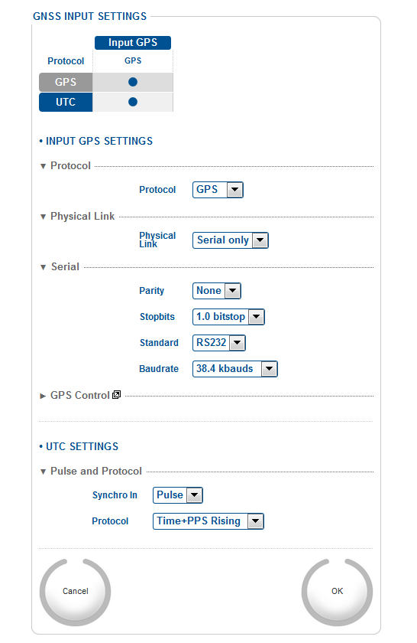
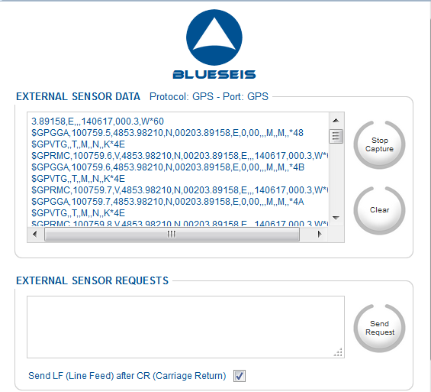
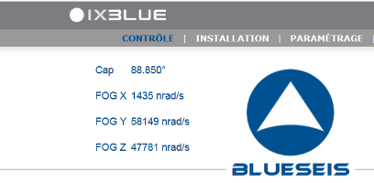
Installation
2- Configure GNSS input
Web interface configuration
3- Check GNSS is ok
1- Check sensors are ok

Slide 24
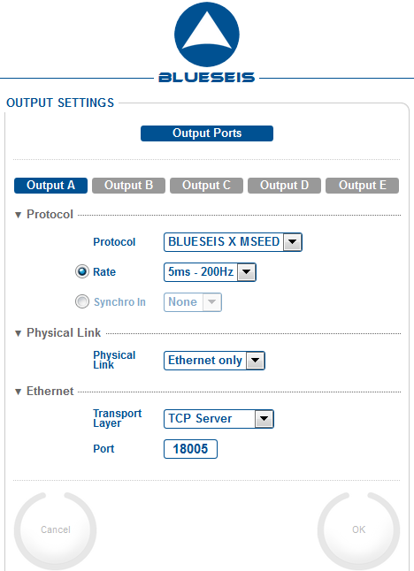
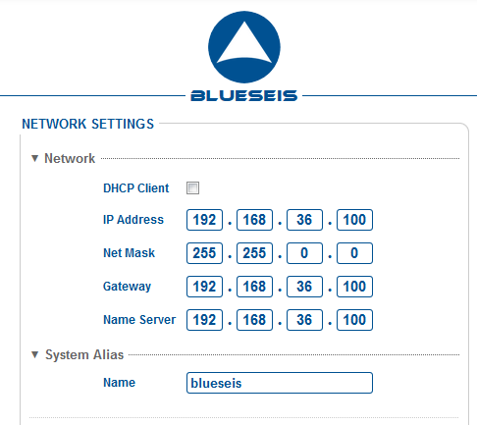
Installation
5- Configure outputs
Web interface configuration
4- Configure network

Slide 25
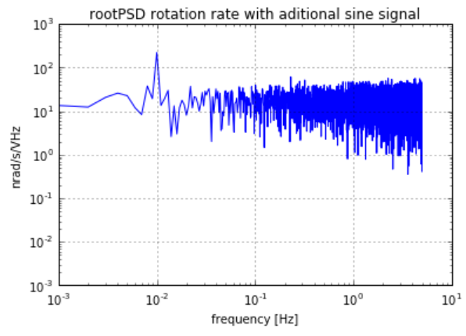
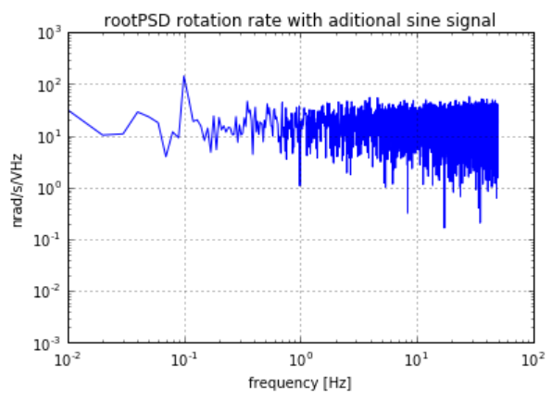
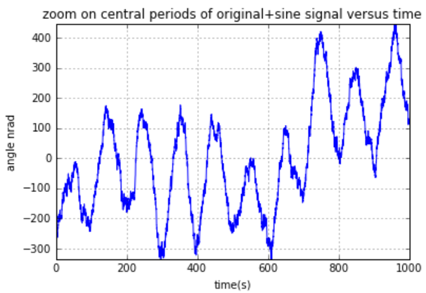
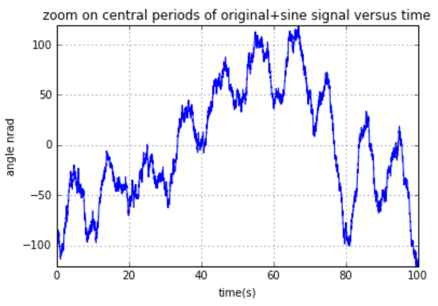
Waiting for interesting signals
What kind of signal can you get with 20 nrad/s/√Hz [0.01 Hz – 50Hz]?
0.01Hz
10 nrad/s peak peak
300 nrad peak peak
0.1Hz
20 nrad/s peak peak
50 nrad peak peak
Notes:
Peut-être remplacé par un tableau….les valeurs en nrad/s peuvent se lire aussi sur le graphique de droite de p18

Slide 26
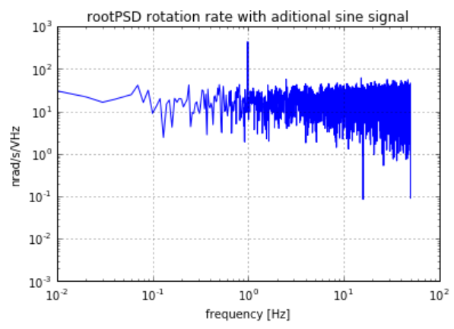
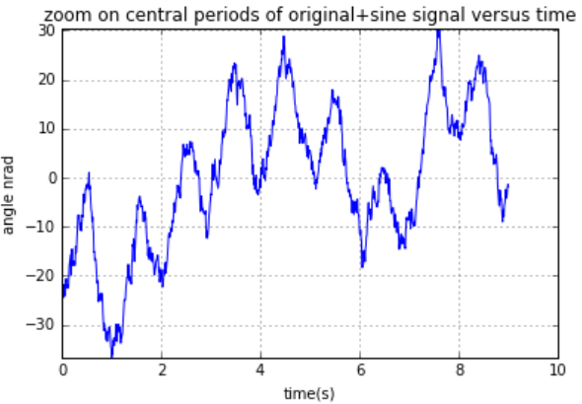
Waiting for interesting signals
What kind of signal can you get with 20 nrad/s/√Hz [0.01 Hz – 50Hz]?
1Hz
60 nrad/s peak peak
20 nrad peak peak
10Hz
150 nrad/s peak peak
5 nrad peak peak

Slide 27
Data retrieval
Many possibilities
- Linux - Windows
Local network
128Gb
Replace SD card
Replace Pi datalogger
Wifi (one file)
Pi Datalogger
SSH
Filezilla
VNC
Wire (multiple files)

Slide 28
Analysis
You are not alone for your first steps
Anything you need to start with this new observable is here:
http://www.seismo-live.org/
Back-azimuth
Back-azimuth
Array Derivative Rotation

Slide 29
Thank you
They trust us!
Come to our poster tomorrow
to talk about upcoming products in blueSeis product line:
Large 1C rotation sensor
Next Generation of blueSeis-3A

