Slide 1
Next generation products roadmap # B6
Tucson SITS 2018 – Theo Laudat – 30/10/2018
Notes:
Thank you mister Chairman for this kind introduction (seulement si il y a une introduction ;-)
Aux states cela se fait beaucoup de se présenter au début
I am theo Laudat, thechnical manager of blueSeis product line from iXblue , And I am pleased to be there to let you know more about our brand new rotational seismometer called blueSeis-3A

Slide 2
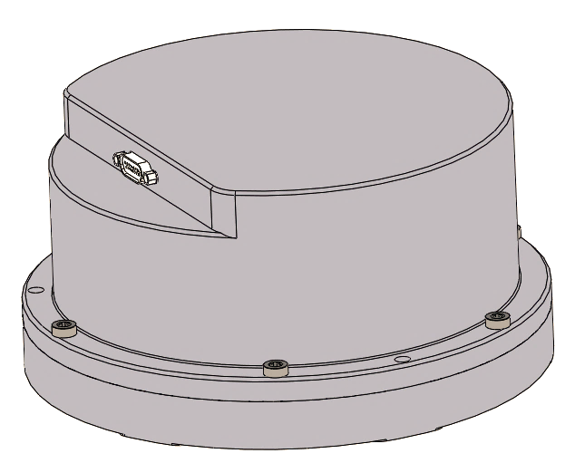
blueSeis-1C: Ultra-low-noise, 1component, sensor cold head
Characteristics
 | blueSeis-1C
Weight | 15kg
Height | 34mm
Diameter | 400mm
Price | TBD
Power consumption | 4W each 6W for 3
Self-noise | 5 nrad/s/√Hz
Very broadband | 0.001 Hz – 100 Hz
GNSS antenna
Digitizer
240V
Battery
12V
1C
Laptop
Config°
Power supply
12V
GNSS antenna
Serial
Serial
4W
Cabling
<1mW
GNSS antenna
240V
Digitizer
Battery
12V
3x1C
Laptop
Config°
Power supply
12V
GNSS antenna
Serial
Serial
6W
<1mW
Signals
to measure
0.5 nrad/s sinus =>
200 nrad sinus @ 0.001Hz
nrad/s sinus =>
2 nrad sinus @ 10Hz
Applications
Seismology
Hydrology OBS seismometer denoising
Large instrument denoising
Planetology
Volcanology
… Any other ideas ?
 | Sensor head | Electronic box
Power consumption | <1mW | 4W (1 sensor head) 6W (3 sensors head)
Time stamping | NA | Only disciplined serial data rate output
Data output | NA | Serial streaming
Data logging | NA | Outside (digitizer with serial input)
To be released, April 2019 @EGU Vienna

Slide 3
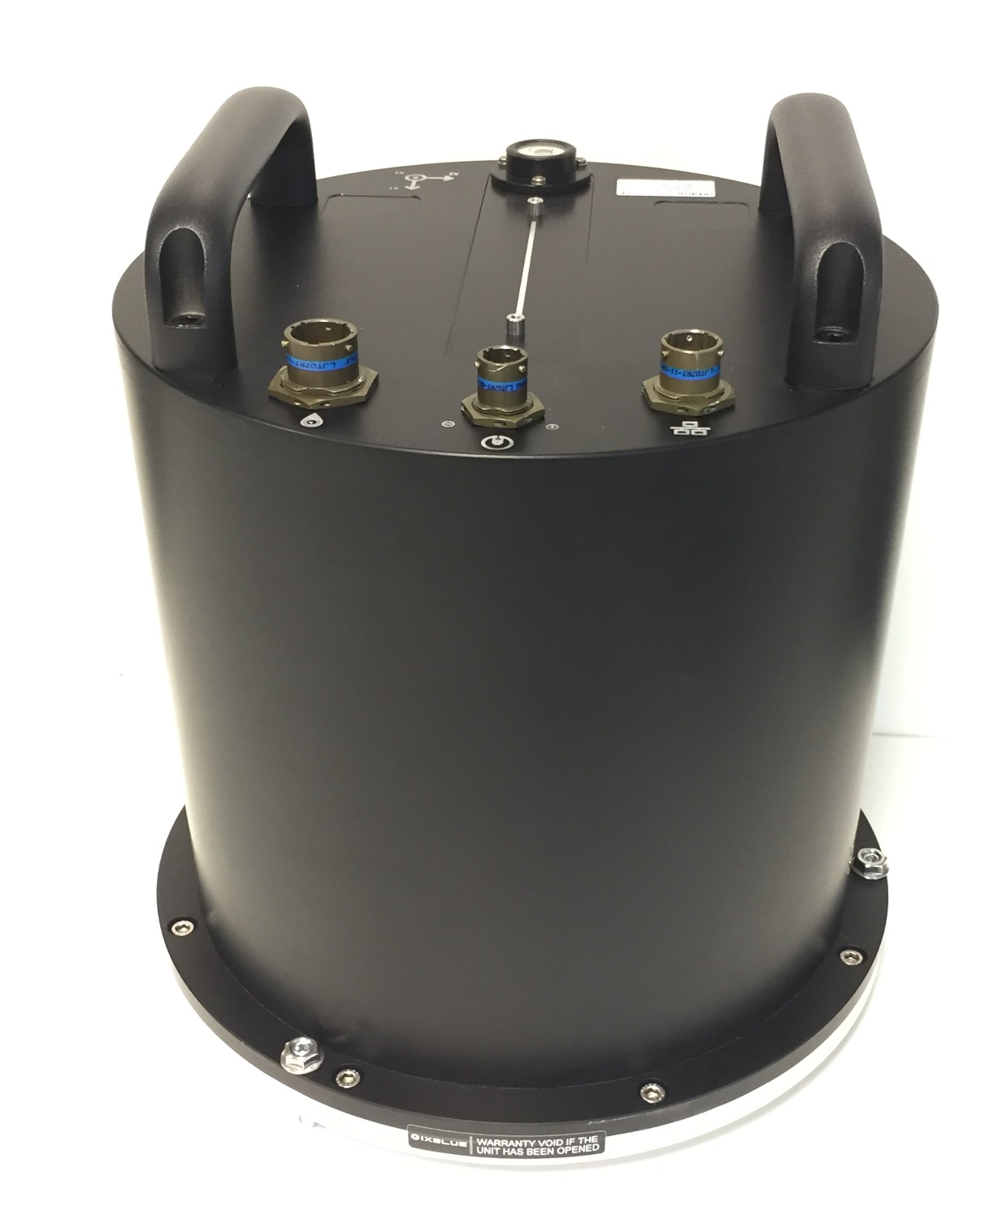
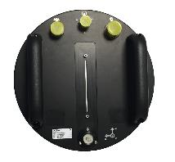
blueSeis-3A Next Generation: smaller, lighter, and more versatile
Characteristics
Data logger
Battery
12V
240V
Cabling
Laptop
Config°
 | blueSeis-3A | blueSeis-3A NG
Weight | 20kg | 18kg
Height | 350mm | 310mm
Diameter | 318 mm
Price | identical
Power consumption | 15W | ‘-e’ : 6W+4W ‘-s’ : 6W+2W
Selfnoise | 20 nrad/s/√Hz
Broadband | 0.01 Hz – 50Hz
Power supply
12V
GNSS antenna
TCP/IP
Data logging
Serial
Data logger
Battery
12V
240V
4W
Laptop
Config°
3A-e
Power supply
12V
GNSS antenna
6W
TCP/IP
Serial
GNSS antenna
Digitizer
240V
3A
15W
Battery
12V
Laptop
Config°
Power supply
12V
GNSS antenna
Serial
Serial
2W
3A-s
6W
Should we ?
Have an omblic instead of connector out of the sensor ?
Have 3A-e and 3A-s options, maybe only one is enough ?
Have a smaller+cheaper+ligher sensor at 50nrad/s/√z ?
Versatil electronic box
 | 3A | 3A-e | 3A-s
Time stamping | Inside sensor | Inside box | Only disciplined serial data rate output
Data output | miniSEED streaming | SEEDlink server | Serial streaming
Data logging | Outside (datalogger) | Inside and outside | Outside (digitizer with serial input)
To be released, April 2019 @EGU Vienna

