Slide 1
OptaSense Distributed Acoustic Sensing Systems
Brief Overview of OptaSense &
DAS System Capabilities
Lisa M. LaFlame
Steve Cole
For Iris Vendor Meeting Oct 30, 2018
Notes:
Don’t give it to anybody, but rather ask interested parties to contact us so we can follow up with them.

Slide 2
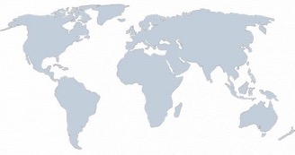
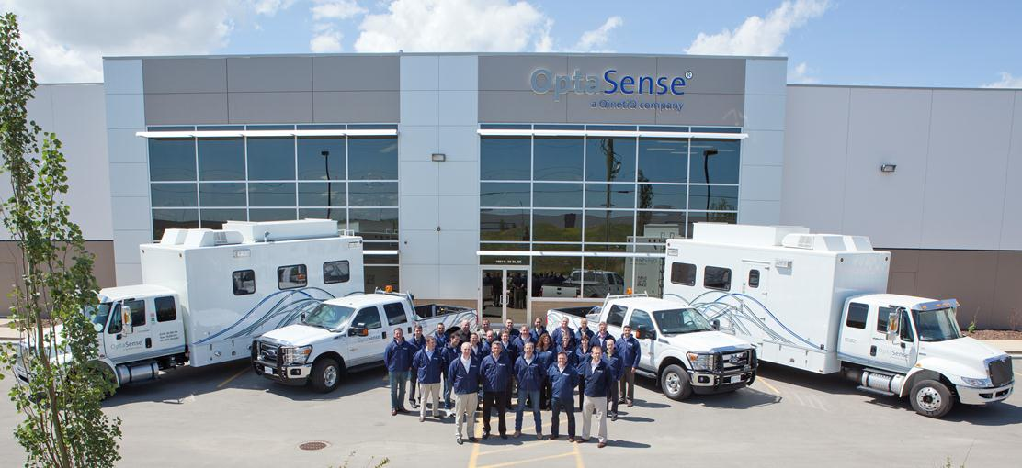
OptaSense
An International Operations Base
Part of the QinetiQ Group, a UK based multinational R&D organization
Founded in 2007
Approximately 160 staff
Headquartered in the UK with offices in USA, Canada, UAE and Australia
Over 400 systems installed and commissioned in over 40 countries
OptaSense Oilfield Services Operations Centre, Calgary

Slide 3
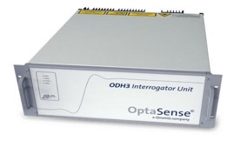
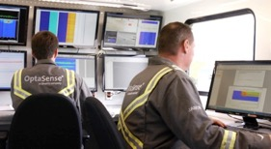
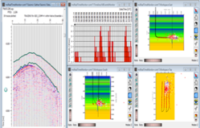
A Vertically Integrated Solutions Provider
From Laser Manufacturing to Data Interpretation
Develop, Design and Manufacture High Performance Lasers
OptaSense develops, designs and manufactures highly coherent semi-conductor lasers used in a variety sensing applications including DAS
Distributed Acoustic Sensing (DAS) System Development and Design
Development and design of the industry leading product range of DAS Interrogator Units and ancillary equipment, including hardware, signal processing and software
Distributed Fibre-Optic Sensing (DFOS) Acquisition Services
Our experienced field crews provide high quality acquisition of DFOS data, on land and offshore
Processing, Interpretation and Analysis Services
OptaSense, have developed the software tools and techniques to provide industry leading processing, analysis and interpretation of DFOS data

Slide 4
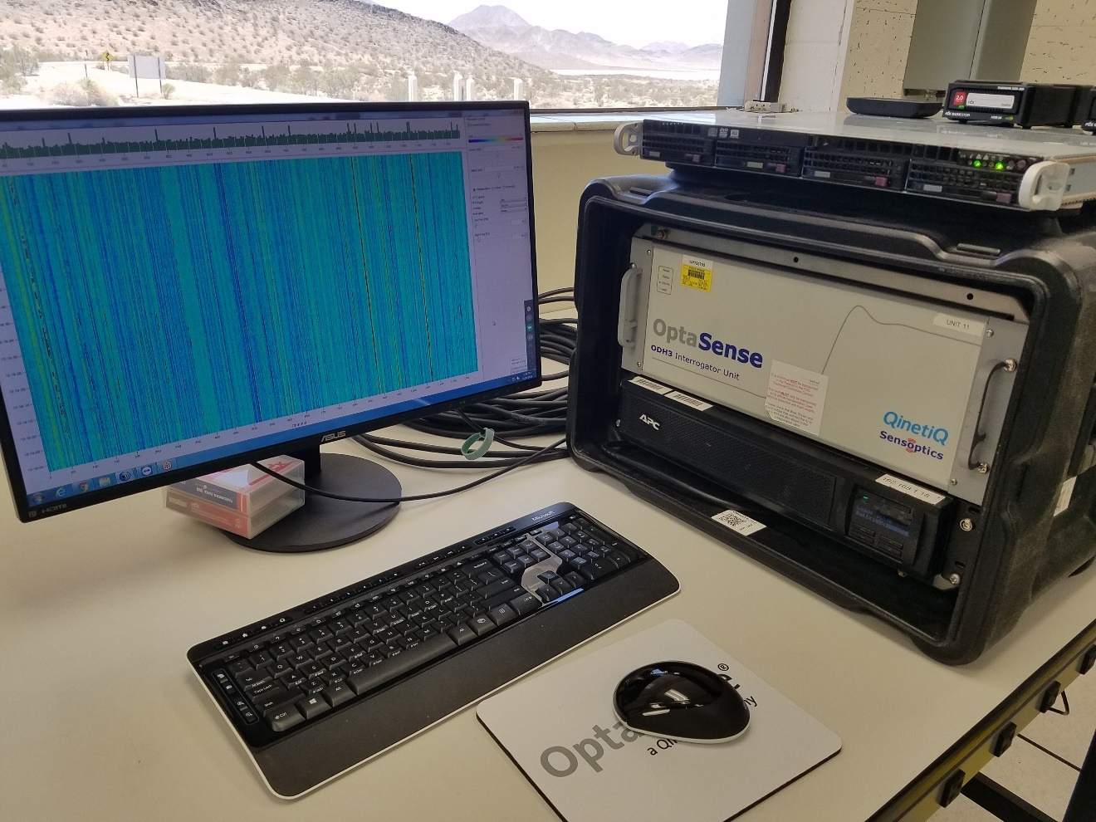
ODH3 Set-Up at NASA Goldstone

Slide 5
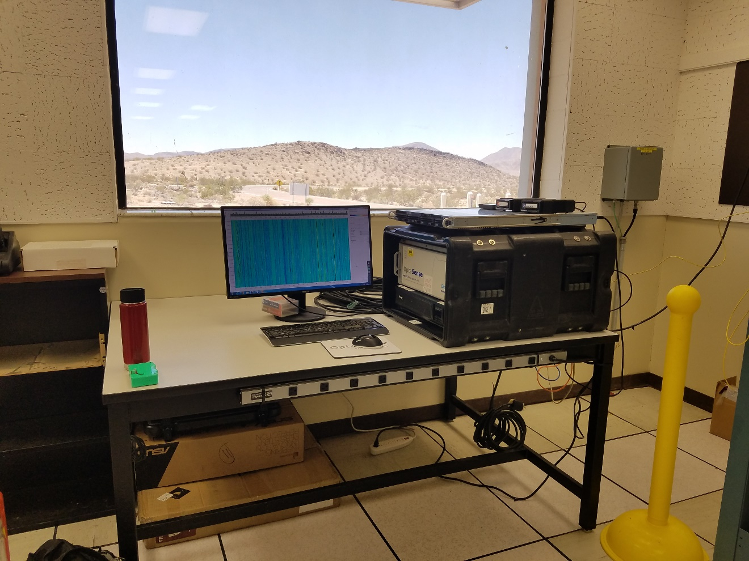
ODH3 Set-Up at NASA Goldstone

Slide 6
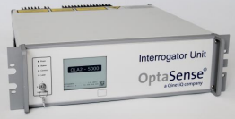
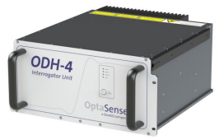
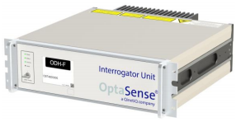
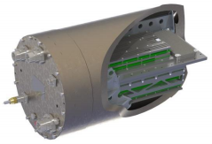

OptaSense’s System Approach to Distributed Sensing
Mix and Match Interrogators and Fiber Cables for Specific Application Requirements
Family of Interrogators:
OLA2.1: infrastructure, pipeline, telecom, perimeter applications; intensity only, range 50km, networked to 1000’s of km, 20 kHz ping rate
ODH4: seismic, microseismic, injectivity applications; high sensitivity, phase consistent, range 10km, 200 kHz ping rate.
ODH-F: flow applications, high sensitivity, phase consistent, 50kHz ping rate, limited range
ODH-M: marinised system for sea floor deployment; high sensitivity. phase consistent, range 10km, 100kHz ping rate.
Proteus™ Family of High-performance Fiber Cables
beyond standard fiber cables
currently 9 type-specific variations
combinations of specialty fiber and specialty cables
Increased acoustic sensitivity
Acoustic + magnetic sensing
Measurement specific cables
Multi-component sensing
Various stages of commercial integration
Looking for validation opportunities

Slide 7
OptaSense’s System Approach to Distributed Sensing
Combine interrogator and fiber cable type to achieve required performance.
ODH4: current commercial DAS system for all seismic, microseismic and flow measurements requiring high sensitivity up to 10 km.
LRQDAS: in development, higher sensitivity, long range (50km) phase consistent, full wave form strain data, dense sensor spacing.
Current Noise floor: ODH3 & Standard Cable
110dB
LRQDAS
ODH4 *
+100dB
Proteus-1
+90dB
+80dB
Spectral Noise Floor Performance (dB √Hz)
Proteus-3
+70dB
+60dB
+50dB
+40dB
Indicative performance only,
some for specialty applications

Slide 8

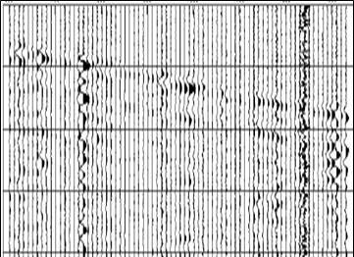
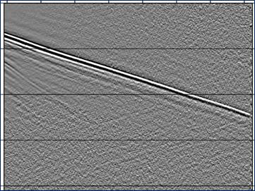
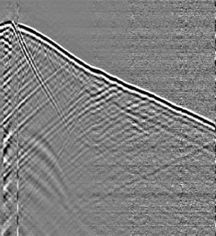
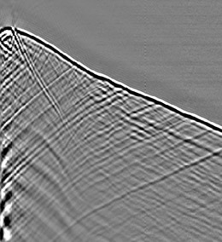
Ongoing Interrogator Development
Building The Next Generation Of DAS Interrogator Units
2009→Version 1
2010→Version 2
2011→Version 3
2017→Version 4
2019→Version 5
SNR equivalent to conventional geophones
Finer spatial resolution
More output channels

Slide 9
Thank you !
Visit us at: www.optasense.com

