Slide 1

Ultra low frequency Noise Properties from Analysis of
Data from the Homestake 3D Broadband Array
Prof. Gary L. Pavlis
Ross Caton¹
James Atterholt²
Department of Earth and Atmospheric Sciences
Indiana University
Frank Vernon, IGPP UCSD
David Thomson, Queens University
¹Phd Student completing this year – great postdoc prospect
²Undergraduate – if he applies to your program you want him

Slide 2
Acknowledgements
Collaborators for Homestake Experiment
  Vuk Mandic, Tanner Prestegard, Patrick Myers, University of Minnesota, Physics (Part of LIGO collaboration)
  Victor Tsai and Daniel Bowden, California Institute of Technology
Supported by National Science Foundation INSPIRE
Active source piggyback funded by NSF Geophysics
Sanford Underground Research Facility (SURF) at Homestake

Slide 3
What does broadband mean?
The Road Less Traveled

Slide 4
Key Point
The unexplored frontier: 30 minutes to 1 day period
  Very few instruments resolve ground noise in this band
  Arrays necessary to resolve ambiguity of marginal snr
  Homestake and PFO borehole data hint at scientific potential
The 1-10 Hz catastrophe
  USArray has shown 1 Hz P waves coherent over 1000+ km
  Since VELA we know 10 Hz signals are hard to stack over more than a wavelength
  For decades I blamed the weathered layer based on experience with JSP arrays
  Homestake active source experiments suggest problem may be more fundamental

Slide 5
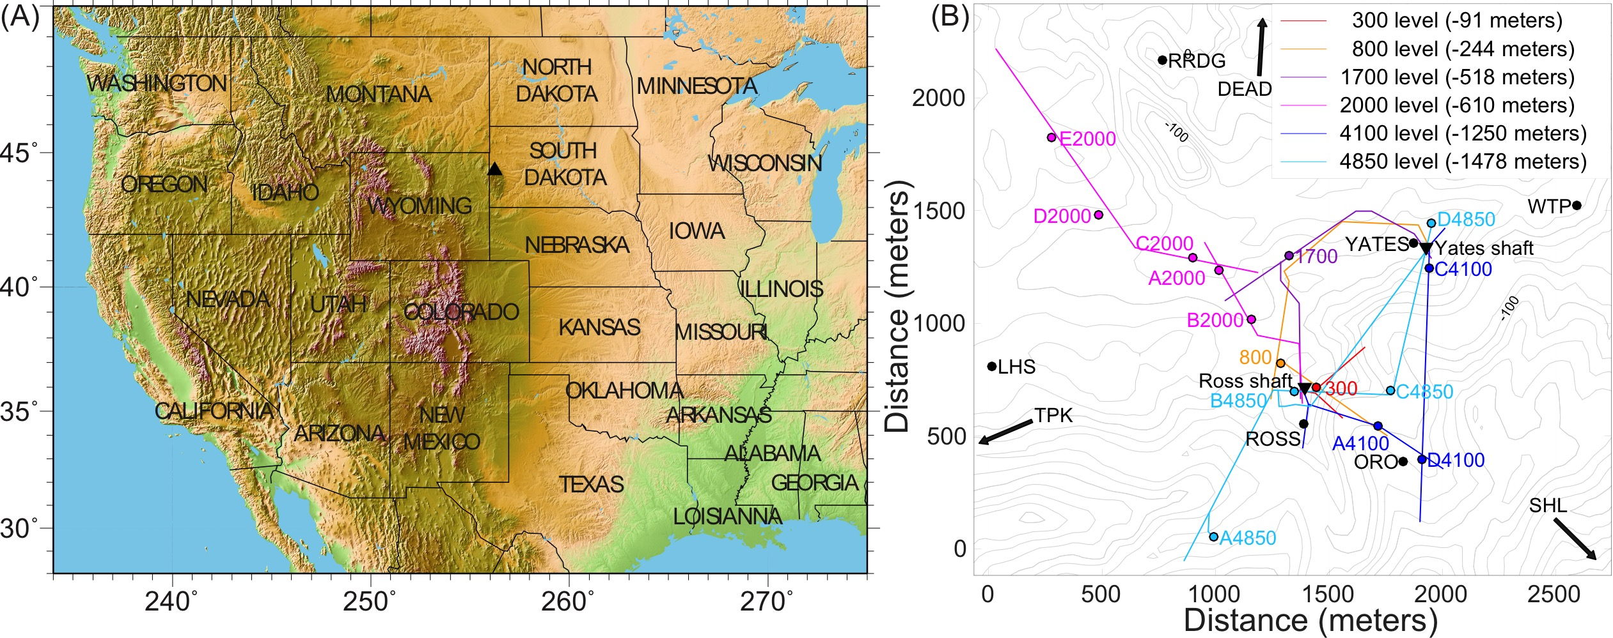
Homestake 3D Broadband Array
Mandic et al (2018) in press in SRL

Slide 6
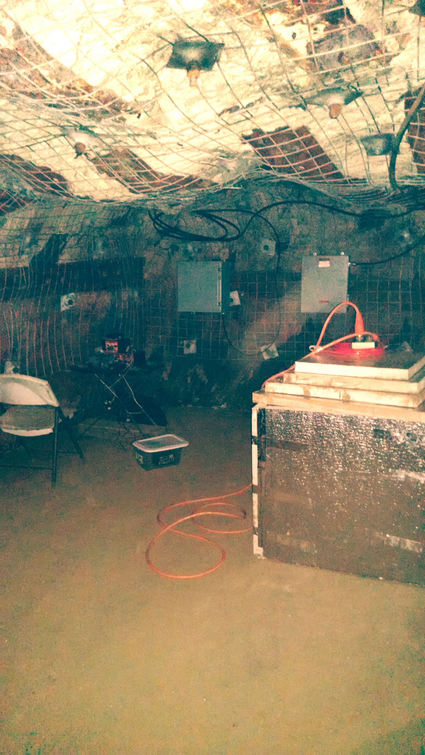
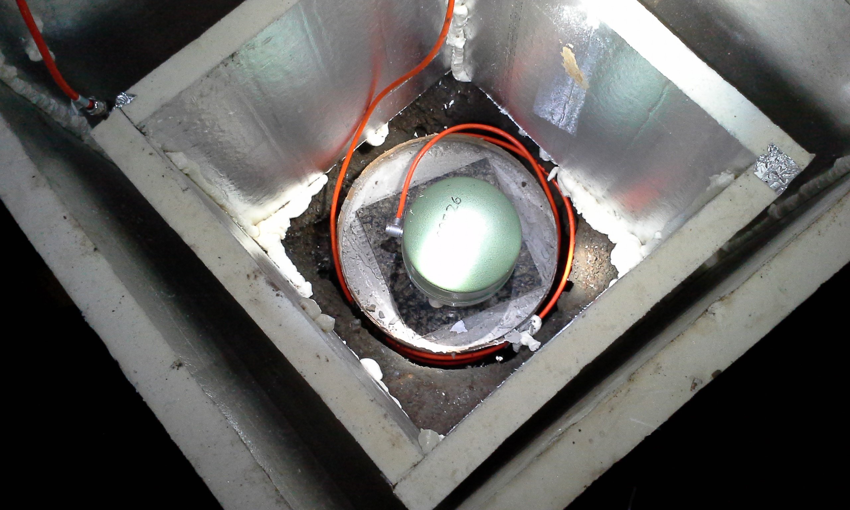
Underground Deployment
Hard rock mine
All in side rooms of various size
Utilized existing concrete from mine
Granite tiles attached to concrete with thinset
All STS-2 sensors
Standard PASSCAL Q330s

Slide 7
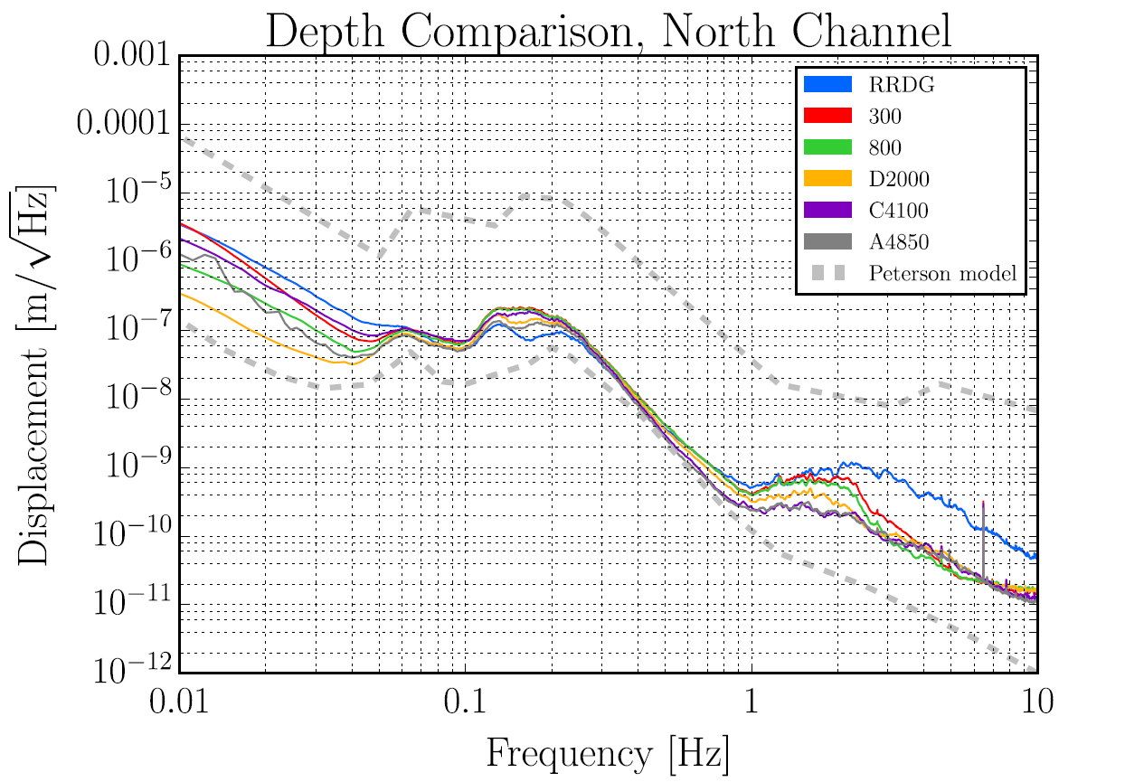
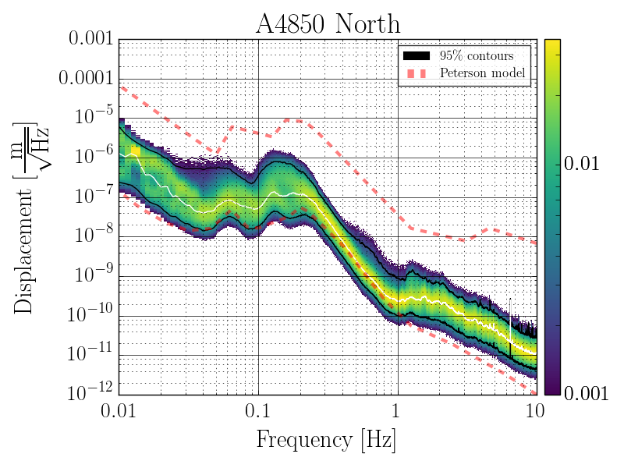
LP band noise good, but not that special

Slide 8
Below 100 s period are where these data are amazing
24 hours

Slide 9
A Key Reason: Temperature stability
Surface
>50C range
Underground
< 1C range

Slide 10
Underground example
1⁰C
One year

Slide 11
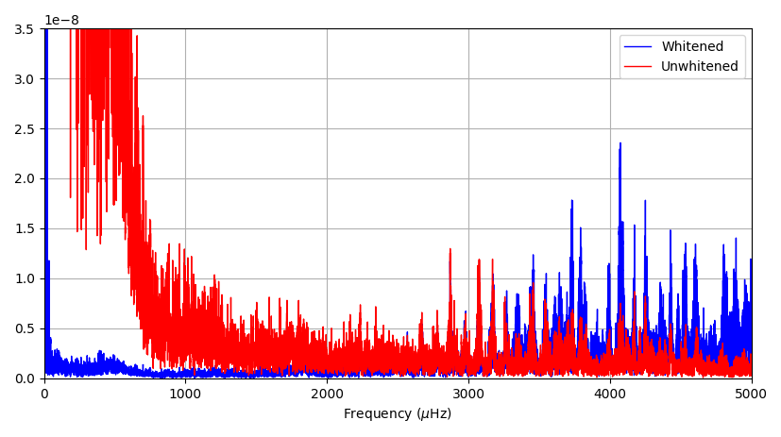
Low Frequency Spectrum Example
?
Earth “hum” modal lines
Earth tides
Lowest free oscillation

Slide 12
Instrumentation Issues in this Band
Issues
Our solution
Instrument response?
Mass recenters
How do we know we are measuring anything but electronic noise?
AR whitening filter
Transient filter
Array stack with jackknife error estimates to measure consistency

Slide 13
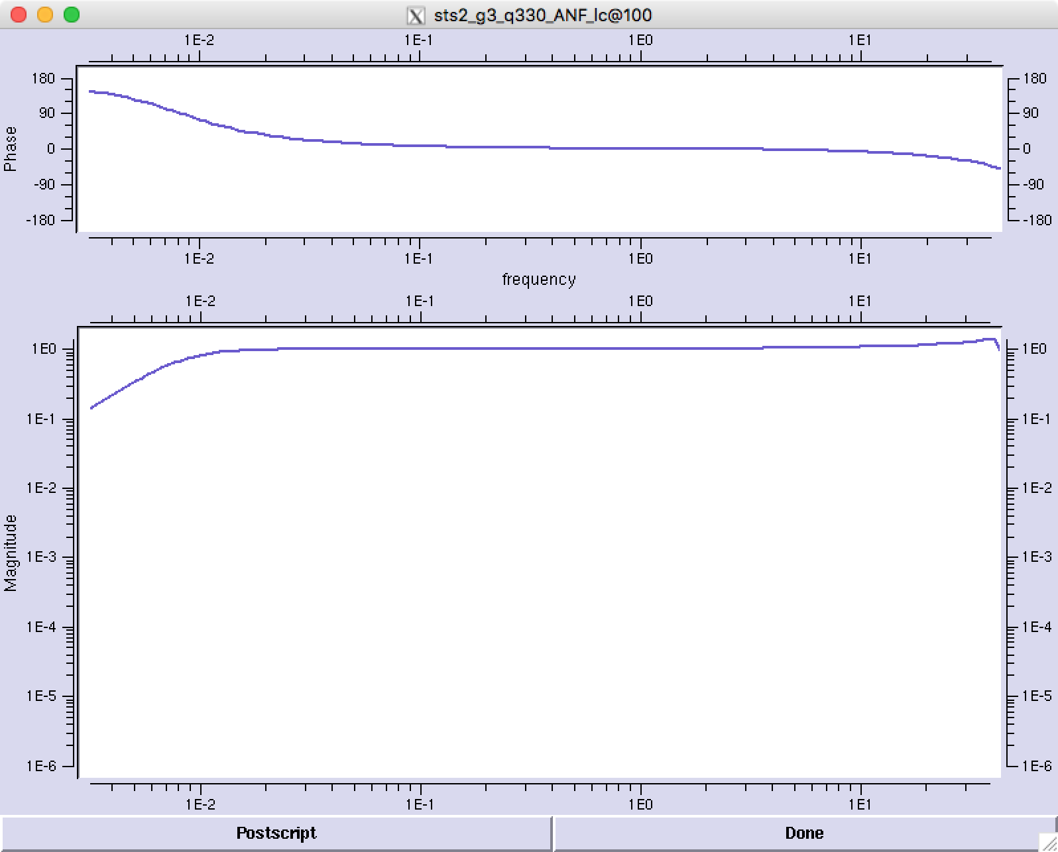
Instrument Response Correction?

Slide 14
Prewhitening
Needed to test hypothesis of Thomson and Vernon that spectra in this band dominated by lines linked to solar modes
Assumption:
  lines are superimposed on a continuous background
  AR filter aims to remove background

Slide 15
AR Prewhitening Operator
Sensor corner 110s =9090

Slide 16
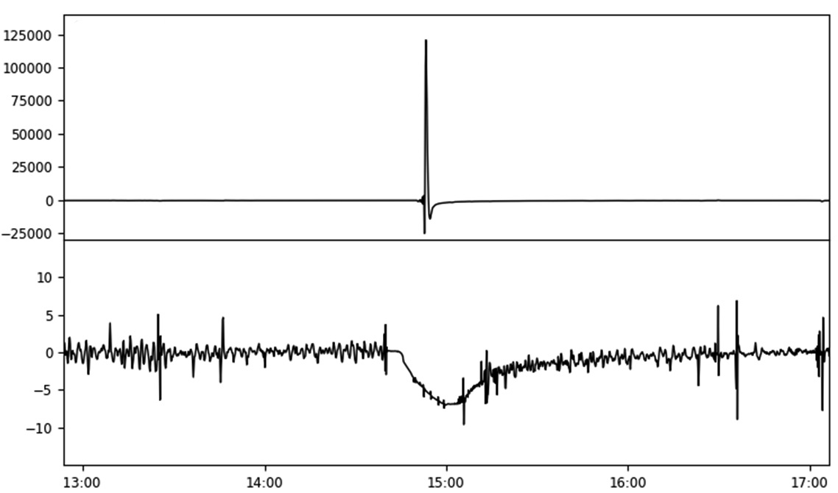
Transient Filter and Mass Recenters
Raw Data
Note Scale Difference
Filtered

Slide 17
Importance of Transient Filter
Studying noise in this band requires a long time series
Frequency resolution scales with 1/length of time series
Try to find any broadband data without a mass recenter in 6 months or more of recording
The big earthquakes we love also will dominate any 1 year long spectrum – works for that too

Slide 18
Importance of a BB array
Redundancy
  Do we see the same signal at all stations?
  Allows statistical error appraisal
Mass recenters don’t align and can be removed by robust stacking

Slide 19
Simulation Validation: 3 lines in white noise
Signal-to-Noise ratio

Slide 20
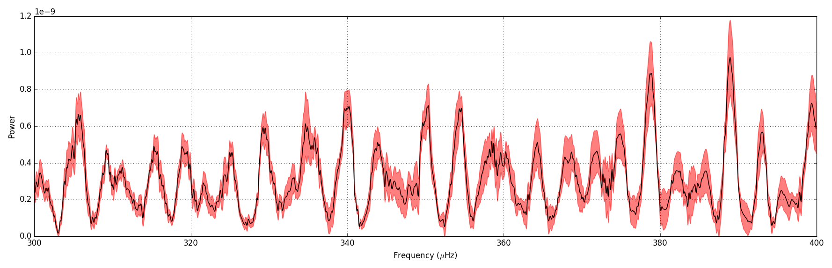
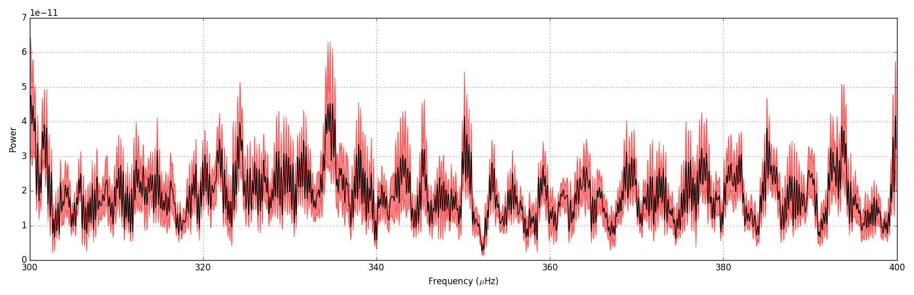
Data Example: Same time period
Homestake
PFO
300
400
Frequency (microHz)

Slide 21
Final Approach: Hard core statistics
Idea:
  Spectra have a different texture than the they should be for white process
  Test using established statistical methods (our colleague David Thomson)
Methods
  Mixing parameter appraises fraction of data in lines
  D-statistic and Kolm0gorov-Smirnov test

Slide 22
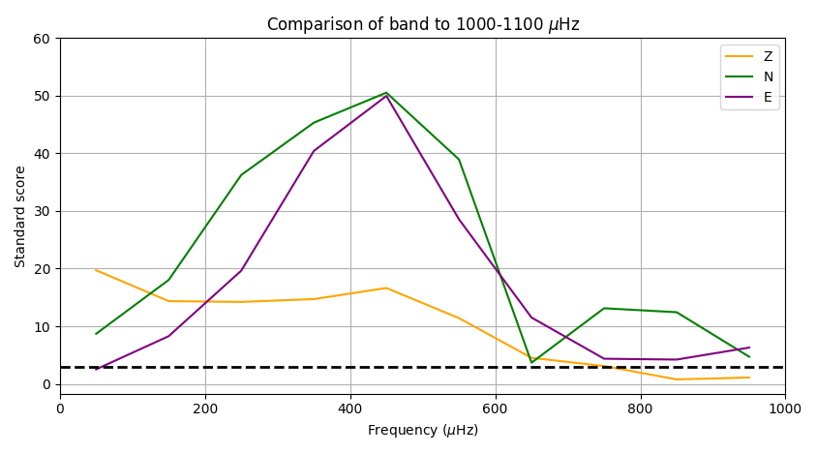
My God, It’s full of Lines!
3 σ threshold

Slide 23
100-800 microHz -Summary
Coherent signals being recorded on underground sites at Homestake and to lesser extend PFO BB array
Spectra characterized by many overlapping pure harmonic lines
Correlates with increase in spectral amplitude trend below 800 microHz at Homestake (unclear if true elsewhere)
Working hypothesis we aim to test – G modes of the sun
  Modes modulate the solar wind
  Geomagnetic field couples to the ground or the seismometer OR
  Coherent signal on instruments created by direct magnetic coupling

Slide 24
Super High Frequency Band (above about 100 Hz) Background
Oil and Gas exploration
  Predominantly 10-100 Hz
  Land versus marine data
  Universally known issue of weathered layer
  Land use of areal arrays for smoothing wavefield
Nuclear monitoring
  0.5-20 Hz band
  Arrays coherent only ~1 or 2 wavelengths
Contrast: short period P waves (1 Hz) are coherent over hundreds of wavelengths

Slide 25
Hypotheses going into this experiment
Proven mostly true
Wrong
Simple linear moveout
Anisotropic media
Limited scattering – simple clean P and S pulses
Neglect the influence of the mine works
Could use plaster and sandbags to anchor sensors to rock

Slide 26
4850 experimental geometry

Slide 27
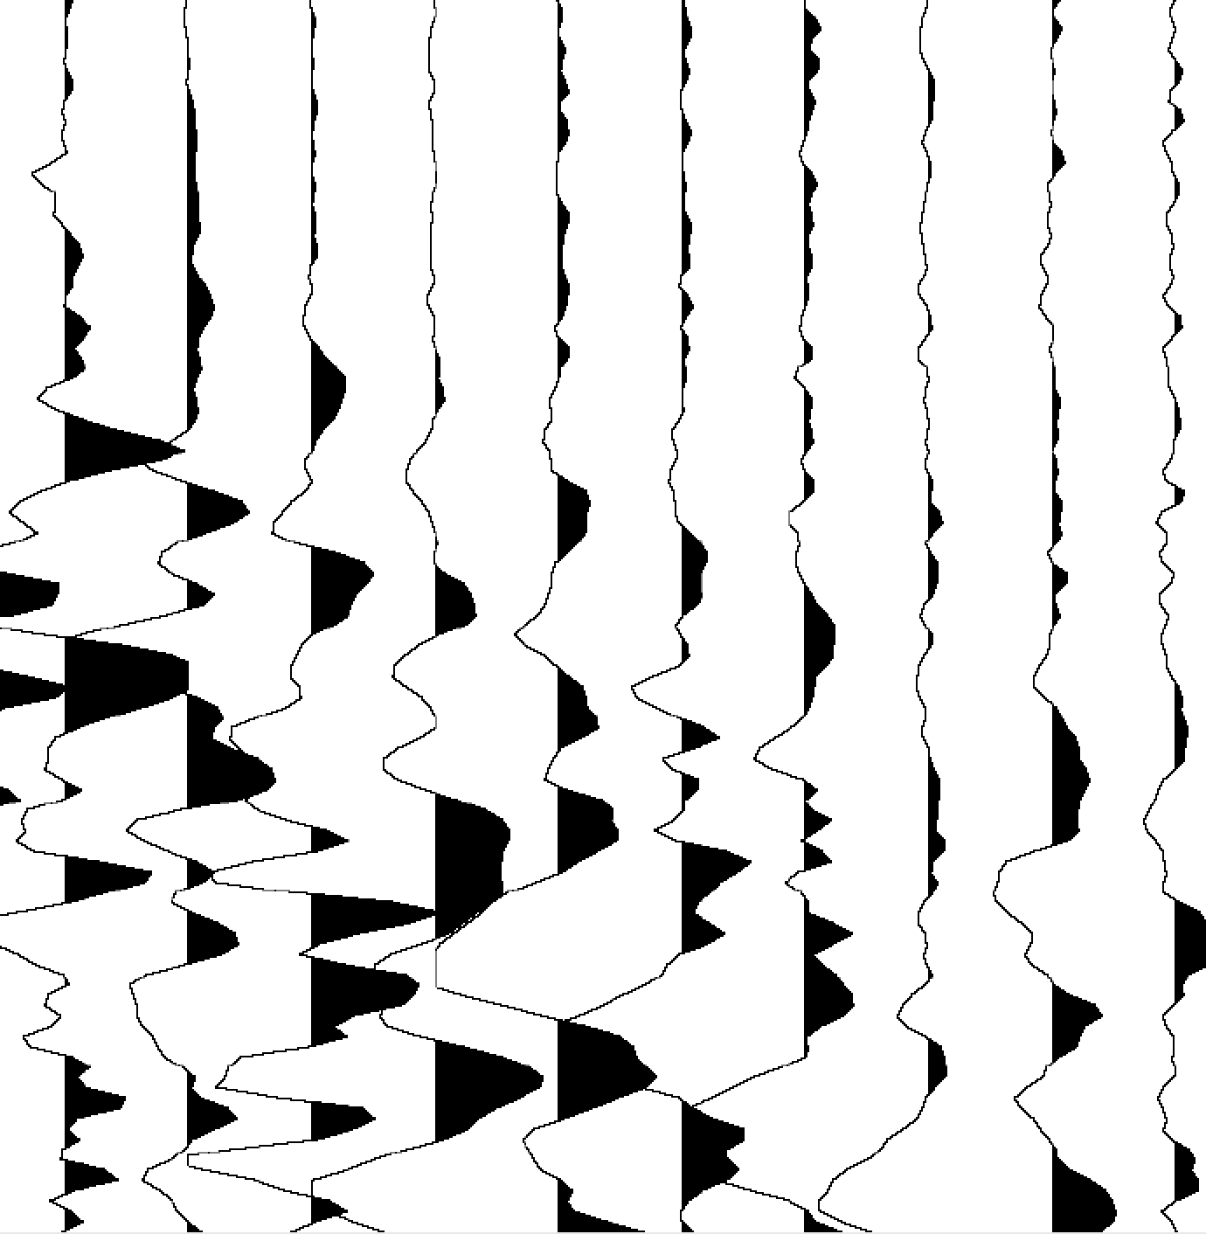
Typical Shot Gather
P
S

Slide 28
Signal and Noise Spectra
Power
Median noise

Slide 29
Common Receiver Gathers from Walkaway
(1 m shot spacing)

Slide 30
Summary Points: super high frequency
Instrumentation
Science
Data
  Wild variations smaller than a wavelength
  Source and receiver side variation
Scattering
  May be higher than expected OR
  May be only seeing local site effects from drift damage zone
  May be fracture related
Fundamental question of how heterogeneity inside the scale of a wavelength is expressed in observables
Anchoring a huge issue
4.5 Hz triaxial phones with spikes problematic
Cables we had available were a nightmare
Followup experiment would ideally use MEMS sensors with much higher spatial density
Anchor sensors with rock bolts
Notes:
Note: Design error – had expected upper limit around 500 not 1500 Hz

