Slide 1
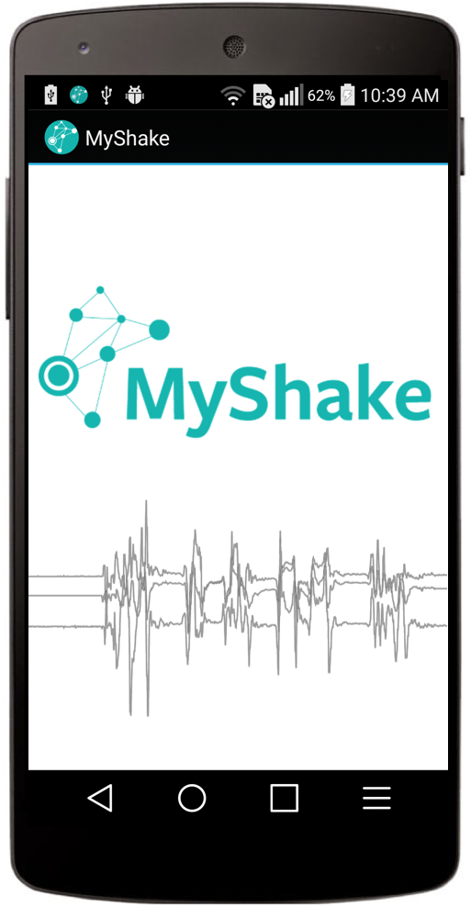
A Dense Seismic Array with Smartphone Sensors

Slide 2
Total downloads: 300,000
Active users: 40,000
Sending data today: 7,000

Slide 3
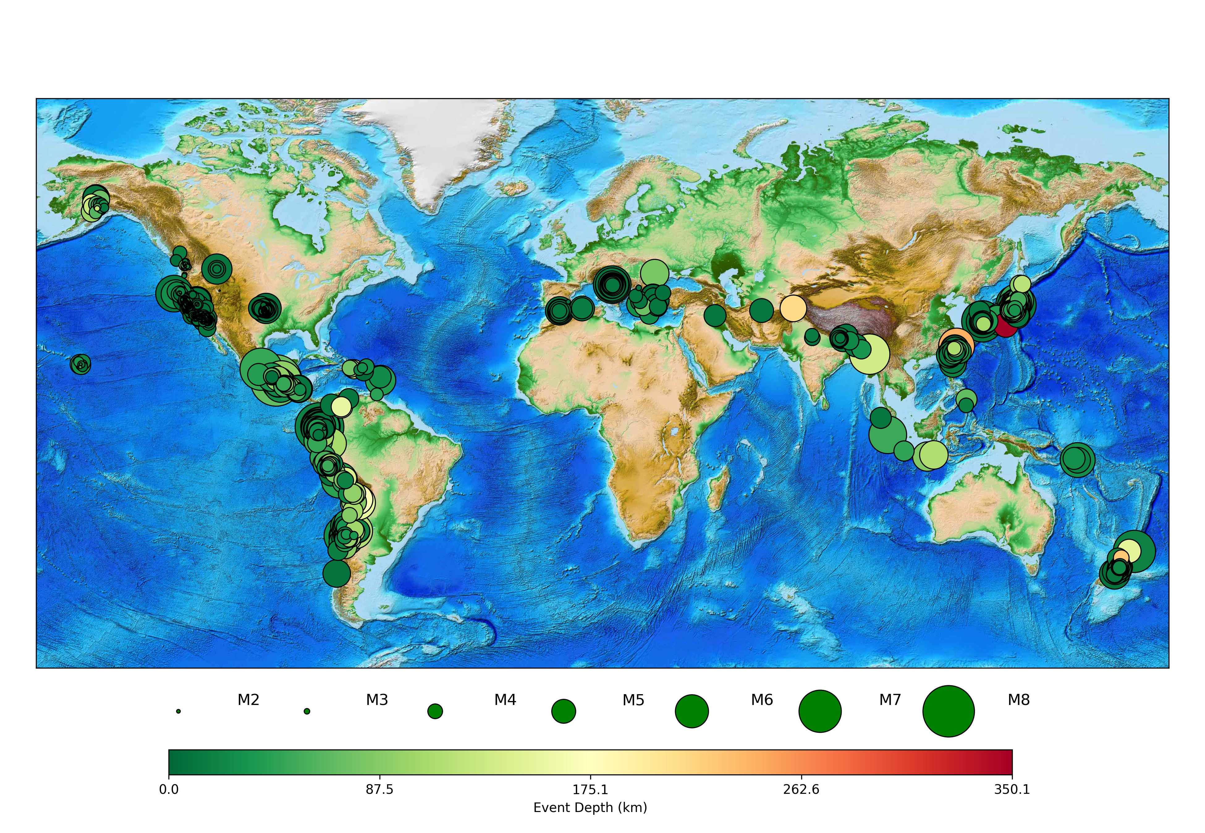
Earthquakes recorded: 800+ to date
M1.7 to M7.8
Surface to 350 km depth
(usable seismic waveforms)
Notes:
780+ events at till Jan 5th this year. These are all based on the USGS catalog.

Slide 4
