Slide 1



Slide 2
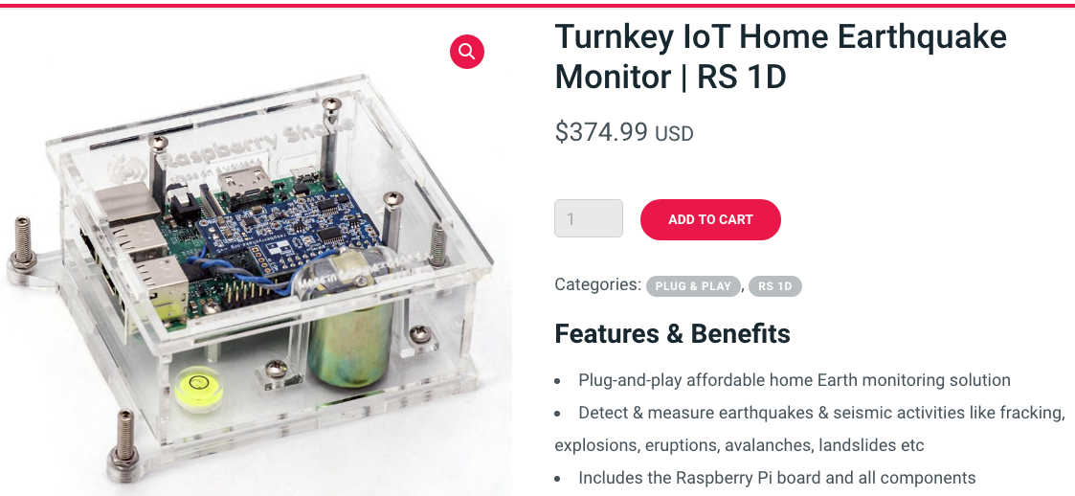
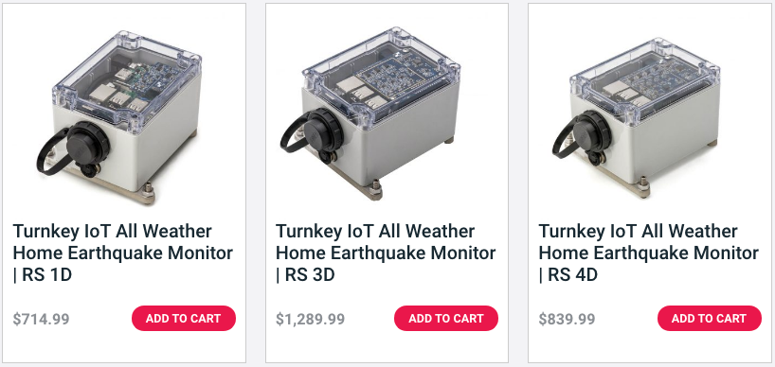
shop.raspberryshake.org
24 bits
100 samples/second
NTP timing
0.5 to 25 Hz
Seedlink server
Auto updates

Slide 3
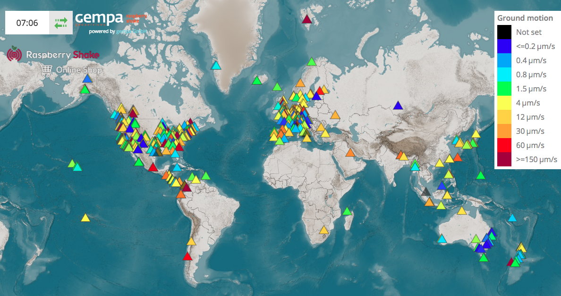
Plug and Play
SeedLink
https://raspberryshake.net/stationview/#

Slide 4
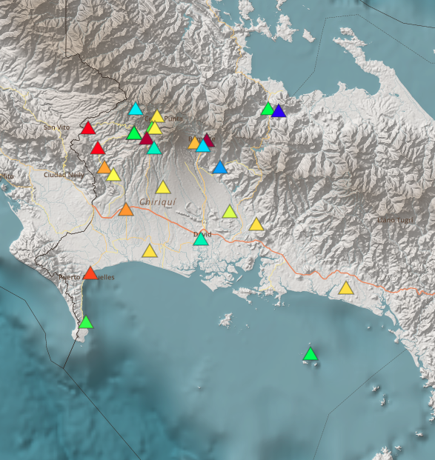
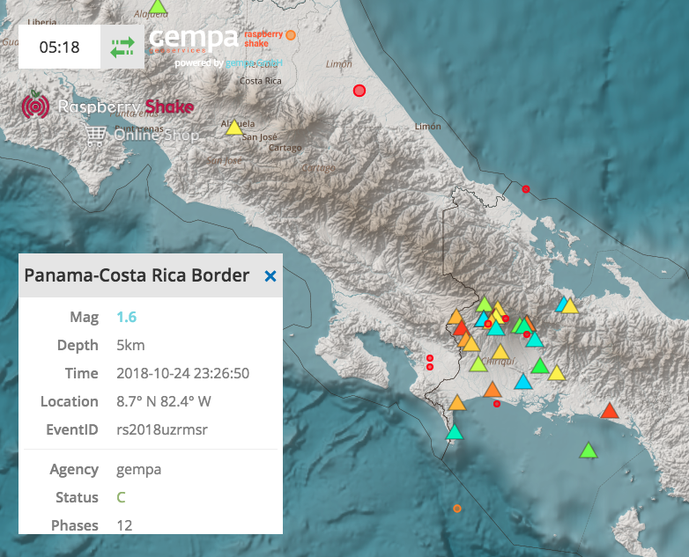
Your Raspberry Shake automatically registers itself into the RShake Data Center where it is immediately used by our Seiscomp to generate earthquake solutions.

Slide 5
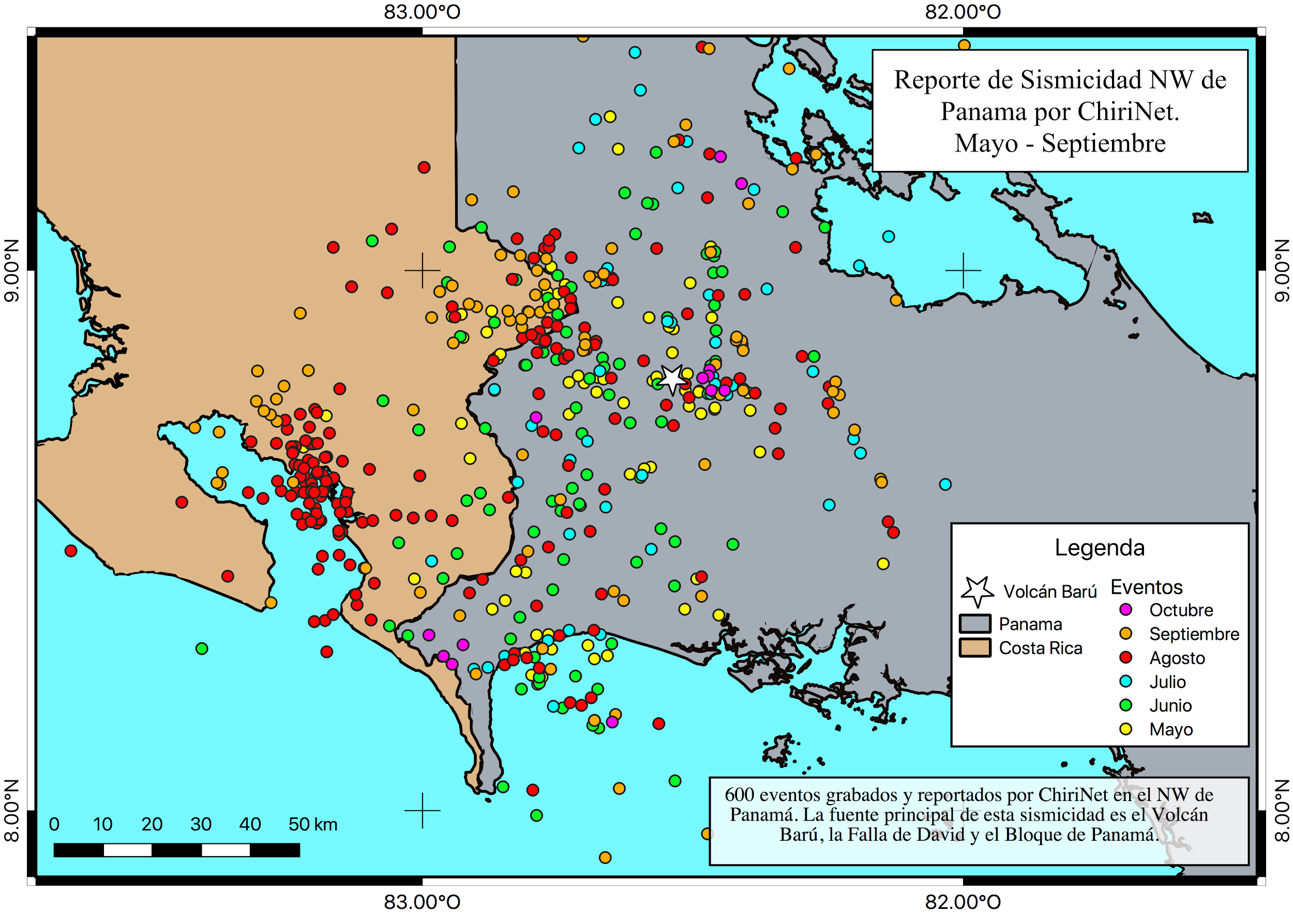
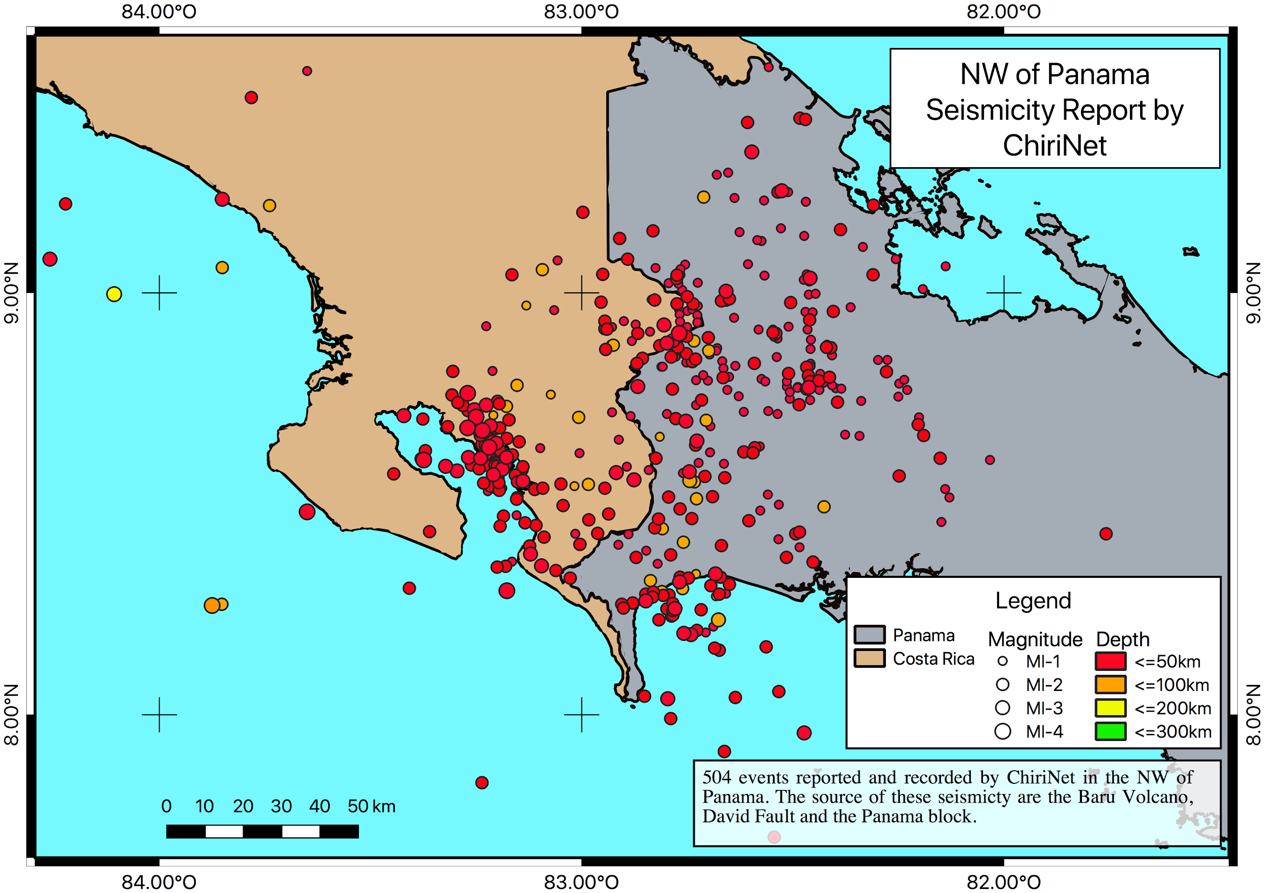
Manual locations can be done with Seiscomp or Earthworm. Since the data is in SEED format all observatory software can use the data easily.
In a 34 station network in Panamá we manually located hundreds of events that automatic systems missed.

Slide 6
https://shop.raspberryshake.org/

