Slide 1
REF TEK Technology Overview
Leonid Zimakov ‖ Sales Segment Manager - Earth Systems
IRIS Seismic Instrumentation Technology SymposiumIn, October 30-31, 2018.

Slide 2
INRODUCTION
Refraction Technology, Inc. known as REF TEK, was established in 1975 and became a part of Trimble Inc. in October 2012.
REF TEK primary business is the design, manufacture, sale, and service of digital seismic recording equipment and systems. Our equipment is mainly used for research and hazard mitigation seismology, specifically:
    Portable seismic stations for hazard mitigation
    Telemetry seismic stations and networks for a variety of communications media Including VSAT, Spread Spectrum Radio, GSM networks, Internet, etc.
    Permanent broad-band stations,
    Strong motion stations,
    Structural monitoring,
    Earthen structure monitoring (earthen dams, open pit mines, landslides, etc.)
    Induced seismicity monitoring

Slide 3
BACKGROUND
Applications
  Local/Regional Seismic Networks
  Broadband Array Studies
  Aftershock Studies
  Telemetry earthquake monitoring
  Active-Source Crystal Studies
  Micro-zonation Surveys
  Site Noise Surveys
  Wide angle reflection & refraction
  Passive broadband and short period tomography & imaging
  Oil & Gas production monitoring
Experience
  Approved instrument supplier for IRIS/PASSCAL experiments
  About 25% of all GSN stations use instruments supplied by REF TEK
  More than 12,000 REF TEK High Resolution seismic recorders are deployed in the field
  Customers in more than 70 countries
  All REF TEK telemetry networks are true error-correction digital telemetry
  More than 50 telemetry networks installed around the world with different communication media

Slide 4
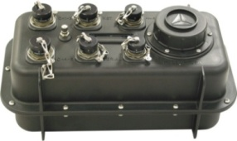
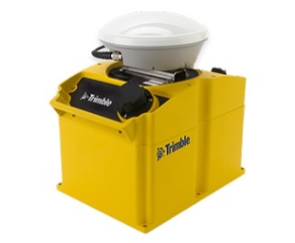
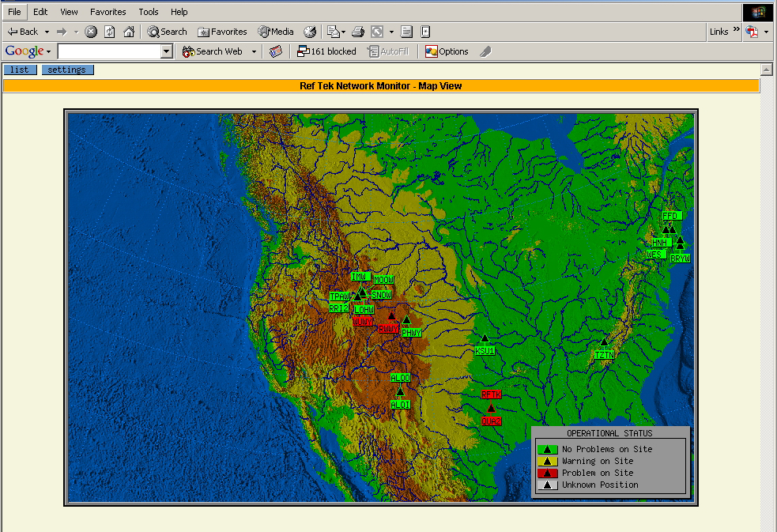

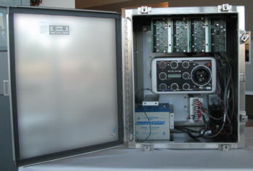
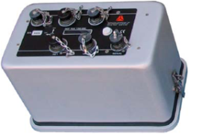
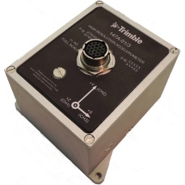
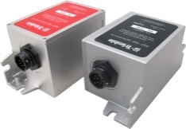
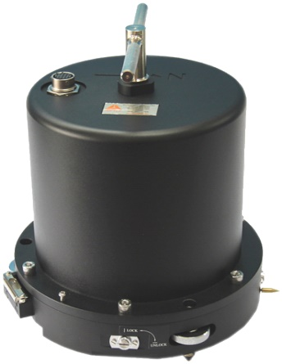
Seismic Equipment Product Line:
Command/Control & Post-processing SW
SeismoGeodetic System
High Resolution Recorders
Sensors

Slide 5

High Resolution Recorders: Seismic Recorder
High Resolution Broadband Seismic Recorder, Model 130S-01 (available in 3- and 6-channel configurations
Applications
Local and Regional Broadband Observatory Aftershock Study Active Source Micro-Zonation Survey Site Noise Survey Induced Seismicity
Main Features:
Compact and light-weight Full duplex error-correction data transmission protocol Multiple sampling rates; data streams, and trigger modes Two Removable mass data storage Standard and REN firmware w/ Ultra-low latency data transmission

Slide 6
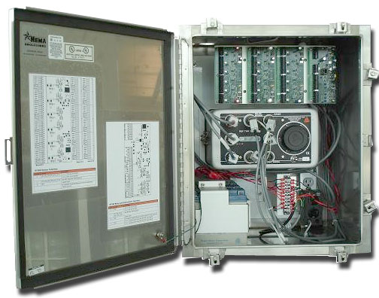
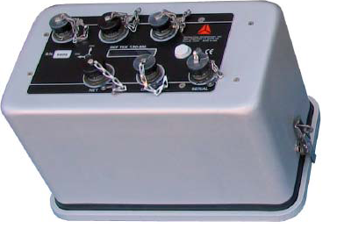
High Resolution Recorders: SM Recorders
High Resolution Accelerograph, Model 130-SMHR (available in 3- , 6- , and 9-channel configurations
12- or 18-channel Central Recording Accelerograph, model 130-MC
3-channel Accelerograph
6-channel Accelerograph
Applications
Building Response Monitoring, Bridge Response Monitoring, Dam Response Monitoring Tunnel Monitoring Building Around Excavation Free Field Site Response Analysis
9-channel Accelerograph

Slide 7
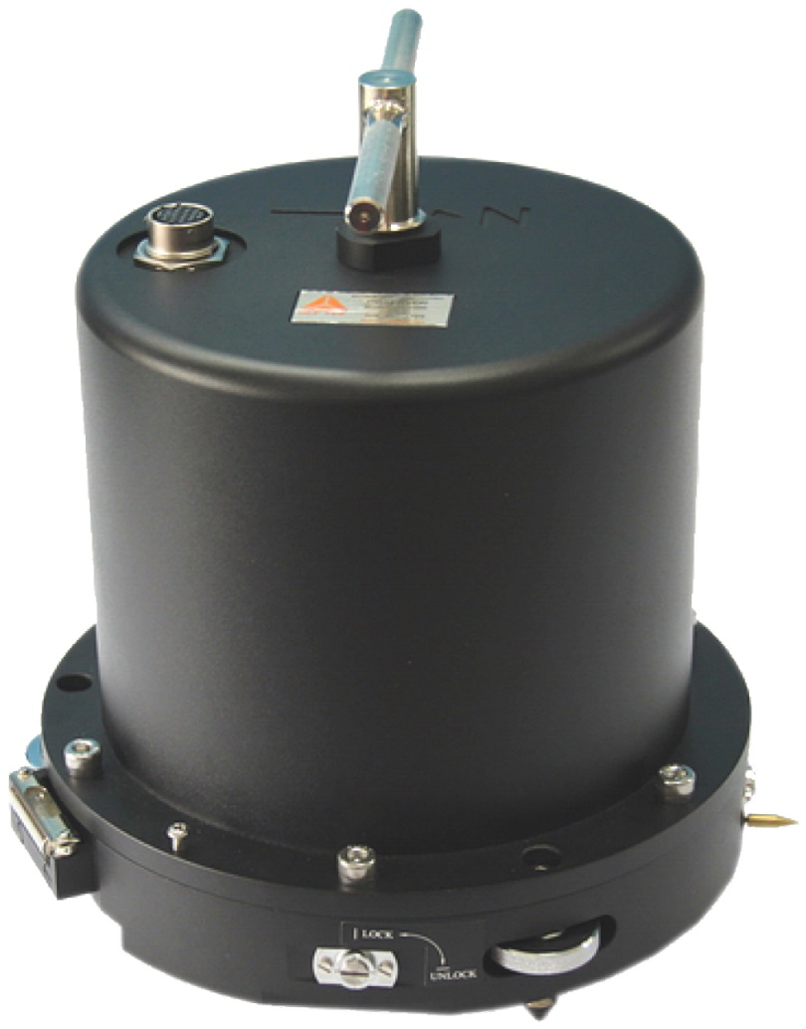
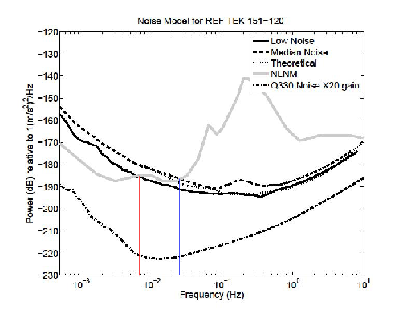
Sensors Product Line: Broadband Seismometer
Ringler, A. & Hutt, C. (2010, November - December). Self Noise Models of Seismic Instruments. Seismological Research Letter, 81(6)
Main Features:
Exceptional self-noise GSN Vault Design Low Power Consumption Force-Balance Electric Feedback Robust Mass Locking Mechanism Robust Thermal and Mechanical stability
Applications
Broadband Observatory Local and Regional Seismic Observation

Slide 8
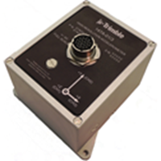
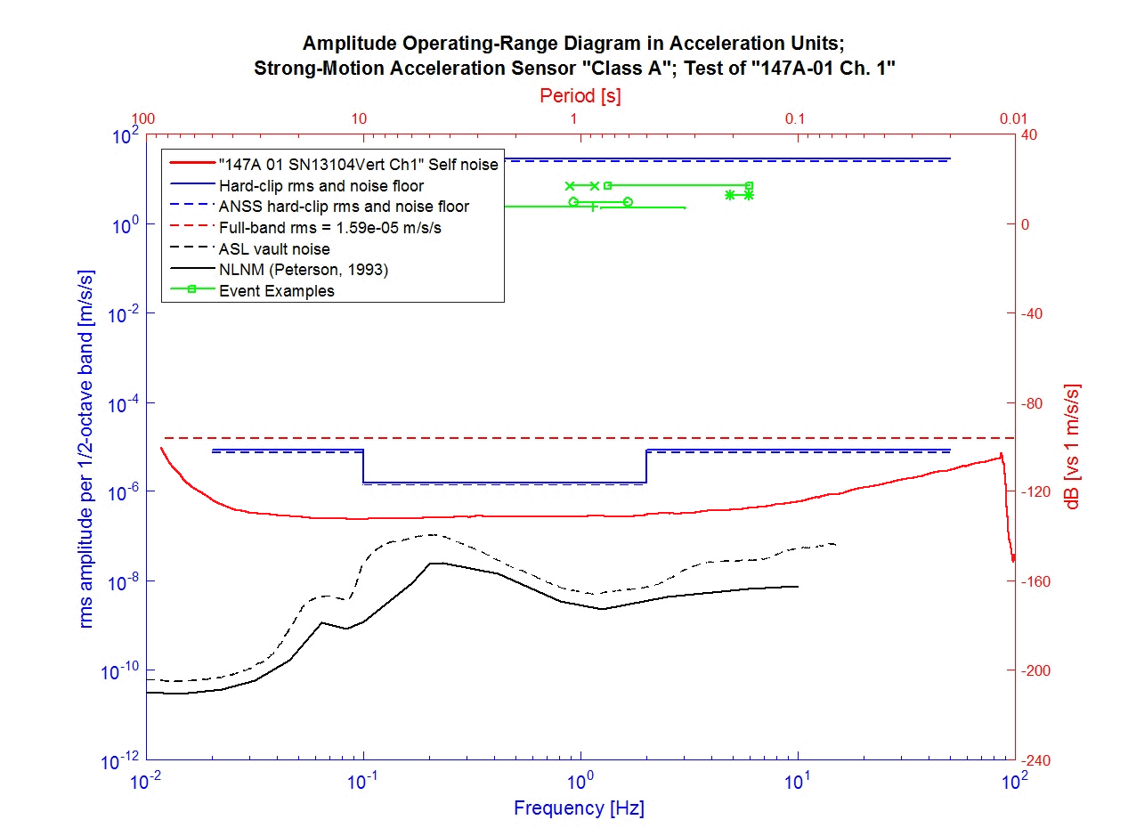

Sensors Product Line: Accelerometers
Class A, Low Noise Accelerometer Model 147A-01/3
Applications
Building Response Monitoring, Bridge Response Monitoring, Dam Response Monitoring Tunnel Monitoring Building Around Excavation Free Field Site Response Analysis
Class A, Low Noise Accelerometer Model 147A-01/1 (available in Horizontal and Vertical orientation)

Slide 9
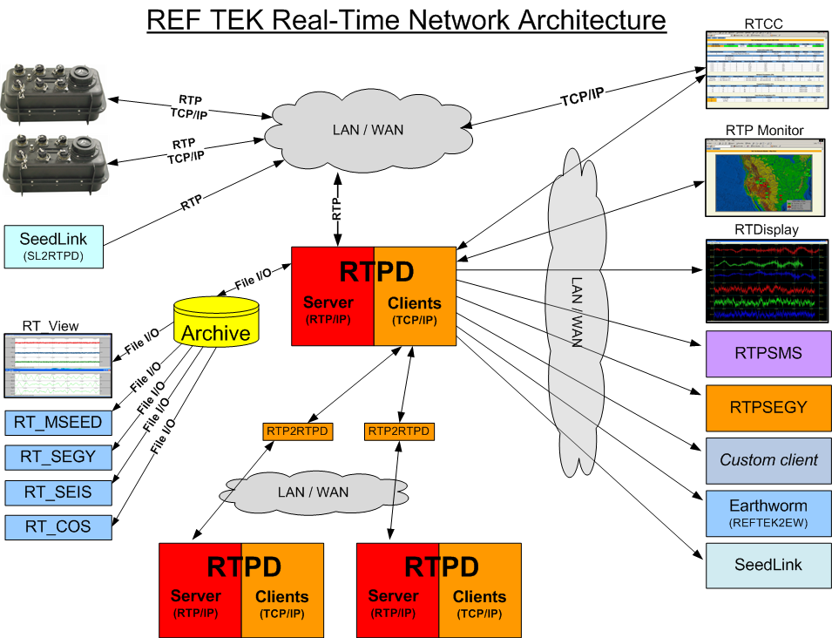
Software:
Data Acquisition & Command/Control s/w via LAN/WAN
iFSC for field operation
Applications:
Command/Control in field Remote Command/Control via LAN/WAN Network Monitoring Interactive Data Processing
COMPASS: Comprehensive Data processing software

Slide 10
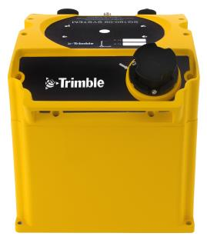
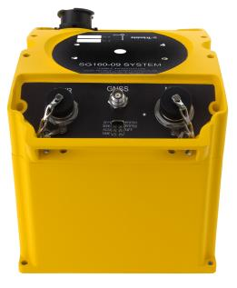
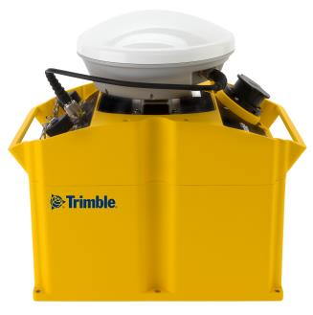
SeismoGeodetic System: SG160-09 Kestrel
USB Drive
GPS Antenna Connector
Power
LED indicators
Ethernet
Attachment for Leveling Plate
GNSS Antenna
(removable)

Slide 11

Advanced Features of SG160-09:
Combined true acceleration (200 sps) and displacement (10 sps) observations: GNSS displacements processing on board receiver (Trimble RTX PPP)
  Instantaneous displacements processed, recorded and transmitted from receiver
  Unified recording format of both seismic and geodetic data (MRF)
Low power
RTX correction over satellite L-bandwidth or IP network
Fast data delivery algorithm (REN) with low latency (0.2sec)
Error-correction communication protocol with Backfill algorithm for data integrity
Different geodetic antenna to choose
Low maintenance
Real Time data display for high resolution acceleration and displacement data (10 or 200 sps) to real-time processing s/w: Earthworm and SeisComp3
Predictive Kalman filter combines GNSS solutions and high frequency accelerometer data
  Output 200Hz displacements
  Raw data can be post processed:
    Forward Kalman filter
    Backward Kalman filter
    Smoothing with forward-backward filter, and
    User defined filter parameter

Slide 12

Thank you

