Slide 1
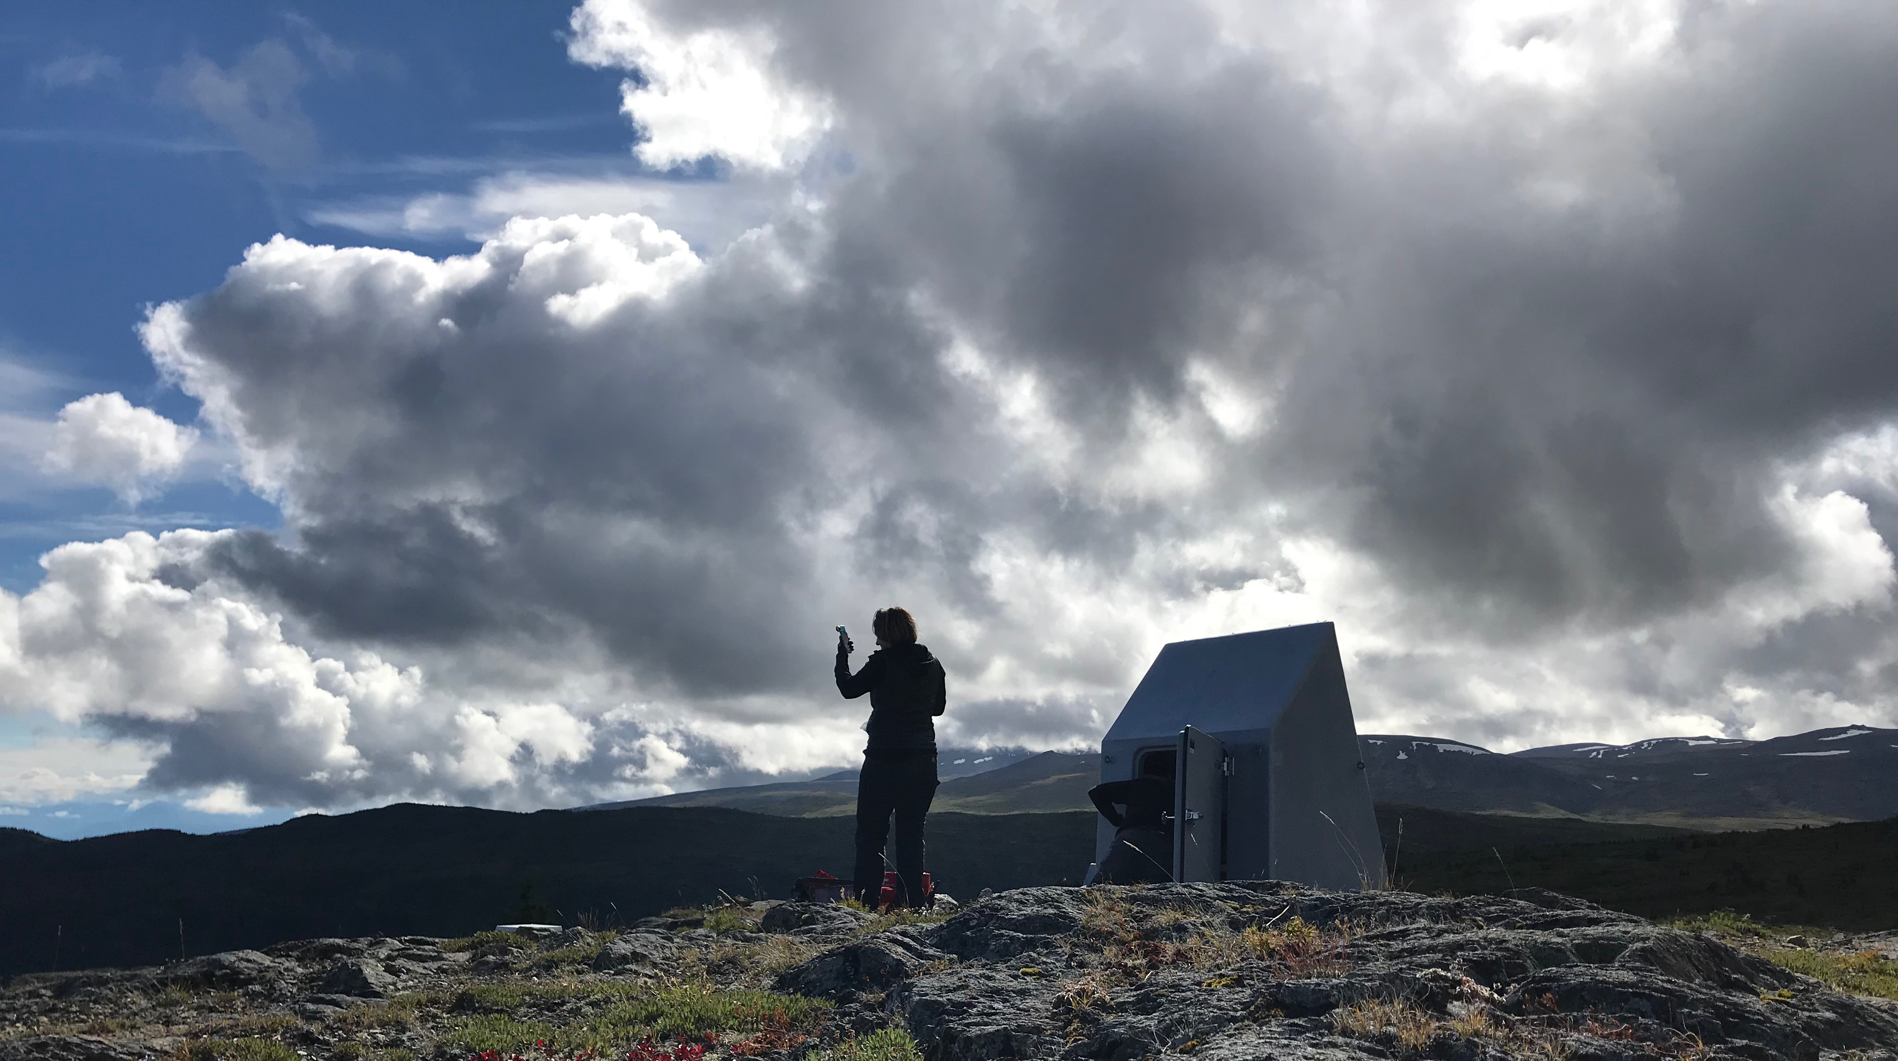
An Update on IRIS Instrumentation Services Activities and Plans
  The Instrumentation Services
  Management Team
Seismic Instrumentation Technology Symposium
October 30-31, 2018
Tucson, AZ

Slide 2

Status of IRIS
Latest proposal successful, renewed for 5-years (thru 9/30/23)
SAGE or SAGE-II, not NGEO
  Seismological Facility for the Advancement of Geoscience
Continued support for IRIS Instrumentation Services
  GSN, PASSCAL, PASSCAL-Polar, PASSCAL-MT
  Enhanced instrumentation for wavefield imaging and rapid response to geohazard events
Alaska TA operations
  Full operation through 2019
  Subsequent years will be some combination of operations, adoptions, and demobilizations
www.iris.edu

Slide 3
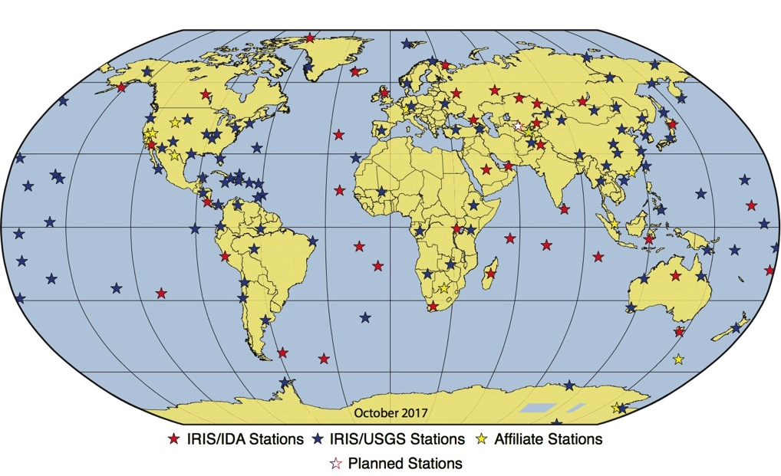
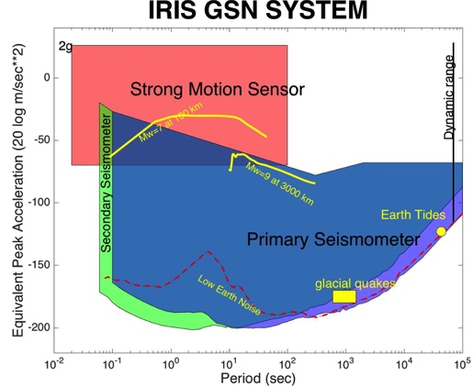
Global Seismographic Network
Partnership between NSF, IRIS/IDA, USGS
150+ stations with a global distribution at ~2,000 km spacing
Very broadband (hrs to ~10 Hz)
High dynamic range
Quiet instruments / sites / installations
Real-time telemetry
Well-characterized instrument response
Plans for the Next 5-10 Years
Continue upgrades to site infrastructure to optimize station performance
Deploy next generation very broadband sensors
Stations as Geophysical Observatories - adding other instrumentation as appropriate
“a global network of uniformly spaced stations (~2000 km spacing), capable of recording the full range of seismic signals, with data collection in real time”

Slide 4
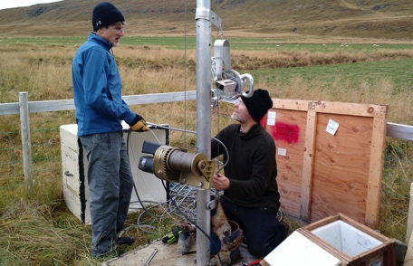
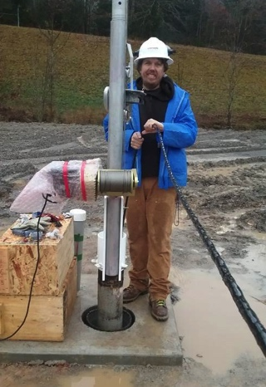
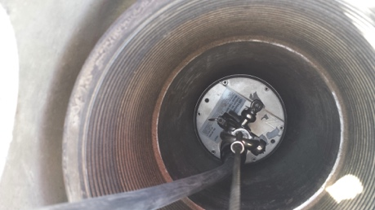
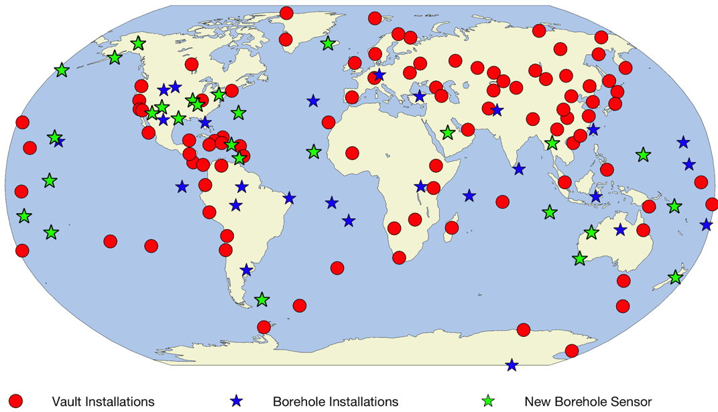
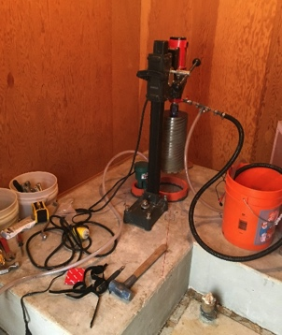
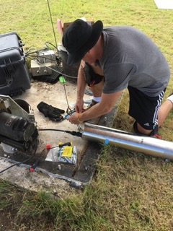
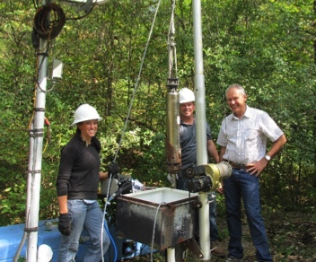
GSN Modernization – New Sensors
II-BORG
IU-WVT
II-RAYN
IU-TUC
IU-SSPA
II-COCO

Slide 5
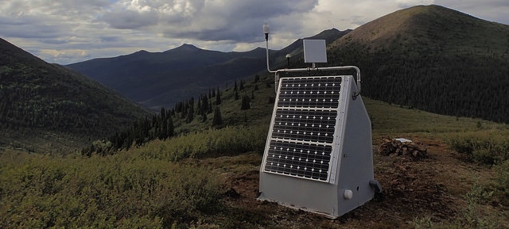
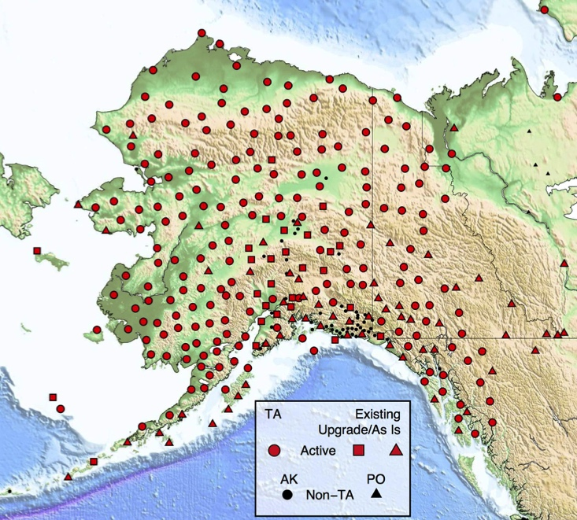
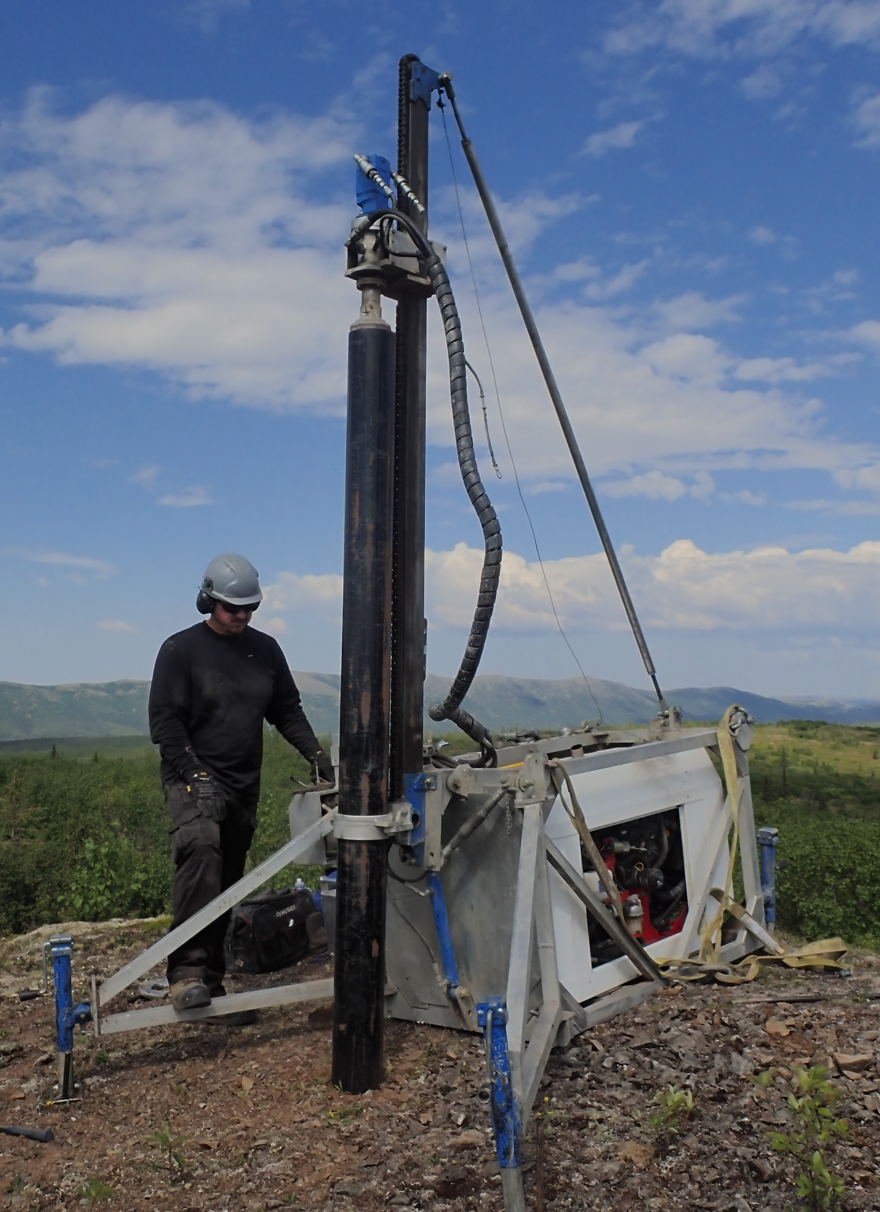
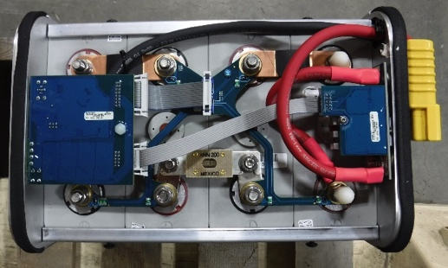
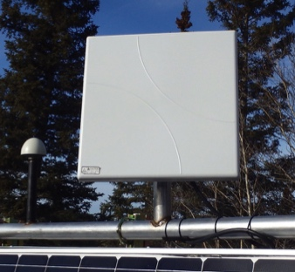
Alaska Transportable Array
Program Status
~280 stations (196 operated by IRIS)
85 km spacing
Broadband posthole seismometers, with infrasound, pressure, meteorological, soil temperature sensors
New techniques and technology
  Portable posthole drill
  Li battery power systems
  Inmarsat BGAN telemetry (< 1 hr)

Slide 6
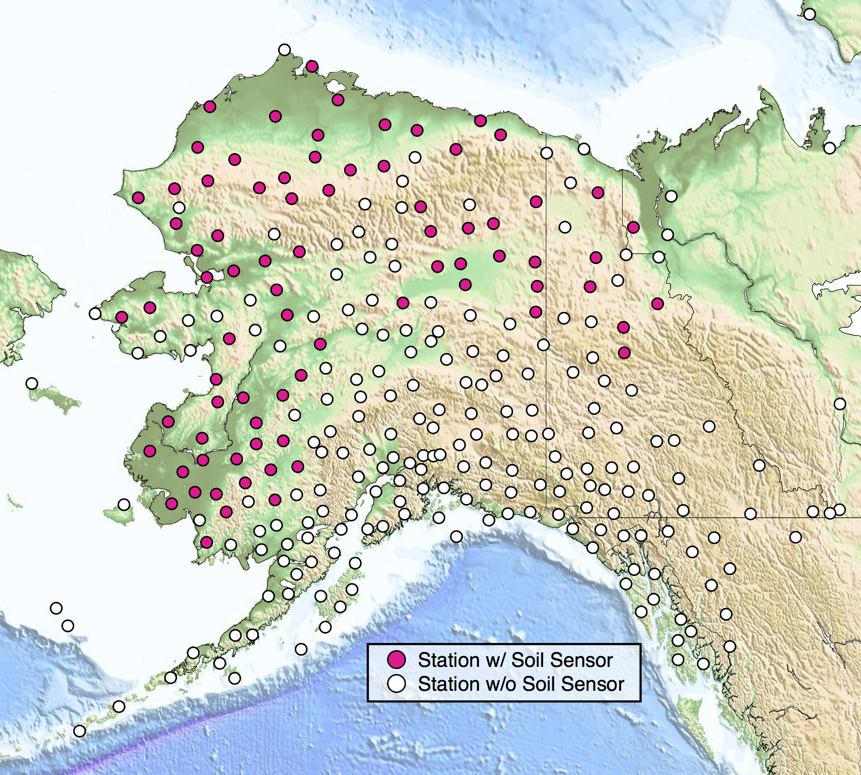
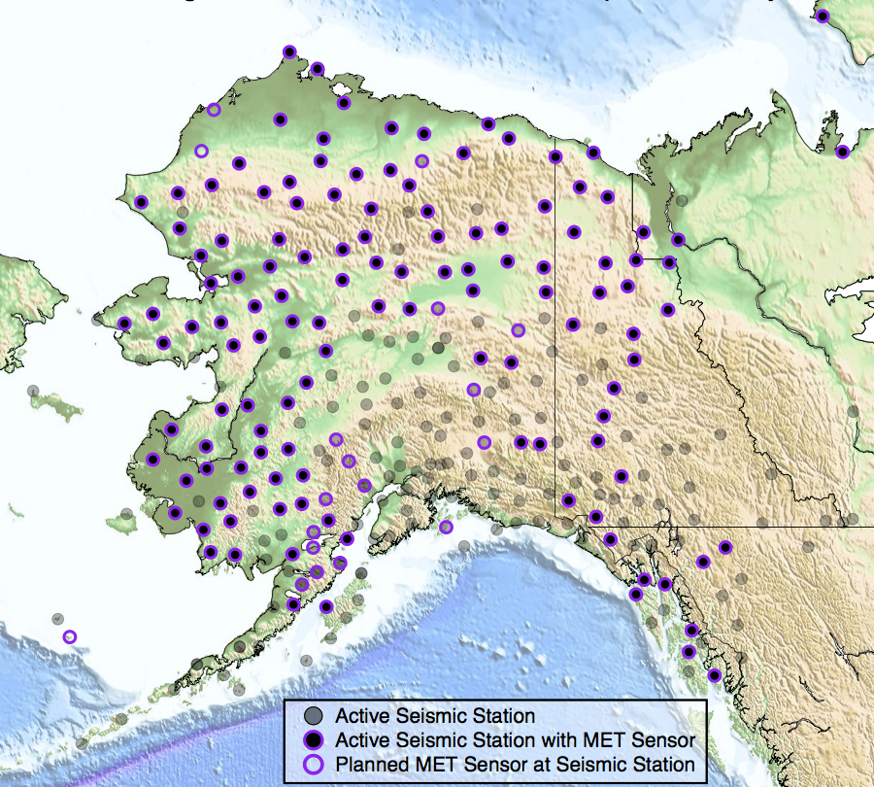
AK-TA Future Opportunities
Plans for the Next 5-10 Years
NSF O&M of full array through 2019
Opportunities for various activities with a prolonged operation
  CCArray
  State/federal earthquake and volcanic monitoring
  Arctic environmental observations
Potential new instruments/observations
  Cameras – weather and fire monitoring
  GNSS receivers – ionosphere activity and soil moisture
Continuing engagement with state and federal stakeholders
Soil Temperature Sites
Met Sensors

Slide 7
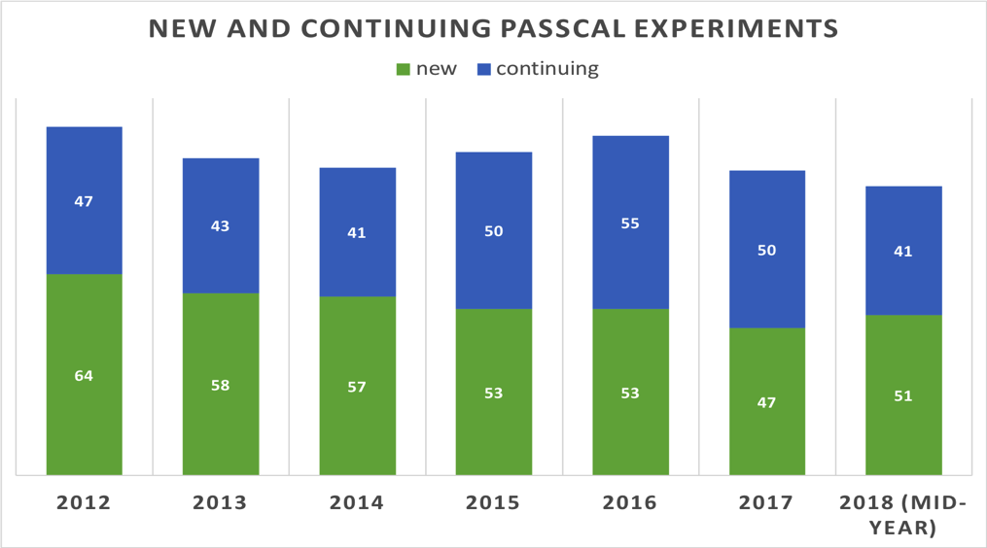
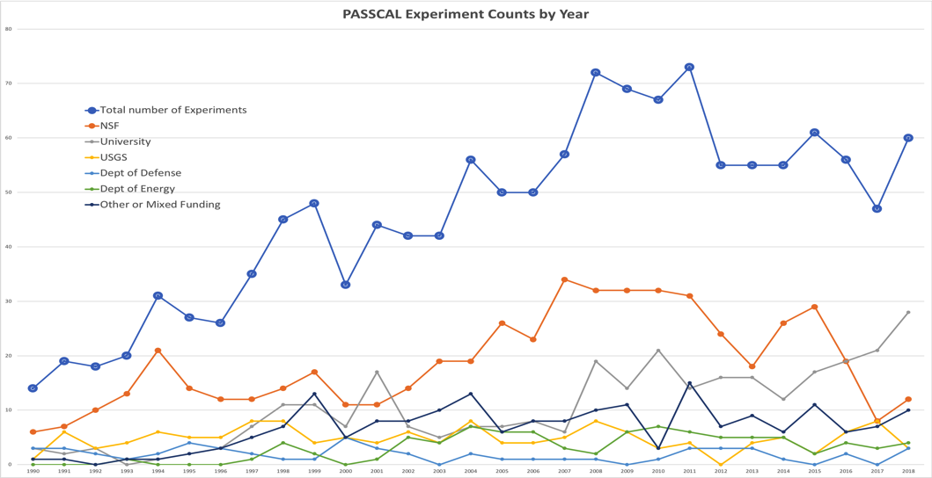
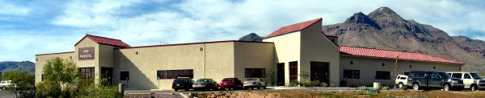
PASSCAL
Program Status
  Sustaining current capabilities – maintain, test, and evaluate pool equipment, train users
  Support over 50 new experiments per year and 40-50 continuing experiments at any given time
  NSF is no longer the predominant funding organization, most are self-funded
    Push to reduce logistics-heavy experiments
1990
2018

Slide 8
PASSCAL Usage/Request Trends
Broadband
Short period
Broadbands
  BB usage has declined over the past 5 years.
  No longer oversubscribed
Short period sensors
  Slightly declining usage, but still near max capacity
Nodes
  Scheduling through 2022 – filling up through 2020
  Requested as quickly as they are added to pool
Nodes

Slide 9
PASSCAL Plans
Plans for the Next 5-10 Years
  Right-size instrument pool to meet community observations needs
  Enhance wavefield imaging with multi-modal array capabilities
  Develop a dedicated rapid response capability based on community requirements
Common Themes
Easier to deploy
  Smaller, lighter
  Direct bury (no vault required)
Longer-lasting
  Nodes (35 days) vs Texans (5 days)
Fewer batteries
  Lower power IP/BB systems

Slide 10
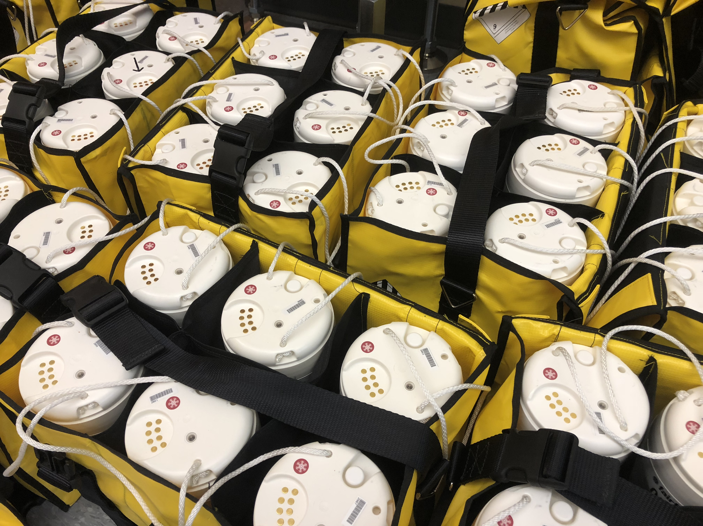
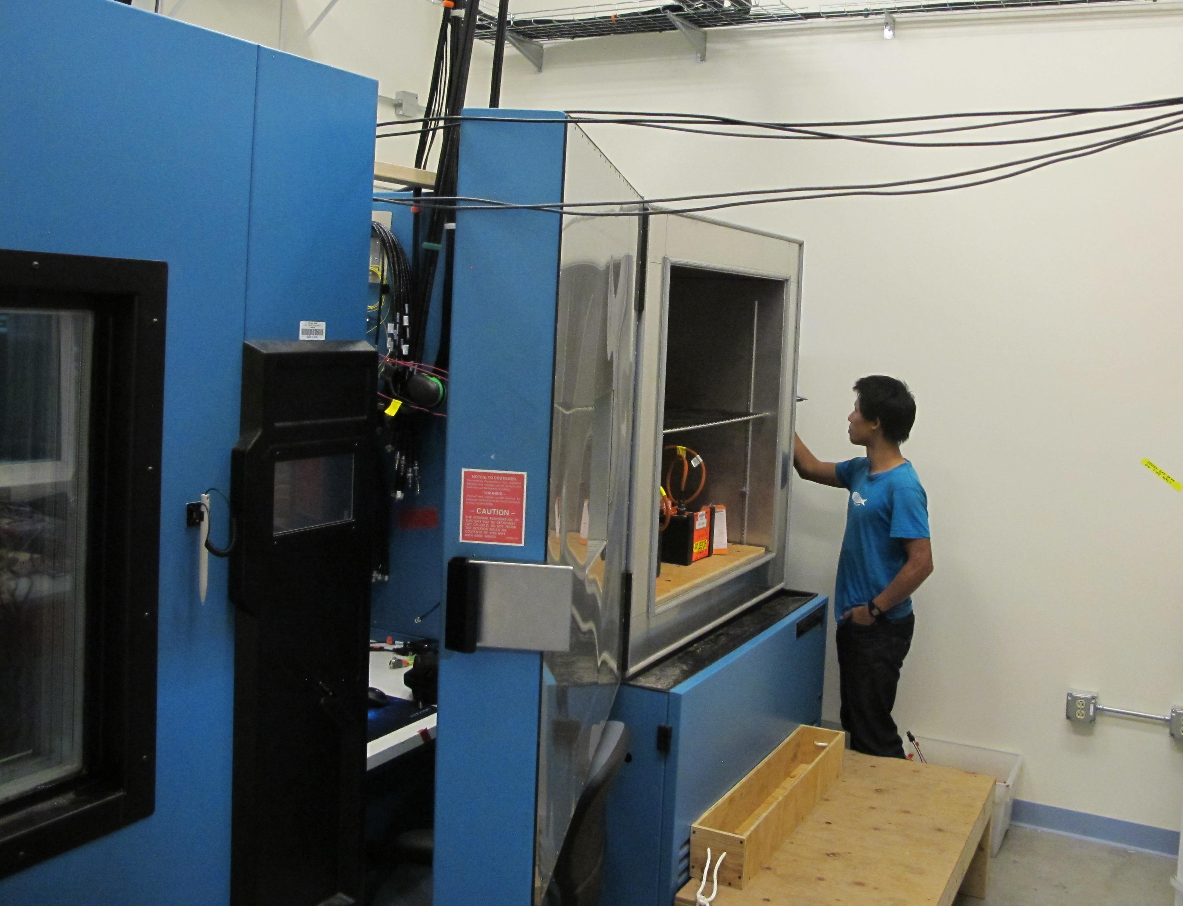
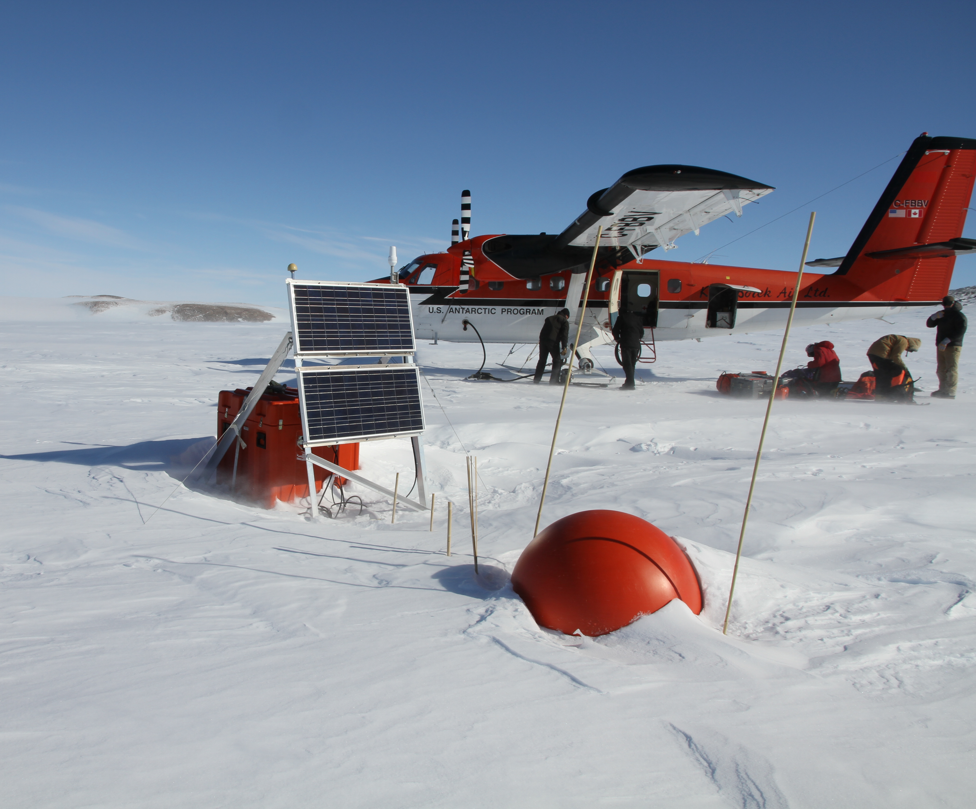
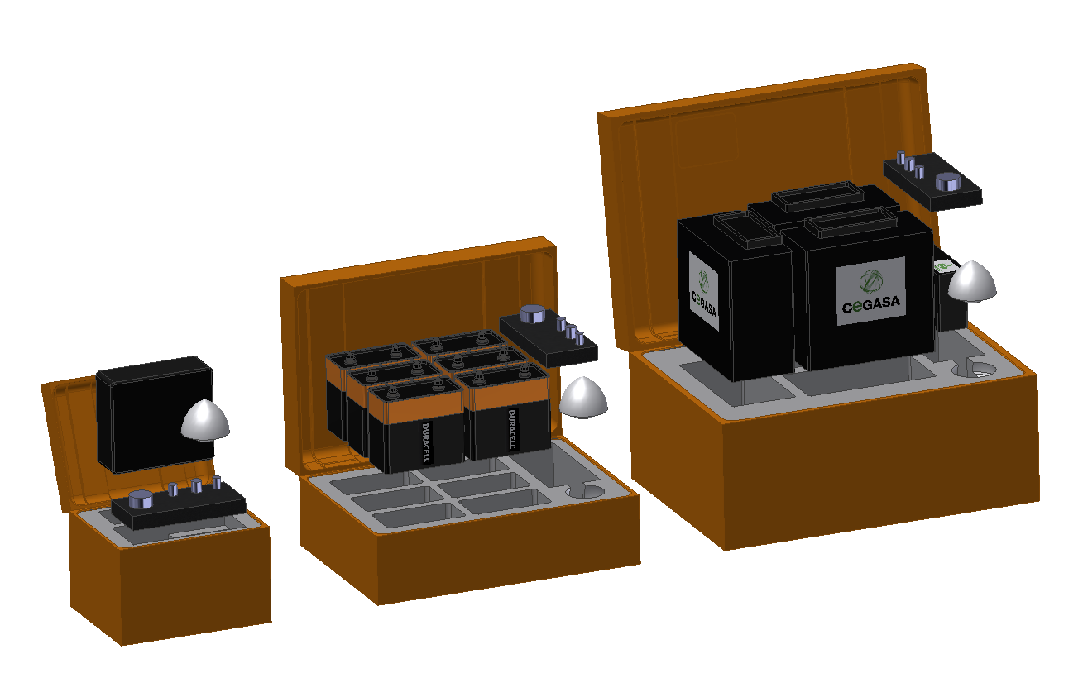
PASSCAL Polar
Plans for the Next 5-10 Years
Continue engineering support for experiments
Maintain polar specific equipment pool
Establish and operate a permanent seismic volcano observatory on Mt. Erebus
Complete the GEOICE program and seek to continue GLISN operations
Incorporate remote node handling for polar regions

Slide 11
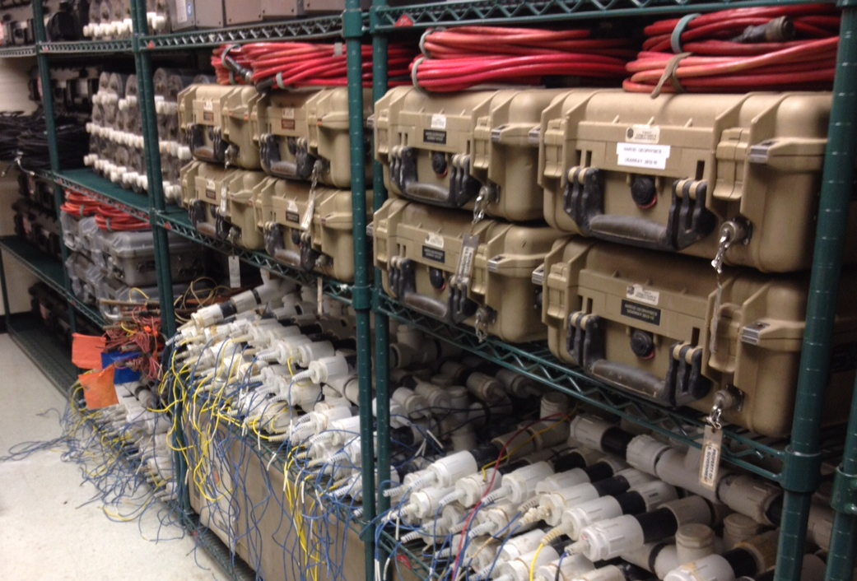
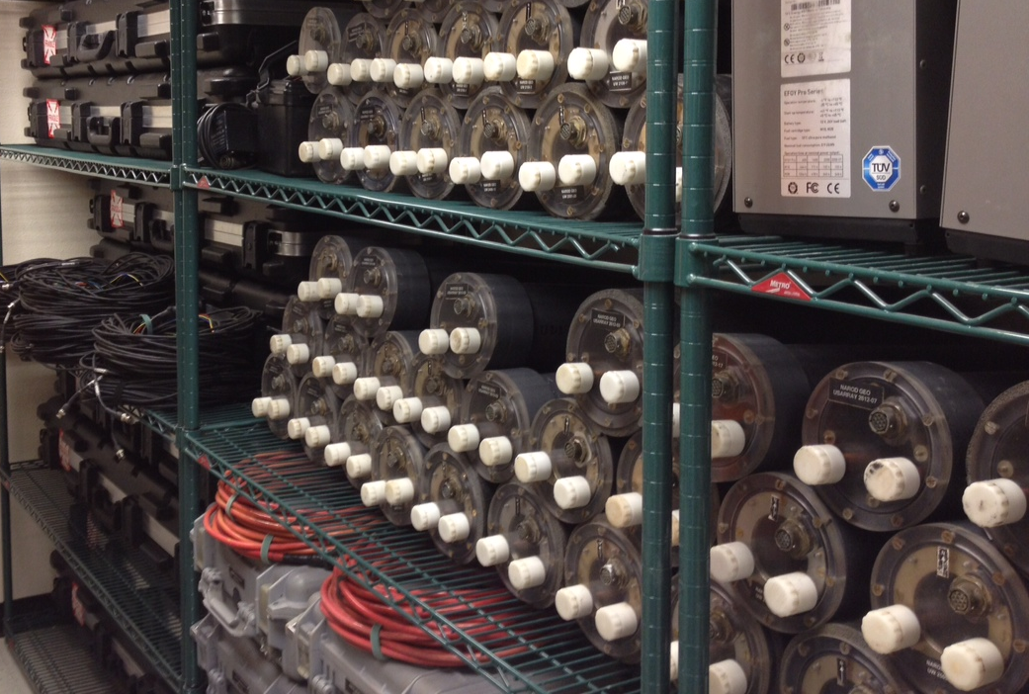
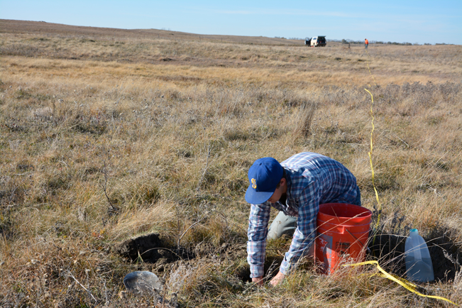
PASSCAL Magnetotellurics
Plans for the Next 5-10 Years
Establish a national, multi-user MT instrumentation pool at the PASSCAL Instrument Center for PI-led projects
Obtain long-period and/or wideband MT instruments through a competitive procurement
Foster MT user community and opportunity for multi-mode experiments

Slide 12
Trends: Instrumentation Services’ Perspective
IRIS installed instruments (GSN/TA)
  Posthole / borehole emplacements for improved performance
  Reducing power
  Accommodate sensor diversity – sensors with analog output and serial output
PASSCAL use (PI-lead experiments)
  Rugged – reducing repair rates
  Cost – reduce the (re)capitalization costs
  Depot turn around – maximize field time
  Telemetry – for State-of-Health? for data?
  Equipment to support educational use (Geodes, GPR, etc.)

Slide 13
Trends: PASSCAL User’s Perspective
Trends
  Specific requests
    Posthole broadbands
    Generally driven more by logistical considerations (direct burial) than a specific desire to achieve benefits of posthole emplacement
  Nodes
    Greatly simplified field logistics
    Caveat: PIs may not have fully discovered the joys of shipping lithium
  Telemetry – very infrequent
more resolution (wavefield imaging)
more instruments
  simplified field logistics and reduced field costs
  reducing SWaP (Size, Weight and Power)

Slide 14
Simpler Metadata Handling
Dirt-to-Desktop: Instruments and processes that streamline producing (accurate) metadata
  Fewer human “touches” between the dirt and the desktop
Key principles:
  Data produced in field and ready to archive
  Self-documenting sensors/dataloggers for minimal metadata processing
  In-field tools for acquiring and integrated ancillary metadata
  In-field QC and data transport
  Work across multiple vendor platforms – mixed instruments
Intent is to shield users from multiple steps – critical for large deployments

Slide 15
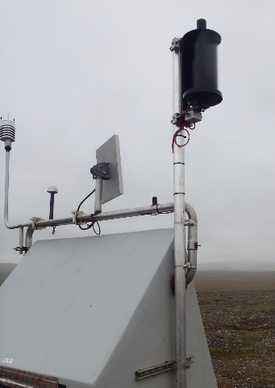
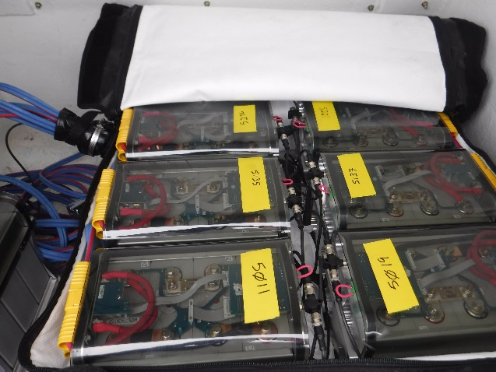
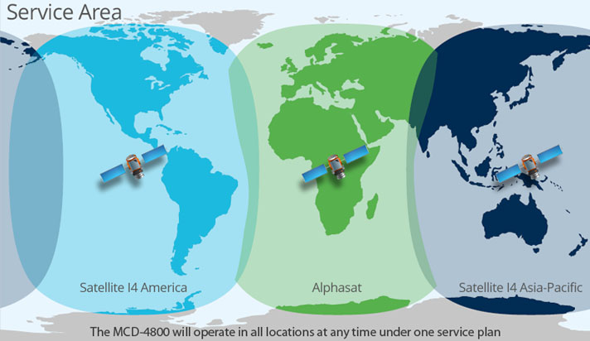
Integrating Next-Generation Technology
Power
  The “Achilles Heel” of remote, autonomous stations
  Major strides made during the implementation of Lower-48 and Alaska TA
  Costs of current lithium systems are prohibitive to many users
  Many nodal technologies with integrated power systems will require a different sustainment model
Communications
  Cell and VSAT are standard and well-run solutions
  Iridium (SBD and RUDICS) used in a variety of modes
  BGAN – new, with some limitations and cost considerations
  Still looking for the goldilocks solution – just right cost and bandwidth

Slide 16
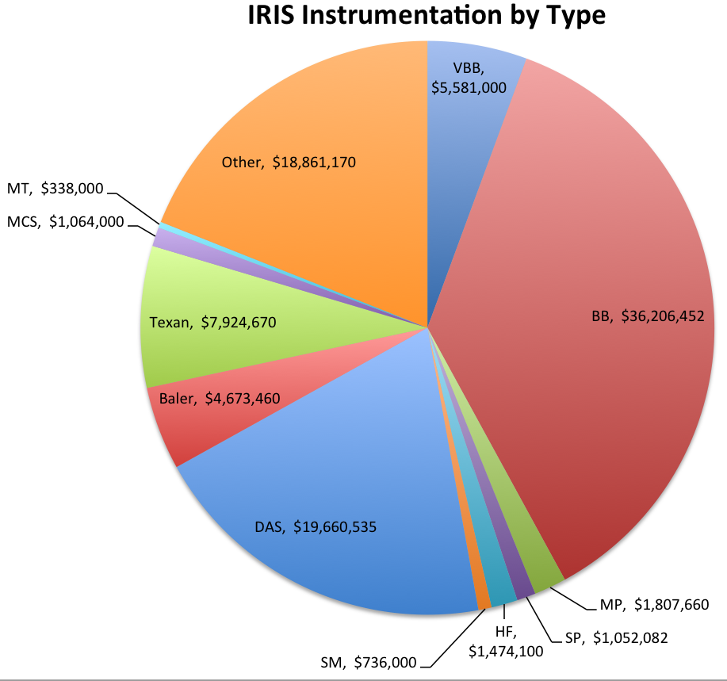
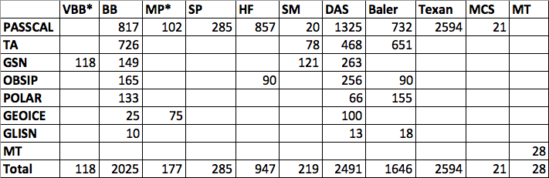
Sustainment
Assessment of key instrumentation conducted in 2015-2016
Size of pool: >10,000 individual instruments and dataloggers
Total value: ~$100 million

Slide 17
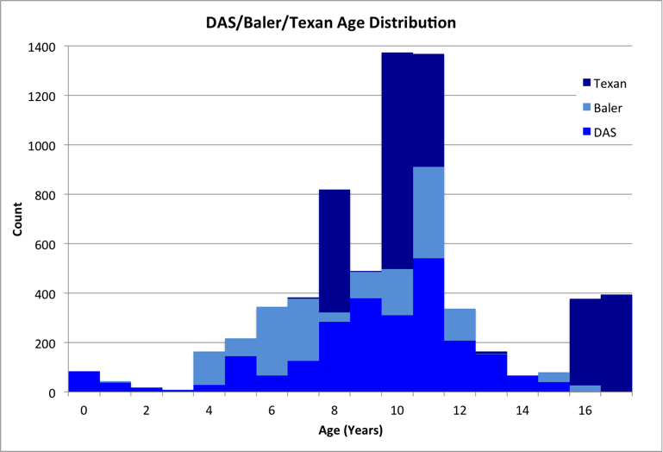
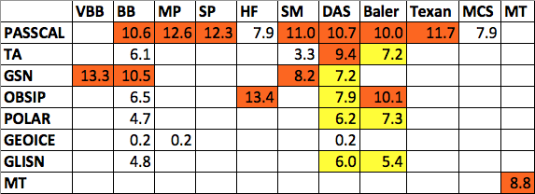
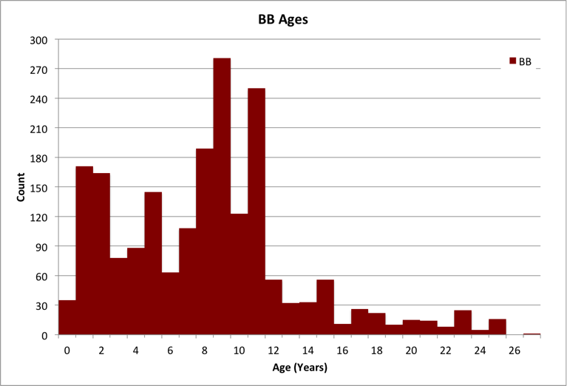
Sustainment
Instruments are not equally distributed in age
Much of this equipment is reaching end-of-life but still in high-demand
New capabilities added will require new models in sustainment
Creative recapitalization strategies will be needed

Slide 18

Sustainment Plan
Lottery tickets are probably not the answer
Some replacement / growth via base operational funding
Recapitalization as part of new projects and efforts
  Last major instrument recap came from EarthScope – TA/FA, N4
More general recapitalization requires proposals, proposals, proposals
  More than NSF

Slide 19
Summary
Goals and Challenges
Increase capacity for making high-quality seismological and geophysical observations
Work continually with the community to ensure capabilities match observation needs
Leverage new telemetry and power capabilities and understand the impacts on operations and science
Develop new workflows for data and metadata to streamline data handling – Large N
Sustain capabilities
Extend sustainment models to new technologies

Slide 20
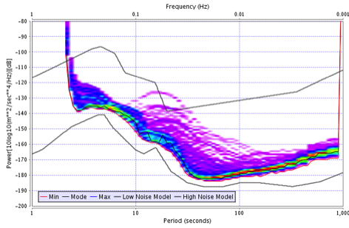
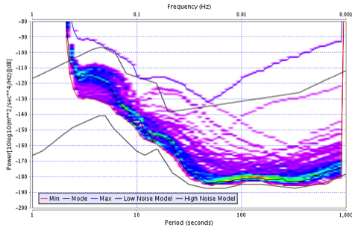
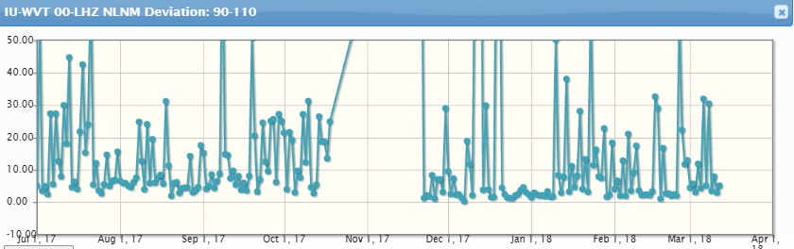
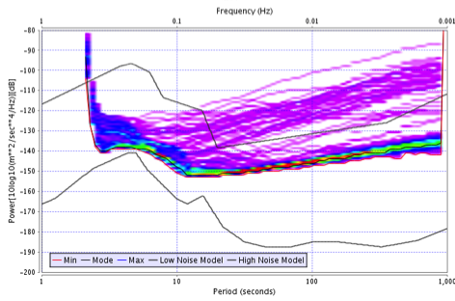
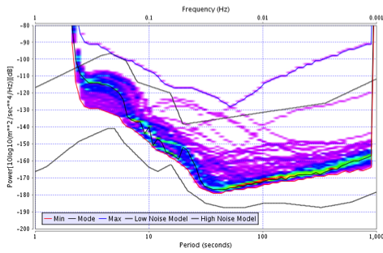
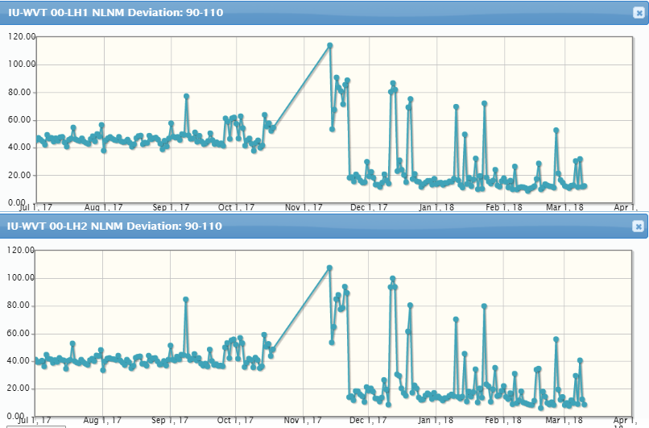
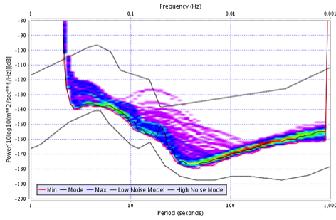
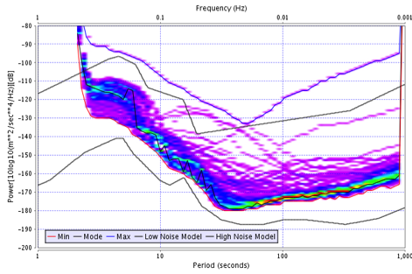
Improved Noise Performance
II.KDAK
IU.WVT
LHZ
LH1
LH2
Before (KS-54000)
After (T360BH)
Before (STS-1)
After (STS-6A)

Slide 21
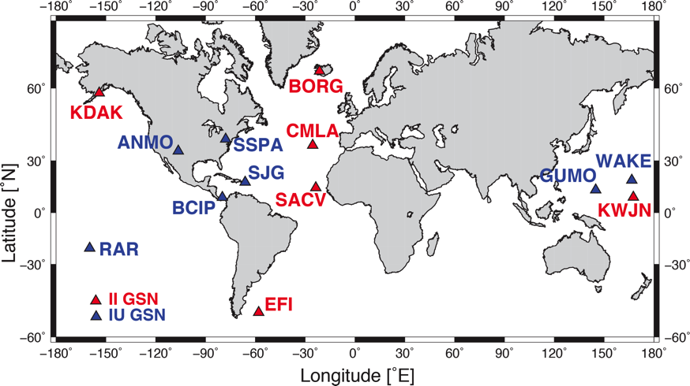
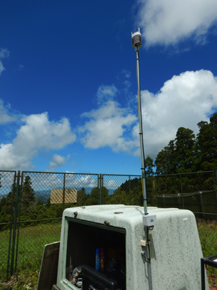
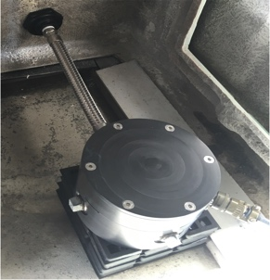
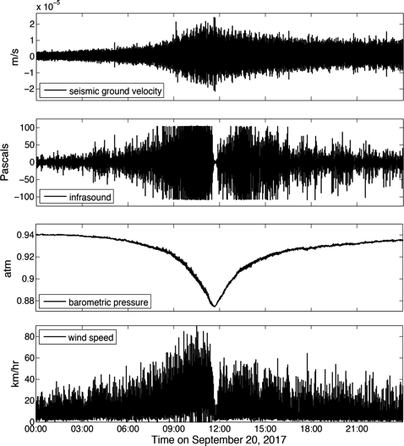
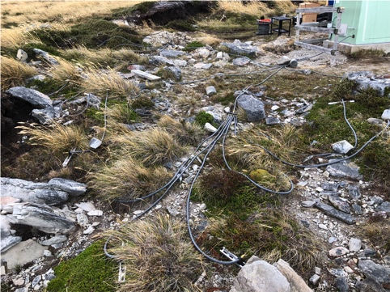
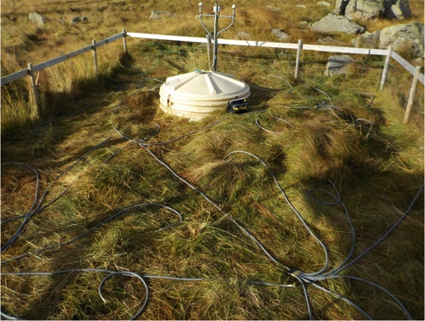
Infrasound/Met Sensor Packages
Hyperion IFS-3313 infrasound sensor
Vaisala WXT520 Weather Transmitter
1
2
3
3
2
1
Wilson, D.C., P. Davis, C. Ebeling, C.R. Hutt, and K. Hafner (2018), Seismic sensors record a hurricane’s roar, EOS, 99, https://doi.org/10.1029/2018EO102963

Slide 22
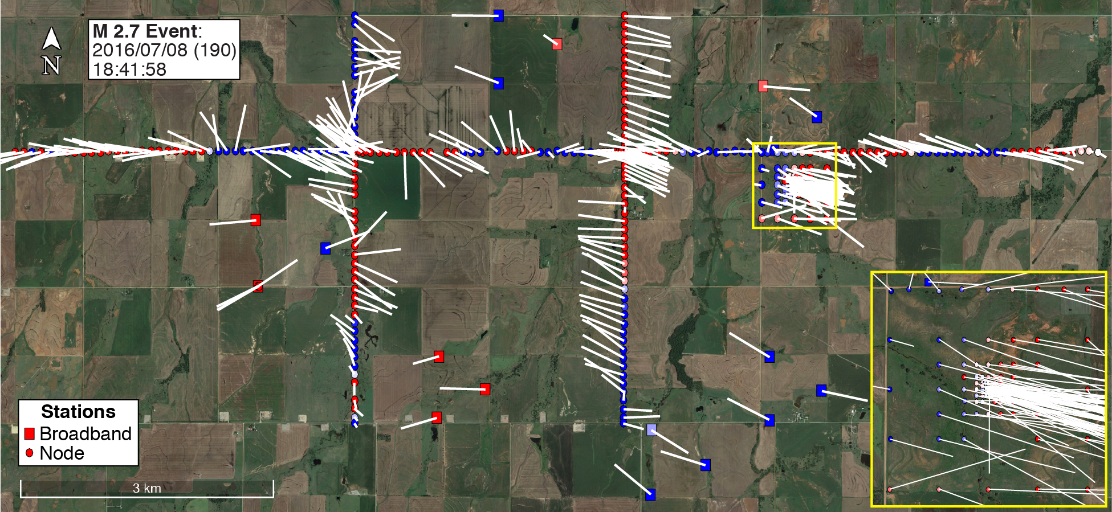
PASSCAL Plans
Oklahoma Wavefields Community Experiment
  Incorporated nodes (360), broadbands (18), and infrasound (10)
  Provided many potential users with experience in new capabilities
  Exemplifies the multi-modal deployments we hope to routinely enable
Ground motion visualization from nearby M2.7 earthquake.

Slide 23

Oklahoma Wavefield Experiment
13 km

