Slide 1

Seismic Instrumentation Technology Symposium
Oct 30-31 2018

Slide 2


Seismic Iridium Telemetry for Polar
XI202 – SoH Telemetry Only
XI-100 – SoH and RUDICS
XI-300 ?? New Polar Telemetry Datalogger/IP telemetry based on new Iridium CERTUS

Slide 3
Alert Geomatics
AlertGeo is a marketing division of Xeos
Focus is Geodetic equipment for Science and Structural Monitoring
Resolute GNSS Receiver
    Low, power, embedded telemetry
    Works with over 500 antenna types
    Septentrio module
Co-locate with Seismic equipment

Slide 4
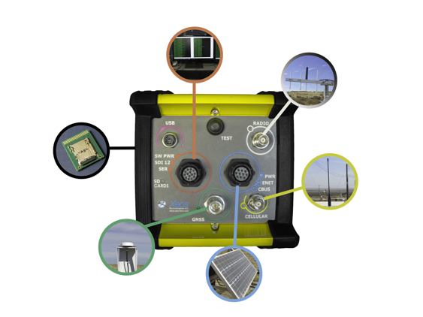
The Instrument
GNSS Receiver:
High Precision Reference Receiver
All Signals, All Frequencies
Ultra Low Power (1 Watt)
Low Noise Measurements
Optional Integrated Telemetry: Radio, Cell, Iridium
Onboard memory for local processing
Onboard user changeable data storage

Slide 5
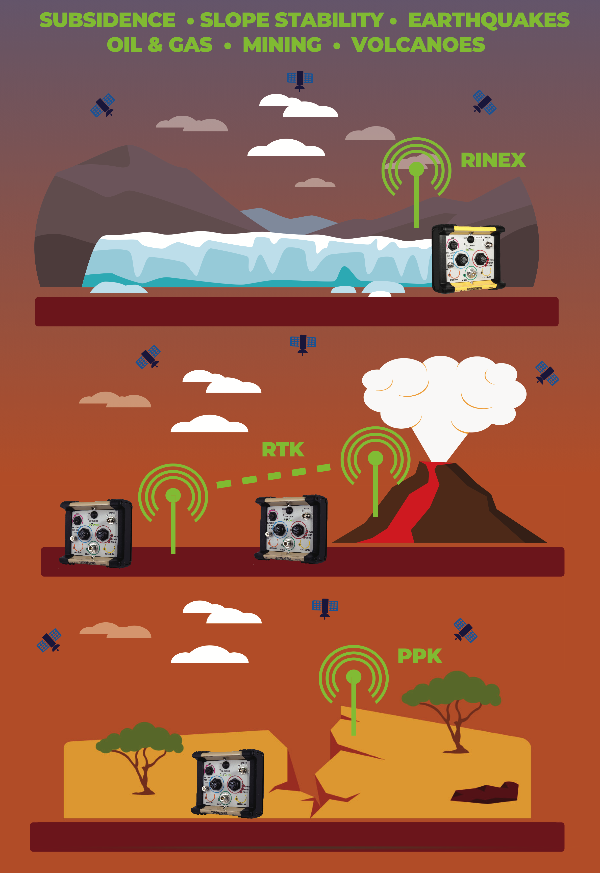
Ice Sheet
Volcano
Earthquake

Slide 6
Current Developments
More power efficient exfiltration of remote data via Iridium Certus
Other sensor integrations with the Resolute
    Accelerometers (IMU, INS)
    Custom Kalman filters
    Space weather variable calculations (TEC)
    Weather - Vaisala
Time Differenced Carrier Phase (TDCP) for short term displacememts

